Slide 1
Contextual reference
Understanding the texts

Slide 2
Contextual reference
Referência contextual é a utilização de palavras para substituir outras, evitando repetição;
Referem-se a palavras que foram citadas ou a ideias que serão apresentadas.
Os pronomes (pessoais, possessivos, relativos, etc) são muito utilizados para evitar repetições, por essa razão são os elementos que precisamos sempre observar para compreender a que estão se referindo.

Slide 3
Contextual reference
Ex: Shangai is one of the most attractive location in China. It is a very modern city and its people are very busy.
A logistician is someone who works in the field of logistics management.
The transport department where I work is at the airport.
Successful supply chain operators work in partnership with their customers. They jointly explore the opportunities for increasing efficiency of the supply chain.

Slide 4
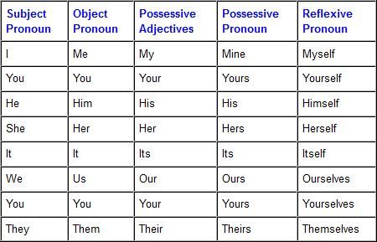
Pronouns table

Slide 5
Relative Pronouns
who / which/ that/ where/ when/ whose
Os pronomes relativos (who / which/ that/ where/ when/ whose/ what) também são usados quando mencionamos alguém ou algo e queremos dar mais informações a respeito da pessoa ou coisa. Eles podem substituir um substantivo que já foi mencionado na oração anterior.
Ex: A logistician is someone who works in the field of logistics management.

Slide 6
Contextual reference
As far as manufacturers are concerned, logistics management has become a lot more complex. By now, many of them have learned that outsorcing single segments to different providers has not really made their logistics operations more efficient.
Them refers to_________________________
Their refers to_________________________

