Slide 1
PEDAGOGIA DE GÊNEROS
PROTOCOLOS

Slide 2
RFC 768 J. Postel ISI 28 August 1980
User Datagram Protocol ---------------------- Introduction ------------
This User Datagram Protocol (UDP) is defined to make available a datagram mode of packet-switched computer communication in the environment of an interconnected set of computer networks. This protocol assumes that the Internet Protocol (IP) [1] is used as the underlying protocol. This protocol provides a procedure for application programs to send messages to other programs with a minimum of protocol mechanism. The protocol is transaction oriented, and delivery and duplicate protection are not guaranteed. Applications requiring ordered reliable delivery of streams of data should use the Transmission Control Protocol (TCP) [2].

Slide 3
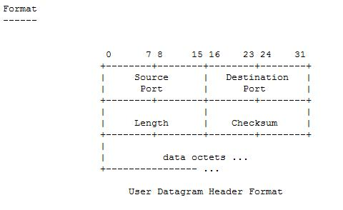

Slide 4
28 Aug 1980 User Datagram Protocol RFC 768
Fields
Destination Port has a meaning within the context of a particular internet destination address. Length is the length in octets of this user datagram including this header and the data. (This means the minimum value of the length is eight.) Checksum is the 16-bit one's complement of the one's complement sum of a pseudo header of information from the IP header, the UDP header, and the data, padded with zero octets at the end (if necessary) to make a multiple of two octets. The pseudo header conceptually prefixed to the UDP header contains the source address, the destination address, the protocol, and the UDP length. This information gives protection against misrouted datagrams. This checksum procedure is the same as is used in TCP. 0 7 8

Slide 5
User Interface --------------
A user interface should allow the creation of new receive ports, receive operations on the receive ports that return the data octets and an indication of source port and source address, and an operation that allows a datagram to be sent, specifying the data, source and destination ports and addresses to be sent.

Slide 6
Protocol Application --------------------
The major uses of this protocol is the Internet Name Server [3], and the Trivial File Transfer [4]. Protocol Number --------------- This is protocol 17 (21 octal) when used in the Internet Protocol. Other protocol numbers are listed in [5]. References ---------- [1] Postel, J., "Internet Protocol," RFC 760, USC/Information Sciences Institute, January 1980. [2] Postel, J., "Transmission Control Protocol," RFC 761, USC/Information Sciences Institute, January 1980. [3] Postel, J., "Internet Name Server," USC/Information Sciences Institute, IEN 116, August 1979. [4] Sollins, K., "The TFTP Protocol," Massachusetts Institute of Technology, IEN 133, January 1980.

Slide 7
Gênero :
-Que tipo de texto é este?
- Qual o objetivo do texto?
- Onde circula este tipo de texto?
- Quais são as partes que geralmente constituem este tipo de texto e qual é a função de cada uma delas?

Slide 8
Protocolos
Um protocolo pode ser definido como "as regras que governam" a sintaxe, semântica e sincronização da comunicação. Os protocolos podem ser implementados pelo hardware, software ou por uma combinação dos dois.
Etapas: Introduction/scope/fields/size/interface/references

Slide 9
PROTOCOLOS
ETAPAS
Introdução- É a descrição ou definição do protocolo;
Formato- É o formato da mensagem, como os dados são organizados;
Fields (campos)- São as informações sobre os campos opcionais e/ou obrigatórios, em que situações serão utilizados.
Size- Quanto ocupa de espaço;
Interface- Interface com o usuário e especificidades do protocolo;
References- Referências.

