Slide 1



THE SIMPLE PAST TENSE
I WENT TO THE ZOO YESTERDAY

Slide 2


Simple past
This verb tense is used to express actions that finished in a definite time in the past.
We use adverbs like: yesterday, last year, last week, ago…
Regular verbs: It’s formed by adding d or ed to the base form of the verb.
Ex: We worked hard yesterday.

Slide 3
Ex. 9: He climbed a mountain yesterday

Slide 4
Ex. 10: He cleaned the house last week

Slide 5
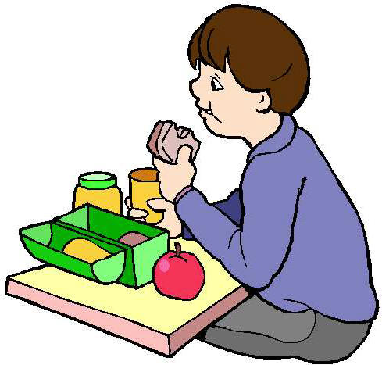
The simple past tense
Irregular verbs affirmative – Irregular past verb forms must be learned because they don’t follow any rule. : He ate vegetables at lunch.
BE –WAS/WERE
BUY-BOUGHT
COME-CAME
DRINK-DRANK
EAT-ATE

Slide 6
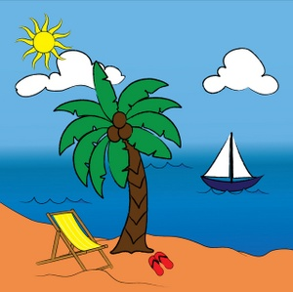
SIMPLE PAST – NEGATIVE FORM
REGULAR AND IRREGULAR
We use did not or didn’t + base form to make the simple past tense negative .
Ex. I didn’t go to the beach yesterday.

Slide 7

SIMPLE PAST INTERROGATIVE FORMS
Use DID + subject+ base form of the verb to make the interrogative form of regular and irregular varbs in the past.
Ex. He didn’t play volleyball
last weekend. He played
soccer.

