Slide 1
English Quiz

Slide 2
1-How often do you play tennis?
a. On Tuesday.
b. For two hours.
c. Almost every day.
d. With John.
2-Where do you usually eat lunch?
a. Sandwich.
b. With Jane.
c. At 12:00.
d. In the cafeteria.

Slide 3
3-How long did you study last night?
a. With Bob.
b. In my room.
c. English.
d. For three hours.
4-What kind of novels do you like?
a. Yes, I do.
b. I like spy novels.

Slide 4
5-What kind of work do you do?
a. I work every day.
b. I'm a piano teacher.
c. I worked for two hours.
6-How many hours a day do you watch TV?
a. About two hours.
b. In my living room.
c. I watch the news.
d. On Tuesday.

Slide 5
7-What is your busiest day of the week?
a. In the morning.
b. Every day.
c. Tuesday.
d. Last week.
8-My mother is a good cook.
a. I agree with you.
b. I agree you.
c. I agree to you.
d. I agree for you.

Slide 6
9-What does "TV" mean?
a. For one hour.
b. Yes
c. Television.
d. For one hour.
e. On Friday.
10-How do you spell "dog"?
a. No
b. D-O-G
c. No
d. I don't
e. Cat.
f. I have one dog.

Slide 7
11-What did you do yesterday?
a. I am swimming.
b. I swim.
c. I will swim.
d. I swam.
12-What do you like to drink?
a. Coffee.
b. Saturday evening.
c. Two.
d. With my friends.

Slide 8
13-What did you eat last night?
a. At six.
b. Spaghetti.
c. With my family.
d. At home.
14-What are you doing?
a. I'm eating.
b. I ate.
c. I will be eating.
d. I have eaten.

Slide 9
15-What will you do this afternoon?
a. I play soccer.
b. I played soccer.
c. I'll play soccer.
d. I was playing soccer.
16-It seems to me that most restaurants are too expensive.
a. I don't think it.
b. I don't think.
c. I don't think so.

Slide 10
17-Where's Mike?
a. At school.
b. At eight.
c. For three hours.
d. No, he isn't.
18-Where do you do your homework?
a. With John.
b. In the evening.
c. About one hour.
d. Every day.
e. At home.

Slide 11
19-Where's Mike?
a. At school.
b. At eight.
c. For three hours.
d. No, he isn't.
20-Where do you do your homework?
a. With John.
b. In the evening.
c. About one hour.
d. Every day.
e. At home.

Slide 12
21-People from Canada are called
a. Canuks
b. Canadians
c. Canadites
22-People from India are
a. Indies
b. Hindus
c. Indians

Slide 13
23-He's from Germany. He is
a. German
b. Germany
c. Dutch
24-She lives in Argentina. She speaks
a. Argentinian
b. Spanish
c. Portuguese
25-She lives in Argentinia. She is
a. Argentinian
b. Argentese
c. Argentonian

Slide 14
26-People in Israel are
a. Jewish
b. Israeli
c. Hebrew
27-People from Israel speak
a. Jewish
b. Israeli
c. Hebrew
28-People in Hong Kong speak English and
a. Hangul
b. Cantonese
c. Mandarin

Slide 15
29-What is the opposite of happy?
30-What is the opposite of black?
31-What is the opposite of up?
32-What is the opposite of under?
33-What is the opposite of father?
34-What is the opposite of sister?
35-What is the opposite of noisy?
36-What is the opposite of empty?
37-What is the opposite of fast?

Slide 16
38-The music “Price tag” is by...
Katy Perry
Jessie J
Christina Aguilera
39-The music “Heart Attack” is by...
One Direction
Katy Perry
Demi Lovato

Slide 17
40-Who sings the music “If I were a boy”?
Beoyncé
Demi lovato
One direction
41-Jessie J sings a song about bullying. The name of the song is...
Don’t bully me up
Don’t call me baby
Who is laughing now?

Slide 18
43-The singer that surprised the audience sings Lek lek lek at Rock in Rio was...
Beoyncé
Anita
Metallica
44-Jessie J sings a song about bullying. The name of the song is...
Don’t bully me up
Don’t call me baby
Who is laughing now?

Slide 19
45-The name of the original singer for “Total Eclipse of the heart” is...
Bonnie Tyler
Westlife
Backstreet boys
46-________ walks off stage after bottle thrown at him at concert (November/2013)
Justin Timberland
Justin Bieber
Justin Hoffman

Slide 20
47-One direction sings
Best song ever
My love
Heart Attack
48-The show held in Rio this 2013 was called...
Carnival
Rock mettal
Rock in Rio

Slide 21
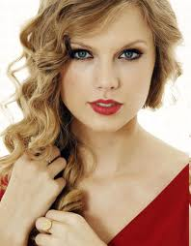
49-Her name is...
Jackie Evancho
Connie Talbot
Taylor Swift

Slide 22
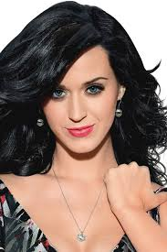
50-Her name is...
Adele
Anastasia Petrik
Katy Perry

Slide 23
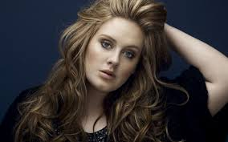
51-Her name is...
Adele
Shakira
Celine Dion

Slide 24
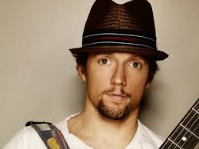
52-His name is...
Jason Mraz
Justin Bieber
Bruno Mars

Slide 25
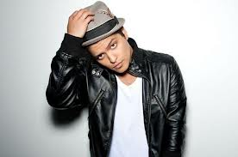
53-His name is...
Jason Mraz
Justin Bieber
Bruno Mars

Slide 26
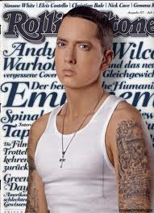
54-His name is...
Eminem
Justin Bieber
Just Timberland

Slide 27
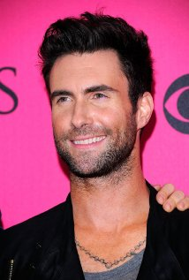
55- His name is...
Eminem
Marron 5
Enrique Iglesias

Slide 28
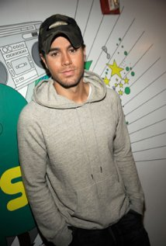
56- His name is...
Eminem
Marron 5
Enrique Iglesias

Slide 29
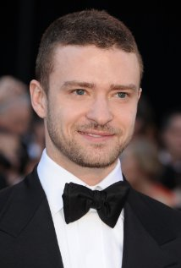
57-His name is...
Rick Martin
Enrique Iglesias
Justin timberland

Slide 30
57-Complete the sentence...
I ______ (think) about you.
a) thinked
b) thought
c) through
58-Complete the sentence...
I want ___ apple
a) a
b) an

Slide 31
59-Answer:
How old are you?
a) I am fine.
b) I am 20.
c) I have 30.
60-Answer:
David ___ a dog
a) have
b) has

Slide 32
61-What is the meaning of “cookie”?
a) Biscoito
b) Carne
c) Cocada
62-What is the meaning of “mad”?
a) intelligent
b) pai
c) louco

Slide 33
63-What is the meaning of “hunt”?
a) caçar
b) pescar
c) perseguir
64-What is the meaning of “wolf”?
a) raposa
b) búfalo
c) lobo

Slide 34
65-What is NOT a name of David Guetta’s songs?
a) She-wolf
b) Titanium
c) Sorry for party rocking
66-What the meaning of “hang over”?
a) ressaca
b) bebida
c) loucura

Slide 35
67-Band that had a great success in the 90’s?
a) Backstreet boys
b) The beatles
c) Restart
68- Band that has a song named “Pay phone”
a) One direction
b) The beatles
c) Marron 5

Slide 36
69-Band that played the great success “We are the champions”?
a) Queen
b) The beatles
c) Backstreet boys
70- Artist who a technician at the voice USA:
a) Christina Aguilera
b) Demi Lovato
c) Mariah Carey

