Slide 1
INTRODUÇÃO AO INGLÊS BÁSICO 1
Profª Cristiane de Brito Cruz
Instituto Federal do Rio Grande do Norte
Campus Currais Novos

Slide 2
INTRODUCING PEOPLE
What’s your name?
My name’s..../I’m...
Are you married?
Yes, I am/ No, I’m not.
Where are you from?
I’m from Brazil. I’m Brazilian
What’s your occupation?
I’m a/an...
How old are you?
I’m... years old
What’s your phone number?
It’s .....

Slide 3
AULA 02 - SENTENCES
How are you?
I’m fine, thanks. What about you?
What’s Natal like?
It’s interesting, boring, etc.
Who’s David?
He’s my brother.
How do you spell that?
It’s S-T-E-V-E-N
Is he David?
Yes, he is/ No, he isn’t/ No, he’s not

Slide 4
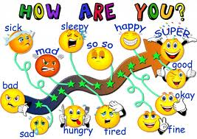

Slide 5
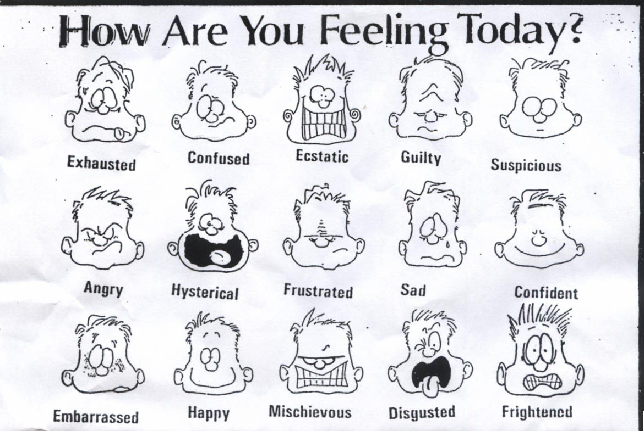

Slide 6
How....
How are you?
I’m fine/sad/happy....
How is she?
She’s sad/happy...
How is he?
He’s happy/sad...
How are they?
They’re confused...

Slide 7
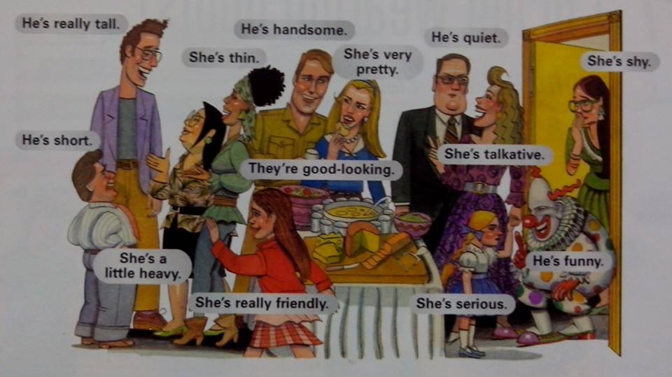
What’s John/Mary like?

Slide 8
What’s ____ like?
Appearance
Unattractive
Ugly
Well-dressed
Nicely dressed
Casually dressed
Poorly dressed
Neat
Clean
Untidy
Dirty
Attractive
Good-looking
Beautiful
Handsome
Pretty
Cute
Nice
Plain
Plain looking

Slide 9
What’s ____ like?
Height
Weight and Build
Tall
Very tall
Quite tall
Six feet tall
Not very tall
Short
Average height
Medium height
Middle height
Thin
Quite thin
Slim
Slender
Skinny
Medium-build
Overweight
Fat
Strong
Muscular, athletic

Slide 10
Personality
Easy-going;
Bad-tempered
Friendly
Outgoing
Immature
Reliable,
Trustworthy
Honest
Reasonable
Sensible
Impulsive;
Ambitious
Hard-working,
Lazy
Thoughtful
Aggressive
Selfish
Self-confident
Shy, timid
Modest,
Humble
Arrogant
Stubborn
Moody
Interesting
Dull, boring
Generous
Kind,
Disorganized
Careless
Funny
Strange
Odd
Weird
Eccentric

Slide 11
Adjectives for places
Beautiful
Horrible
Touristic
Religious
Mountainous
Cold
Hot
Wonderful
Pleasant
Warm
Interesting
Calm
Cool
Polluted
Noisy
Ugly
Large
Small
Exciting
Clean
Modern
Ancient
Crowded
Village
Capital

Slide 12
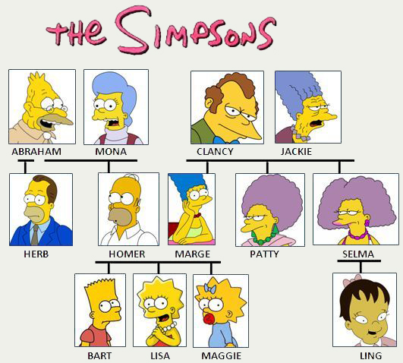
Family members

Slide 13
Family members

Slide 14
Family members
Cousins
Husband
Wife
Son
Daughter
Nephew
Niece
Step-
-in-law
Half-
Greatgrandmother
Greatgrandfather
Grandfather
Gradmother
Father
Mother
Brother
Sister
Uncle
Aunt

Slide 15
Family members
-in-law
Father-in-law
Mother-in-law
Son-in-law
Daughter-in-law
Brother-in-law
Sister-in-law
Step-
Stepfather
Stepmother
Stepson
Stepdaughter
Half-
Half-brother
Half-sister

Slide 16
ABC...
Q
R
S
T
U
V
W
X
Y
Z
A
B
C
D
E
F
G
H
I
J
K
L
M
N
O
P

Slide 17
SPELLING

Slide 18
SPELLING

Slide 19
Verb To be
Present
Future
Past
I am – I’m
You are – You’re
He is – He’s
She is – She’s
It is – It’s
We are – We’re
They are – They’re
I was
You were
He was
She was
It was
We were
They were
Will be

Slide 20
Verb To be - negative
Present
Past
I am – I’m not
You are – You’re not (aren’t)
He is – He’s not (isn’t)
She is – She’s not (isn’t)
It is – It’s not (isn’t)
We are – We’re not (aren’t)
They are – They’re not (aren’t)
Was not (wasn’t)
Were not (weren’t)
Future
Will not be
(‘ll not be)
(won’t be)

Slide 21
Verb To be - interogative
Present
Past
Future
Am I?
Are you?
Is he?
Is she?
Is it?
Are we?
Are they?
Was I?
Were you?
Will I be?
Short answer
Am I right?
Yes, you are
No, you’re not
Are you ok?
Yes, I am/ No, I’m not

Slide 22
QUESTIONS
Are you a student?
Am I a teacher?
Is he Thomas?
Is she Andrea?
Are we students?
Are they married?
Are we learning?
Are you ok?
Is he tall?
Is she beautiful?
Is it right?
Are you intelligent?
Is he John?
Is she Olivia?
Are you reading?
Are we speaking?

Slide 23
Dialogues
Treinem em duplas os diálogos;
Depois troquem as duplas;
Speak in English.

