Slide 1
INTRODUÇÃO AO INGLÊS BÁSICO 1
Profª Cristiane de Brito Cruz
Instituto Federal do Rio Grande do Norte
Campus Currais Novos

Slide 2
INTRODUCING PEOPLE
What’s your name?
My name’s..../I’m...
Are you married?
Yes, I am/ No, I’m not.
Where are you from?
I’m from Brazil. I’m Brazilian
What’s your occupation?
I’m a/an...
How old are you?
I’m... years old
What’s your phone number?
It’s .....

Slide 3
AULA 02 - SENTENCES
How are you?
I’m fine, thanks. What about you?
What’s Natal like?
It’s interesting, boring, etc.
Who’s David?
He’s my brother.
How do you spell that?
It’s S-T-E-V-E-N
Is he David?
Yes, I am/ No, he isn’t/ No, he’s not

Slide 4
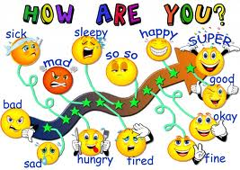

Slide 5
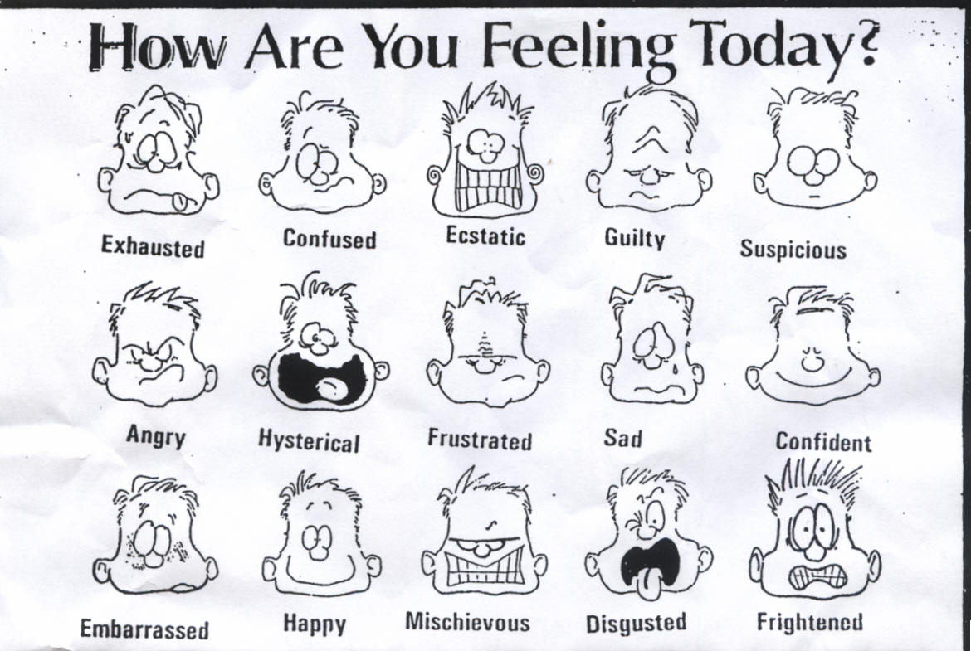

Slide 6
Adjectives
Beautiful
Horrible
Touristic
Religious
Mountainous
Cold
Hot
Wonderful
Pleasant
Warm
Interesting
Calm
Cool
Polluted
Noisy
Ugly
Large
Small
Exciting
Clean
Modern
Ancient
Crowded
Village
Capital

