Slide 1
Future Time: Be Going To, Will, and the Present Continuous

Slide 2
Meaning and Use: Be Going To and the Present Continuous as Future
Use the present continuous tense to talk about intentions or future plans.
A future time expression is usually used with the present continuous to show that the sentence refers to the future (and not something happening now).
The verbs go, come, do, and have, as well as verbs related to travel, are especially common with the present continuous as future.
The present continuous often refers to more definite plans than be going to.
With be going to, the speaker often has not decided on the details.

Slide 3
Meaning and Use: Be Going To and the Present Continuous as Future
Present Continuous as Future (Details Definite)
Be Going To (Details Not Definite)
Use be going to for predictions (guesses about the future), especially when there is evidence that something is just about to happen.
The present continuous is not used to make predictions.

Slide 4
Will vs. Be Going To
Predictions with Will and Be Going To
Use will or be going to to make predictions (guesses about the future). You can also use probably and other adverbs with will and be going to to express certainty.
With predictions, the meanings of will and be going to are not exactly the same.
Use be going to when you are more certain that an event will happen because there is evidence. Do not use will in this situation.
Quick Decisions vs. Advance Plans
will—often used to express a quick decision at the time of speaking (such as an offer to help).
be going to—shows that you have thought about something in advance. Do not use be going to for quick decisions.

Slide 5
Present Continuous vs. Simple Present
The verbs go, come, do, and have, as well as verbs related to travel, are especially common with the present continuous as future.
Use the present continuous tense to talk about intentions or future plans.
The present continuous often refers to more definite plans than be going to.
Use Present Continuous as Future (Details Definite)
Scheduled Activities with timing
Use Simple Present for timing schedules such as bus, airplanes, trains, meetings, etc. Something that is scheduled and you have the exact time it is going to happen.

Slide 6
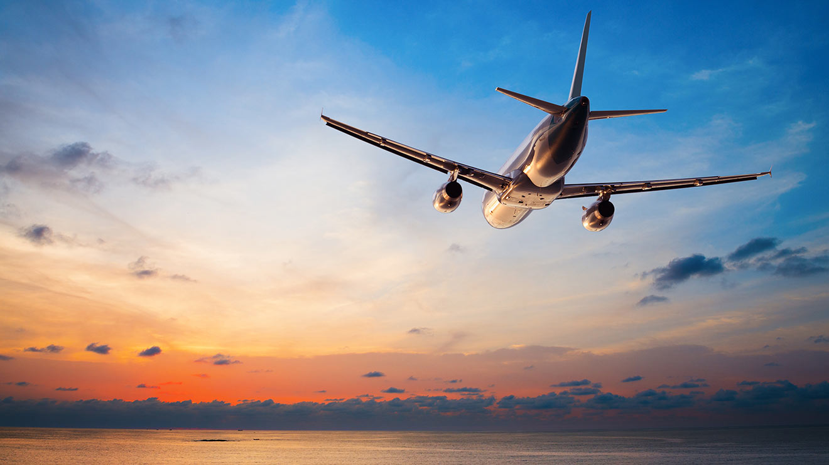
FUTURE
My flight ____________________in the afternoon.
My father ____________________ me at the airport.
arrives/meets
arrives/is meeting
is arriving/is meeting
will arrive/is going to meet

Slide 7
FUTURE
A: What ______you _____________tomorrow?
B: I _____________ lunch with friends. Then we’re going to a movie.
will you do/will go
are you doing/’m having
are you doing/’m going to have
are you going to do/’m going to have

Slide 8
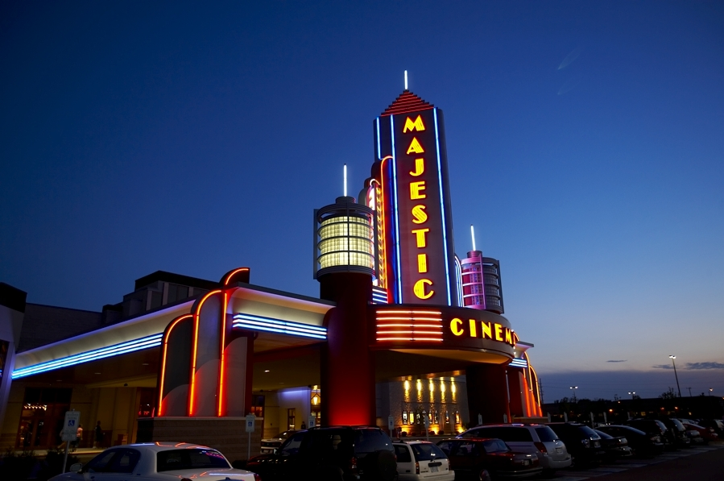
FUTURE
Let’s hurry John! The movie _______________ at seven and you are still getting dressed! The train _______________ the station in 15min and we have to walk to go there.
will start/will leave
is starting/ is living
is going to start/is going to leave
starts/leaves

Slide 9
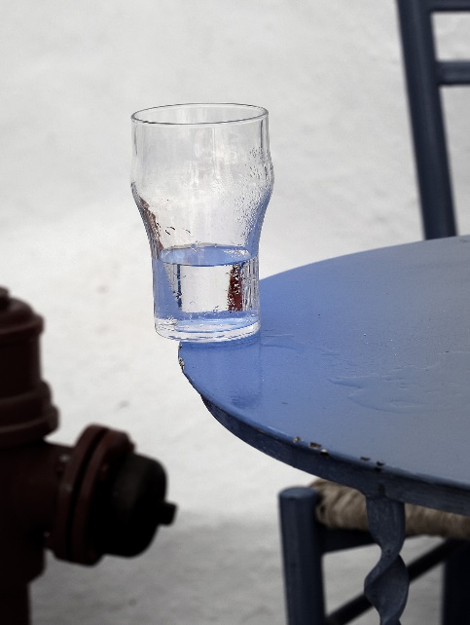
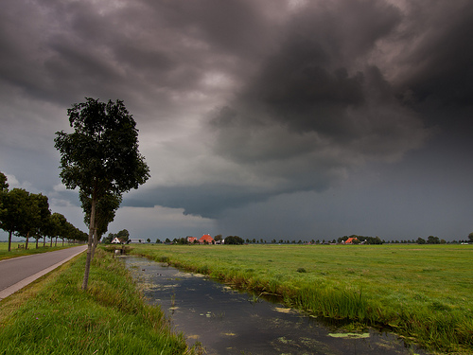
FUTURE
Be careful! That glass ________________!
a) will fall
b) is going to fall
c) falls
d) is falling
It’s cloudy. I think it ____________ going to rain tonight.
a) will rain
b) is going to rain
c) rains
d) is raining

Slide 10
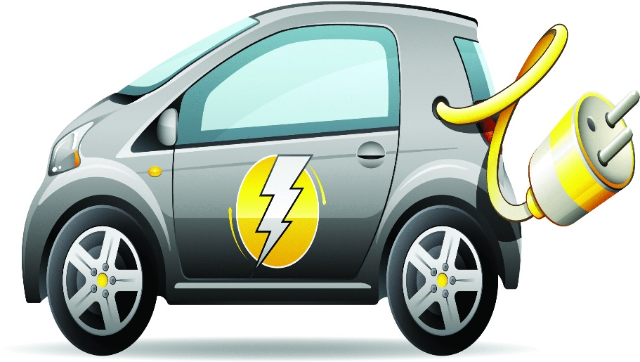
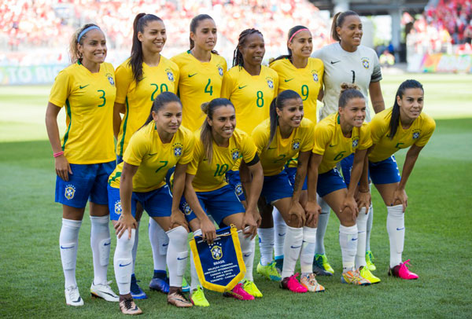
FUTURE
Electric cars _____________ popular in the next ten years.
a) will become
b) are going to become
c) becomes
d) are becoming
They _____ probably ___________
the championship.
a) will win
b) are going to win
c) do win
d) are winning

Slide 11
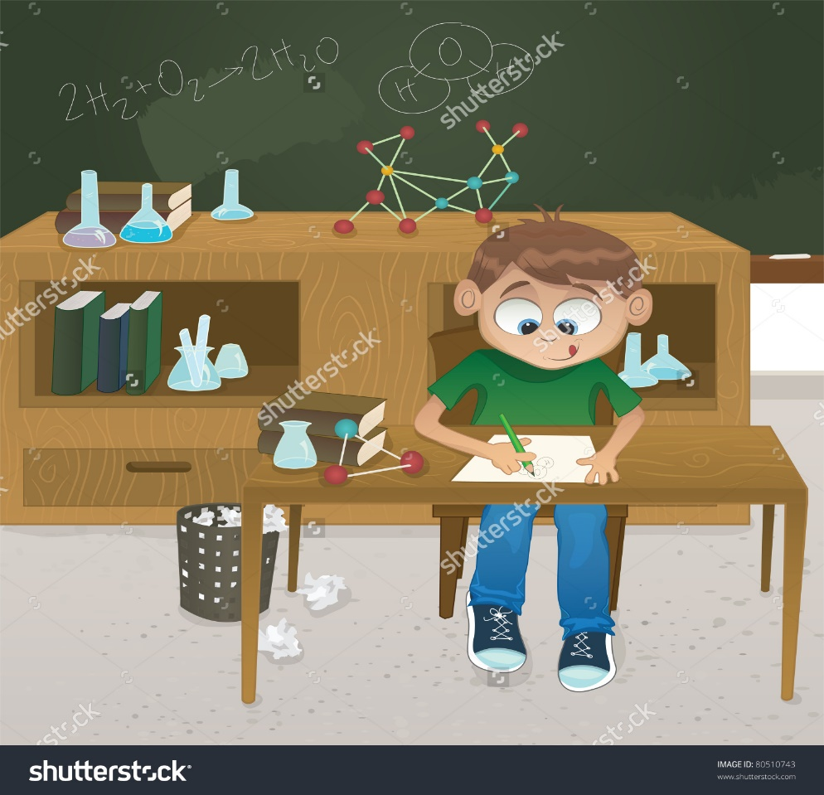
FUTURE
A: What _____Josh __________________at college?
B: He __________________ chemistry.
will/study/will study
does/study/studies
is/going to study/is going to study
is/studying/is studying

Slide 12
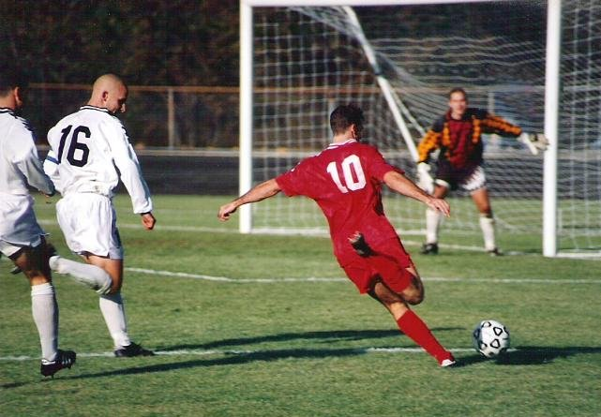
FUTURE
A: What are you going to do tonight?
B: Elisa and I __________________ the stadium to watch Champions League. The match ___________ at 8hp.m.
are going to/starts
go/is starting
will go/will start
are going to go/is going to start

Slide 13
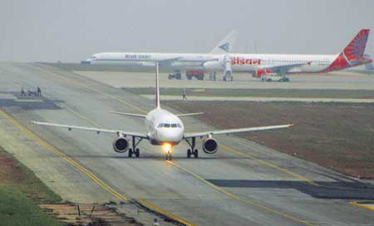
FUTURE
I’m going to take a 3:00 flight to Chicago. In Chicago, I_________________ (change) planes and _________________ (fly) on to Miami.
‘m changing/flying
change/fly
will change/will fly
‘m going to change/ flying

Slide 14
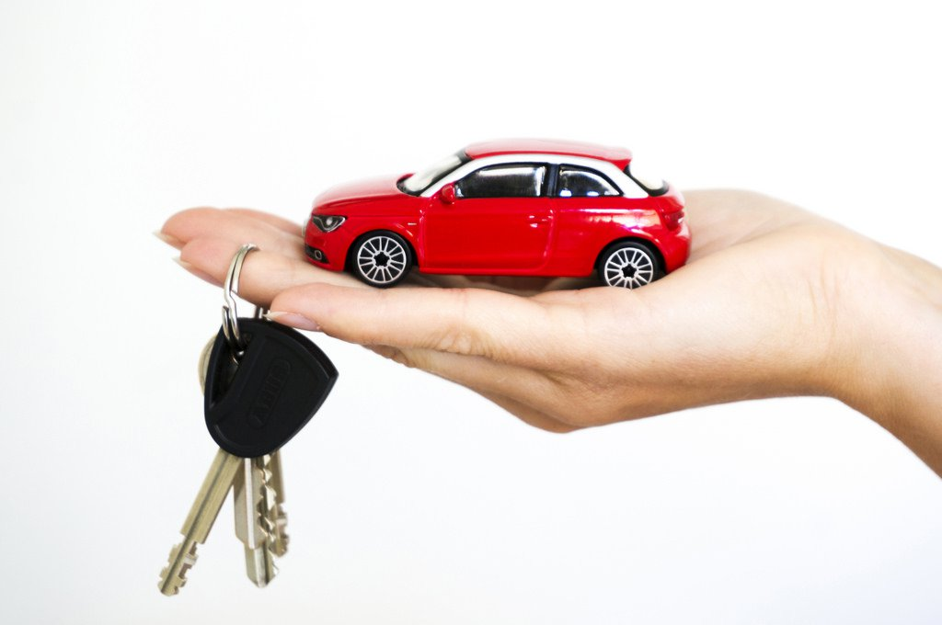
FUTURE
A: I _________________ (buy) a car.
B: What kind ________ you _________________ ?
A: I don’t know yet.
will buy/will you get
buy/do you get
‘m going to buy/ are you going to get
‘m buying/are you getting

Slide 15
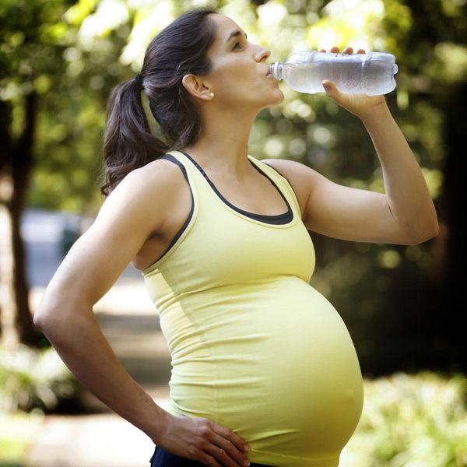
FUTURE
She _____________ a baby.
a) will have
b) are going to have
c) has
d) are having

Slide 16
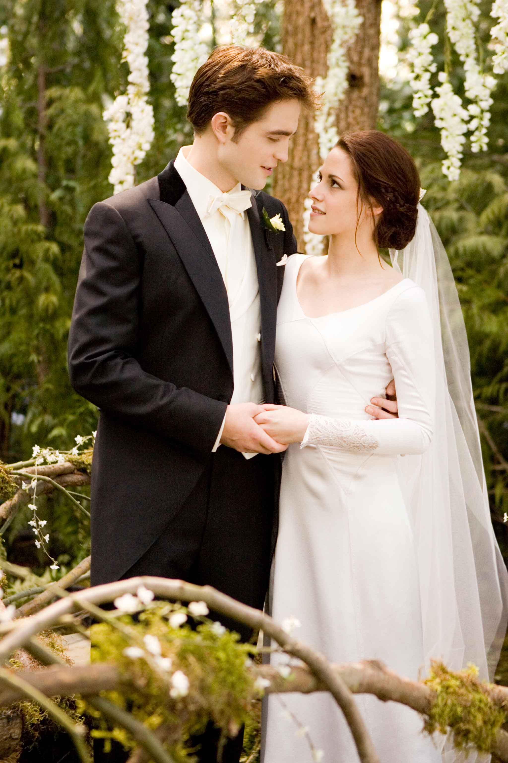
FUTURE
They ___________ married.
a) will get
b) are going to get
c) get
d) are getting

Slide 17
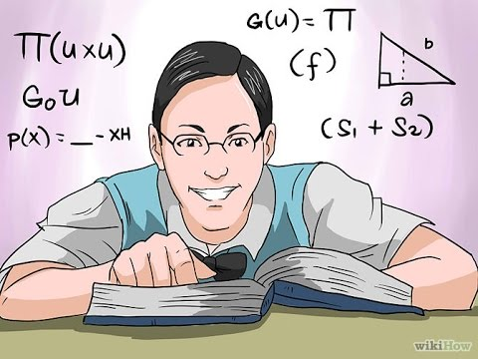
FUTURE
I___________________ hard for the test.
will study
studies
am going to study
am studying

Slide 18
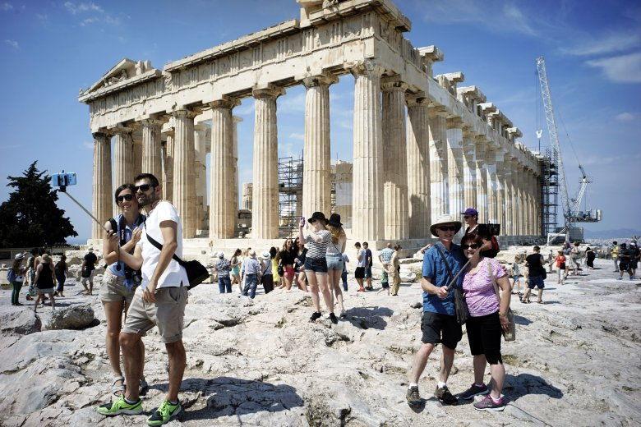
FUTURE
I_____________________________ Greece this summer.
will visit
visits
am going to visit
am visiting

Slide 19
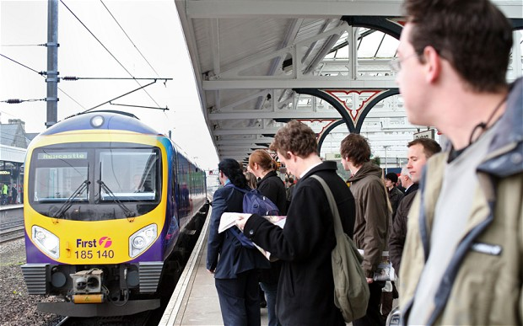
FUTURE
Where is Lisa? The train _______________ in 20min.
will leave
leaves
is going to leave
is leaving

Slide 20
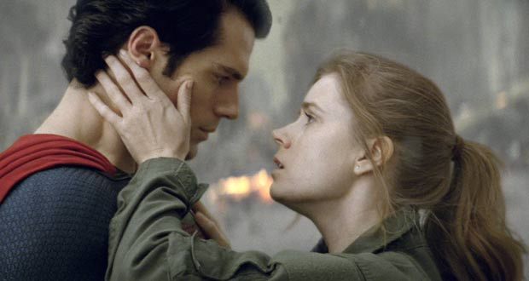
FUTURE
Louise _____________ Superman.
will kiss
kisses
is going to kiss
is kissing

Slide 21
FUTURE
They _______________ tonight
will loose
looses
are going to loose
are loosing

