Slide 1
Questions, titles and Marital status
Group 1 - English

Slide 2
Members:
Ana Beatriz Pequeno;
Ana Júlia;
Eleonora Maria;
Melissa Leandra.

Slide 3
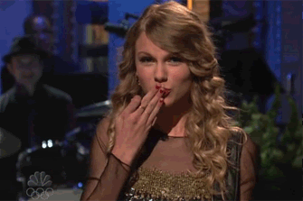
questions
"Hello! What’s your name?"
"Do you speak english?"
"Do you like listening to music?"
"Do you have a girlfriend?"

Slide 4
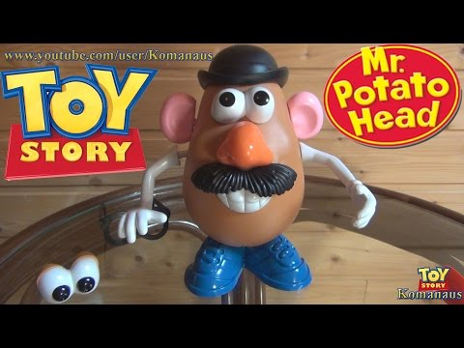
titles
"Mr. Peterson, do you like cats?"
“Does Mrs. Sparks like milk?"
"Could you help me, Miss?"
"Hi! Miss Swift, how are you?"
"Good morning, Mrs. Sheeran! How are you doing?"
"Ms. Hale, stop!"

Slide 5
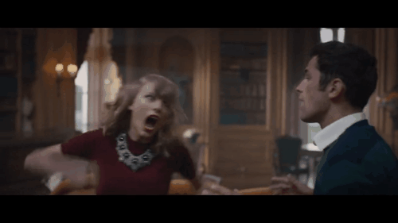
Marital status
"What is your marital status?"
"Are you married or single?"
"I am single.. And you?"

