Slide 1

Bruno Henrique
Eloiza Keylla
Fernanda Skarllat
Gabriela Santos
Marcos Vinicios
Yasmim Lima
E SUAS FORMAS

Slide 2

PERFECT
O Past Perfect é um tempo verbal semelhante ao nosso Pretérito mais-que-perfeito.
É formado pelo pretérito do auxiliar TO HAVE seguido do particípio do verbo principal.

Slide 3
PAST PERFECT
QUANDO
USAR?
Usamos o Past Perfect para expressar um fato que aconteceu no passado antes de outro que também aconteceu no passado.
Também pode-se usar para descrever desejos que ainda não foram realizados.
Ex.:
1. When I arrived at the bus station, the bus had already left.
2. We had hoped to send her a letter but we didn’t have time.

Slide 4
PAST PERFECT
E SUAS FORMAS
FORMA AFIRMATIVA
Sujeito + HAD + Particípio
EX.: The movie had already started when I got home yesterday.
(O filme já tinha começado quando eu cheguei em casa ontem)
FORMA NEGATIVA
Sujeito + HAD NOT + Particípio
(hadn’t) EX.: My parents hadn’t had dinner yet when I arrived.
(Meus pais ainda não tinham jantado quando eu cheguei)
FORMA INTERROGATIVA
HAD + Sujeito + Particípio
EX.: Had she seen the movie before reading the book?
(Ela tinha assistido ao filme antes de ler o livro?)

Slide 5
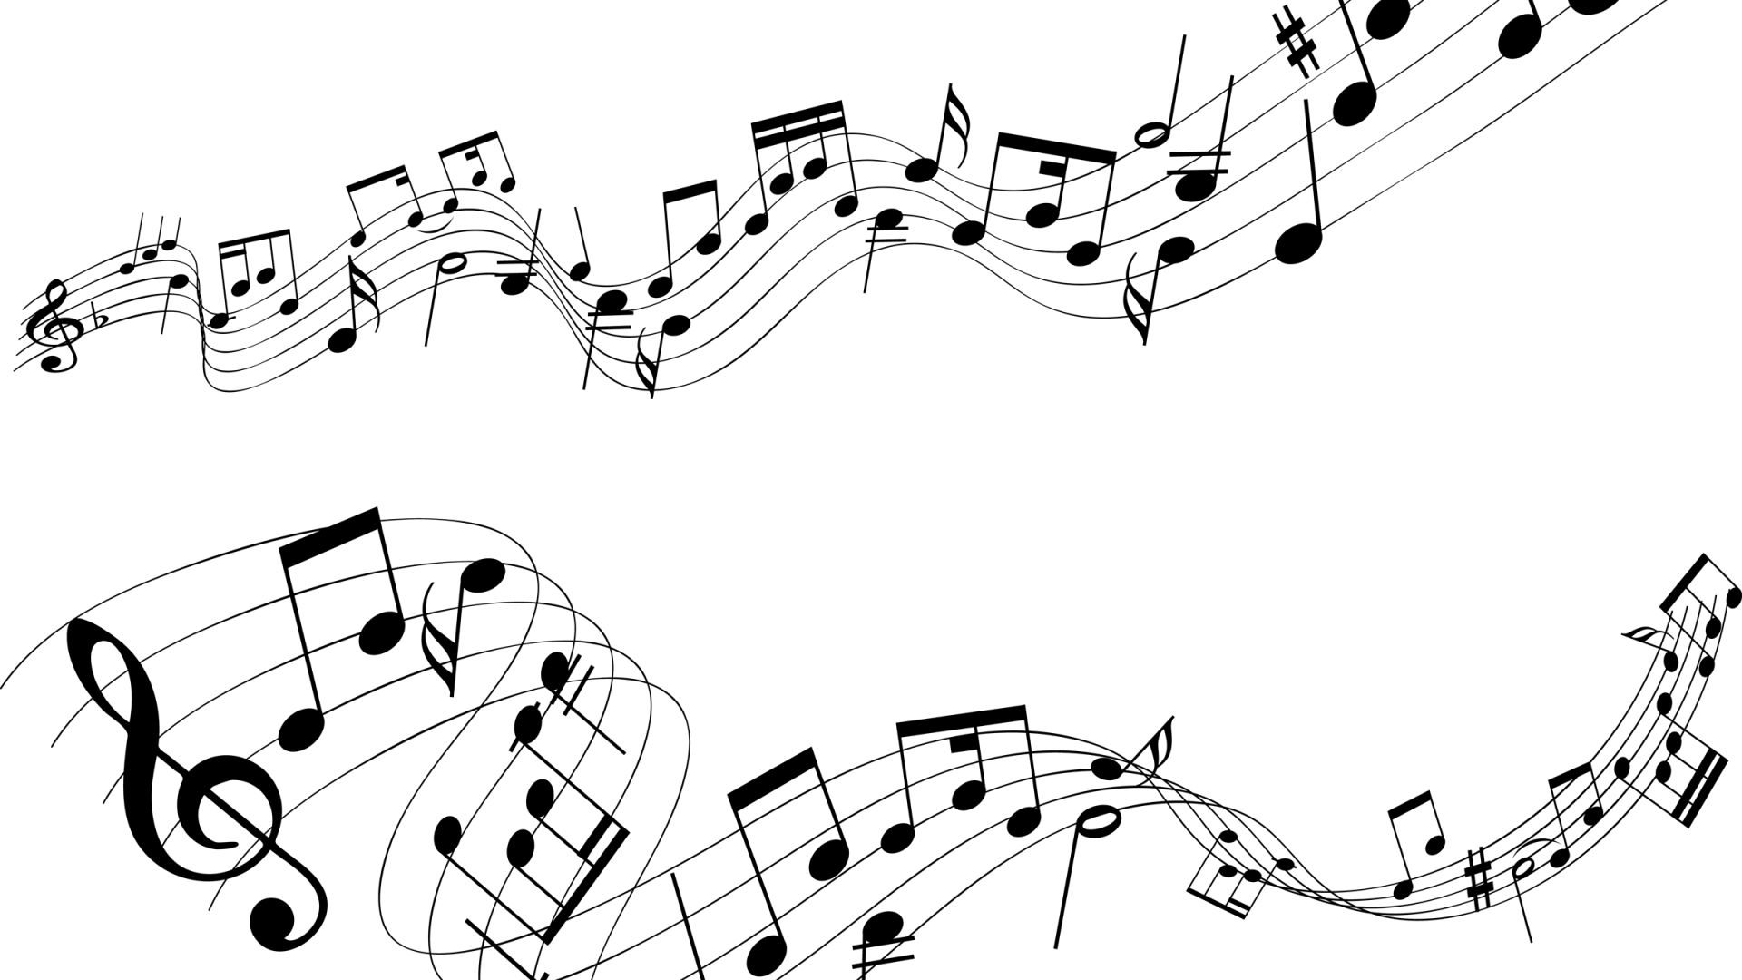
When I look into your eyes It's like watching the night sky Or a beautiful sunrise There's so much they hold And just like them old stars I see that you've come so far To be right where you are How old is your soul? I won't give up on us Even if the skies get rough I'm giving you all my love I'm still looking up And when you're needing your space To do some navigating I'll be here patiently waiting To see what you find
Cause even the stars, they burn Some even fall to the earth We got a lot to learn God knows we're worth it No I won't give up
I Won't Give Up
Jason Mraz
I don't wanna be someone who walks away so easily I'm here to stay and make the difference that I can make Our differences they do a lot to teach us how to use The tools and gifts we've got yeah we got a lot at stake And in the end, you're still my friend At least we didn't intend For us to work we didn't break, we didn't burn We had to learn how to bend without the world caving in I had to learn what I've got, and what I'm not And who I am I won't give up on us Even if the skies get rough I'm giving you all my love I'm still looking up I'm still looking up I won't give up on us God knows I'm tough, he knows We got a lot to learn God knows we're worth it I won't give up on us Even if the skies get rough I'm giving you all my love I'm still looking up

Slide 6
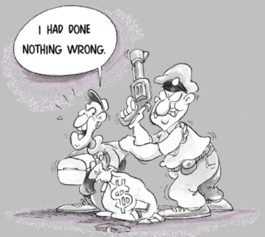

Slide 7
GO!
The couch got soaked because they had not closed the window while it was raining.
The mall had already closed when I arrived there.
Peter hadn't realized that the place was so dangerous.
Had they finished your work last month?

