Slide 1
WORD FORMATION PROCESSES
TEACHER CRISTIANE CRUZ
http://www.brighthubeducation.com/esl-lesson-plans/60060-formation-types-coinages-nonce-loanwords-and-calques/

Slide 2
Coinage Eponym Borrowing

Slide 3
COINAGE
Coinage is the word formation process in which a new word is created either deliberately or accidentally without using the other word formation processes and often from seemingly nothing.
For example, the following list of words provides some common coinages found in everyday English:
ASPIRIN
ESCALATOR (escada rolante)
HEROIN
BAND-AID
FACTOID (fato inverídico)
FRISBEE (pratinho)
GOOGLE
KEROSENE
KLEENEX (lenço umedecido)
LAUNDROMAT (Lavand. Pública)
LINOLEUM (carpete)
MUGGLE (trouxa)
NYLON
PSYCHEDELIC (cores, luzes)
QUARK (parte do átomo)
XEROX
ZIPPER

Slide 4
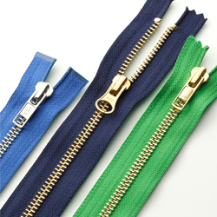

Slide 5
EPONYMS
Eponyms are a word formed from the name of a real of fictitious person. For example:
Mirandize (lei da polícia) – Ernesto A. Miranda
narcissistic – Narcissus
nicotine – Jean Nicot
pasteurization – Louis Pasteur
poinsettia (tipo de flor) – Noel Roberts Poinsett
Praline (doce de castanha) – César de Choiseul, Count Plessis–Praslin
sadistic – Marquis de Sade
salmonella – Daniel Elmer Salmon
sandwich – John Montagu, 4th Earl of Sandwich
volcano – Vulcan
Turing (Machine) – Alan Turing
Turing Test – Alan Turing
atlas – Atlas
boycott – Charles C. Boycott
cardigan – James Thomas Brudnell, 7th Earl of Cardigan
cereal – Ceres
Dunce (estúpido) – John Duns Scotus
guillotine – Joseph Ignace Guillotin
jacuzzi (tipo de piscina)– Candido Jacuzzi
Luddite (antiquado*) – Ned Ludd
Malapropism (falar errado/confundir palavras) – Mrs. Malaprop
Mesmerize (hypnothize) – Franz Anton Mesmer

Slide 6
EPONYMS
Eponyms are a word formed from the name of a real of fictitious person. For example:
Ada Language – Ada Lovelace, a 19th-century mathematician (and the daughter of Lord Byron).
Pascal Language – Blaise Pascal
Euler Language – for the mathematician Leonhard Euler.
Haskell Language – American mathematician Haskell Curry,
Erlang Language – Danish mathematician Agner Krarup Erlang
Gödel Language – logician Kurt Gödel.
Escher Language – artist M. C. Escher.
operating system Linux – a combination of the originator's first name (Linus Torvald) and Unix, which was the name of the system he was copying.
https://www.visualthesaurus.com/cm/wc/ada-to-ziv-names-in-computers/

Slide 7
BORROWING
Borrowing is the word formation process in which a word from one language is borrowed directly into another language. For example, the following common English words are borrowed from foreign languages:
ALGEBRA – Arabic
BAGEL (tipo de pão em forma de rosquinha)– Yiddish
CHERUB (querubim) – Hebrew
CHOW MEIN (tipo yaksoba) – Chinese
FJORD (lago entre montanhas) – Norwegian
GALORE (em abundância) – Irish
HAIKU (tipo de poema) – Japanese
KIELBASA (tipo de linguiça) – Polish
MURDER (assassinato) – French
NEAR – Sanskrit
PAPRIKA (tipo de tempero) – Hungarian
PIZZA – Italian
SMORGASBORD (tipo de jantar) – Swedish
TAMALE (parece com pamonha) – Spanish
YO-YO – Tagalog
TORTILLA (comida) - Mexican

Slide 8
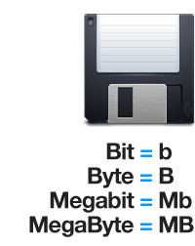
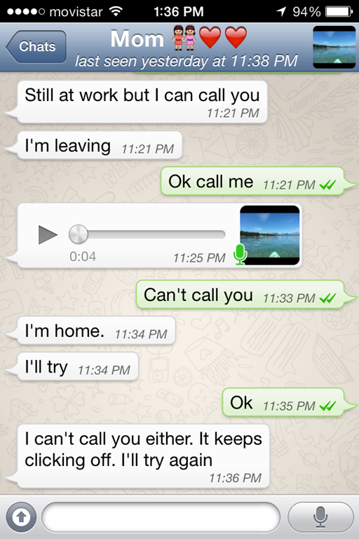
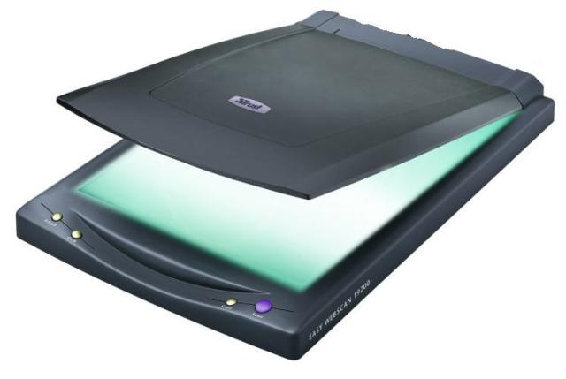
BRASIL

Slide 9
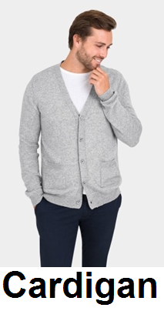
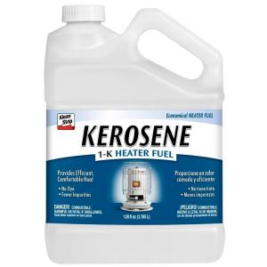
1) Que figura corresponde ao processo de EPONYM?

Slide 10
1) Que figura corresponde ao processo de EPONYM?

Slide 11
2) Que figura corresponde ao processo de COINAGE?

Slide 12
2) Que figura corresponde ao processo de COINAGE?

Slide 13
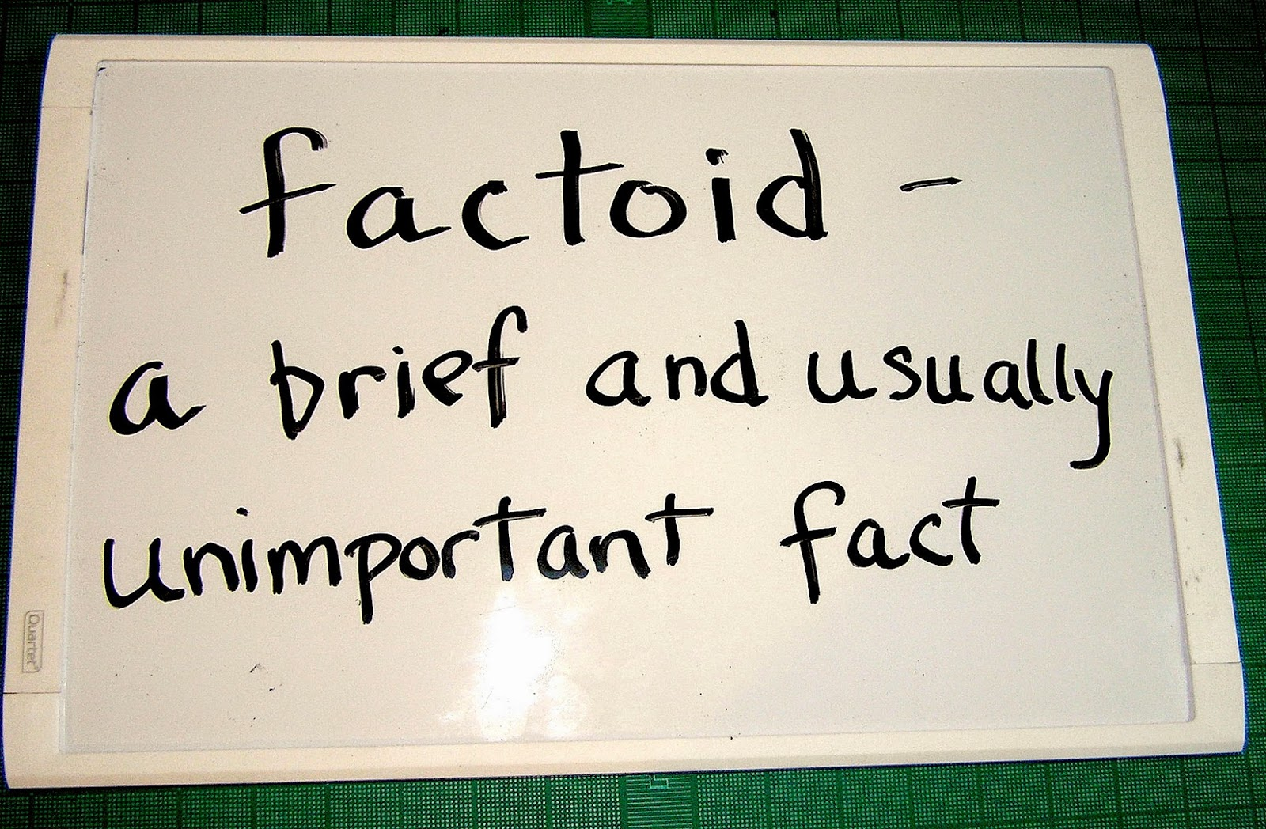
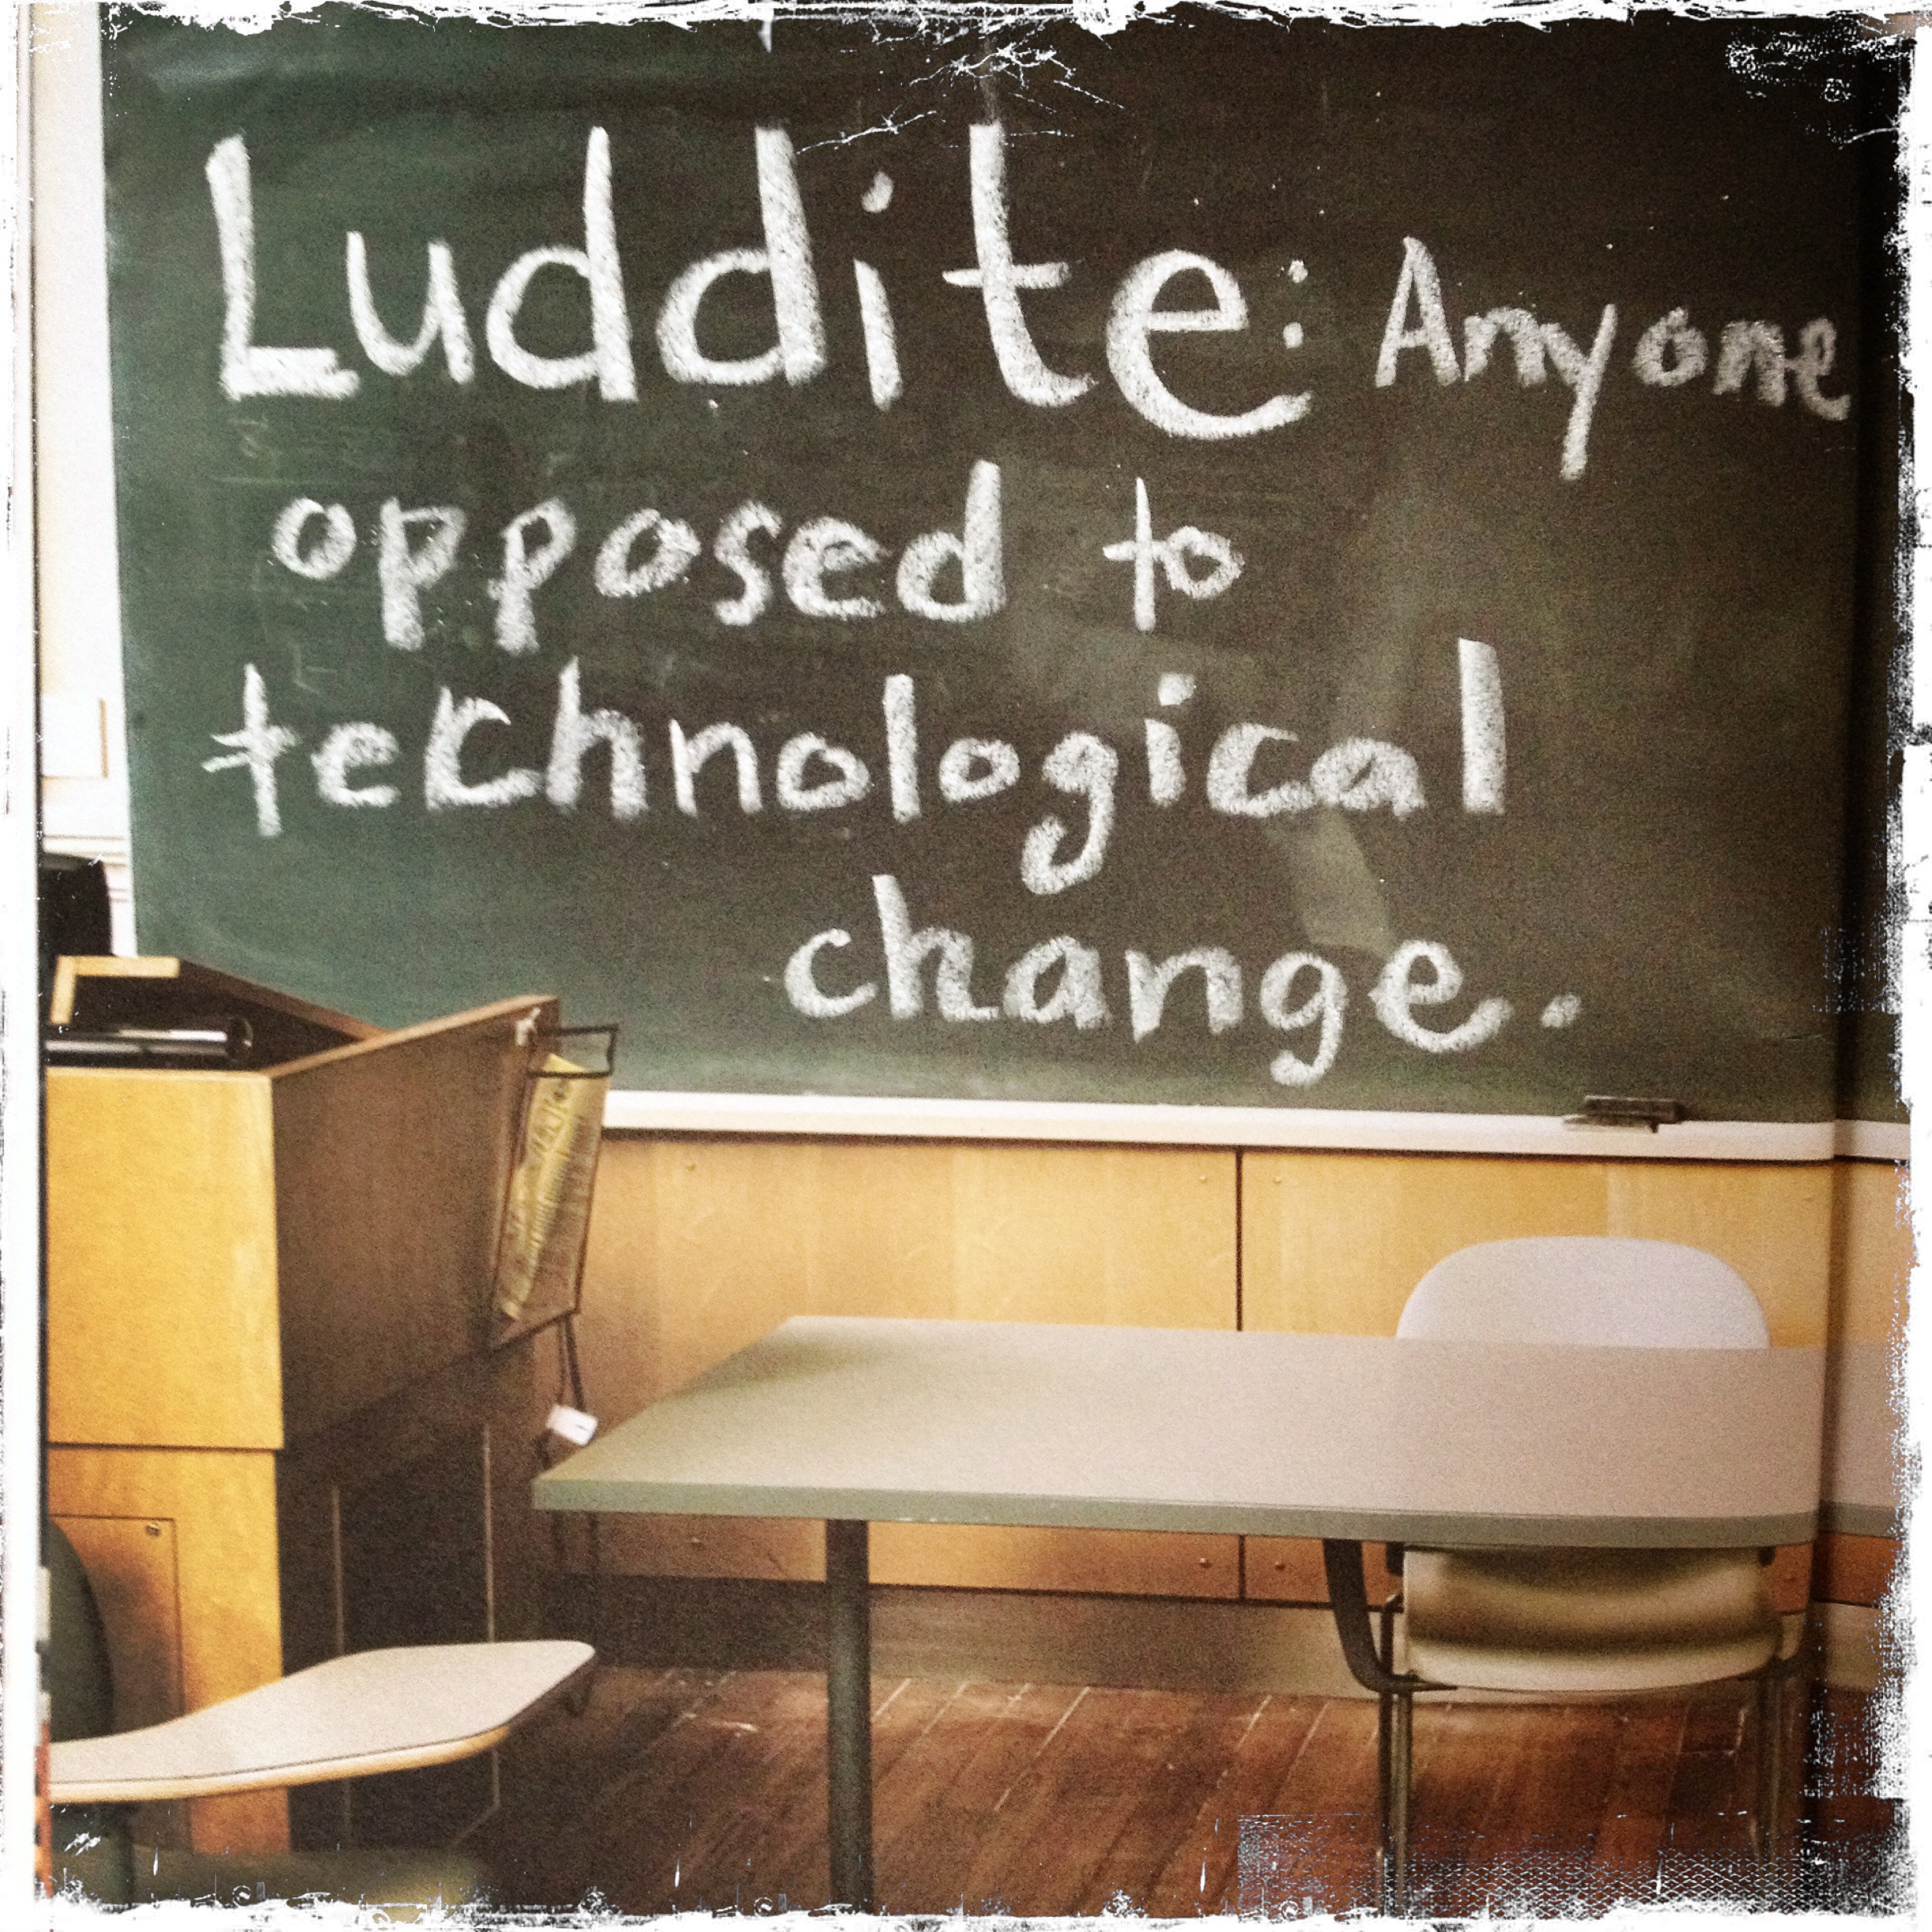
3) Que figura corresponde ao processo de BORROWING?

Slide 14
3) Que figura corresponde ao processo de BORROWING?

Slide 15
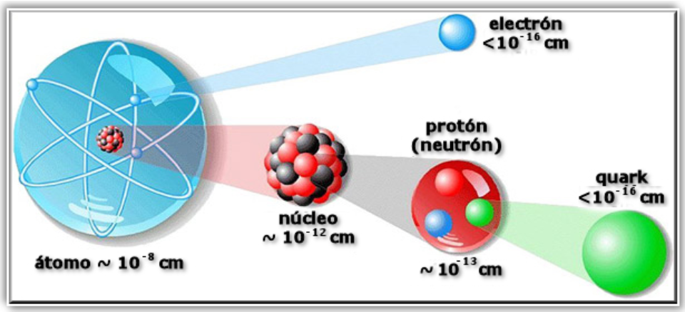
4) Que figura corresponde ao processo de EPONYM?

Slide 16
4) Que figura corresponde ao processo de EPONYM?

Slide 17
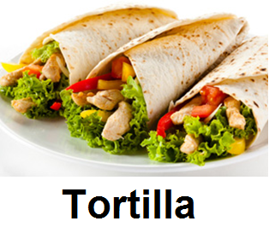
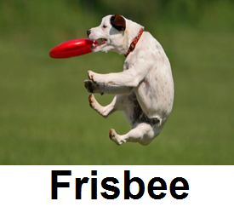
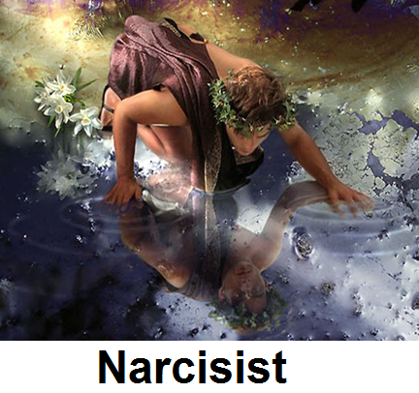
5) Que figura corresponde ao processo de COINAGE?

Slide 18
5) Que figura corresponde ao processo de COINAGE?

Slide 19
6) Que figura corresponde ao processo de EPONYM?

Slide 20
6) Que figura corresponde ao processo de EPONYM?

Slide 21
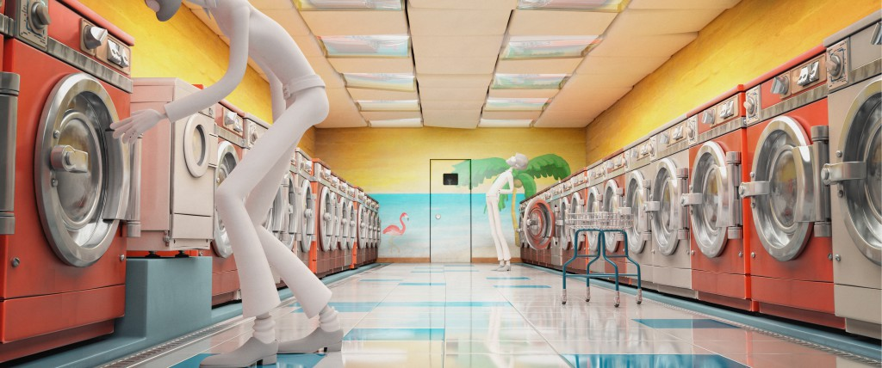
7) Na palavra representada pela figura ao lado temos o processo de:
COINAGE
EPONYM
BORROWING

Slide 22
7) Na palavra representada pela figura ao lado temos o processo de:
COINAGE
EPONYM
BORROWING

Slide 23
8) Na palavra representada pela figura ao lado temos o processo de:
COINAGE
EPONYM
BORROWING

Slide 24
8) Na palavra representada pela figura ao lado temos o processo de:
COINAGE
EPONYM
BORROWING

Slide 25
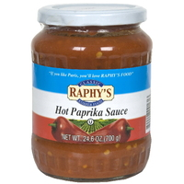
9) Na palavra representada pela figura ao lado temos o processo de:
COINAGE
EPONYM
BORROWING

Slide 26
9) Na palavra representada pela figura ao lado temos o processo de:
COINAGE
EPONYM
BORROWING

Slide 27
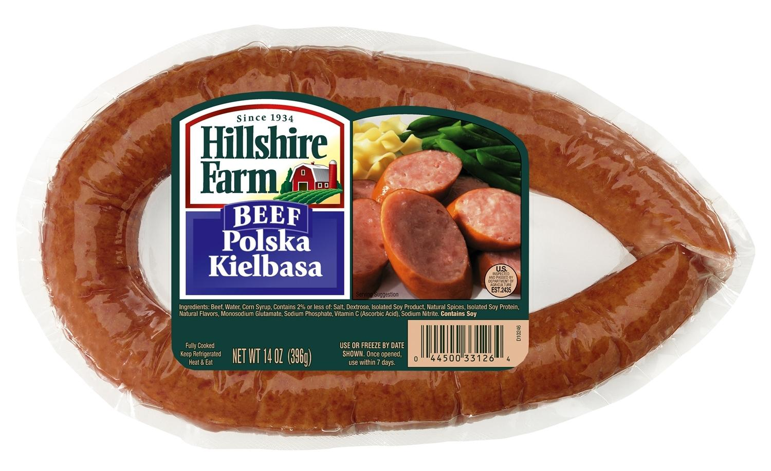
10) Na palavra representada pela figura ao lado temos o processo de:
COINAGE
EPONYM
BORROWING

Slide 28
10) Na palavra representada pela figura ao lado temos o processo de:
COINAGE
EPONYM
BORROWING

Slide 29
RESUMINDO
Coinage: o processo de criação de uma palavra-nova também chamado de NEOLOGISMO. Geralmente acontece com nomes de marcas e produtos famosos ou termos da internet que não existiam antes.
Eponym: é o nome formado a partir de uma pessoa para homenageá-lo(a), aparecem em produtos, processos, marcas e em termos da internet.
Borrowing: são palavras que vieram de outras línguas e não tem tradução na língua inglesa.

Slide 30
Clipping Blending Backformation Acronym

Slide 31
CLIPPING
Clipping is the word formation process in which a word is reduced or shortened without changing the meaning of the word. Clipping differs from back-formation in that the new word retains the meaning of the original word. For exam
advertisement – ad
alligator – gator
examination – exam
gasoline – gas
gymnasium – gym
influenza – flu
laboratory – lab
mathematics – math
Internet – net
memorandum – memo
photograph – photo
public house – pub
raccoon – coon
reputation – rep
situation comedy – sitcom
telephone – phone
Information – info
Alexander – Alex

Slide 32
BLENDING
Blending is the word formation process in which parts of two or more words combine to create a new word whose meaning is often a combination of the original words. For example:
advertisement + entertainment → advertainment
biographical + picture → biopic
breakfast + lunch → brunch
Chuckle (RISADA) + snort (RESFOLEGAR)→ chortle
cybernetic + organism → cyborg
guess + estimate → guesstimate
hazardous (PERIGOSO) + material → hazmat
motor + hotel → motel
prim (PURITANO) + sissy (MARIQUINHA)→ prissy
simultaneous + broadcast → simulcast
smoke + fog → smog
Spanish + English → Spanglish
spoon + fork → spork
telephone + marathon → telethon
web + seminar → webinar

Slide 33
BACKFORMATION
Back-formation is the word formation process in which an actual or supposed derivational affix detaches from the base form of a word to create a new word. For example, the following list provides examples of some common back-formations in English:
babysitter – babysit
donation – donate
gambler – gamble
hazy – haze
moonlighter – moonlight
obsessive – obsess
procession – process
resurrection – resurrect
sassy – sass
television – televise

Slide 34
ACRONYM
Acronyms are words formed by the word formation process in which an initialism is pronounced as a word. For example,HIV is an initialism for Human Immunodeficiency Virus that is spoken as the three letters H-I-V. However, AIDS is an acronym for Acquired Immunodeficiency Syndrome that is spoken as the word aids. Other examples of acronyms in English include:
ASAP – as soon as possible
AWOL – absent without leave
LASER - light amplification by stimulated emission of radiation
NASA – National Aeronautics and Space Administration
NASDAQ - National Association of Securities Dealers Automated Quotations
PIN – personal identification number
RADAR - radio detection and ranging
SCUBA - self-contained underwater breathing apparatus
TESOL – Teachers of English to Speakers of Other Languages
WASP – White Anglo-Saxon Protestant

Slide 35
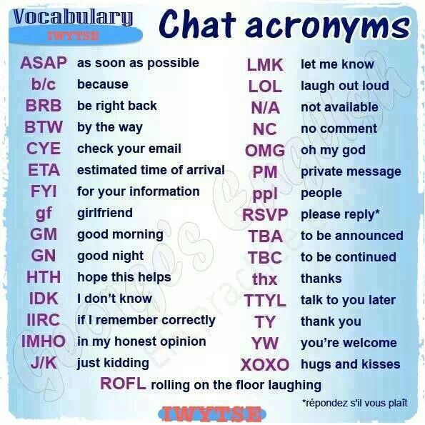
ACRONYM
http://www.netlingo.com/top50/popular-text-terms.php
TOP 50 MOST POPULAR ACRONYMS:

Slide 36
Have fun with English/
Can you work out the meaning of this text message conversation between 2 friends?
http://www.bloomsbury-international.com/blog/2014/04/25/how-to-use-text-message-abbreviations-and-chat-acronyms/
Sam: BTW, Jen, Gotta TK. It’s RI.
Jen: WTF happened. PCM now. Sam: I’ve never felt like this B4. BION: ILU Jen: TMI. Lets talk F2F tmrw Sam: Haha JK. U believed me? ROFL. I don’t like you! Jen: UR def not funny! Sam: LOL. K CU tmrw. ETA? Jen: IDK. 9 I guess Sam: LMK Jen: GTG TTYL Sam: BFN XOXO

Slide 37
Have fun with English/
Can you work out the meaning of this text message conversation between 2 friends?
http://www.bloomsbury-international.com/blog/2014/04/25/how-to-use-text-message-abbreviations-and-chat-acronyms/
Sam: By the way, Jen, We’ve got to talk. It’s really important.
Jen: What the f*** happened? Please call me now. Sam: I’ve never felt like this before. Believe it or not: I love you. Jen: Too much information. Let’s talk face to face tomorrow. Sam: Haha Just Kidding. You believed me? Rolling on the floor laughing!
I don’t like you! Jen: You are definitely not funny! Sam: Laughing out loud. Ok. See you tomorrow. Estimated time of arrival? Jen: I don’t know. 9h I guess. Sam: Let me know Jen: I’ve got to go. Talk to you later Sam: Bye for now. Kisses and huggs.

Slide 38
1) A palavra gas é feita pelo processo de:
A) ACRONYM
B) BACKFORMATION
C) CLIPPING
D) BLENDING

Slide 39
1) A palavra gas é feita pelo processo de:
A) ACRONYM
B) BACKFORMATION
C) CLIPPING
D) BLENDING

Slide 40
2) A palavra brunch é feita pelo processo de:
A) ACRONYM
B) BACKFORMATION
C) CLIPPING
D) BLENDING

Slide 41
2) A palavra brunch é feita pelo processo de:
A) ACRONYM
B) BACKFORMATION
C) CLIPPING
D) BLENDING

Slide 42
3) A palavra smog é feita pelo processo de:
A) ACRONYM
B) BACKFORMATION
C) CLIPPING
D) BLENDING

Slide 43
3) A palavra smog é feita pelo processo de:
A) ACRONYM
B) BACKFORMATION
C) CLIPPING
D) BLENDING

Slide 44
4) A palavra xoxo é feita pelo processo de:
A) ACRONYM
B) BACKFORMATION
C) CLIPPING
D) BLENDING

Slide 45
4) A palavra xoxo é feita pelo processo de:
A) ACRONYM
B) BACKFORMATION
C) CLIPPING
D) BLENDING

Slide 46
5) A palavra cyborg é feita pelo processo de:
A) ACRONYM
B) BACKFORMATION
C) CLIPPING
D) BLENDING

Slide 47
5) A palavra cyborg é feita pelo processo de:
A) ACRONYM
B) BACKFORMATION
C) CLIPPING
D) BLENDING

Slide 48
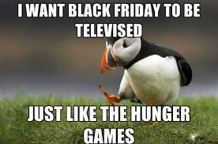
6) A palavra ao lado é feita de qual processo?
A) ACRONYM
B) BACKFORMATION
C) CLIPPING
D) BLENDING

Slide 49
6) A palavra ao lado é feita de qual processo?
A) ACRONYM
B) BACKFORMATION
C) CLIPPING
D) BLENDING

Slide 50
8) A palavra flu é feita pelo processo de:
A) ACRONYM
B) BACKFORMATION
C) CLIPPING
D) BLENDING

Slide 51
8) A palavra flu é feita pelo processo de:
A) ACRONYM
B) BACKFORMATION
C) CLIPPING
D) BLENDING

Slide 52
9) A palavra webinar é feita pelo processo de:
A) ACRONYM
B) BACKFORMATION
C) CLIPPING
D) BLENDING

Slide 53
9) A palavra webinar é feita pelo processo de:
A) ACRONYM
B) BACKFORMATION
C) CLIPPING
D) BLENDING

Slide 54
10) A palavra process é feita pelo processo de:
A) ACRONYM
B) BACKFORMATION
C) CLIPPING
D) BLENDING

Slide 55
10) A palavra process é feita pelo processo de:
A) ACRONYM
B) BACKFORMATION
C) CLIPPING
D) BLENDING

Slide 56
RESUMINDO
Clipping: é o processo de diminuição/abreviação de uma palavra sem que ela perca o sentido.
Blending: é o processo no qual partes de 2 ou mais palavras se juntam para formarem outra.
Backformation: a palavra aqui é diminuída em poucas letras para tornar-se um verbo geralmente.
Acronym: é o processo de abreviação onde só se usam as letras iniciais de uma conjunto de palavras ou no caso de palavras de uma frase.

Slide 57
Compounding Conversion Prefixes Sufixes

Slide 58
COMPOUNDING
Compounding is the word formation process in which two or more lexemes combine into a single new word. Compound words may be written as one word or as two words joined with a hyphen. For example:
noun-noun compound:
note + book → notebook
adjective-noun compound:
blue + berry → blueberry
verb-noun compound:
work + room → workroom
noun-verb compound:
breast + feed → breastfeed
verb-verb compound:
stir + fry → stir-fry
adjective-verb compound:
high + light → highlight
verb-preposition compound:
break + up → breakup
preposition-verb compound:
out + run → outrun
adjective-adjective compound: bitter + sweet → bittersweet
preposition-preposition compound: in + to → into

Slide 59
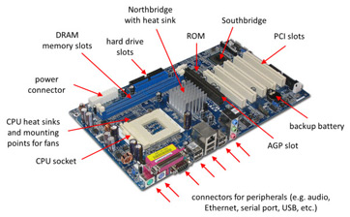
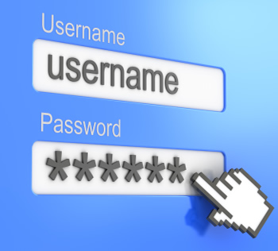
COMPOUNDING
http://www.enchantedlearning.com/wordlist/compoundwordscategorized.shtml

Slide 60
CONVERSION
Conversion is the word formation process in which a word of one grammatical form becomes a word of another grammatical form without any changes to spelling or pronunciation. For example:
The noun email appeared in English before the verb:
A decade ago I would have sent you an email (noun) whereas now I can either send you an email (noun) or simply email (verb) you. The original noun email experienced conversion, thus resulting in the new verb email.
Noun – Verb
access – to access
bottle – to bottle
can – to can
closet – to closet
email – to email
eye – to eye
fiddle – to fiddle
fool – to fool
Google – to google
host – to host
Noun – Verb
microwave – to microwave
name – to name
pocket – to pocket
salt – to salt
shape – to shape
ship – to ship
spear – to spear
torch – to torch
verb – to verb

Slide 61
CONVERSION
Verb – Noun
to alert – alert
to attack – attack
to call – call
to clone – clone
to command – command
to cover – cover
to cry – cry
Verb – Noun
to experience – experience
to fear – fear
to feel – feel
to hope – hope
to increase – increase
to judge – judge
to laugh – laugh
Verb – Noun
to rise – rise
to run – run
to sleep – sleep
to start – start
to turn – turn
to visit – visit
Other conversion
adjective to verb:
green → to green (to make environmentally friendly)
preposition to noun:
up, down → the ups and downs of life
conjunction to noun:
if, and, but → no ifs, ands, or buts
interjection to noun:
ho ho ho → I love the ho ho hos of Christmastime.

Slide 62
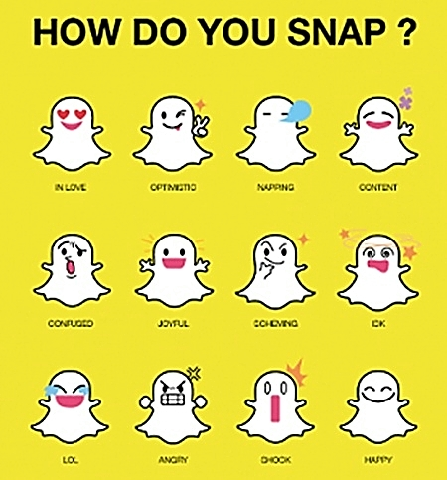
CONVERSION

Slide 63
PREFIXATION
Prefixes are first syllables like “non-” and “re-” that have their own meaning.
Prefixes combine with words to create new meanings.
Direction Prefixes:
De —lower—descend-move to a lower place
Mid —middle—midway—middle of the way
In —in/into—inhale—breath in
Im —in/into—import—bring into
Re —back—recurve—a backwards bend
Sub —under—submarine—underwater
Super —above—superimpose—place above
Not Prefixes :These prefixes indicate the word not:
il —illegal—not legal
Im —impossible—not possible
In —inactive—not active
Ir —irregular—not regular
Non —nonsense—no sense
Un —unable—not able,

Slide 64
PREFIXATION
Prefixes are first syllables like “non-” and “re-” that have their own meaning.
Prefixes combine with words to create new meanings.
Time Prefixes:
Fore —ahead of time—forewarn—warn ahead of time
Pre —before—prefix—before the word
Re —again—redo—do again
Behavior Prefixes:
Mis —wrongly—misunderstand—wrongly understand
Mis —badly—misbehave—badly behave
Combining Prefixes:
Com —together—compact—packed together
Con —with—contact—communicate with

Slide 65
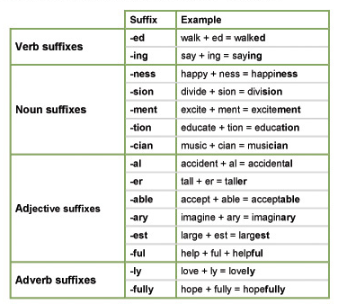
SUFIXATION
Suffixes are last syllables like “ed” and “ly” that have their own meaning.
Suffixes combine with words to create new meanings.

Slide 66
1) A palavra ao lado é feita de qual processo?
A) COMPOUNDING
B) CONVERSION
C) PREFIXATION
D) SUFIXATION

Slide 67
1) A palavra ao lado é feita de qual processo?
A) COMPOUNDING
B) CONVERSION
C) PREFIXATION
D) SUFIXATION

Slide 68
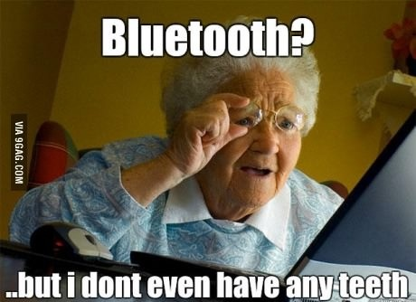
2) A palavra ao lado é feita de qual processo?
A) COMPOUNDING
B) CONVERSION
C) PREFIXATION
D) SUFIXATION

Slide 69
2) A palavra ao lado é feita de qual processo?
A) COMPOUNDING
B) CONVERSION
C) PREFIXATION
D) SUFIXATION

Slide 70
3) A palavra ao lado é feita de qual processo?
A) COMPOUNDING
B) CONVERSION
C) PREFIXATION
D) SUFIXATION

Slide 71
3) A palavra ao lado é feita de qual processo?
A) COMPOUNDING
B) CONVERSION
C) PREFIXATION
D) SUFIXATION

Slide 72
4) A palavra ao lado é feita de qual processo?
A) COMPOUNDING
B) CONVERSION
C) PREFIXATION
D) SUFIXATION

Slide 73
4) A palavra ao lado é feita de qual processo?
A) COMPOUNDING
B) CONVERSION
C) PREFIXATION
D) SUFIXATION

Slide 74
5) A palavra ao lado é feita de qual processo?
A) COMPOUNDING
B) CONVERSION
C) PREFIXATION
D) SUFIXATION

Slide 75
5) A palavra ao lado é feita de qual processo?
A) COMPOUNDING
B) CONVERSION
C) PREFIXATION
D) SUFIXATION

Slide 76
6) A palavra ao lado é feita de qual processo?
A) COMPOUNDING
B) CONVERSION
C) PREFIXATION
D) SUFIXATION

Slide 77
6) A palavra ao lado é feita de qual processo?
A) COMPOUNDING
B) CONVERSION
C) PREFIXATION
D) SUFIXATION

Slide 78
7) A palavra ao lado é feita de qual processo?
A) COMPOUNDING
B) CONVERSION
C) PREFIXATION
D) SUFIXATION

Slide 79
7) A palavra ao lado é feita de qual processo?
A) COMPOUNDING
B) CONVERSION
C) PREFIXATION
D) SUFIXATION

Slide 80
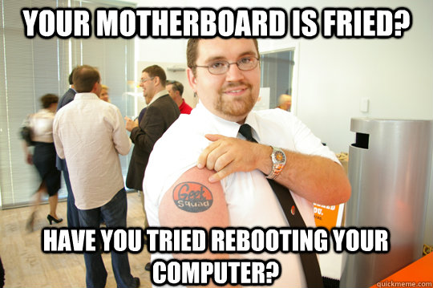
8) A palavra MOTHERBOARD é feita de qual processo?
A) COMPOUNDING
B) CONVERSION
C) PREFIXATION
D) SUFIXATION

Slide 81
9) A palavra MOTHERBOARD é feita de qual processo?
A) COMPOUNDING
B) CONVERSION
C) PREFIXATION
D) SUFIXATION

Slide 82
9) A palavra REBOOTING é feita de qual processo?
A) COMPOUNDING
B) CONVERSION
C) PREFIXATION
D) SUFIXATION

Slide 83
10) A palavra ao lado é feita de qual processo?
A) COMPOUNDING
B) CONVERSION
C) PREFIXATION
D) SUFIXATION

Slide 84
10) A palavra ao lado é feita de qual processo?
A) COMPOUNDING
B) CONVERSION
C) PREFIXATION
D) SUFIXATION

Slide 85
RESUMINDO
Compounding: é o processo no qual 2 ou mais palavras se juntam para formar uma outra.
Conversion: é o processo no qual a palavra muda de classe gramatical.
Prefixation: é o acréscimo de um prefixo no início da palavra.
Sufixation: é o acréscimo de um sufixo no final da palavra.
Afixation: é o acréscimo de prefixo ou sufixo ou os dois na palavra.

