Slide 1
TRAVELLING TO YOUR DESTINATION
Check-in; Departure Gate;
Airport Terminal; Departure Lounge; Duty-Free; Ferry;

Slide 2
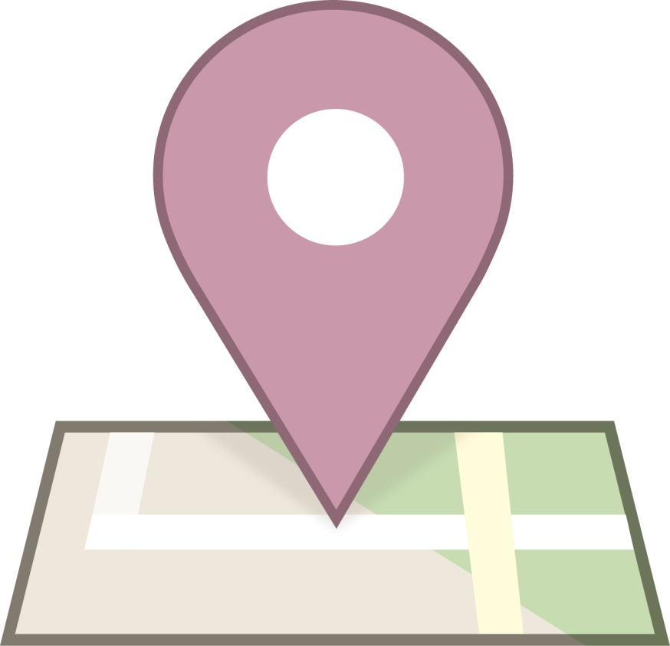
CHECK-IN
The act of reporting one’s presence and registering, typically at na airport or hotel.

Slide 3
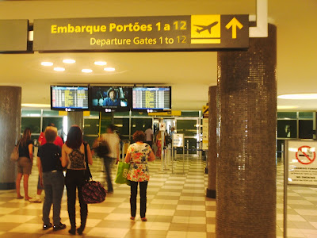
DEPARTURE GATE
Gate where passengers embark.

Slide 4
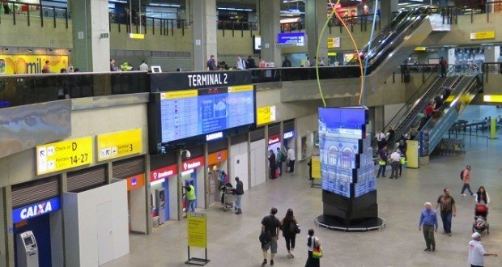
AIRPORT TERMINAL
This is a building at na airport, where passengers transfer between ground transportation and facilities that allow them to board or disembark from na aircraft.

Slide 5
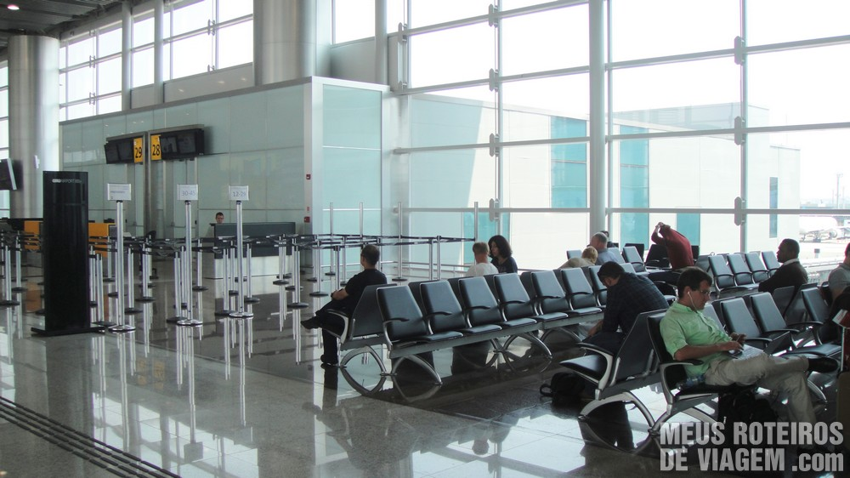
DEPARTURE LOUNGE
A seating area in an airport where passengers wait to board na aircraft or vehicle.

Slide 6
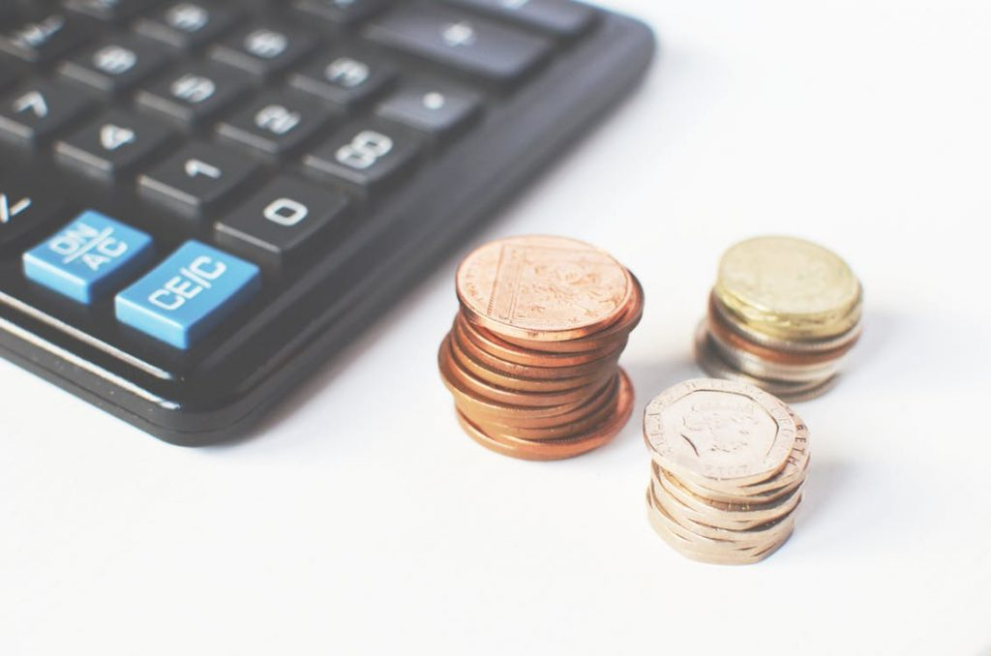
DUTY-FREE
Items available for purchase that are free of duty or tax charges in a particular country, generally sold at airports.

Slide 7
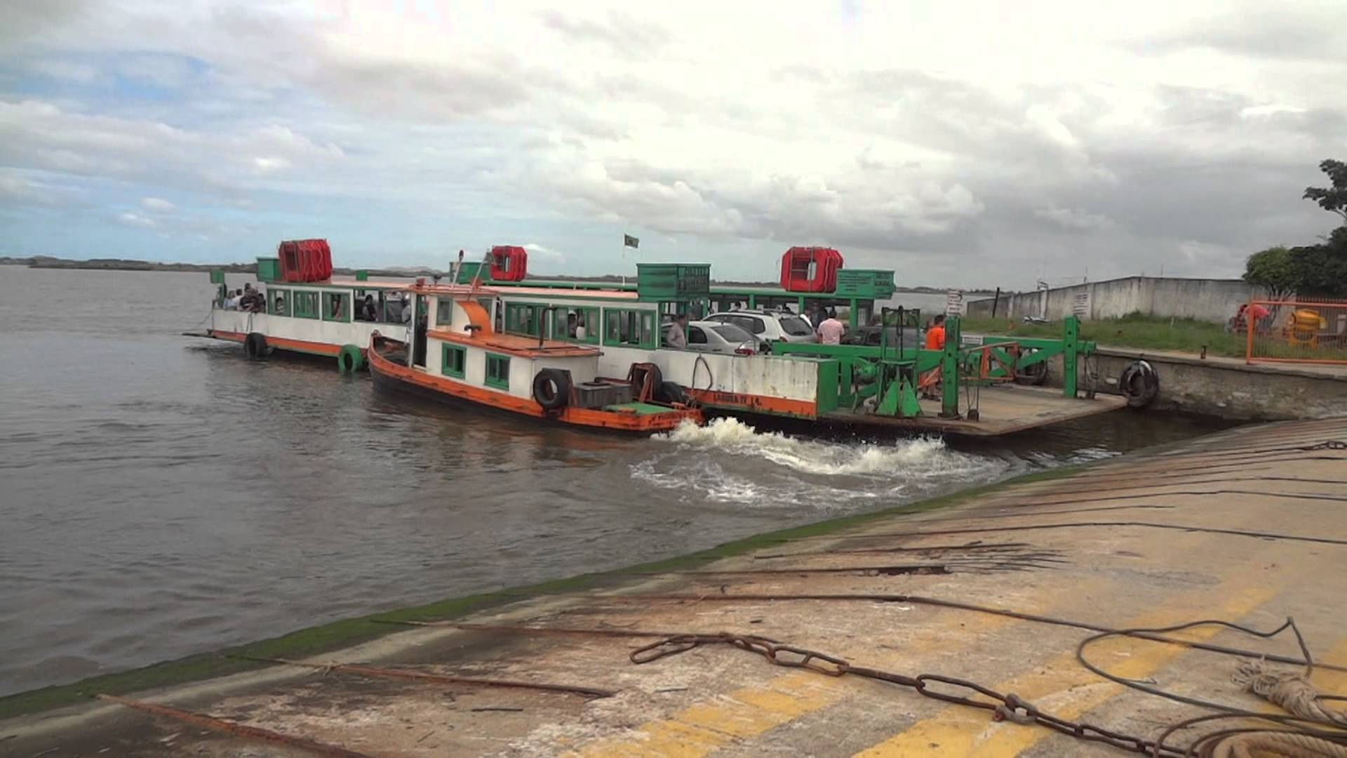
FERRY
A boat or ship for conveying passengers or goods, especially over a relatively short distance and as regular service.

Slide 8
Components:
Ana Paula;
Maria Fernanda;
Simone Souza;

