Slide 1
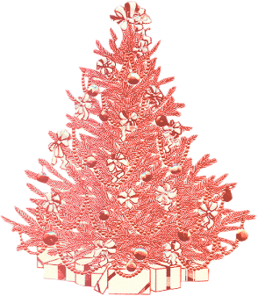
7 eventos históricos que aconteceram no Natal
3° ano – Alimentos/Matutino
Cristiane Cruz

Slide 2
Componentes:
01. Alana Dias
02. Ana Mylena Bezerra
03. Brenda Gundim
04. Esther Alice
05. Gabriella Silva
06. Maria Beatriz Lírio

Slide 3
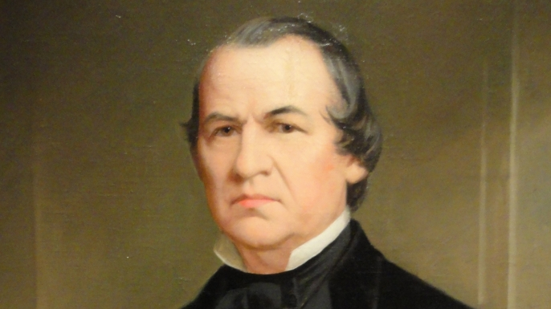
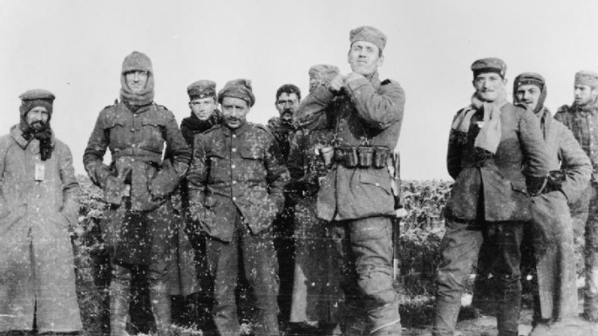
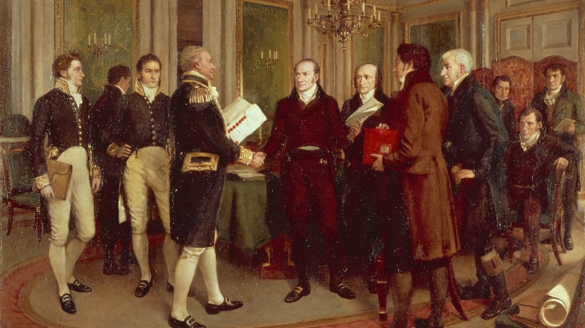
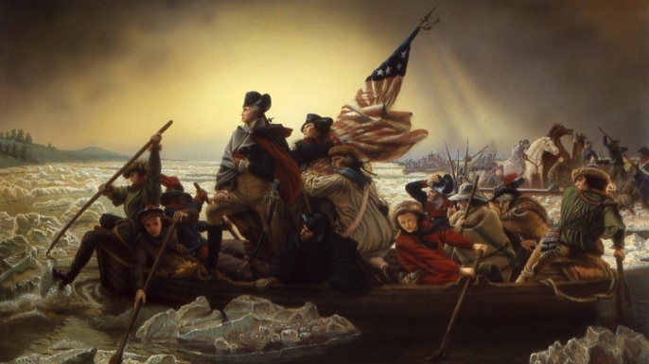
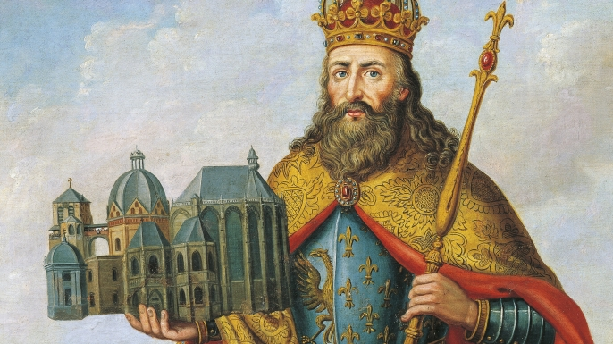
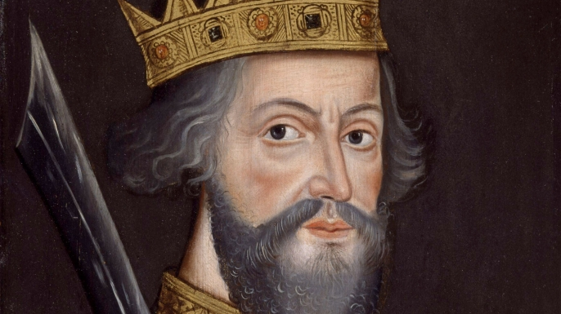
Resumo
Resumo

Slide 4
Tag Questions
Carlos Magno is often called “Father of europe”, isn’t he?
William was crowned king of England, wasn’t he?
Apollo 8 orbits the moon in 1968, doesn’t he?
George Washington led 2400 soldiers, isn’t he?

Slide 5
Tag Questions
The loss of Christmas was a unconditional act, wasn’t?
Andrew Johnson issued a final loss, didn’t he?
The truce of The First World War is achieved, isn’t?
United States and Grain Britain signed a peace agreement, didn’t they?

