Slide 1
AESTHETICS AND HEALTH
English
CRISTIANE DE BRITO CRUZ

Slide 2
INTRODUCTION
The quest for the "perfect body" has been gaining a great deal of space in today's society. The gym, diets, plastic surgery, anabolic are the methods used in the search for the "perfect body", but the big problem lies in many risking their lives because of aesthetics.

Slide 3
BUT WHAT DOES AESTHETIC, AND HEALTH MEAN?
Aesthetics is defined as the act of perceiving, of noting.
Health, in turn, according to WHO (World Health Organization) means the result of complete physical, mental and social well-being.

Slide 4
WHEN AESTHETICS CAN AFFECT HEALTH?
Aesthetics affect health when the goal of the individual is to seek a perfect body, without medical guidance or even when there is an abusive excess of anabolic, esthetic surgeries, and bad eating habits.

Slide 5
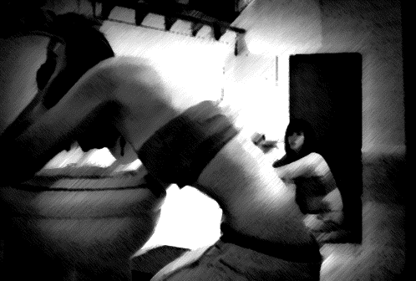
INFLUENCED DISEASES
ANOREXIA: it is characterized by the need that the person has to decrease the weight, refusing to eat and claiming lack of appetite.
BULIMIA: is characterized by repeated bouts of binge eating followed by inappropriate behaviors such as vomiting, misuse of laxatives, medications, fasting, and excessive exercise.

Slide 6
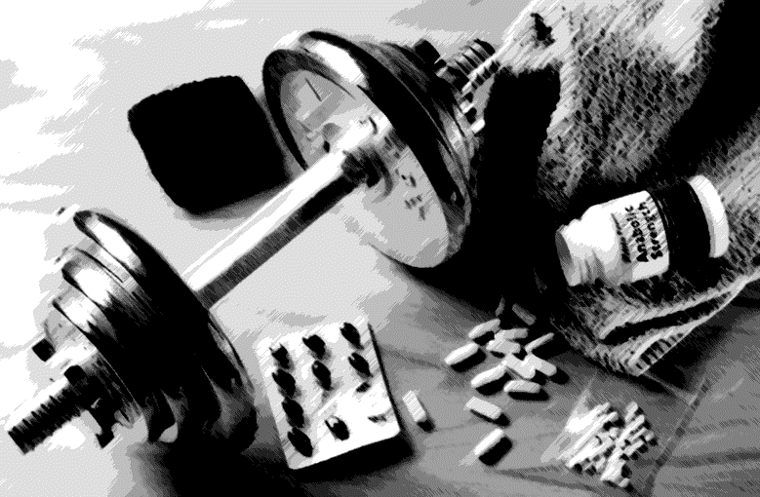
ANABOLIZANTS
They are hormones that serve to rebuild the tissues that have become weak, and can also be used to gain lean body mass or bone mass. And in spite of bringing benefits, its abusive use can bring several health risks, such as:
Mood swings
Violent behavior
Sterility
Fluid retention

Slide 7
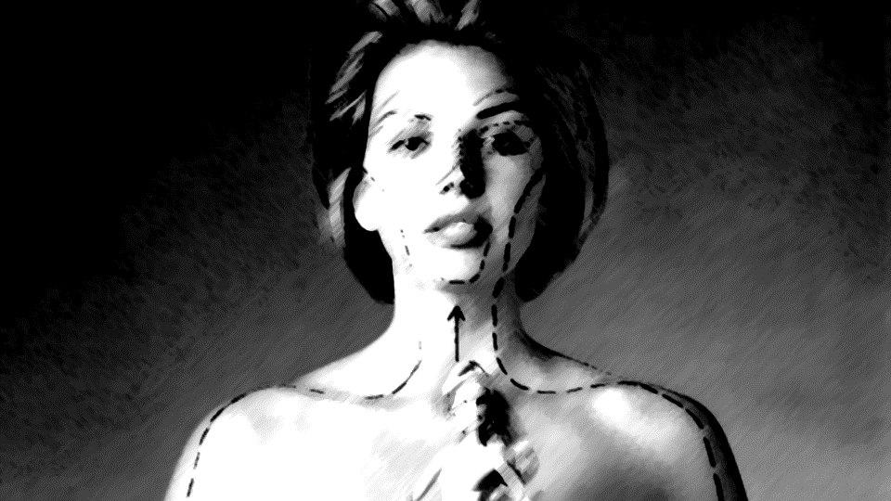
PLASTIC SURGERY
Brazil is considered the country with the largest number of aesthetic surgeries in the world.
Plastic surgeries can be considered dangerous because some complications can arise, such as infection, thrombosis or rupture of the stitches.
Breast augmentation and liposuction are the most successful types of plastic surgery.

Slide 8
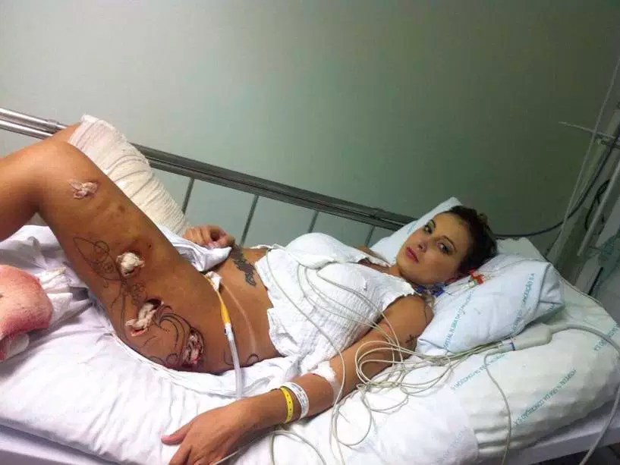
WHEN BEAUTY SEEMS
Andressa Urach is perhaps the most emblematic example of when the obsessive search for beauty becomes harmful to health. After resorting to a hydrogel-based implant on the buttocks and thighs, she was a victim of complications from infection and was at risk of death, and had very little of one of her legs amputated.
Hydrogel:
Substance composed of 98% water and 2% polyamide used
to fill and increase volume in regions such as buttocks and thighs.

Slide 9
TANNING
Tanning has been banned for eight years in Brazil.
The world health organization has categorized tanning beds at the same height as cigarettes. And before age 35 accelerates the premature aging, increases the chance of skin cancer and can cause dermatoses.
Four minutes in the tanning chamber equals more than an hour of sun exposure.

Slide 10
CHARGEs

Slide 11
SHORT FILM supervenus

Slide 12
Music All About That Bass

Slide 13
CONCLUSION
We conclude by showing how much society is influenced by a pattern of beauty and the risks that excessive abuse of aesthetics can bring to health. So be careful; If accepted; Love yourself and be healthy.

Slide 14
Components
Gabriel Ângelo
Jayane Souza
Pâmylla Santos
Rauany Silva
Raissa Souza

