Slide 1
BULLYING and CYBERBULLYING
DISCENTEs:
José Airton;
Luana Azevedo;
Renata Beatriz;
Rita Beatriz;
Thayse Emanuelle.

Slide 2
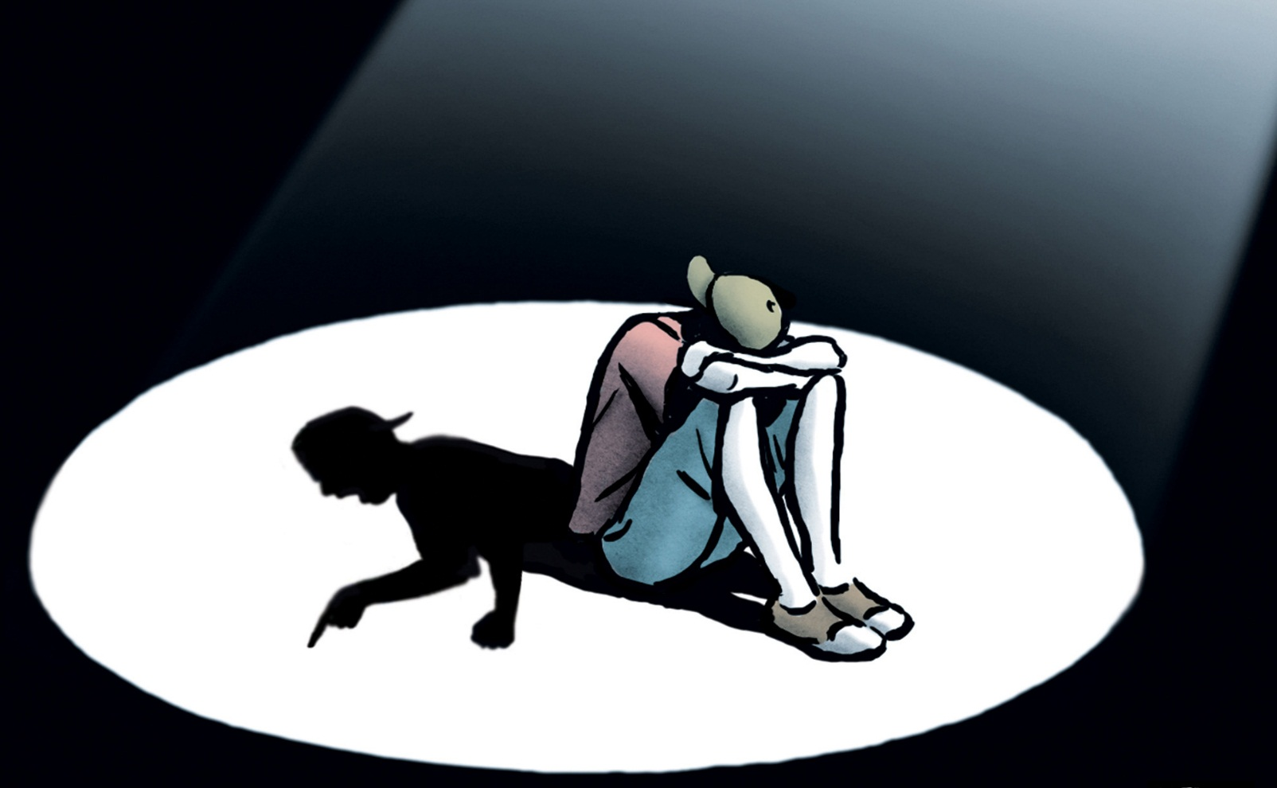

Slide 3
What is bullying?
Are intentional, verbal or physical aggressions, made in a repetitive way, by one or more people against one or more colleagues.
Occur in any social context: schools, universities, families, neighborhoods and workplaces.

Slide 4
What leads the author to practice it?
Want to be more popular and feel powerful.
It is a person who has not learned to turn his anger into dialogue and feels satisfied with the oppression of the attacked, supposing or anticipating how painful that cruelty lived by the victim.

Slide 5
How to identify the target of bullying?
The target is usually a child or a young person with low self-esteem and withdrawn both at school and at home.
Because of these characteristics, it is difficult to react.
If the person seeks help, the tendency is for the provocation to cease.

Slide 6
Consequences:
To the target:
Low immunological resistance and self-esteem;
Stress;
Psychological disorders;
Phobia;
Anxiety;
Depression;
And suicide;

Slide 7


Slide 8
Consequences:
For viewers:
Insecurity;
Anxiety;
Fear;
Stress;
Committing your socio-educational process.

Slide 9
Consequences:
For the aggressors:
The overvaluation of violence as a way of gaining power;
Skills development for future criminal conduct;
Projection of violent behaviors in adult life.

Slide 10
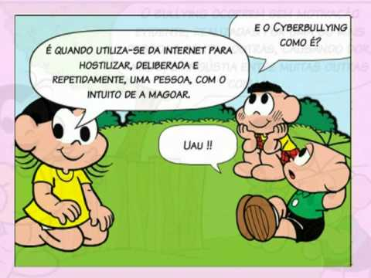

Slide 11
What is cyberbullying?
It is bullying that occurs in electronic media, with defamatory or threatening messages circulating virtual, social networks and cell phones.
Anonymity can increase the cruelty of comments and threats and the effects can be so severe Or worse.

Slide 12
How to deal with bullying and cyberbullying?
Bullying:
Encourage the persons to report cases;
Recognize and value the attitudes of persons in tackling the problem.
Cyberbullying: avoid aggression on the internet.

Slide 13
References:
21 perguntas e respostas sobre bullying. Nova Escola, 2009. Disponível em: https://novaescola.org.br/conteudo/336/bullying-escola. Acesso em 01 de junho de 2017.

