Slide 1
DRUGS

Slide 2
Effects of some drugs
Heroin: Upon crossing the blood-brain barrier, which occurs soon after introduction of the drug into the bloodstream, heroin is converted into morphine, which mimics the action of endorphins, creating a sense of well-being; the characteristic euphoria has been described as an “orgasm” centered in the gut.
Cocaine: It is both a stimulant of the central nervous system and an appetite suppressant, giving rise to what has been described as a euphoric sense of happiness and increased energy.

Slide 3
Methamphetamine: Since it stimulates the mesolimbic reward pathway, causing euphoria and excitement, it is prone to abuse and addiction. Users may become obsessed or perform repetitive tasks such as cleaning, hand-washing, or assembling and disassembling objects
Ecstasy (MDMA): The primary effects of MDMA include an increased awareness of the senses, feelings of openness, euphoria, empathy, love, happiness, heightened self-awareness, feeling of mental clarity and an increased appreciation of music and movement.

Slide 4
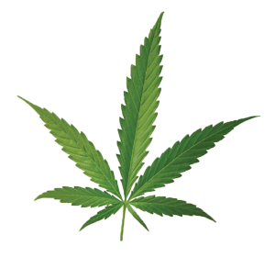
Marijuana: Cannabis, known as marijuana in its herbal form, is a psychoactive product of the plant Cannabis sativa. Humans have been consuming cannabis since prehistory, although in the 20th century there was a rise in its use for recreational, religious or spiritual, and medicinal purposes.
It is estimated that about four percent of the world’s adult population use cannabis annually. It has psychoactive and physiological effects when consumed, usually by smoking or ingestion.
The state of intoxication due to cannabis consumption is colloquially known as a “high”; it is the state where mental and physical facilities are noticeably altered due to the consumption of cannabis.

Slide 5
Wrongly used drugs
Drugs, such as cocaine, crack and ecstasy, can affect the functioning of the heart, liver, lungs and even the brain, being very harmful to health. In addition the consumption of an excessive dose can lead to death due to overdose which can cause cardiac and respiratory arrest. These changes can happen when consuming any kind of drugs, but especially the illicit drugs that include amphetamines and heroin, for example.

Slide 6
Positive points of drugs
“Recent research on the medicinal use of cannabidiol (CBD) has shown that this substance extracted from marijuana may be effective in treating patients with Parkinson's disease.” – g1.globo.com
Morphine is a substance extracted from opium and named after the Greek god of sleep, Morpheus. One of the most active analgesics that exist, it has important medical application in the control of very strong pains, in cases of serious illnesses, like cancer or violent traumas caused by accidents.
Etc…

Slide 7
Marijuana in the economy
“Since Justin Trudeau's government announced its intention to legalize Canadian marijuana production, trade, and consumption for recreational purposes from 2018, interest in the subject has skyrocketed. According to a study by the Deloite consulting firm, based on data from 2016, if legalization is approved, the billing of the sector may reach US $ 16 billion per year.” – Uol
“The legalization of marijuana in Brazil would move R $ 5.7 billion a year, with the prospect of generating a tax revenue of R $ 5 billion, according to a study prepared by professionals of the Legislative Consulting of the Chamber of Deputies.” – O globo

Slide 8
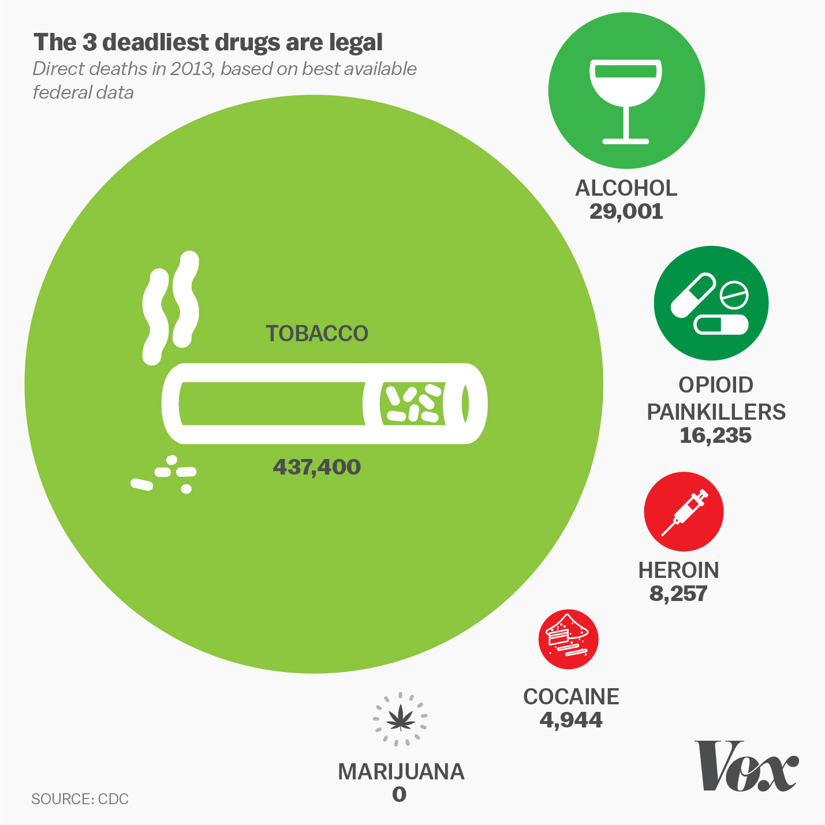

Slide 9

Or just the beginning?

Slide 10
References
http://listverse.com/2007/09/27/top-10-drugs-and-their-effects/
http://g1.globo.com/sp/ribeirao-preto-franca/noticia/2014/10/estudo-aponta-eficacia-do-canabidiol-em-pacientes-com-mal-de-parkinson.html
http://www1.folha.uol.com.br/mundo/2017/05/1885978-canada-preve-lucrar-us-16-bilhoes-por-ano-com-uso-recreativo-de-maconha.shtml
https://oglobo.globo.com/sociedade/comercio-formal-de-maconha-movimentaria-57-bilhoes-no-brasil-19468621

Slide 11
Components
Flávia Macedo de Araújo
Matheus Antônio Queiroz dos Santos
Thiago Christofany Pereira Franco
Luís Eduardo Dantas Fernandes

