Slide 1
Gender Equality
Componentes:
Alianna Varela
Alice Danielle
Jordan Dias
Luiza Lorena
Mariana Luiza

Slide 2
What is Gender Equality?
Gender equality is achieved when women and men enjoy the same rights and opportunities across all sectors of society, including economic participation and decision-making, and when the different behaviours, aspirations and needs of women and men are equally valued and favoured.
Gender equality is not only a fundamental human right, but a necessary foundation for a peaceful, prosperous and sustainable world.

Slide 3
Facts
About two thirds of countries in the developing regions have achieved gender parity in primary education
In Southern Asia, only 74 girls were enrolled in primary school for every 100 boys in 1990. By 2012, the enrolment ratios were the same for girls as for boys.
In sub-Saharan Africa, Oceania and Western Asia, girls still face barriers to entering both primary and secondary school.

Slide 4
Women in Northern Africa hold less than one in five paid jobs in the non-agricultural sector. The proportion of women in paid employment outside the agriculture sector has increased from 35 per cent in 1990 to 41 per cent in 2015
In 46 countries, women now hold more than 30 per cent of seats in national parliament in at least one chamber.

Slide 5
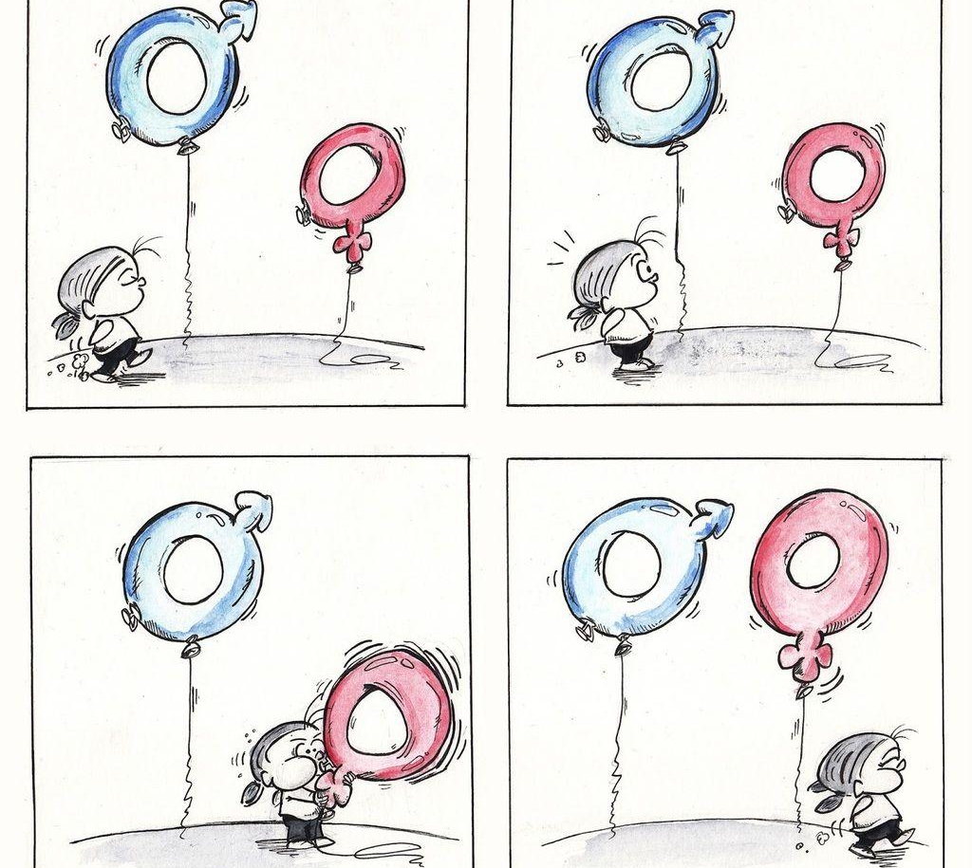
9 actions to contribute to gender equality, in practice

Slide 6
1. Stop using cursing that perpetuates gender values
Without realizing it, we use many offenses that reaffirm gender patterns and perpetuate the macho values of our culture;
bitch, Motherfucker, son of a bitch, tom boy, Minger,Ninny, Sex pot, etc.;
curses that say that woman has active sexual behavior, Adjectives linked to the myth that women are unreliable beings and those linked to beauty and aesthetic ideals;
In the case of men they use curses that speak of male prisons: fear of presenting any trait that refers to the feminine, virility, performance at work and success.

Slide 7
2. Beware of sexist jokes and expressions
“All men are the same”
“Real man doesn't cry”
“This is male stuff”
Jokes of mother-in-law, blonde, women at the wheel, women and shopping, among others that caricature women as being dumb.

Slide 8
3. Talk to family and friends
It is necessary the dialogue between you and your family, whenever possible, try to make affirmations against certain types of comments, we can see as example this conversation between father and son:
"Is that boy fucked up, Rodrigo?"
"Why, father, just because he's quiet and sensitive?"
"Yeah, I do not know, he has an effeminate way."
"I was shy and I'm not even homosexual." "Teo - son of Aunt Leila - is, and you love him."

Slide 9
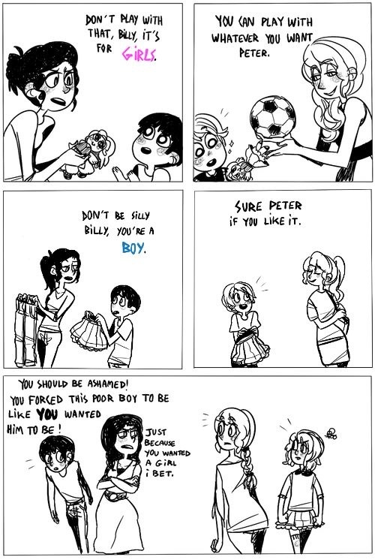
4. Give more space for children to develop fully
Boys toys or girls toys?

Slide 10
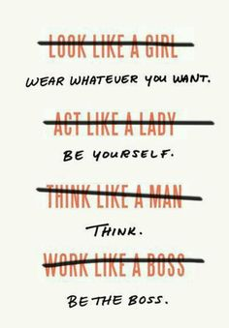

Slide 11
5. Reflect about pornography
The word "pornography" comes from the Greek porne, which means "sexual slave woman"
Objectification of the women, treated by the porn industry as something available for men's consumption;

Slide 12
6. Support yourself projects related to gender equality
Questioned
Participate and promote discussions on gender equality
Encourage smaller projects through collective financing

Slide 13
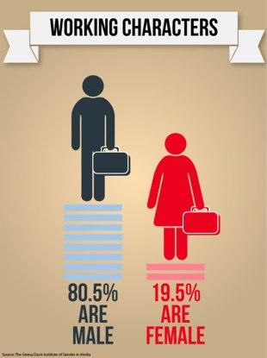
7. Help boost women's careers and their businesses
A CEO, or anyone in a managerial position, can take a variety of steps: to encourage the hiring of women, to open up dialogue on the subject and to preach equal treatment, to set up commissions or groups of women dealing with gender issues, rights and professional needs, among other examples.

Slide 14

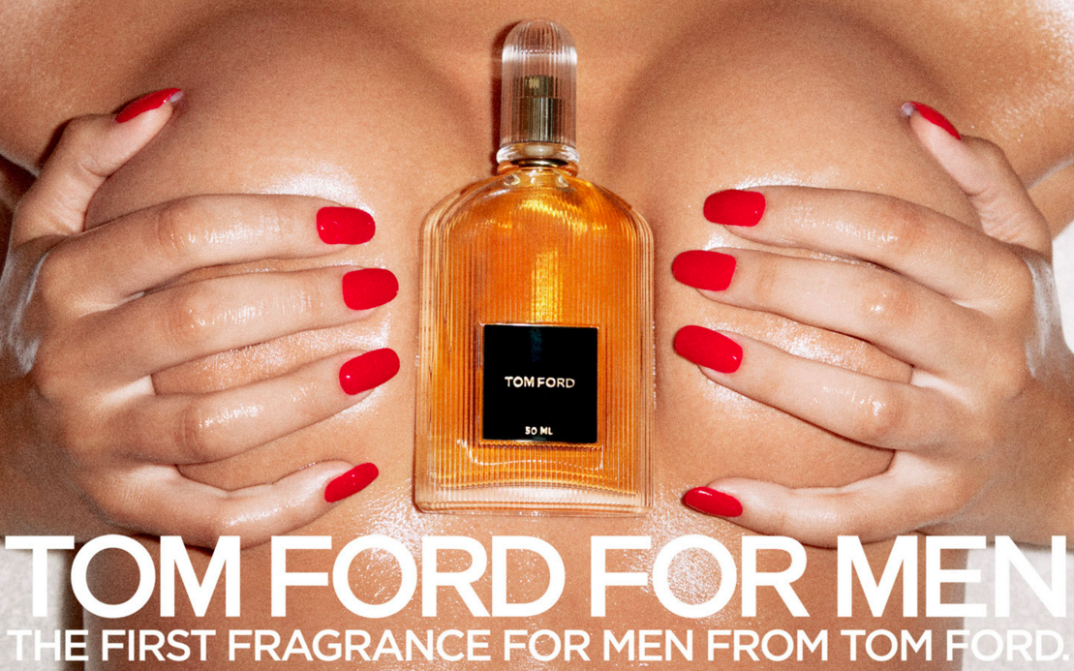
8. Support brands that believe in equality
Many brands launch products or develop advertising campaigns that reinforce a logic of inequality;
We can stop consuming branded products that perpetuate sexism through advertising;
They are usually focused on a male audience, objectify and hypersexualize the woman, support harassment and rape.

Slide 15




We may prefer brands that produce, support or fund campaigns for equality and respect.
ESPN has launched a platform to stimulate Brazilian women's sport.
Companies like Microsoft and Intel fund campaigns like "Girls who code" and "Do it, girls!" That focus on the inclusion of women in science.

Slide 16
9. Attention with the xabec and chivalry
"Hey, hottie!"
"Where is your boyfriend? Are you alone?"
Offensive flirtations on the street and ballad, invasive approaches to public transport, disrespectful looks - all of which can put women in a place of fear, insecurity and objectification.
Being kind to just women

Slide 17
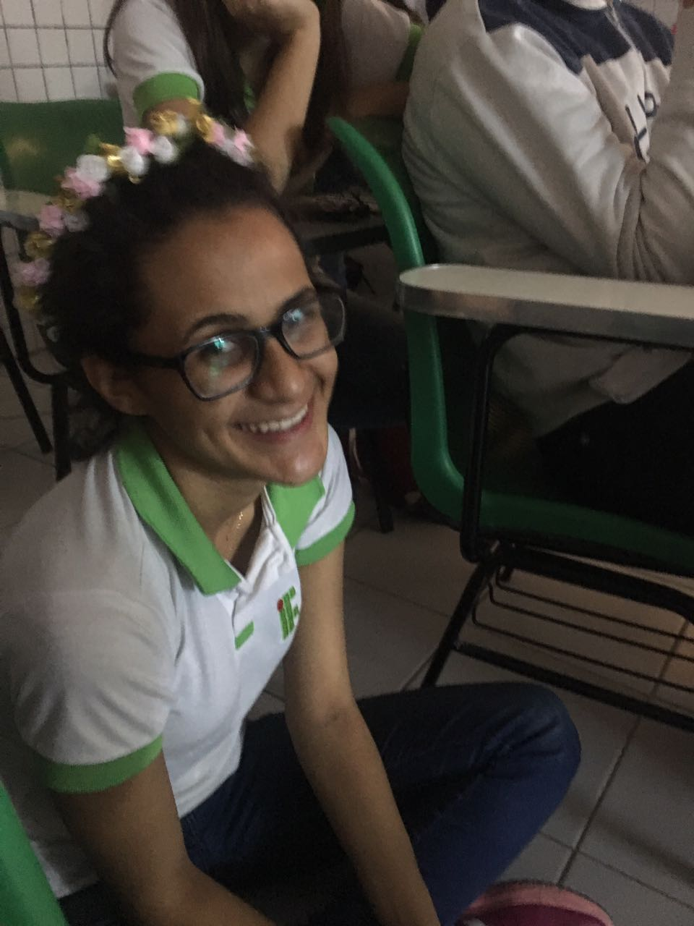
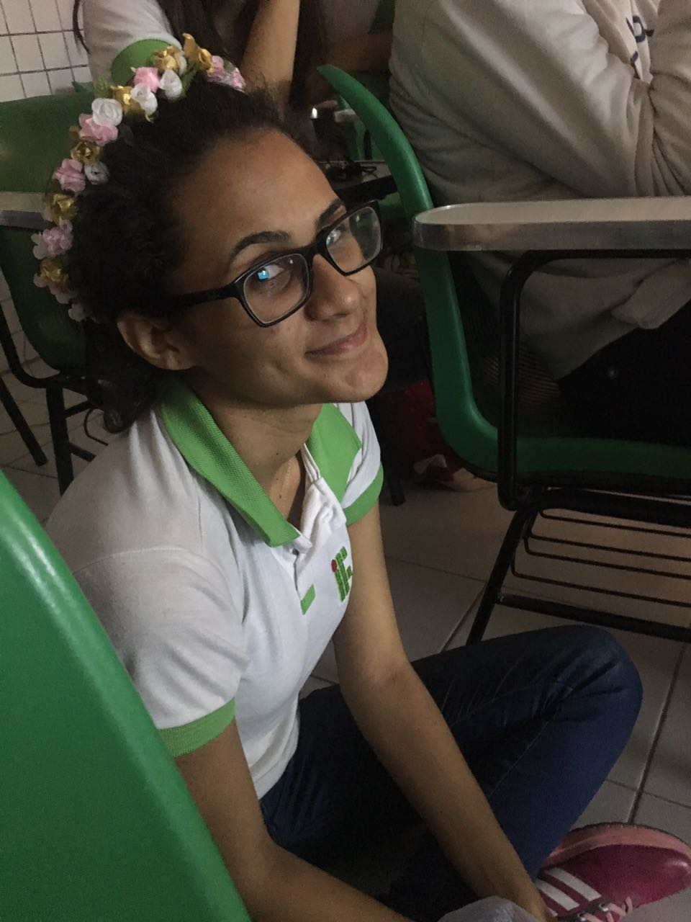
THANK YOU!!!
very much

Slide 18
References
http://www.un.org/sustainabledevelopment/gender-equality/#
http://www.genderequality.ie/en/ge/pages/whatisge
https://papodehomem.com.br/9-acoes-pra-contribuirmos-com-a-igualdade-de-genero-na-pratica/
http://aprenderpalavras.com/xingamentos-insultos-e-palavroes-em-ingles/

