Slide 1
HOMOPHOBIA
COMPONENTES:
ANA CAROLINA
ANTHONNY RAFAEL
DAÉMILLY MOURA
LUÍSA ISABELE
MARCOS VINÍCIUS
PAULO ROBERTO

Slide 2
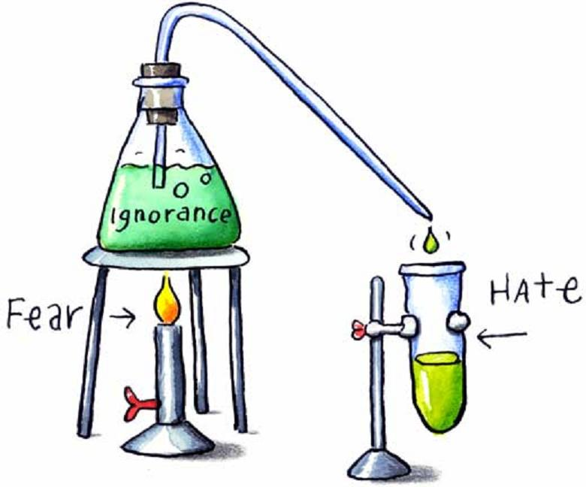
WHAT IS HOMOPHOBIA?
Homophobia is a pervasive, irrational fear of homosexuality. Homophobia includes the fear heterosexuals have of any homosexual feelings within themselves, any overt mannerisms or actions that would suggest homosexuality, and the resulting desire to suppress or stamp out homosexuality. And it also includes the self-hatred and self-denial of homosexuals who know what they are but have been taught all their lives by a heterosexual society that people like themselves are sick, sinful and criminal.

Slide 3
WHAT IS HOMOPHOBIC BULLYING OR HARRASSMENT?
Most homophobic bullying takes place at a time when young people are unsure about their own developing identity - subjected as they are to the confusing messages our society sends out about what it means to be “a man” or “a woman” and the stereotype of what it means to be gay. Homophobia presents itself in young people as the fear of and the reaction to an issue about which they can have little understanding and to a person perceived as “different”.
Homophobic harassment of adults is unwanted behaviour which is offensive, causing the man or woman affected to feel threatened, humiliated or patronised. Such behaviour can seriously interfere with a person's personal health, work perfomance and security, creating a threatening living or workplace environment.

Slide 4
HOMOPHOBIA IN SCHOOLS AND SOCIETY, IS A MAJOR ISSUE?
One in a five lesbian and gay people have experienced a homophobic hate crime or incidente in the last three years;
68% of those targeted did not report the incidente to anyone;
Young people aged 18 to 24 are more likely to be the target of homophobic abuse;
In schools, 98% of young gay people hear phrases such as “that’s so gay”, “you’re so gay” and over four fifths hear them frequently.

Slide 5
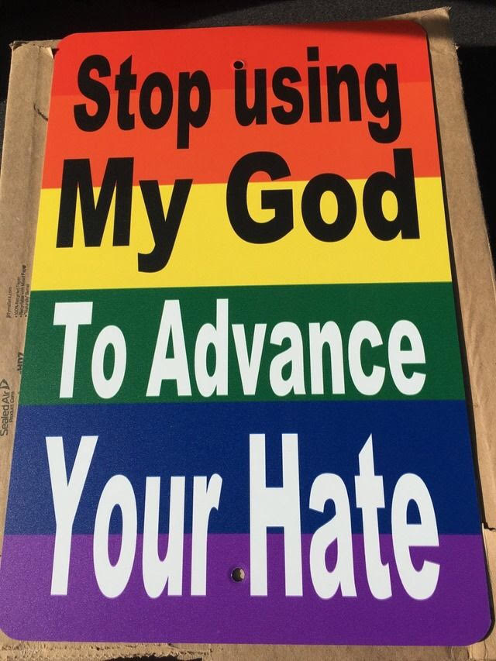
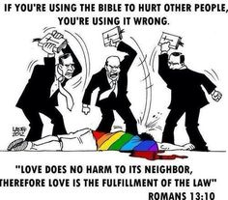
RELIGION AND HOMOPHOBIA
It’s common for people to use the religion to carry out homophobic attitudes. This attitude is wrong, because no there is justification in the world to humiliate and despise another human being.
This is what I ask you now: how long will they use the name of God to justify their own hypocrisy? Until when will love be a mockery, a laugh? Finally, how much longer will love be a sin?

Slide 6
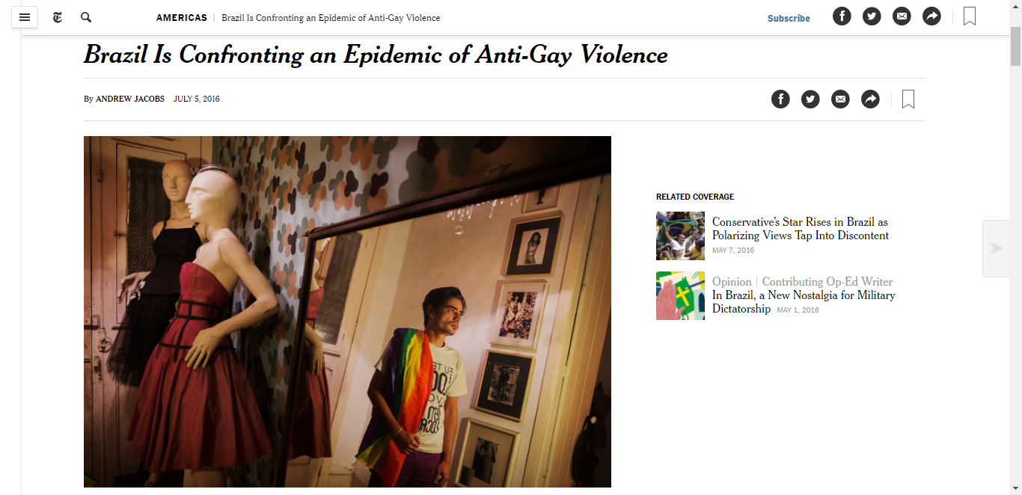
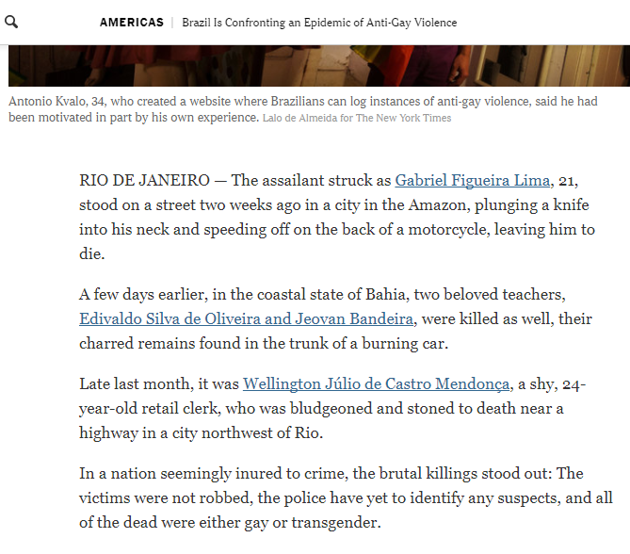
HOMOPHOBIA IN BRAZIL

Slide 7
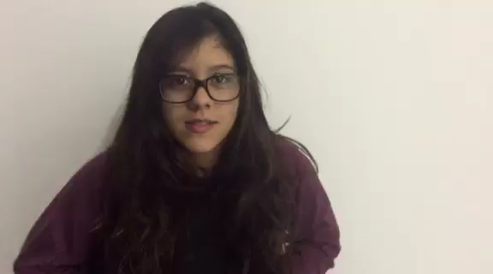

Slide 8
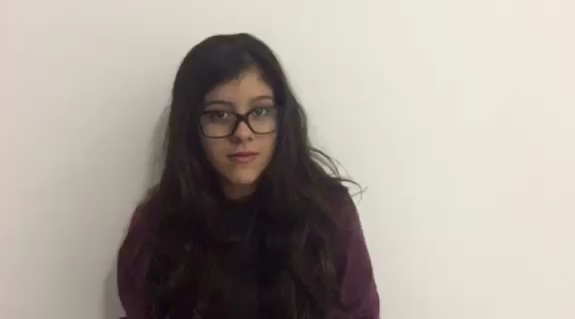

Slide 9
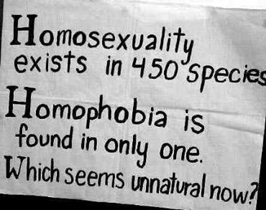
Thank you very much!

