Slide 1

DEATH PENALTY
DISCENTES:
ERICA MACEDO
EVELLYN MYCAELA
ISADORA STÉFANY
MÍRIA GABRIELLY
RUANE KALINE
WHY NOT

Slide 2
“
Salil Shetty
THE DEATH PENALTY IS A SYMPTOM OF A CULTURE OF VIOLENCE, NOT A SOLUTION TO IT.

Slide 3
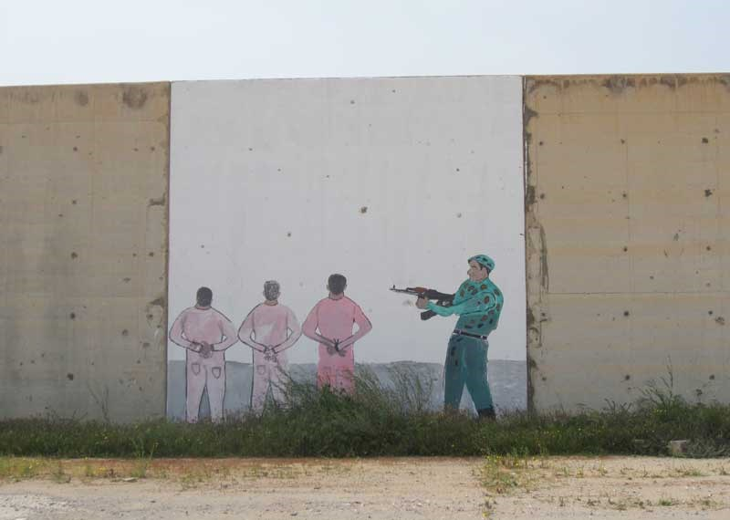
We know that, together, we can end the death penalty everywhere.
Every day, people are executed by the state as punishment for a variety of crimes – sometimes for acts that should not be criminalized. In some countries it can be for who you sleep with, in others it is reserved for acts of terror and murder.
“THE DEATH PENALTY IS CRUEL, INHUMAN AND DEGRADING.”

Slide 4
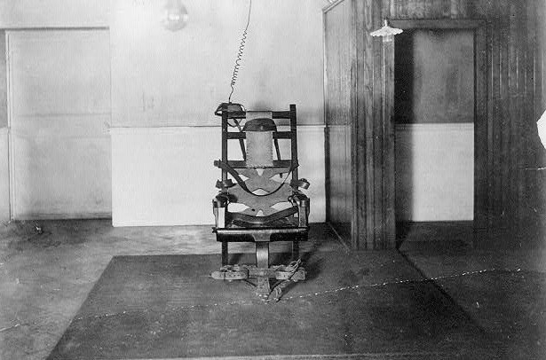
WHY DO WE KILL PEOPLE WHO KILL PEOPLE TO SHOW KILLING PEOPLE IS WRONG?
Some countries execute people who were under 18 years old when the crime was committed, others use the death penalty against people who suffer mental problems. Before people die they are often imprisoned for years on “death row”. Not knowing when their time is up, or whether they will see their families one last time.

Slide 5
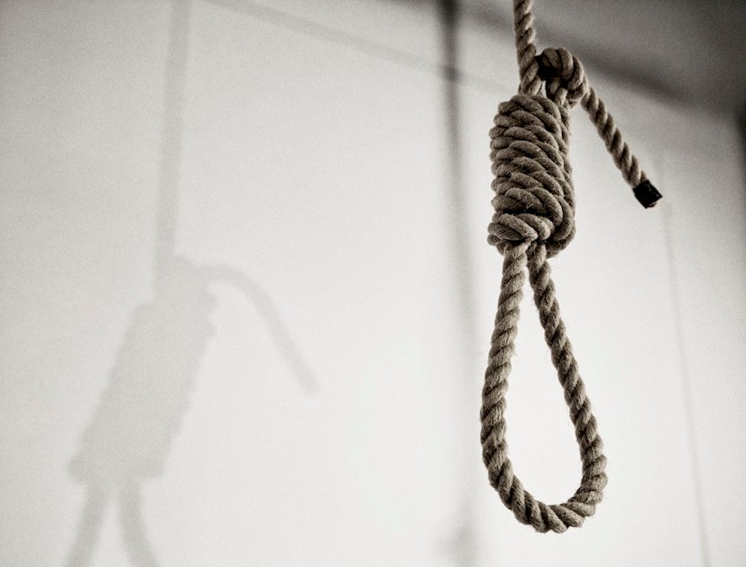
THE PROBLEM
IRREVERSIBLE AND MISTAKES HAPPEN. Execution is the ultimate, irrevocable punishment: the risk of executing an innocent person can never be eliminated. Since 1973, for example, 150 US prisoners sent to death row have later been exonerated. Others have been executed despite serious doubts about their guilt.
DOES NOT DETER THE CRIME. Countries who execute commonly cite the death penalty as a way to deter people from committing crime. This claim has been repeatedly discredited, and there is no evidence that the death penalty is any more effective in reducing crime than imprisonment.

Slide 6
THE PROBLEM
DISCRIMINATORY. You are more likely to be sentenced to death if you are poor or belong to a racial, ethnic or religious minority because of discrimination in the justice system. Also, poor and marginalized groups have less access to the legal resources needed to defend themselves.
USED AS A POLITICAL TOOL. The authorities in some countries, for example Iran and Sudan, use the death penalty to punish political opponents.

Slide 7

EXECUTION METHODS
There are many and varied types of execution used around the world today, including:
• Beheading
• Electrocution
• Hanging
• Lethal injection
• Shooting in the back of the head and by firing squad

Slide 8
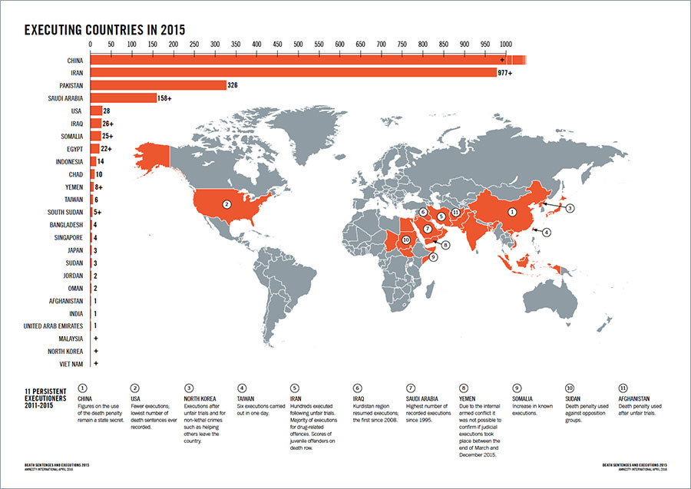

Slide 9
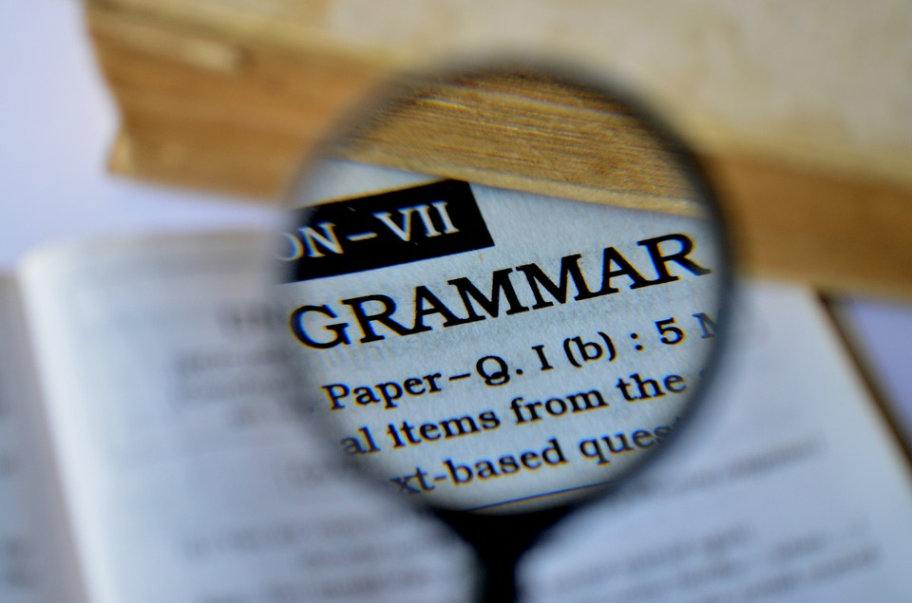
GRAMMAR - SIMPLE PRESENT AND PRESENT CONTINUOUS
AUTHORITIES
KILLING
KNOWING
DEGRADING
IT IS
INCLUDING
BEHEADING
ELECTROCUTION

Slide 10
GRAMMAR - SIMPLE PRESENT AND PRESENT CONTINUOUS
IV. HANGING
X. SHOOTING
XI. YOU ARE
XII. DISCRIMINATION
XIII. EXECUTION
XIV. REDUCING
XV. COMMITTING

Slide 11
REFERÊNCIA
AMNESTY, INTERNATIONAL. DEATH PENALTY. DISPONÍVEL EM: <https://www.amnesty.org/en/what-we-do/death-penalty/>

Slide 12
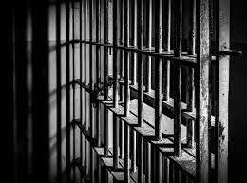
THANKS!

