Slide 1
RELIGION
Gabriela da Costa Xavier
Isadora Bezerra Silva
Juliana Lara Dantas Haussler
Laianny Kelly da Silva Neves
Matheus Felipe Araujo Souza

Slide 2
What is Religion?
Religion is a faith, a devotion to everything that is considered sacred. It is a cult that brings man closer to the entities to which supernatural powers are attributed. It is a belief that people seek satisfaction in religious practices or faith, to overcome suffering and achieve happiness.
All kinds of religion have their foundations, some are based on various philosophical analyzes, which explain what we are and why we come into the world.

Slide 3
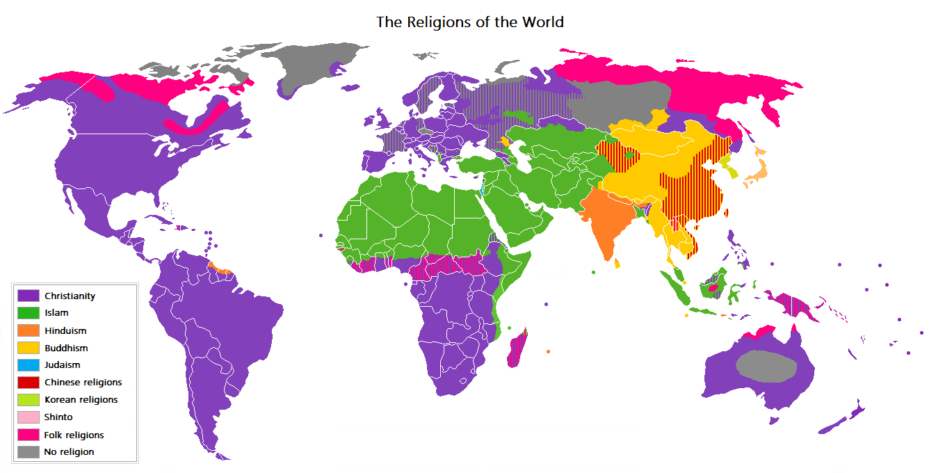
The 8 largest religions in the world
Spiritism
Judaism
Sikhism
Buddhism
Traditional Chinese Religion
Hinduism
Islam
Christianity

Slide 4
Religious intolerance
Religious intolerance is discrimination against people and groups that have different beliefs or religions, and is marked primarily by aggressive and offensive attitudes.
Freedom of expression guarantees individuals the right to express their opinions on a particular subject, including criticism of religious dogmas, for example. However, religious intolerance begins to take shape when the person acts with indifference, violence or in any other way that damages the dignity of others.

Slide 5
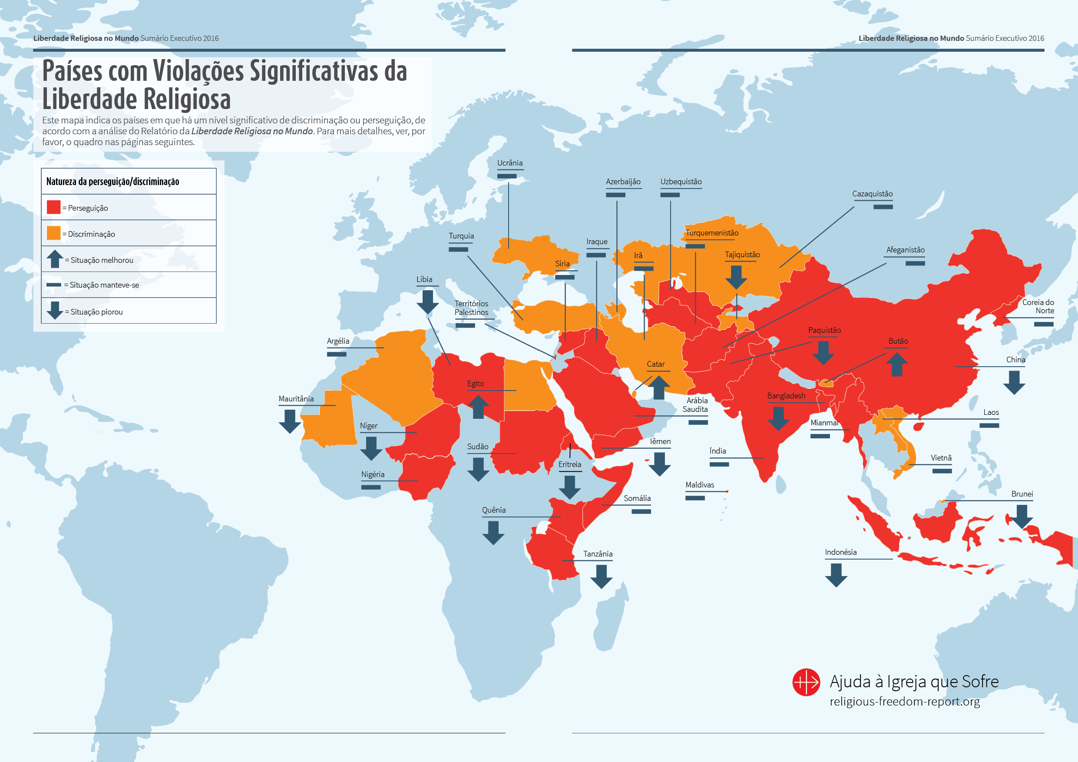

Slide 6
Religious intolerance in Brazil
With the growth of religious diversity in Brazil there is a growth of religious discrimination.
The Constitution provides for freedom of religion and the Church and State are officially separated, with Brazil being a secular state.
Adepts and houses of worship of religions of African matrices are the majority among cases of religious intolerance. Of the 300 cases denounced to Disque 100, of the Secretariat of Human Rights, 26,19% of the victims were “candomblecistas” and 25,79% were “umbandistas”. Acts of religious intolerance, however, hit other religions as well.

Slide 7
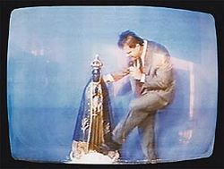
Examples of intolerance in Brazil
Photograph of a television showing the moment when Sérgio von Helder kicks a religious statue, an episode that became known as "santa's kick".

Slide 8
Examples of intolerance in Brazil
On October 22, five days after being installed in Jardim Bom Retiro, the gate of the Pai Mané Spiritist Center of Angola dawned with the following phrase: "We do not want macunba here”.
In Araraquara, in the interior of São Paulo, the Religious Temple Hermínio Marques, a Umbandist orientation, was targeted in September for a criminal arson, with the destruction of more than 60 images of saints.
A 13-year-old teenager overturned the images of Our Lady of the Conception and the Sacred Heart of Jesus on the side altars of the mother church of the Diocese of Duque de Caxias.
In the Sobradinho II neighborhood of Brasília, five men used gasoline and ethanol to burn the Auta de Souza Spiritist Center in January.

Slide 9
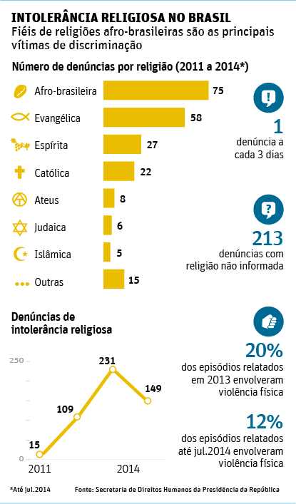
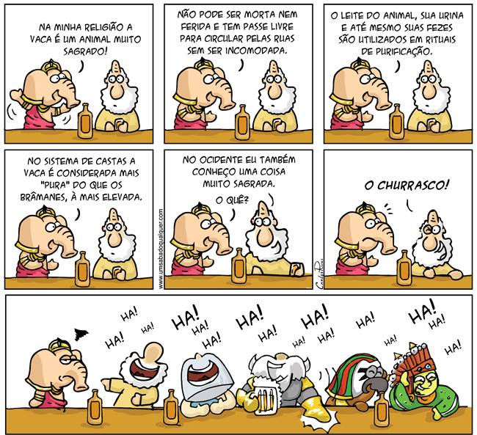

Slide 10

Religious alienation
It is the diminution of the capacity of individuals to think of acting on their own. The alienated individuals have no interest in hearing different opinions and only care about what interests them.

Slide 11
The alienated religious doesn’t know what he says. It bases its criticism, its hatred, its debauchs and offenses against everything and against all.
Little knows what he believes, but believes that he knows everything. Answer everything, even if proven and thinks that everything is wrong, only its atrophied concept is right.
Religious alienation is fanaticism, which shapes itself as dementia.

Slide 12
Thank you for your attention!

