Slide 1
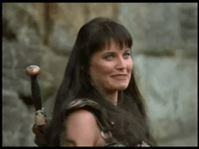
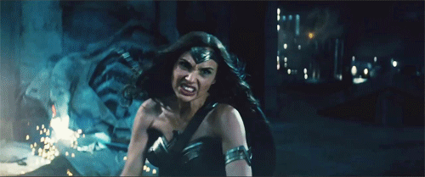
Adjectivies
3° ano – Alimentos/ Matutino

Slide 2
Alunos:
01. Alana Dias
02. Brenda Gundim
03. Esther Alice
04. Marcelo Arrison

Slide 3
Wonderwoman Xena

Slide 4
Wonderwoman is more beautiful than Xena.
Wonderwoman is as powerful as Xena.
Xena is less famous than Wonderwoman.
Wonderwoman is not so old as Xena.
Wonderwoman is the most sexy character.
Xena is the most courageous the world.
Wonderwoman is the best warrior of the heroines.
Xena is the least modern in that movie.
Xena is older than Wonderwoman.
Wonderwoman is smarter than Xena.

