Slide 1
LÍNGUA INGLESA
ENEM 2017
Profª Cristiane de Brito Cruz

Slide 2
Língua Inglesa no ENEM
2010 – 1ª VEZ
2017 – Escolha de idiomas (inglês ou espanhol)
Escolher inglês ou espanhol?
Inglês por quê?
Aulas de inglês – 6º ao 9º e do 1º ao 3º
Espanhol apenas no Ensino Médio (professores que não são da área)
No IFRN espanhol apenas no 4os anos
Faça provas anteriores e veja seu gabarito.

Slide 3
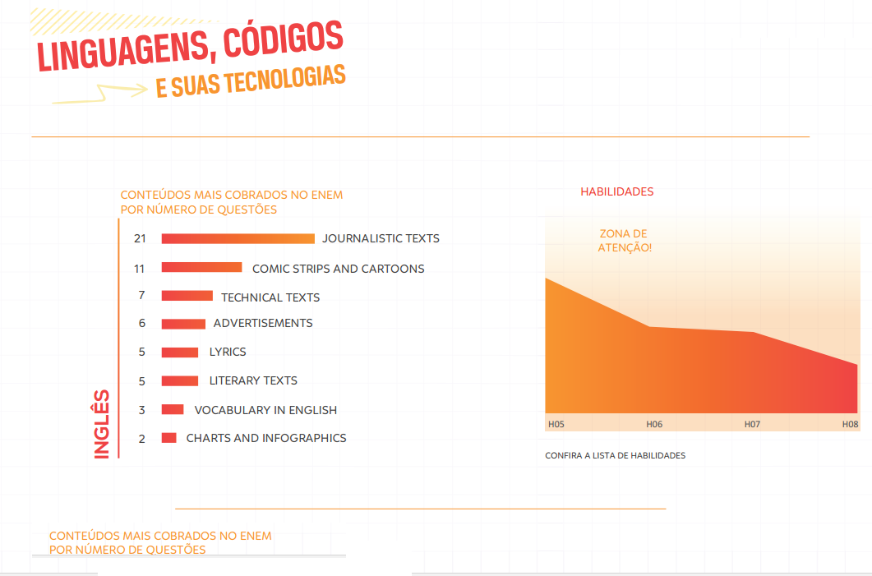
No ENEM se cobra leitura e interpretação de textos.

Slide 4

É possível ler em língua estrangeira?

Slide 5
Leitura
(latim tardio lectura, do latim lectio, onis, escolha, eleição, leitura). substantivo feminino
1. O que se lê.
2. Arte ou .ato de ler.
3. Conjunto de conhecimentos adquiridos com a leitura.
4. Maneira de interpretar um conjunto de informações.
5. Registro da medição feita por um instrumento.
6. [Tecnologia] .Decodificação de dados a partir de determinado suporte (ex.: aparece um erro na leitura do disco).
"leitura", in Dicionário Priberam da Língua Portuguesa [em linha], 2008-2013, https://www.priberam.pt/dlpo/leitura
[consultado em 26-03-2017].

Slide 6

Livros e flores
Teus olhos são meus livros.
Que livro há aí melhor,
Em que melhor se leia
A página do amor?
Flores me são teus lábios.
Onde há mais bela flor,
Em que melhor se beba
O bálsamo do amor?
(Machado de Assis)

Slide 7







Slide 8







Na dúvida, não use!!!!

Slide 9
É possível ler em língua estrangeira?

Slide 10
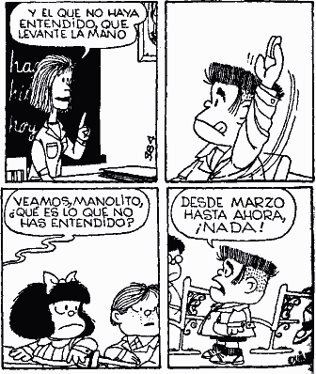
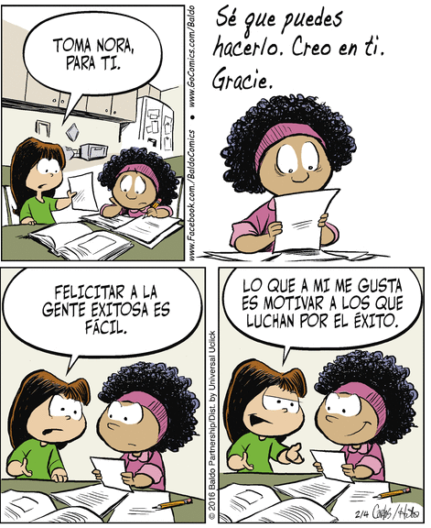

Slide 11
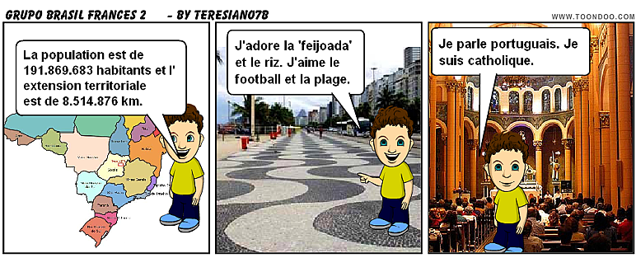

Slide 12
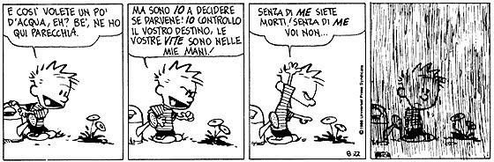

Slide 13
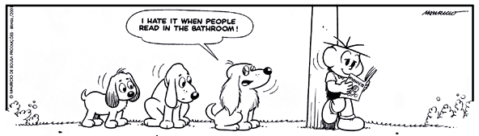
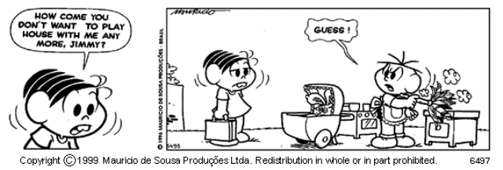

Slide 14
Leitura em Língua Inglesa
Skimming – assunto principal
Scanning – procurar informação específica
Guessing – adivinhar o significado de palavras
Predicting – com base no seu conhecimento de mundo você advinha o que traz o texto.
Figuras/símbolos

Slide 15
Leitura em Língua Inglesa
Cognates – ajudam a você ler mais rápido (sem saber as palavras)
A) Idênticos: chocolate, hospital, crime, diabetes, virus, social, hotel, nuclear, radio, ...
B) Semelhantes ou bastante parecidos: telephone, apartment, diet, factor, inflamatory, violence, industry, ...
C) Vagamente parecidos: electricity, pressure, possible, effects, activity, computer, responsible, success,…

Slide 16
Leitura em Língua Inglesa
Not-cognates – ajudam a você ler mais rápido (sabendo o significado).
Close the door (feche a porta) Open the door (* a porta)
False cognates – São chamados também de falsos amigos. São aquelas que parecem com português mais tem significado diferente.
- push: parece o verbo “puxar”, mas na verdade significa “empurrar”;
- college: parece “colégio”, mas na verdade significa “universidade”;
- fabric: parece “fábrica”, mas na verdade significa “tecido”.

Slide 17
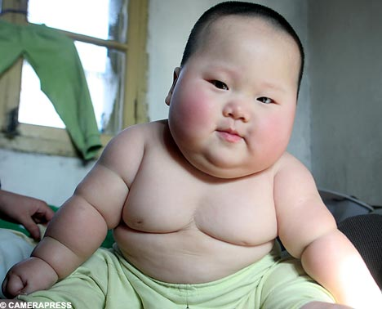
How does a baby get to be obese?
By Madison Park, CNN/ June 27, 2011 -- Updated 1340 GMT (2140 HKT)

Slide 18
How does a baby get to be obese?
By Madison Park, CNN/ June 27, 2011 -- Updated 1340 GMT (2140 HKT)
(CNN) -- A 4-year-old lumbered into a Boston pediatric clinic. He walked with a limp.
"He was carrying so much weight, he displaced his hips," recalled Dr. Elsie Taveras, co-director of the Obesity Prevention Program at Harvard Medical School.
The boy, an extreme example of childhood obesity, carried more than 100 pounds and had a body mass index that was over the 99th percentile for his age group. He is part of a disturbing trend among the youngest Americans.
Poor diet, huge portion sizes, lack of physical activity, inadequate sleep and uninformed parents are contributing to larger numbers of overweight or obese young children.

Slide 19
How does a baby get to be obese?
By Madison Park, CNN/ June 27, 2011 -- Updated 1340 GMT (2140 HKT)
Predicting – com base no seu conhecimento de mundo você advinha o que traz o texto.
(CNN) -- A 4-year-old lumbered into a Boston pediatric clinic. He walked with a limp.
"He was carrying so much weight, he displaced his hips," recalled Dr. Elsie Taveras, co-director of the Obesity Prevention Program at Harvard Medical School.
The boy, an extreme example of childhood obesity, carried more than 100 pounds and had a body mass index that was over the 99th percentile for his age group. He is part of a disturbing trend among the youngest Americans.
Poor diet, huge portion sizes, lack of physical activity, inadequate sleep and uninformed parents are contributing to larger numbers of overweight or obese young children.

Slide 20
How does a baby get to be obese?
By Madison Park, CNN/ June 27, 2011 -- Updated 1340 GMT (2140 HKT)
Predicting – com base no seu conhecimento de mundo você advinha o que traz o texto.
Quais as ideias que tenho sobre a obesidade?
Obesidade faz bem à saúde?
Quais os problemas que a obesidade causa?
Quais as atitudes nossas que tornam com que fiquemos obesos?
Quais as formas que os pais tem de prevenir a obesidade dos filhos?
Bebês obesos – de quem é a culpa?
Existe cura para a obesidade mórbida?
Para tratar-se o que fazer?
Qual país sofre mais com a obesidade?
(CNN) -- A 4-year-old lumbered into a Boston pediatric clinic. He walked with a limp.
"He was carrying so much weight, he displaced his hips," recalled Dr. Elsie Taveras, co-director of the Obesity Prevention Program at Harvard Medical School.
The boy, an extreme example of childhood obesity, carried more than 100 pounds and had a body mass index that was over the 99th percentile for his age group. He is part of a disturbing trend among the youngest Americans.
Poor diet, huge portion sizes, lack of physical activity, inadequate sleep and uninformed parents are contributing to larger numbers of overweight or obese young children.

Slide 21
How does a baby get to be obese?
By Madison Park, CNN/ June 27, 2011 -- Updated 1340 GMT (2140 HKT)
Predicting – com base no seu conhecimento de mundo você advinha o que traz o texto.
(CNN) -- A 4-year-old lumbered into a Boston pediatric clinic. He walked with a limp.
"He was carrying so much weight, he displaced his hips," recalled Dr. Elsie Taveras, co-director of the Obesity Prevention Program at Harvard Medical School.
The boy, an extreme example of childhood obesity, carried more than 100 pounds and had a body mass index that was over the 99th percentile for his age group. He is part of a disturbing trend among the youngest Americans.
Poor diet, huge portion sizes, lack of physical activity, inadequate sleep and uninformed parents are contributing to larger numbers of overweight or obese young children.

Slide 22
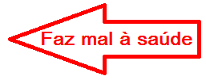
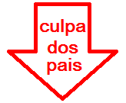

How does a baby get to be obese?
By Madison Park, CNN/ June 27, 2011 -- Updated 1340 GMT (2140 HKT)
Predicting – com base no seu conhecimento de mundo você advinha o que traz o texto.
(CNN) -- A 4-year-old lumbered into a Boston pediatric clinic. He walked with a limp.
"He was carrying so much weight, he displaced his hips," recalled Dr. Elsie Taveras, co-director of the Obesity Prevention Program at Harvard Medical School.
The boy, an extreme example of childhood obesity, carried more than 100 pounds and had a body mass index that was over the 99th percentile for his age group. He is part of a disturbing trend among the youngest Americans.
Poor diet, huge portion sizes, lack of physical activity, inadequate sleep and uninformed parents are contributing to larger numbers of overweight or obese young children.

Slide 23
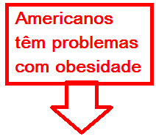
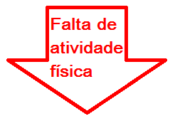
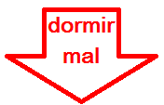
How does a baby get to be obese?
By Madison Park, CNN/ June 27, 2011 -- Updated 1340 GMT (2140 HKT)
Predicting – com base no seu conhecimento de mundo você advinha o que traz o texto.
(CNN) -- A 4-year-old lumbered into a Boston pediatric clinic. He walked with a limp.
"He was carrying so much weight, he displaced his hips," recalled Dr. Elsie Taveras, co-director of the Obesity Prevention Program at Harvard Medical School.
The boy, an extreme example of childhood obesity, carried more than 100 pounds and had a body mass index that was over the 99th percentile for his age group. He is part of a disturbing trend among the youngest Americans.
Poor diet, huge portion sizes, lack of physical activity, inadequate sleep and uninformed parents are contributing to larger numbers of overweight or obese young children.

Slide 24
How does a baby get to be obese?
By Madison Park, CNN/ June 27, 2011 -- Updated 1340 GMT (2140 HKT)
Skimming – assunto principal
(CNN) -- A 4-year-old lumbered into a Boston pediatric clinic. He walked with a limp.
"He was carrying so much weight, he displaced his hips," recalled Dr. Elsie Taveras, co-director of the Obesity Prevention Program at Harvard Medical School.
The boy, an extreme example of childhood obesity, carried more than 100 pounds and had a body mass index that was over the 99th percentile for his age group. He is part of a disturbing trend among the youngest Americans.
Poor diet, huge portion sizes, lack of physical activity, inadequate sleep and uninformed parents are contributing to larger numbers of overweight or obese young children.

Slide 25
How does a baby get to be obese?
By Madison Park, CNN/ June 27, 2011 -- Updated 1340 GMT (2140 HKT)
Skimming – assunto principal
(CNN) -- A 4-year-old lumbered into a Boston pediatric clinic. He walked with a limp.
"He was carrying so much weight, he displaced his hips," recalled Dr. Elsie Taveras, co-director of the Obesity Prevention Program at Harvard Medical School.
The boy, an extreme example of childhood obesity, carried more than 100 pounds and had a body mass index that was over the 99th percentile for his age group. He is part of a disturbing trend among the youngest Americans.
Poor diet, huge portion sizes, lack of physical activity, inadequate sleep and uninformed parents are contributing to larger numbers of overweight or obese young children.

Slide 26
How does a baby get to be obese?
By Madison Park, CNN/ June 27, 2011 -- Updated 1340 GMT (2140 HKT)
Scanning – procurar informação específica – idade da criança
(CNN) -- A 4-year-old lumbered into a Boston pediatric clinic. He walked with a limp.
"He was carrying so much weight, he displaced his hips," recalled Dr. Elsie Taveras, co-director of the Obesity Prevention Program at Harvard Medical School.
The boy, an extreme example of childhood obesity, carried more than 100 pounds and had a body mass index that was over the 99th percentile for his age group. He is part of a disturbing trend among the youngest Americans.
Poor diet, huge portion sizes, lack of physical activity, inadequate sleep and uninformed parents are contributing to larger numbers of overweight or obese young children.

Slide 27
How does a baby get to be obese?
By Madison Park, CNN/ June 27, 2011 -- Updated 1340 GMT (2140 HKT)
Scanning – procurar informação específica – idade da criança
(CNN) -- A 4-year-old lumbered into a Boston pediatric clinic. He walked with a limp.
"He was carrying so much weight, he displaced his hips," recalled Dr. Elsie Taveras, co-director of the Obesity Prevention Program at Harvard Medical School.
The boy, an extreme example of childhood obesity, carried more than 100 pounds and had a body mass index that was over the 99th percentile for his age group. He is part of a disturbing trend among the youngest Americans.
Poor diet, huge portion sizes, lack of physical activity, inadequate sleep and uninformed parents are contributing to larger numbers of overweight or obese young children.

Slide 28
How does a baby get to be obese?
By Madison Park, CNN/ June 27, 2011 -- Updated 1340 GMT (2140 HKT)
Guessing – adivinhar o significado de palavras
(CNN) -- A 4-year-old lumbered into a Boston pediatric clinic. He walked with a limp.
"He was carrying so much weight, he displaced his hips," recalled Dr. Elsie Taveras, co-director of the Obesity Prevention Program at Harvard Medical School.
The boy, an extreme example of childhood obesity, carried more than 100 pounds and had a body mass index that was over the 99th percentile for his age group. He is part of a disturbing trend among the youngest Americans.
Poor diet, huge portion sizes, lack of physical activity, inadequate sleep and uninformed parents are contributing to larger numbers of overweight or obese young children.

Slide 29
How does a baby get to be obese?
By Madison Park, CNN/ June 27, 2011 -- Updated 1340 GMT (2140 HKT)
Guessing – adivinhar o significado de palavras
(CNN) -- A 4-year-old lumbered into a Boston pediatric clinic. He walked with a limp. Um menino de 4 anos lumbered em uma clínica.
"He was carrying so much weight, he displaced his hips," recalled Dr. Elsie Taveras, co-director of the Obesity Prevention Program at Harvard Medical School.
The boy, an extreme example of childhood obesity, carried more than 100 pounds and had a body mass index that was over the 99th percentile for his age group. He is part of a disturbing trend among the youngest Americans.
Poor diet, huge portion sizes, lack of physical activity, inadequate sleep and uninformed parents are contributing to larger numbers of overweight or obese young children.

Slide 30
How does a baby get to be obese?
By Madison Park, CNN/ June 27, 2011 -- Updated 1340 GMT (2140 HKT)
Guessing – adivinhar o significado de palavras
(CNN) -- A 4-year-old lumbered into a Boston pediatric clinic. He walked with a limp. Um menino de 4 anos arrastou-se para uma clínica.
"He was carrying so much weight, he displaced his hips," recalled Dr. Elsie Taveras, co-director of the Obesity Prevention Program at Harvard Medical School.
The boy, an extreme example of childhood obesity, carried more than 100 pounds and had a body mass index that was over the 99th percentile for his age group. He is part of a disturbing trend among the youngest Americans.
Poor diet, huge portion sizes, lack of physical activity, inadequate sleep and uninformed parents are contributing to larger numbers of overweight or obese young children.

Slide 31
How does a baby get to be obese?
By Madison Park, CNN/ June 27, 2011 -- Updated 1340 GMT (2140 HKT)
Figuras/símbolos
(CNN) -- A 4-year-old lumbered into a Boston pediatric clinic. He walked with a limp.
"He was carrying so much weight, he displaced his hips," recalled Dr. Elsie Taveras, co-director of the Obesity Prevention Program at Harvard Medical School.
The boy, an extreme example of childhood obesity, carried more than 100 pounds and had a body mass index that was over the 99th percentile for his age group. He is part of a disturbing trend among the youngest Americans.
Poor diet, huge portion sizes, lack of physical activity, inadequate sleep and uninformed parents are contributing to larger numbers of overweight or obese young children.

Slide 32
How does a baby get to be obese?
By Madison Park, CNN/ June 27, 2011 -- Updated 1340 GMT (2140 HKT)
COGNATES
(CNN) -- A 4-year-old lumbered into a Boston pediatric clinic. He walked with a limp.
"He was carrying so much weight, he displaced his hips," recalled Dr. Elsie Taveras, co-director of the Obesity Prevention Program at Harvard Medical School.
The boy, an extreme example of childhood obesity, carried more than 100 pounds and had a body mass index that was over the 99th percentile for his age group. He is part of a disturbing trend among the youngest Americans.
Poor diet, huge portion sizes, lack of physical activity, inadequate sleep and uninformed parents are contributing to larger numbers of overweight or obese young children.

Slide 33
How does a baby get to be obese?
By Madison Park, CNN/ June 27, 2011 -- Updated 1340 GMT (2140 HKT)
NOT-COGNATES
(CNN) -- A 4-year-old lumbered into a Boston pediatric clinic. He walked with a limp.
"He was carrying so much weight, he displaced his hips," recalled Dr. Elsie Taveras, co-director of the Obesity Prevention Program at Harvard Medical School.
The boy, an extreme example of childhood obesity, carried more than 100 pounds and had a body mass index that was over the 99th percentile for his age group. He is part of a disturbing trend among the youngest Americans.
Poor diet, huge portion sizes, lack of physical activity, inadequate sleep and uninformed parents are contributing to larger numbers of overweight or obese young children.

Slide 34
How does a baby get to be obese?
By Madison Park, CNN/ June 27, 2011 -- Updated 1340 GMT (2140 HKT)
FALSE COGNATES
(CNN) -- A 4-year-old lumbered into a Boston pediatric clinic. He walked with a limp.
"He was carrying so much weight, he displaced his hips," recalled Dr. Elsie Taveras, co-director of the Obesity Prevention Program at Harvard Medical School.
The boy, an extreme example of childhood obesity, carried more than 100 pounds and had a body mass index that was over the 99th percentile for his age group. He is part of a disturbing trend among the youngest Americans.
Poor diet, huge portion sizes, lack of physical activity, inadequate sleep and uninformed parents are contributing to larger numbers of overweight or obese young children.

