Slide 1

Instituto Federal de Educação, Ciência e Tecnologia do Rio Grande do Norte
Vacations
Components:
José Douglas da Silva Nascimento,
Luigi Eduardo Silva de Lima,
Vinicius Gabriel de Araújo Ferreira,
João Batista Macedo da Silva e
Jeová José da Silva Oliveira.
Teacher: Cristiane de Brito Cruz

Slide 2
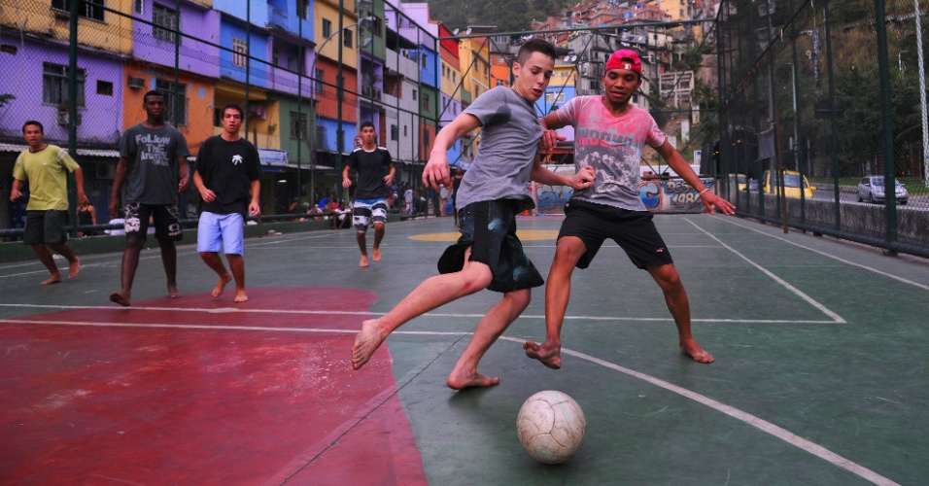
Douglas is playing soccer with your friends.

Slide 3
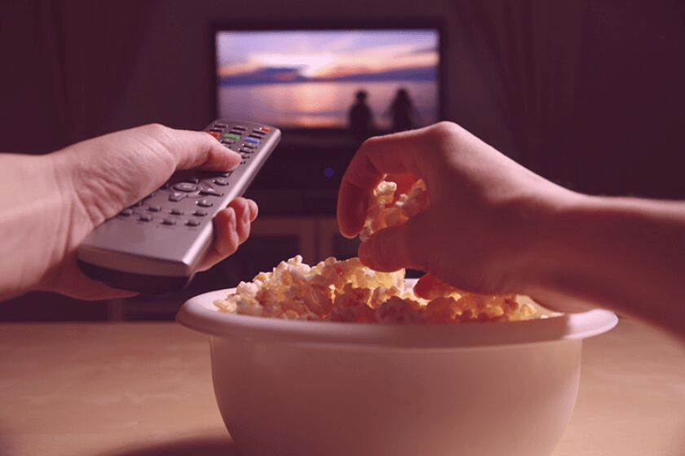
Douglas is attending films during your vacations.

Slide 4
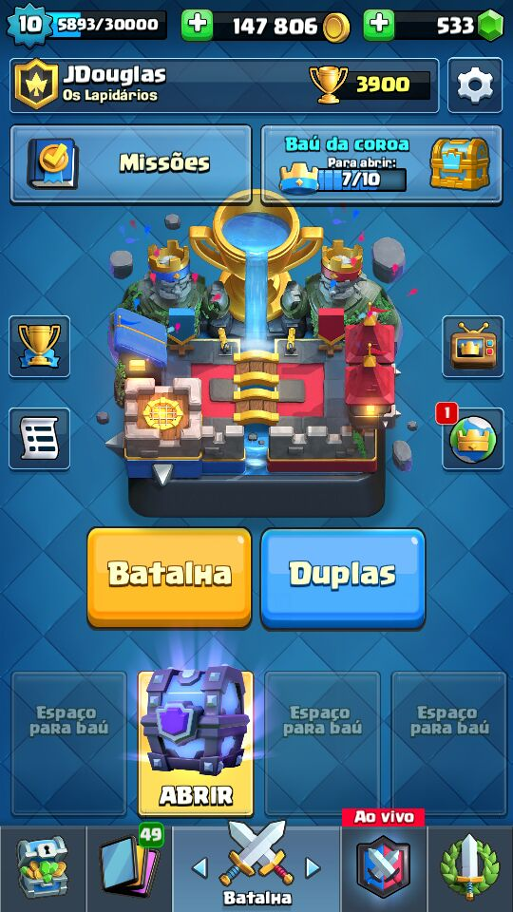
Douglas is playing Clash Royale.

Slide 5
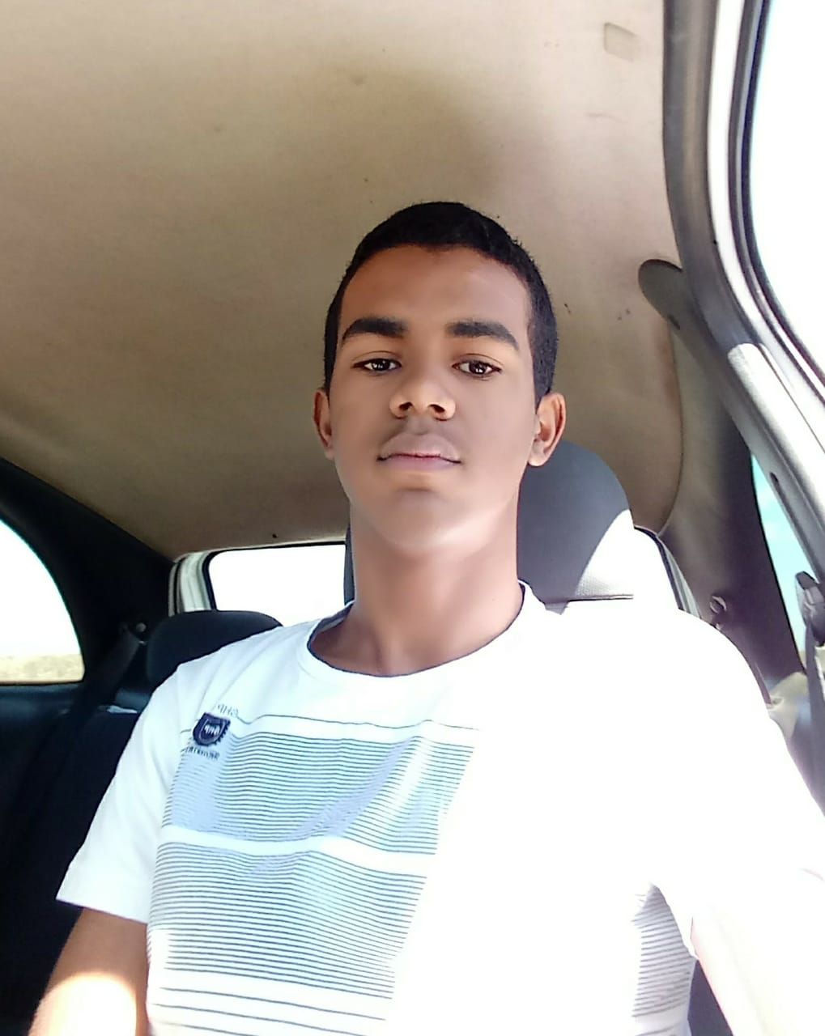
Luigi is going of car your grandmother's house among Lagoa Nova and I Cerro Corá.

Slide 6
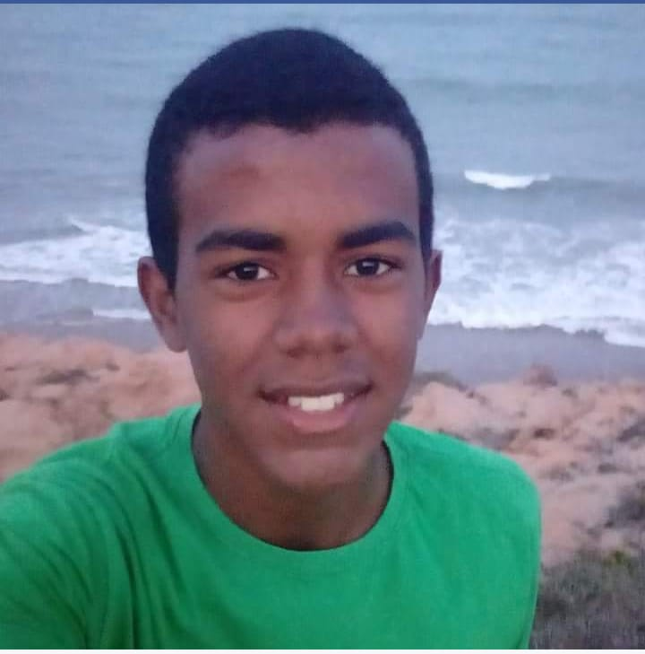
Luigi is taking a picture in the beach in Maxaranguape, in the coast of RN.

Slide 7
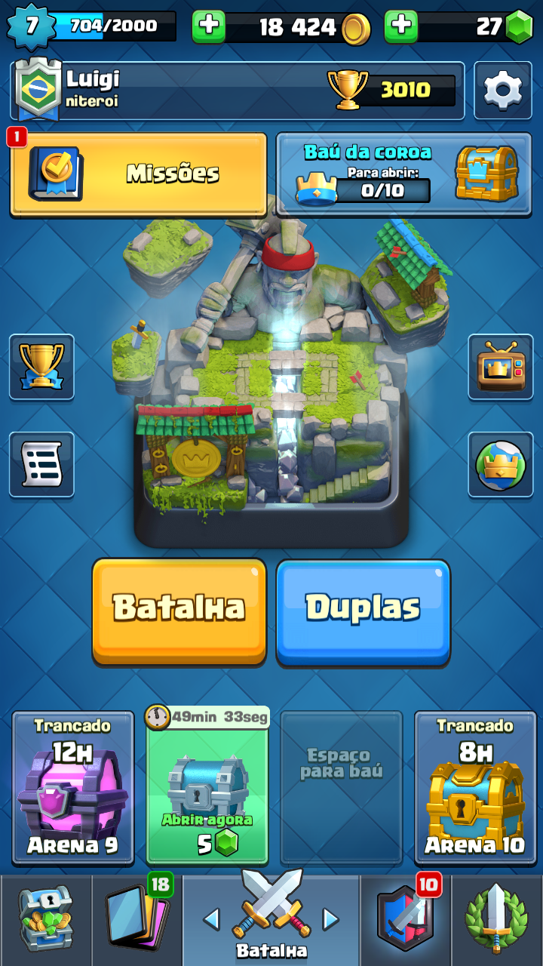
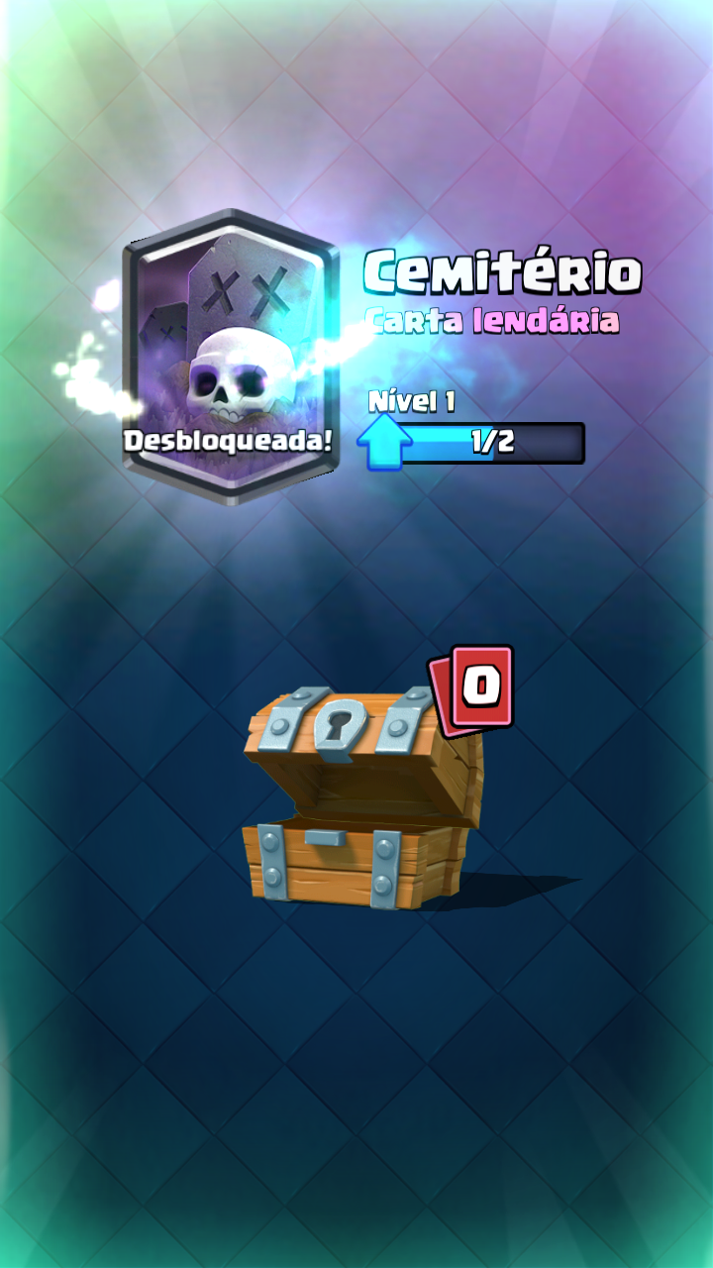
Luigi is playing Clash Royale and has just won a letter lendaria.

Slide 8
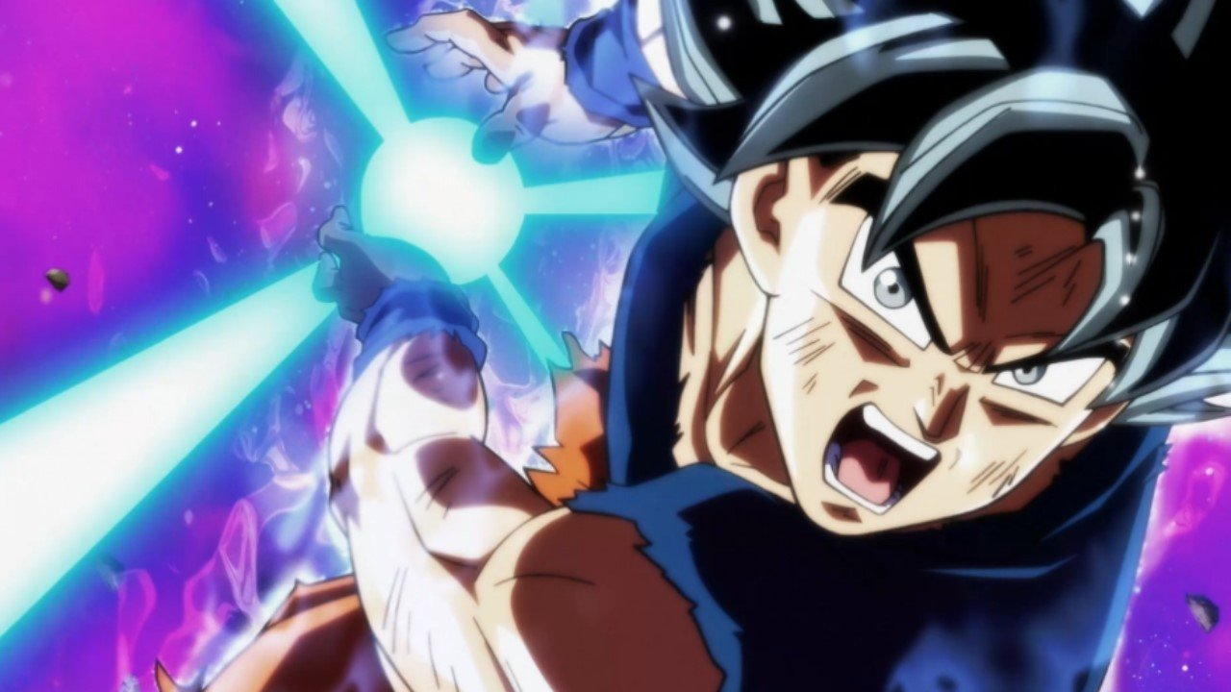
Jeová is attending Dragon Ball Super.

Slide 9

Jeová is practicing the reading.

Slide 10
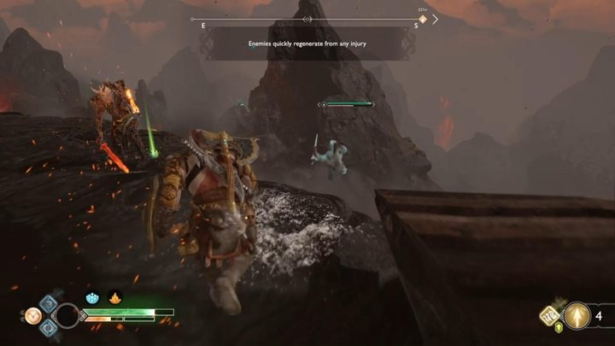
Jeová is playing God of War.

Slide 11

Jeová is making a medical treatment.

Slide 12
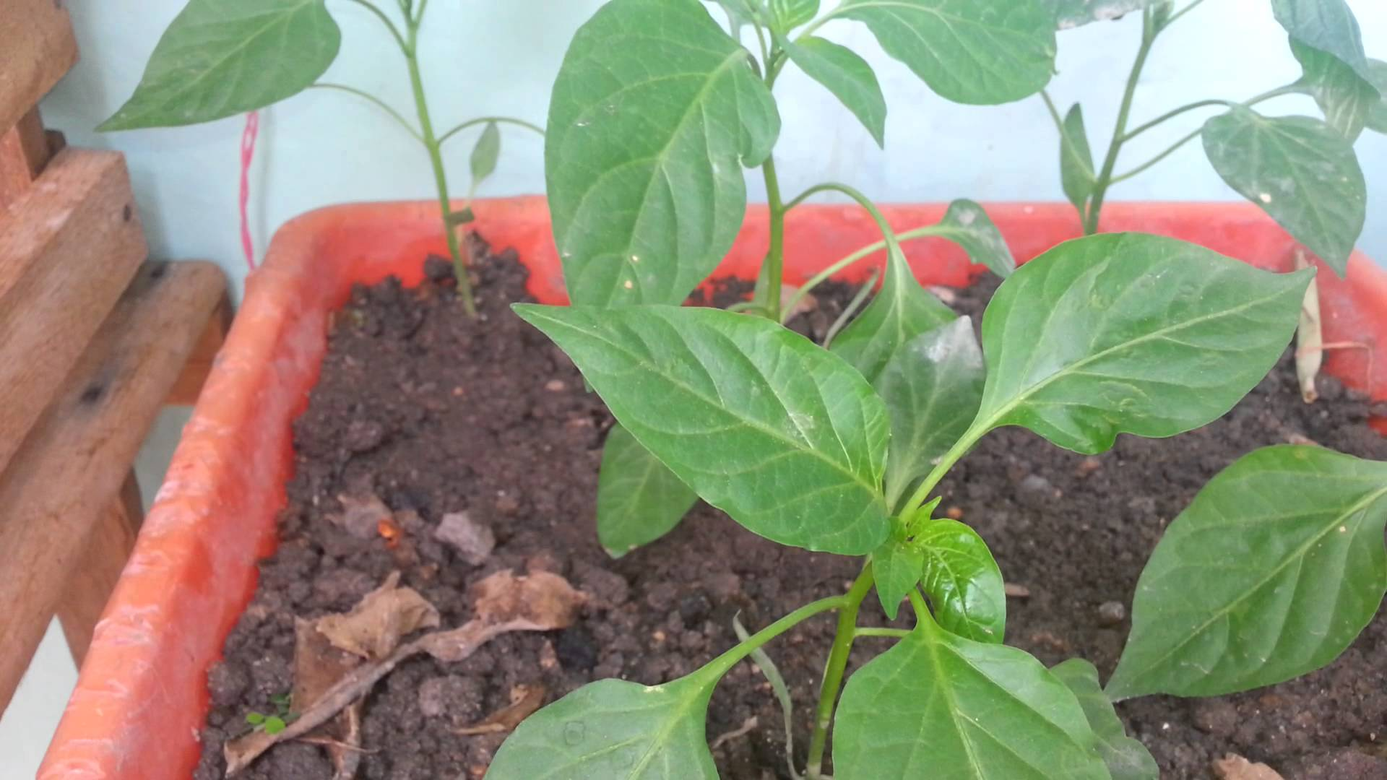
João Batista is planting peppers in your vase.

Slide 13
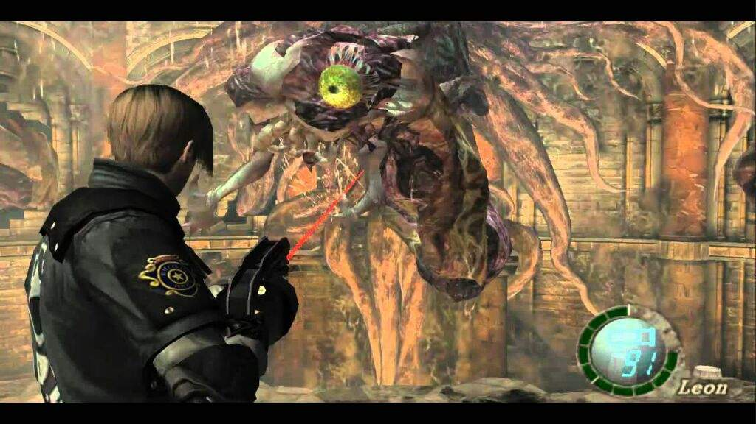
João the Batista is playing Resident Evil 4.

Slide 14
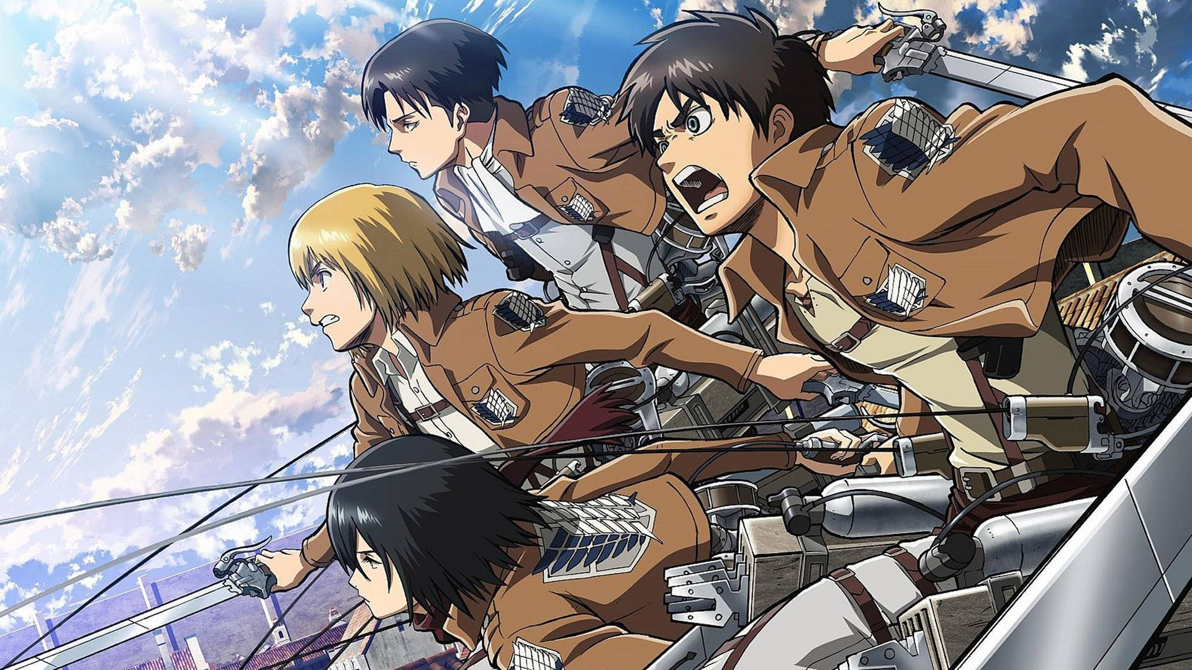
João Batista is attending Attack on Titan.

Slide 15
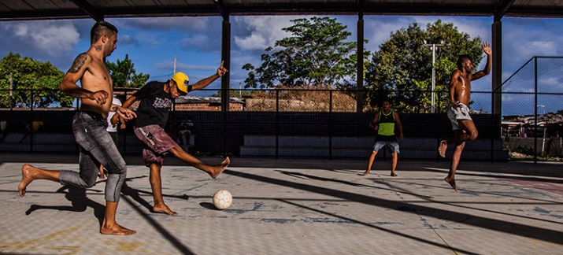
Vinícius is playing soccer with your friends.

Slide 16
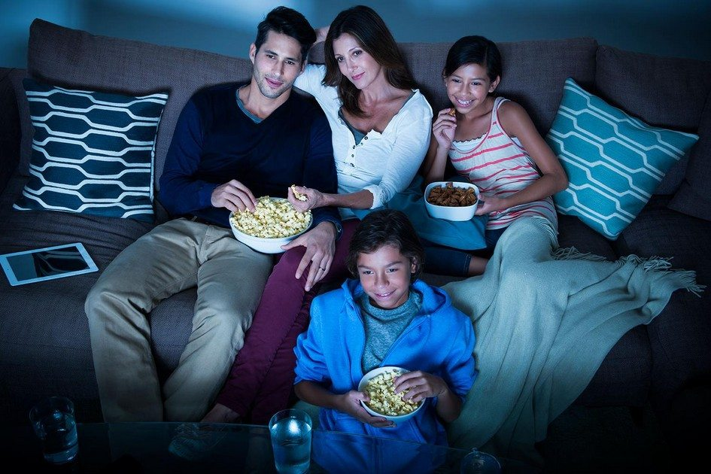
Vinícius is attending films with your family.

Slide 17
Thank you for the attention

