Slide 1
English Homework
Discentes: Docente:
Nicolas Lopes Cristiane Brito Cruz
Luís Eduardo
Jobel Araújo
Sérgio Victor
Thervyson Elyedson

Slide 2
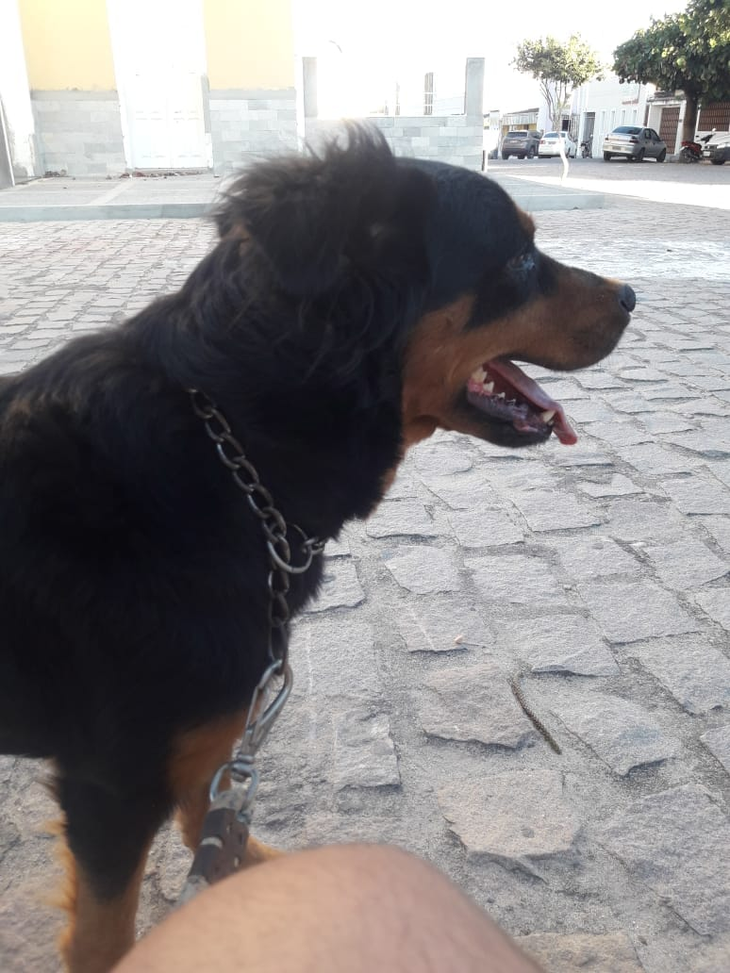
Thervyson is walking with your dog

Slide 3
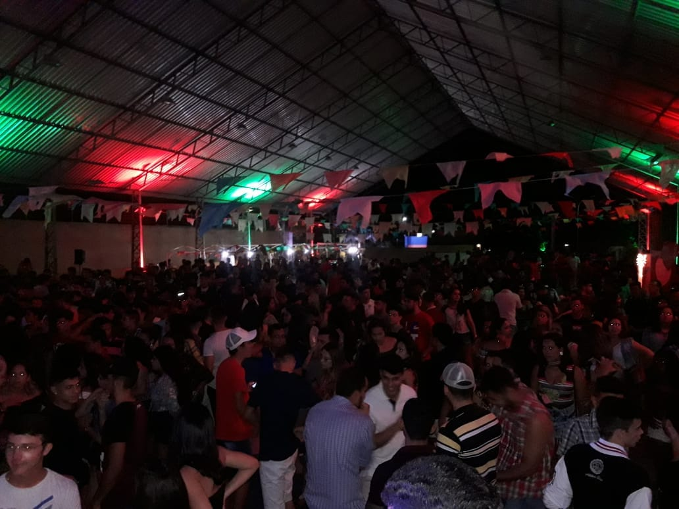
We on IFRN’s São Pedro

Slide 4
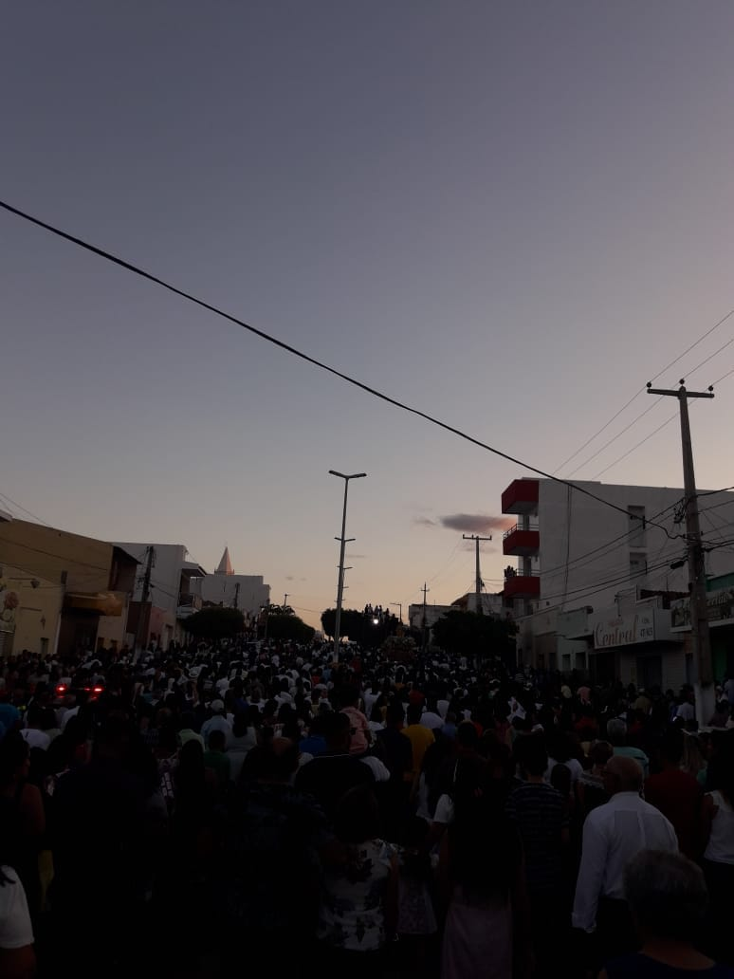
We following Sant’Ana

Slide 5
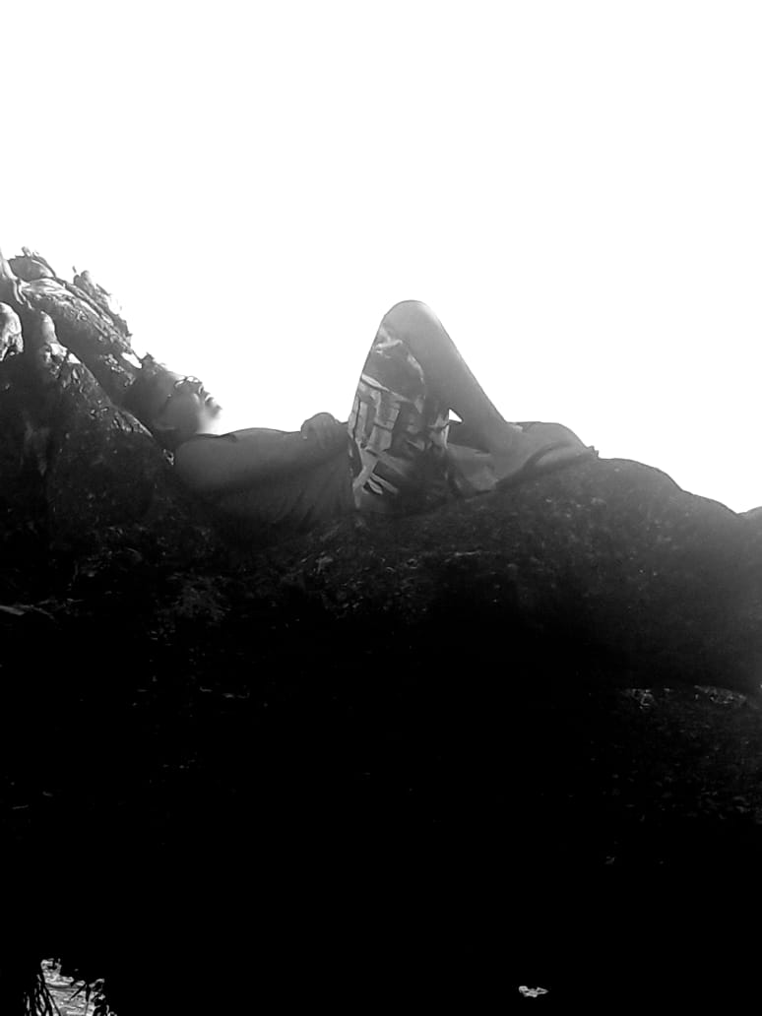
Thervyson is taking a picture

Slide 6
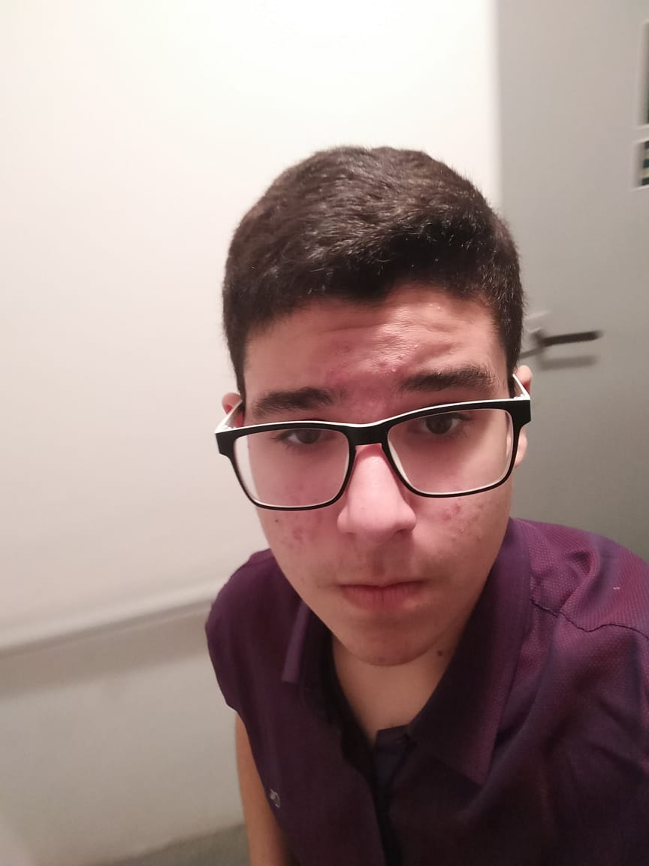
Nicolas is going to IFRN’s São Pedro

Slide 7
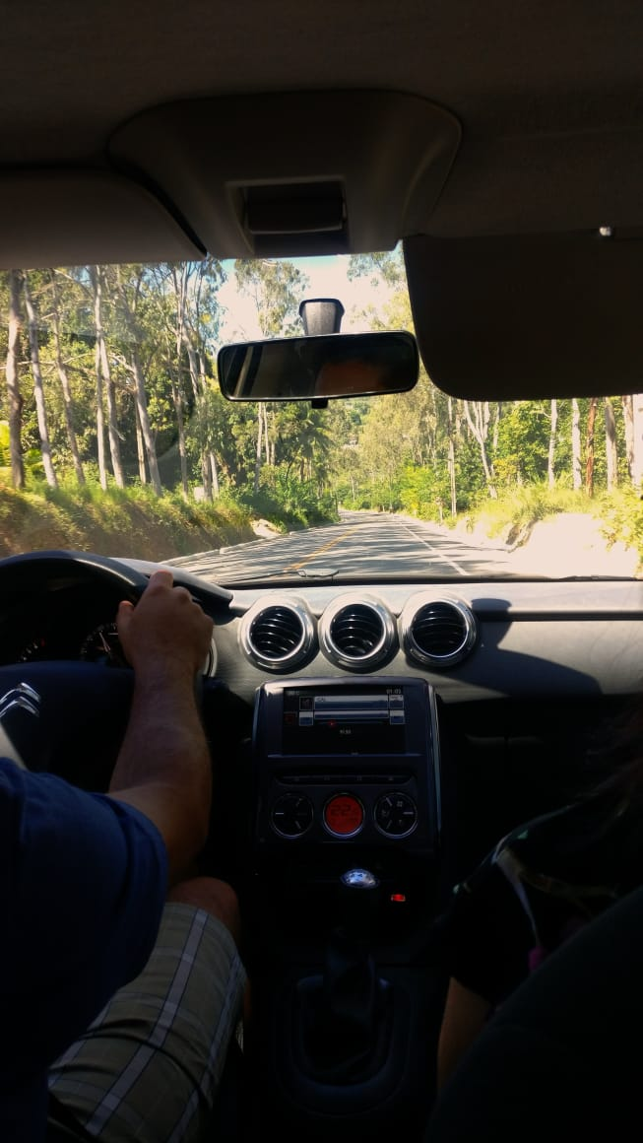
Nicolas is going to João Pessoa

Slide 8
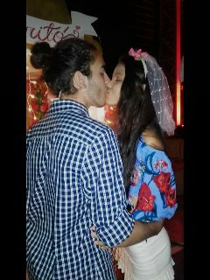
Luis Eduardo with your girlfriend

Slide 9
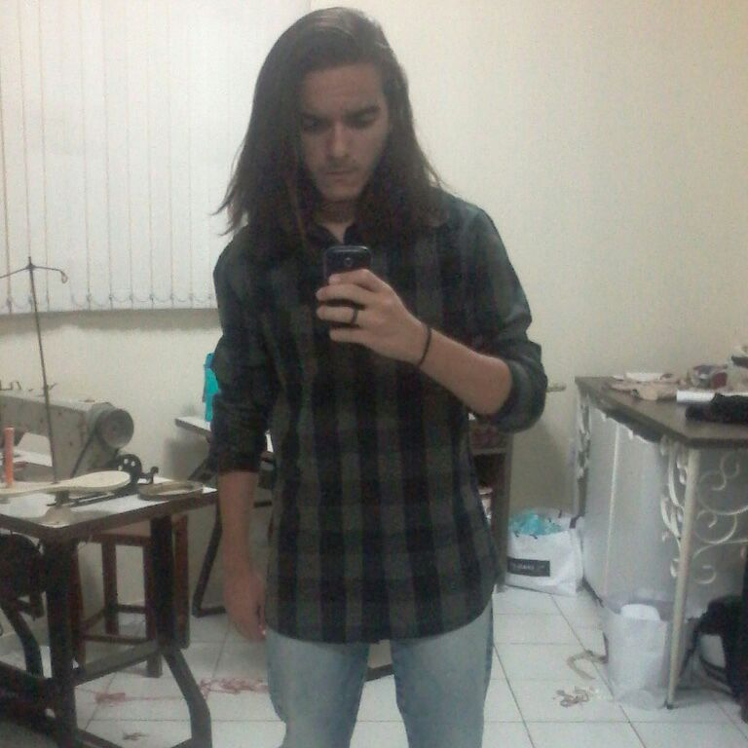
Luis Eduardo is going Sant’Ana’s party

Slide 10
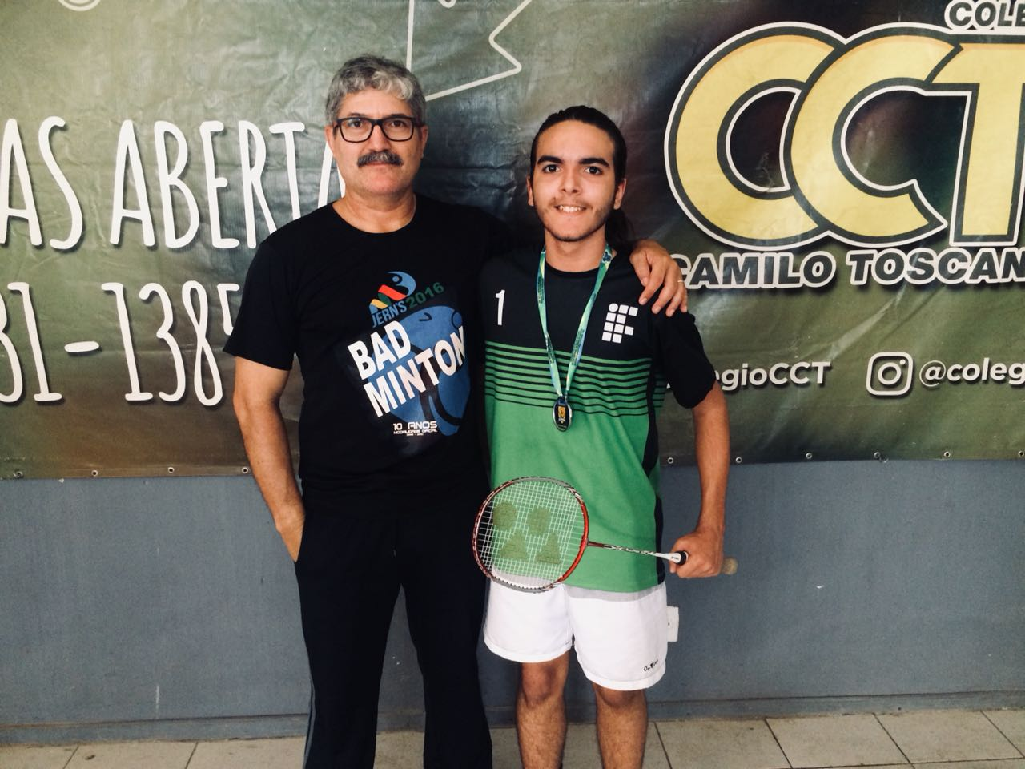
Luis Eduardo is winning the Juverns

Slide 11
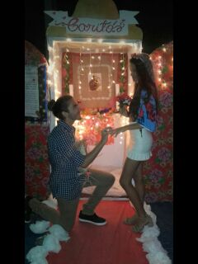
Luis Eduardo getting married

Slide 12
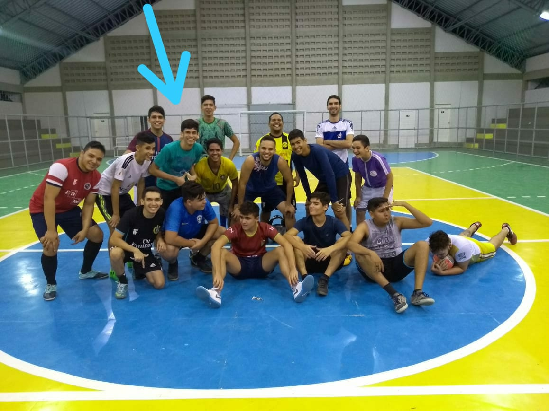
Jobel in soccer match with your friends

Slide 13
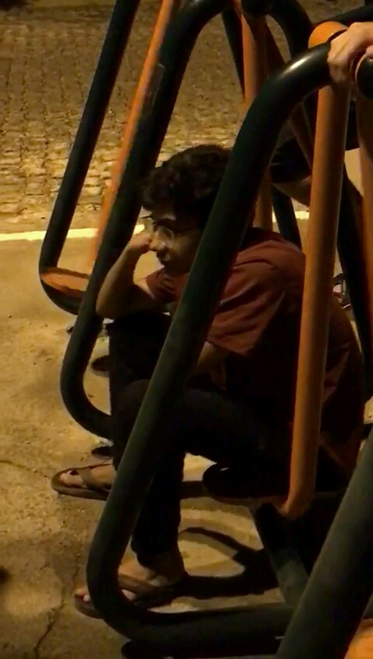
Sergio is alone and sad at the vacation

Slide 14
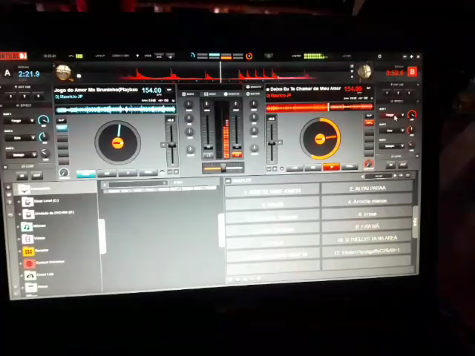
Thervyson is remixing at the Swing Variado’s show

Slide 15
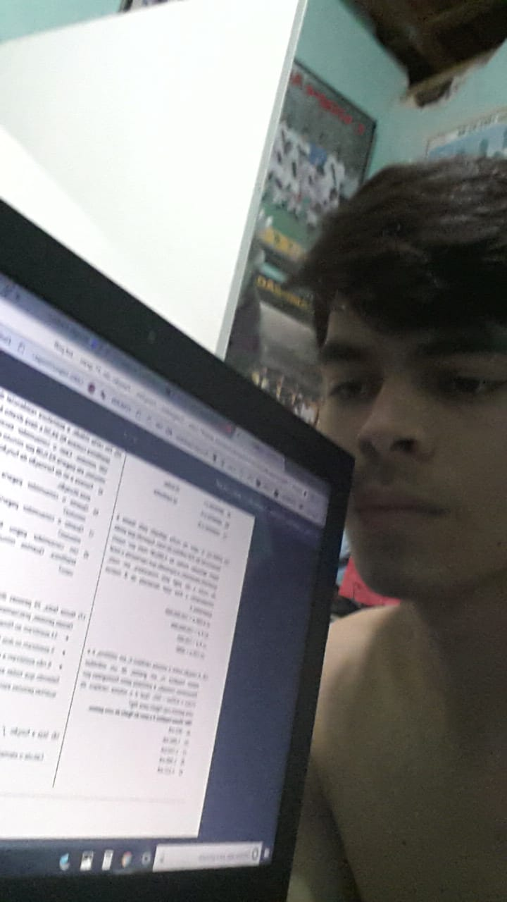
Jobel is crying with Jonaldo’s activity

