Slide 1
Inglês I
Profª Esp. Cristiane de Brito Cruz
cristiane.cruz@ifrn.edu.br
(84) 996-087-119

Slide 2
What’s your name?

Slide 3
Pronouns and Possessives
I
You
He
She
It
We
You
They
My
Your
His
Her
Its
Our
Your
Their
What’s your name?
My name’s Kelen.
What’s my name?
Your name’s Cristiane.
What’s his name?
He’s John.
What’s her name?
She’s Lucy.
What’s its name?
She’s Brenda.
What are our names?
You’re Lucy and Tom.
What are their names?
They’re Peter and Liz.

Slide 4
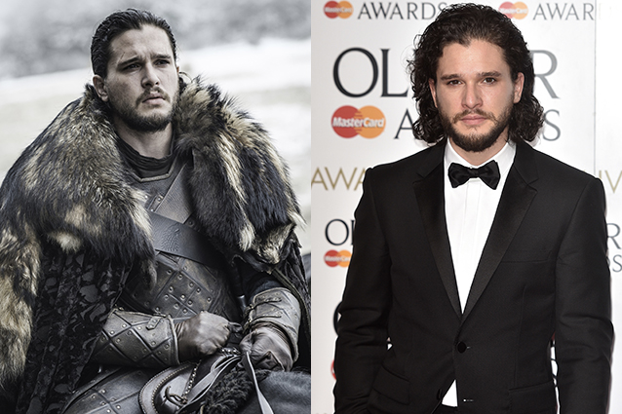
Pronouns and Possessives
What’s his name?
He’s Kit Harington.
His name’s Kit Harington.
What’s his character’s name in G.O.T?
He’s Jon Snow.

Slide 5
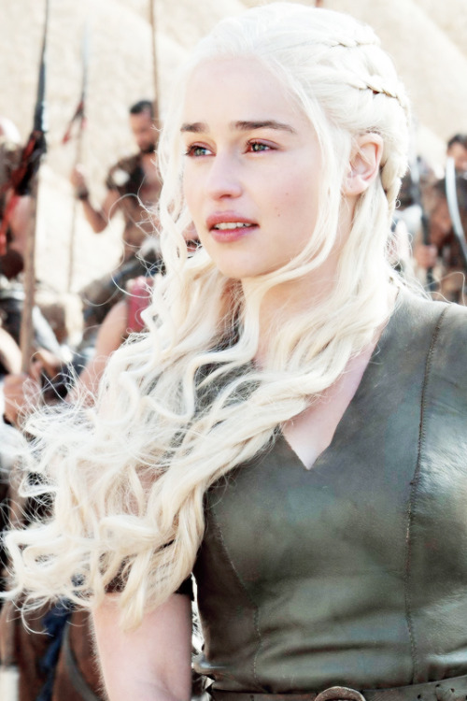
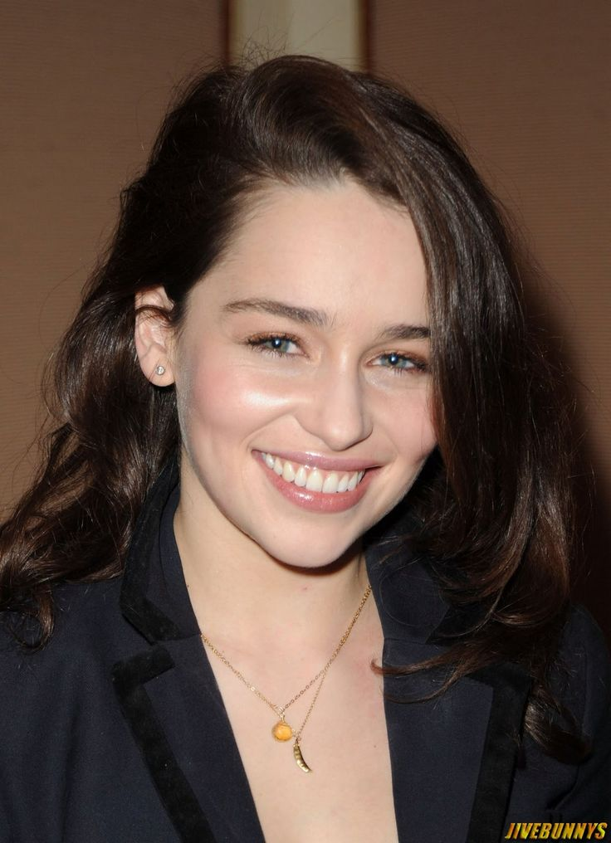
Pronouns and Possessives
What’s her name?
She’s Emilia Clarke.
Her name’s Emilia Clarke.
What’s her character’s name in G.O.T?
She’s Jon Snow Daenerys Targaryen.

Slide 6
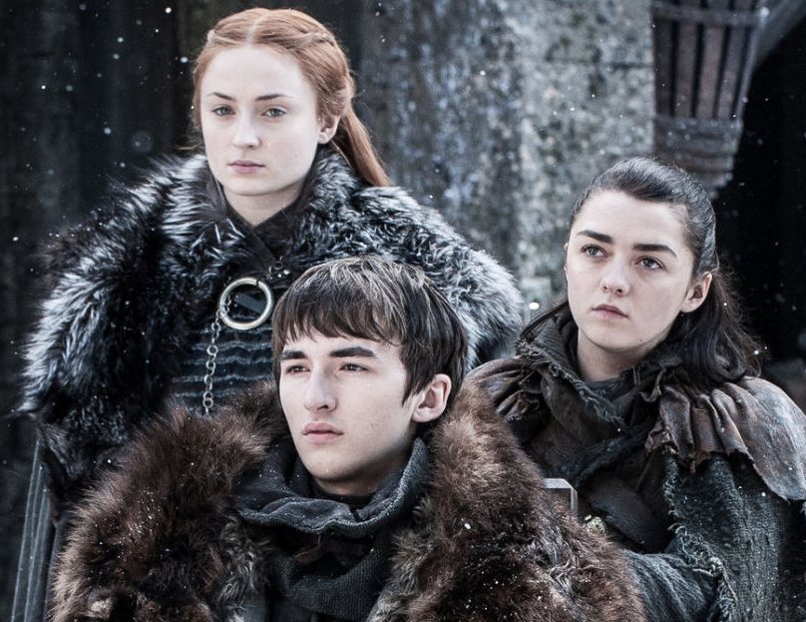
Pronouns and Possessives
What are their names?
They’re Sophie Turner, Maisie Williams and Isaac Hempstead.
What are their character’s name in G.O.T?
They’re Sansa, Arya and Brandon Stark.

Slide 7
ABC
B.C.D.E.G.P.T.V.Z
A.J.K
F.L.M.N.S
I.O.U
R.H.W.X.Y
Bi.Ci.Di.Ei.Gi.Pi.Ti.Vi.Zi
Ei.Djei.Kei
éF.éL.éM.éN.éSS
Ai.Ou.Iu
áR.Eitch.Dabliu.éCX.Uai
C.R.I.S.T.I.A.N.E
Ci.áR.Ai.éS.Ti.Ai.Êi.éN.I
VITÓRIA
DAVID
ROBERT

Slide 8
Are you married/single?

Slide 9

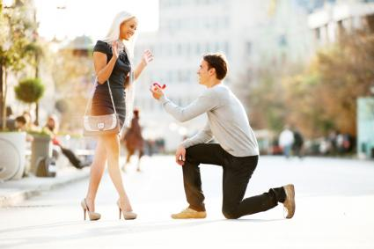
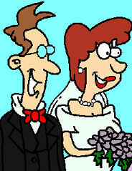
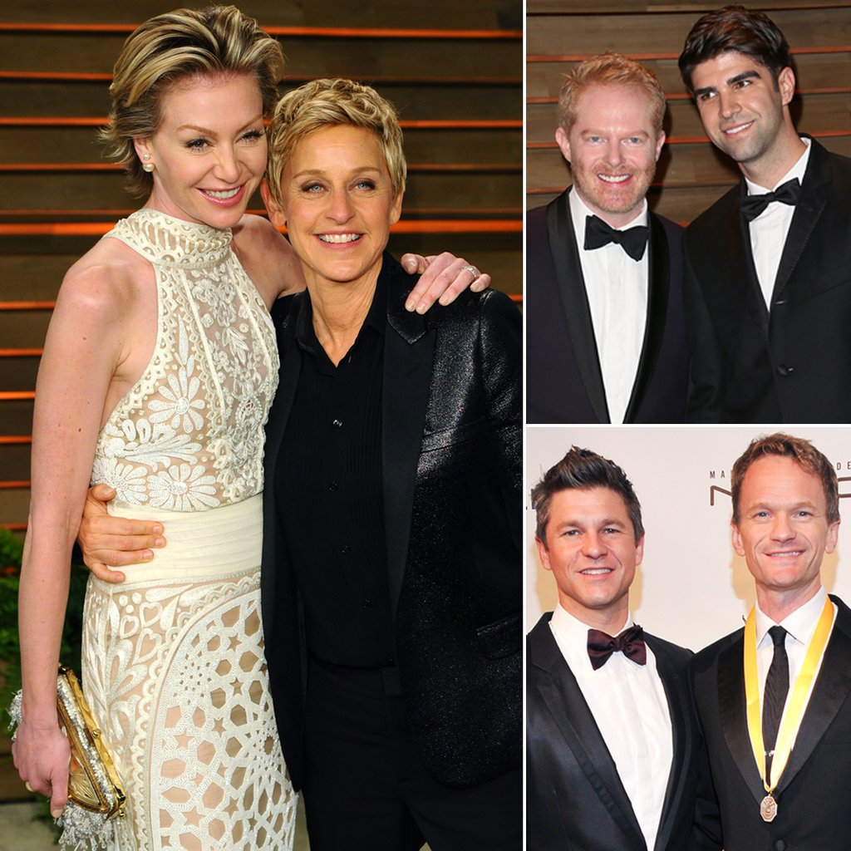
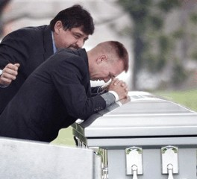
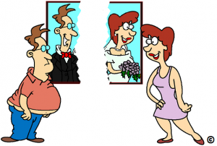
Marital Status
DATING
BOYFRIEND
GIRLFRIEND
ENGAGED
FIANCÉ (HE)
FIANCÉE (SHE)
MARRIED
HUSBAND
WIFE
SEPARATED/
DIVORCED
EX-HUSBAND
EX-WIFE
WIDOW
PARTNER

Slide 10
How are you?

Slide 11
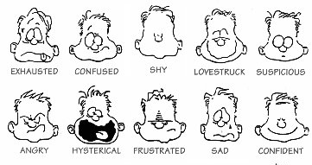
How are you today?
How are you today?
I’m fine. Thank you.
I’m tired.
I’m sad.
I’m exausted.
How do you do?

Slide 12
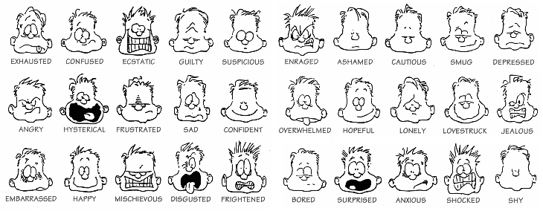
Adjectives

Slide 13
Where are you from?

Slide 14

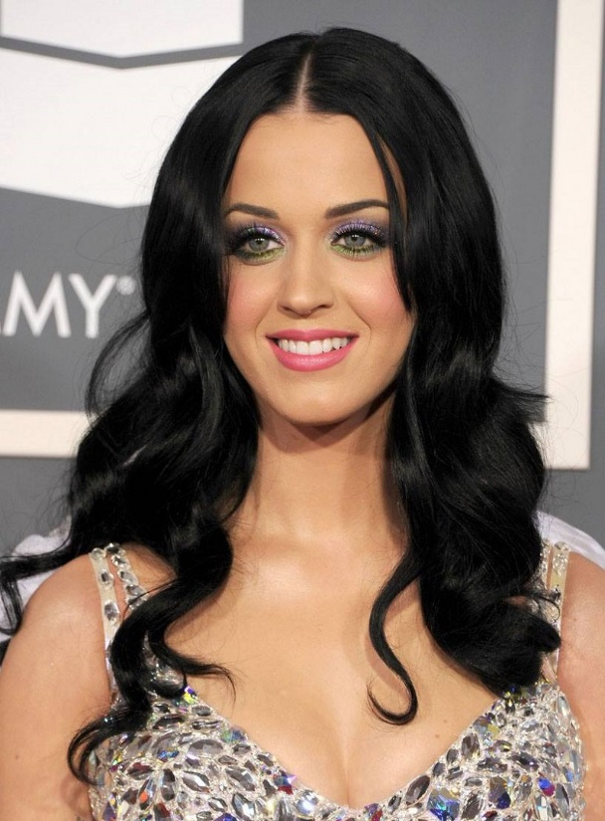
Countries and Nationalities
What’s her name?
She’s Katy Perry.
Where is she from?
She’s from United States of America. She’s American.

Slide 15
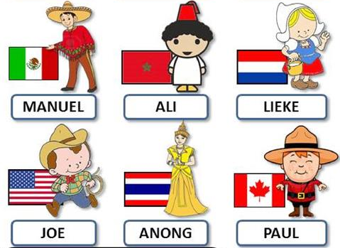
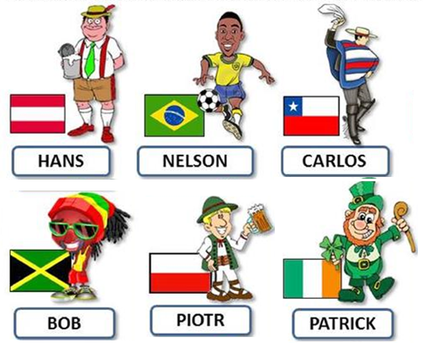
Countries and Nationalities
Where are they from?

Slide 16
What do you do?
What’s your occupation?

Slide 17
Countries and Nationalities
What’s her name?
She’s Katy Perry.
Where is she from?
She’s from United States of America. She’s American.
What does she do?
She’s a singer.

Slide 18
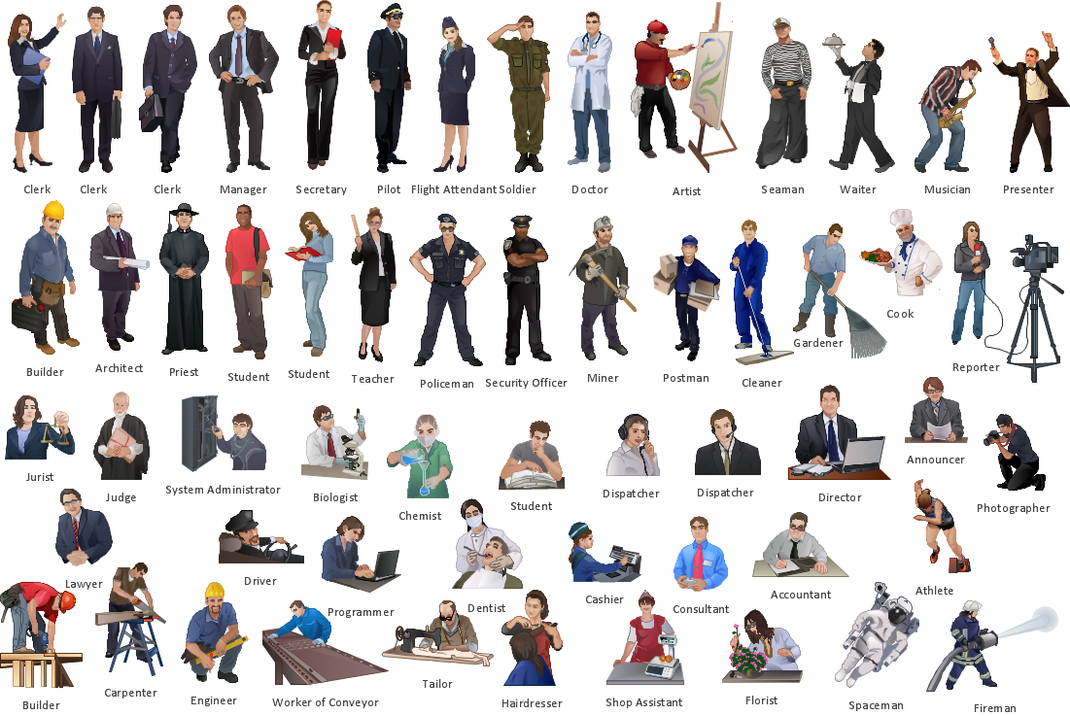
Jobs and occupations

Slide 19
How old are you?
What’s your phone number?

Slide 20
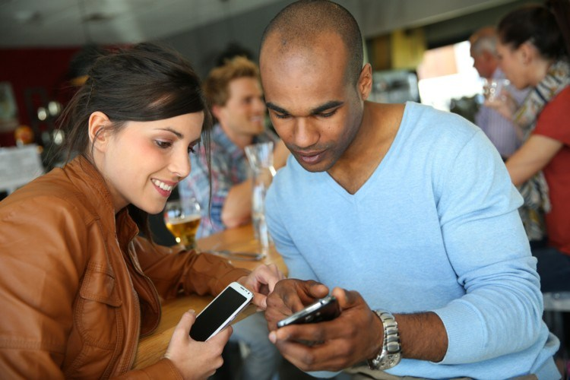
Phone number
Hello, Lucy.
Hi, David. Long time no see.
Yes. Listen I have to go. What’s your phone number? I’ve lost it.
It’s 999-865-562.
Thanks. I call you later or text you.
That’s fine. See you later.

Slide 21
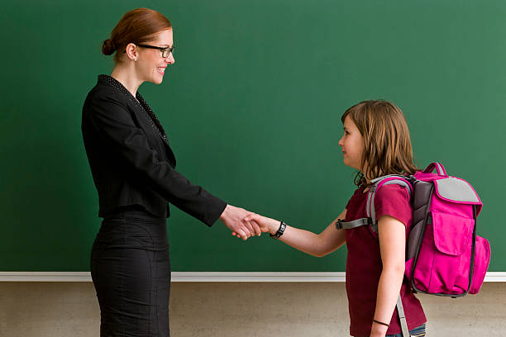
Phone number
Good morning, Teacher.
Good morning, what’s your name?
My name’s Elisabeth. But you can call me Beth.
Ok, Beth. How old are you?
I’m 12 years old. And you?
I’m 39. Please call me Mrs. Anderson.
Oh, ok, sorry Mrs. Anderson.
That’s ok Beth. Sit down please.

Slide 22

Numbers
TIPS:
TEEN – 13 – 19
TY – 20 – 90
HUNDRED – 100 – 900
THOUSAND = MIL
M.B.TR. = MILLION, BILLION, TRILLION
ONE TWO THREE FOUR FIVE
SIX SEVEN EIGHT NINE TEN

Slide 23
Numbers
TEEN – 13 – 19
11 – ELEVEN
12 – TWELVE
13 – THIRTEEN
14 – FOURTEEN
15 – FIFTEEN
16 – SIXTEEN
TEEN – 13 – 19
17 – SEVENTEEN
18 – EIGHTEEN
19 – NINETEEN
20 – TWENTY
ONE TWO THREE FOUR FIVE
SIX SEVEN EIGHT NINE TEN

Slide 24
Numbers
TY – 20 – 90
20 – TWENTY
30 – THIRTY
40 – FOURTY
50 – FIFTY
60 – SIXTY
TY – 20 – 90
70 – SEVENTY
80 – EIGHTY
90 – NINETY
21 – TWENTY-ONE
ONE TWO THREE FOUR FIVE
SIX SEVEN EIGHT NINE TEN

Slide 25
Numbers
HUNDRED – 100 – 900
100 – ONE HUNDRED
200 – TWO HUNDRED
500 – FIVE HUNDRED
965 – NINE HUNDRED SIXTY FIVE
ONE TWO THREE FOUR FIVE
SIX SEVEN EIGHT NINE TEN

Slide 26
Numbers
THOUSAND = MIL
1,000 – ONE THOUSAND
8,000 – EIGHT THOUSAND
16,000 – SIXTEEN THOUSAND
215,897 – TWO HUNDRED FIFTEEN THOUSAND EIGHT HUNDRED NINETY SEVEN
ONE TWO THREE FOUR FIVE
SIX SEVEN EIGHT NINE TEN

Slide 27

Numbers
M.B.TR = MILLION, BILLION, TRILLION
1,000,000 – ONE MILLION
85,000,000 – EIGHTY-FIVE BILLION
65,000,000,000 – SIXTY-FIVE TRILLION
895,245,607,589,814
ONE TWO THREE FOUR FIVE
SIX SEVEN EIGHT NINE TEN

Slide 28
Who is....?

Slide 29
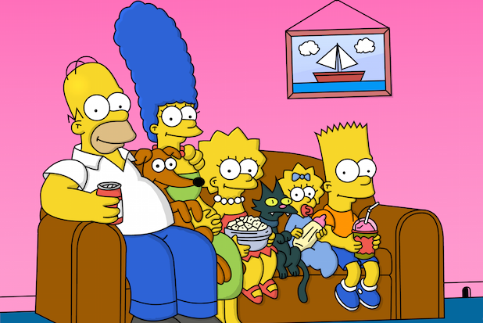
Family members
Homer Simpson – Father
Marge Simpson – Mother
Lisa Simpson – Sister
Bart Simpson – Brother
I’m Maggie Simpson!

Slide 30
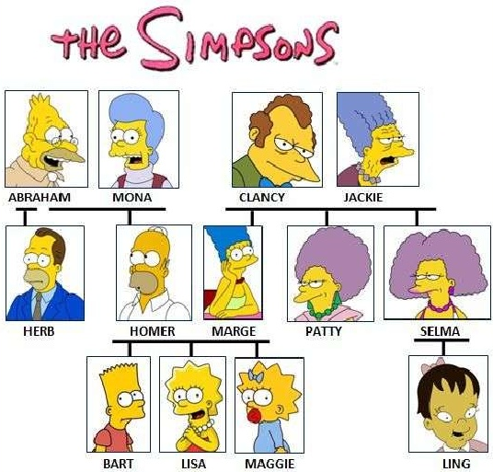
Family members
Abraham and Clancy – Grandfathers
Mona and Jackie – Grandmothers
Herb – Uncle
Patty and Selma – Aunts
Ling – Cousin

Slide 31
Family members
Homer is Clancy’s son-in-law
Marge is Abraham’s daughter-in-law
Patty is Homer’s sister-in-law
Herb is Marge’s brother-in-law
Ling is Marge’s niece
Maggie is Homer’s daughter
Bart is Patty’s nephew
Homer is Abraham’s son

Slide 32
Introducing People
What’s your name?
Are you married?
Where are you from?
What’s your occupation?
How old are you?
What’s your phone number?
My name’s..../I’m...
Yes, I am/ No, I’m not.
I’m from Brazil. I’m Brazilian
I’m a/an...
I’m... years old
It’s .....

Slide 33
Introducing People
How are you?
Who’s David?
How do you spell that?
Is he David?
Do you have kids/children?
I’m fine, thanks. What about you?
He’s my brother.
It’s S-T-E-V-E-N
Yes, I am/ No, he isn’t/ No, he’s not
No, I don’t/Yes, I have two.

