Slide 1
PAST PERFECT
DISCENTES:
AIRTON JUNIOR
LUANA AZEVEDO
OTHACYLIA OSMÊNIA
RITA BEATRIZ
RENATA BEATRIZ
THAYSE EMANUELLE

Slide 2
Quando usar o past perfect...
O past perfect é utilizado para falar sobre coisas que aconteceram antes de outras.

Slide 3
A estrutura do past perfect
O past perfect é formado por uma estrutura simples, utilizando had e o particípio do verbo principal.
The movie had already started when we arrived.

Slide 4
Forma Negativa (negative form)
Nas frases negativas é necessário acrescentar-se o “not” após o verbo auxiliar, que é o passado simples do verbo to have (had).
Ex: I had not seen it before.

Slide 5
Ex: The couch got soaked because they had not closed the window while it was raining.
SUJEITO
HAD
NOT (hadn't)
PARTICÍPIO PASSADO DO VERBO PRINCIPAL

Slide 6
Forma Interrogativa (Interrogative Form)
Para se fazer perguntas no past perfect o verbo auxiliar (had) deve aparecer no início da frase, antes do sujeito. Portanto as perguntas apresentam a seguinte estrutura:
Ex.: Had you changed your clothes before the end of the party?
Verbo to have no simple past + sujeito + verbo principal no past participle + complemento

Slide 7
Questões
Passe as sentenças a seguir para o “Past Perfect” e complete os espaços com a forma correta dos verbos em parênteses nesse tempo verbal da língua inglesa:
a) He ____________________ (live) in Germany before she went to Brazil.
b) After I____________________ (eat) the birthday cake, I began to feel sick.
c) If we ____________________ (listen) to her, we would have got the best place in the theater.

Slide 8
Respostas
a) He had lived in Germany before she went to Brazil.
b) After I had eaten the birthday cake, I began to feel sick.
c) If we had listened to her, we would have got the best place in the theater.

Slide 9
Harry Potter - The Tale of the Three Brothers
“The first brother traveled to a distant village where with the elder wand in hand, he killed a wizard with whom he had once quarreled. Drunk with the power that the elder wand had given him, he bragged to his invincibility. But that night, another wizard stole the wand and slit the brother’s throat for good measure, and so Death took the first brother for his own.”

Slide 10
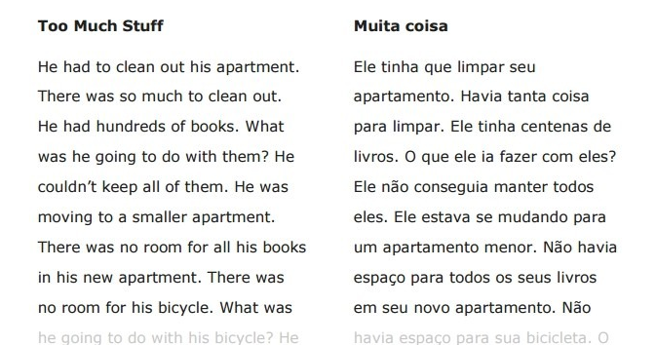

Slide 11
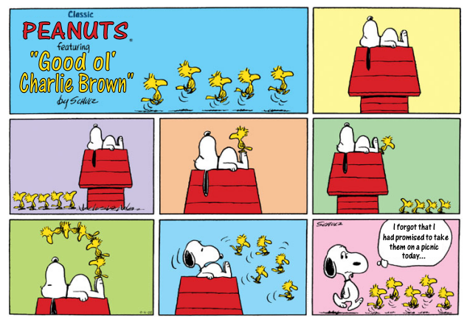

Slide 12
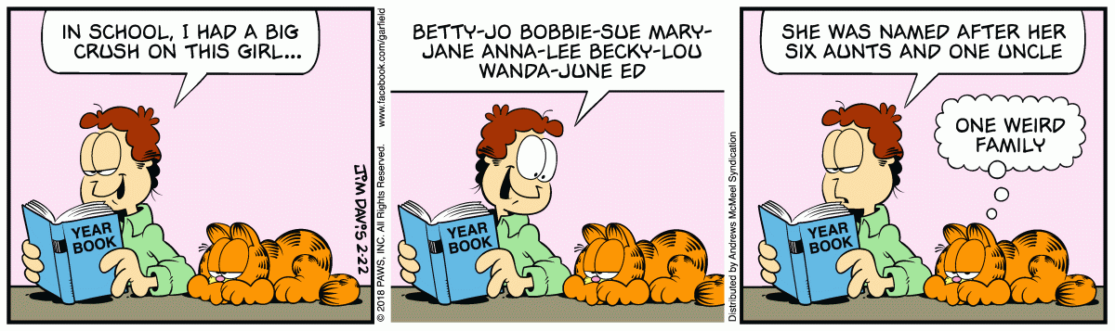

Slide 13
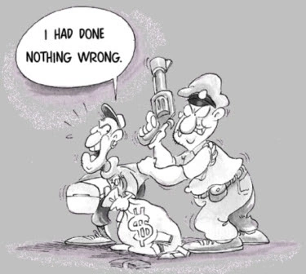

Slide 14
Referências
http://www.solinguainglesa.com.br/conteudo/Verbos11.php
https://www.todamateria.com.br/past-perfect-continuous/

