Slide 1

Types of
Pronouns

Slide 2
Seven Types of Pronouns
Personal
Possessive
Reflexive
Relative
Demonstrative
Indefinite
Interrogative

Slide 3

Personal Pronouns
Take the place of nouns
The Personal Pronouns:
I, me, us, we, you, he, him, she, her, it, them, they
Example
Colonel Mustard was invited to the
party at Mrs. Witherspoon’s mansion,
but he didn’t want to go alone.

Slide 4

Pronoun Case
Some pronouns change form based on whether they are subjects or object
I taught myself to skateboard
because nobody else would
teach me.
When do we use I?
When do we use me?
When do we use myself?

Slide 5
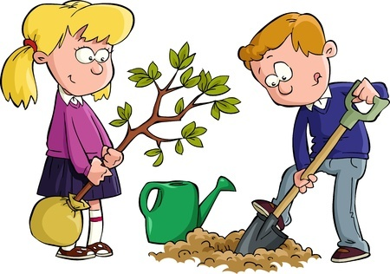
More Examples of Pronoun Case
My Dad and _______ were planting a tree for Earth Day.
Do we need a subjective
or objective pronoun?

Slide 6
More Examples of Pronoun Case
My Dad and ___I____ were planting a tree for Earth Day.
Do we need a subjective
or objective pronoun?
Subjective

Slide 7

More Examples of Pronoun Case
Alyssa was pleased when the teacher put ______ and Ahmad in a group.
Do we need a subjective
or objective pronoun?

Slide 8
More Examples of Pronoun Case
Alyssa was pleased when the teacher put __her____ and Ahmad in a group.
Do we need a subjective
or objective pronoun?
Objective

Slide 9

More Examples of Pronoun Case
The patient John tried to run from Nurse Christie but ______was faster than ______.
Do we need a subjective
or objective pronoun?

Slide 10
More Examples of Pronoun Case
The patient John tried to run from Nurse Christie but __she__was faster than _him_.
Do we need a subjective
or objective pronoun?
Subjective

Slide 11
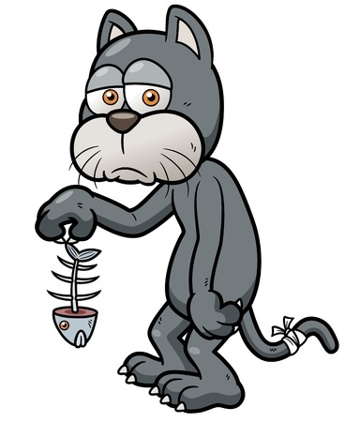
Possessive Pronouns
Take the place of possessive nouns
The Possessive Pronouns:
My, mine, our, ours, your, yours, his, her, hers, their, theirs, its
Example
Mr. Whiskers was disappointed with
his dinner.

Slide 12
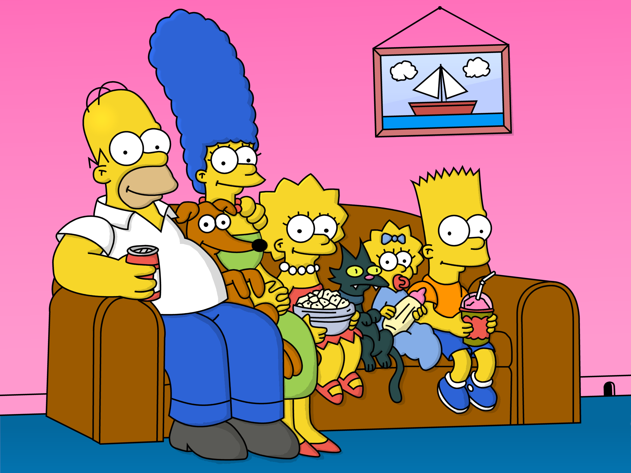
Possessive Pronouns Examples
Hommer Simpson sat on _______ sofa with _____ family.
Do we need possessive adjectives
or pronouns?

Slide 13
Possessive Pronouns Examples
Hommer Simpson sat on __his__ sofa with _his_ family.
Do we need possessive adjectives
or pronouns?
Adjective/ his

Slide 14
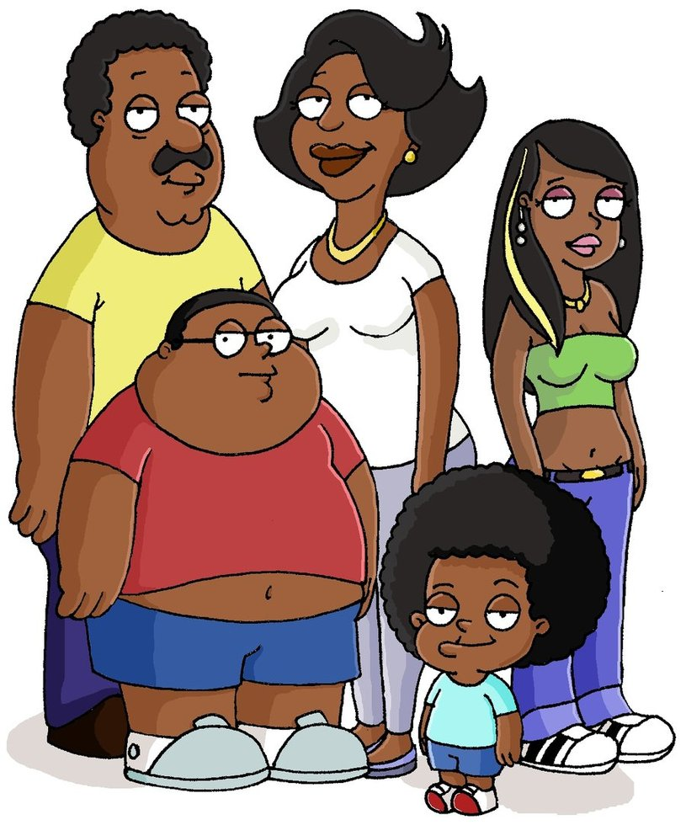
Possessive Pronouns Examples
Marge Simpson sat on the sofa with her family. Donna was standing with _________
Do we need possessive adjective
or pronoun?

Slide 15
Possessive Pronouns Examples
Marge Simpson sat on the sofa with her family. Donna was standing with __hers___
Do we need possessive adjective
or pronoun?
Pronoun/ hers

Slide 16
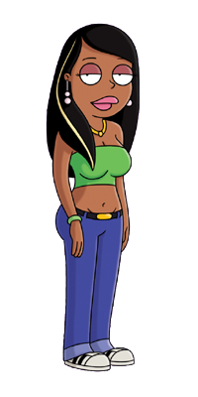
Possessive Pronouns Examples
Roberta is _____ friend. (I)
Do we need possessive adjective
or pronoun?

Slide 17
Possessive Pronouns Examples
Roberta is _my__ friend. (I)
Do we need possessive adjective
or pronoun?
Adjective/ my

Slide 18
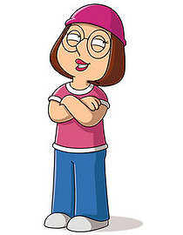
Possessive Pronouns Examples
Meg Griffin is a friend of _________. (Roberta)
Do we need possessive adjective
or pronoun?

Slide 19
Possessive Pronouns Examples
Meg Griffin is a friend of __hers___. (Roberta)
Do we need possessive adjective
or pronoun?
Pronoun/ hers

Slide 20
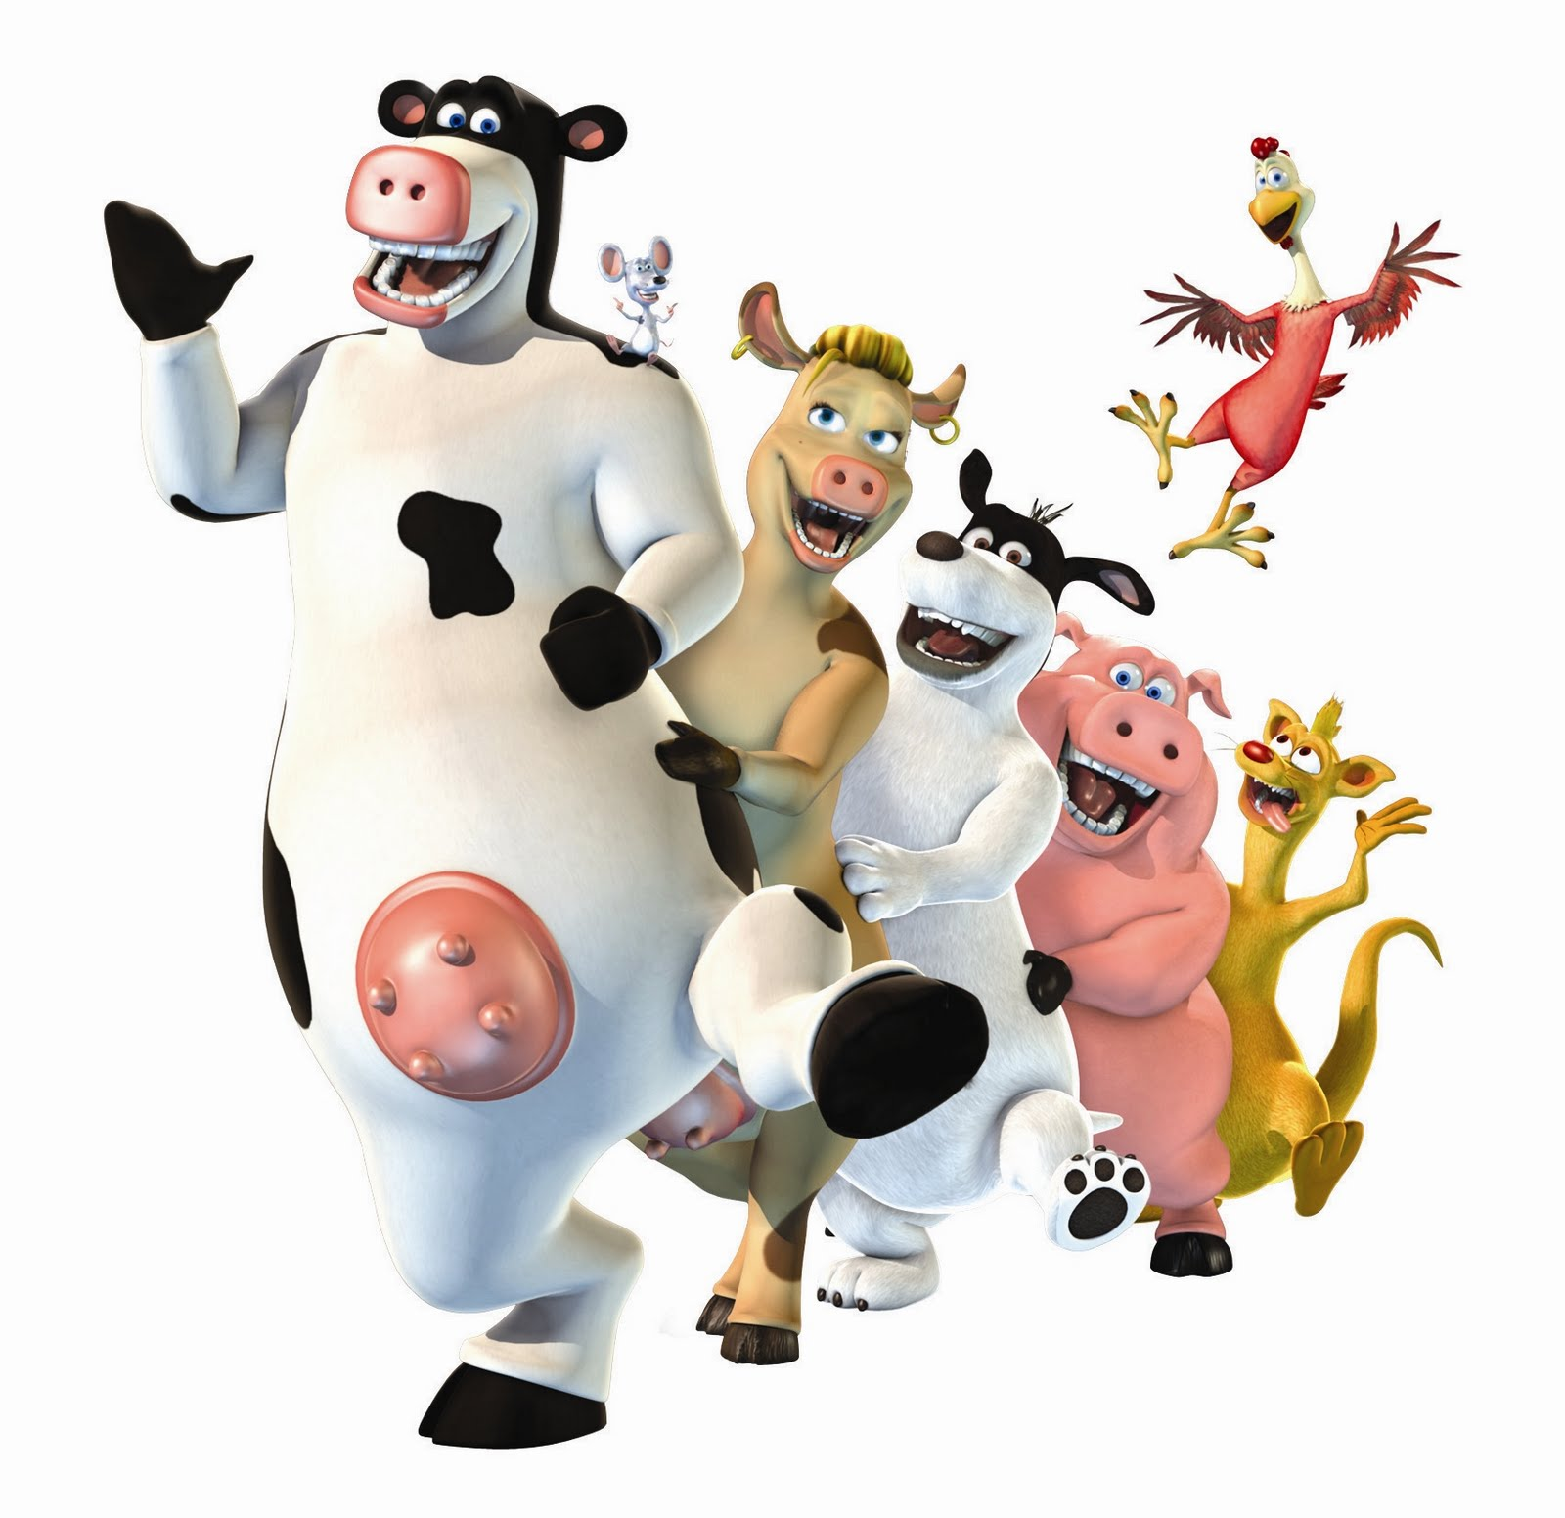
Possessive Pronouns Examples
Your pet is the cow, ________ is the dog, _________ is the pig and ________ is the chicken. (they, she, I)
Do we need possessive adjectives
or pronouns?

Slide 21
Possessive Pronouns Examples
Your pet is the cow, __theirs__ is the dog, __hers___ is the pig and __mine__ is the chicken. (they, she, I)
Do we need possessive adjectives
or pronouns?
Pronouns/ theirs, hers AND mine.

Slide 22
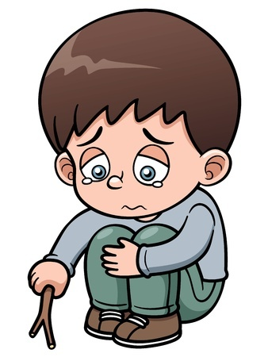
Reflexive Pronouns
Refer or reflect back to the subject
The Reflexive Pronouns:
Myself, ourselves, yourself, yourselves, himself, herself, themselves, itself
Example
Andre just wanted to be by himself.

Slide 23
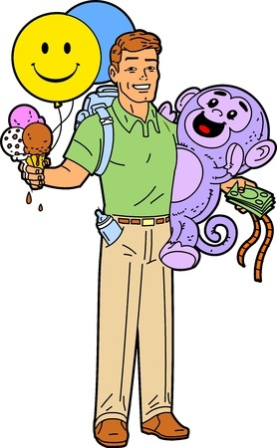
Use Reflexive Pronouns Carefully
They can only be used after a name or pronoun to which they refer.
Don’t
My children wanted to go to
Happyland with myself.
Do
My children wanted to go to Happyland
with me, but I wanted to go by myself.

Slide 24
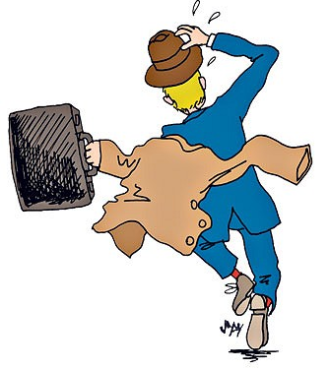
Use Reflexive Pronouns Carefully
They can only be used with verbs that allows reflexivity.
Don’t
I ran myself to get the train and got hurt.
Do
I hurt myself running to get the train.

Slide 25
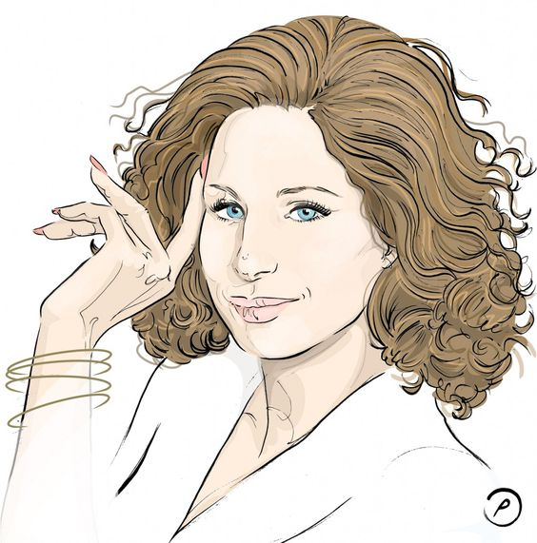
Use Reflexive Pronouns
To show there’s nobody else to do that.
He got himself the book.
We gave ourselves that prize.
She did the exercise by herself.
I finished the job by myself.
By + Reflexive means alone.
All by myself don’t wanna live…
(Barbara Streisand)
Robert doesn’t want to do that by himself.

Slide 26

Relative Pronouns
Introduce relative clauses
The Relative Pronouns:
That, who, whom, whose, which, whoever,
whomever, whichever
Example
The pirate captain, who had never
seen the inside of a schoolroom,
struggled to read the ransom note.

Slide 27
Relative Pronouns
Example
The pirate captain, who had never seen the inside of a schoolroom, struggled to read the ransom note.
Example
The pirate captain had never seen the inside of a schoolroom, struggled to read the ransom note.

Slide 28
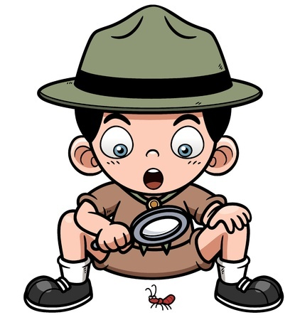
Relative Clauses
Begin with a relative pronoun and give more information about a noun.
Examples
Willard, who had just learned of the sun’s power, used a magnifying glass to terrorize ants.
Ants that are exposed to magnified sunlight
tend to combust.

Slide 29
Relative Clauses
The man who works next block lives in Manhattan.
Be careful! There's the man that ran towards my sister last week.
This is George, whose brother went to school with me.
I had an uncle in Germany, from whom I inherited a bit of money.
Who – subject
Whom – object
Whose – possession
That – people and things

Slide 30
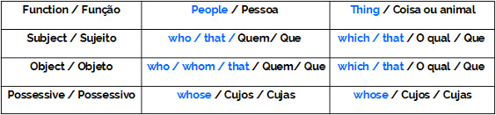
Relative Pronouns
The Relative Pronouns:

Slide 31
Relative Pronouns
After prepositions:
Never use WHO
Possession:
Always use WHOSE
After first, last, tallest (superlatives), any, no, some, none, only, everything:
Always use THAT

Slide 32


Relative Pronouns
After prepositions:
Bill is the man for who I dedicated my book.
Bill is the man for whom I dedicated my book.
Possession:
I met a guy who car crashed yesterday.
I met a guy that car crashed yesterday.
I met a guy whose car crashed yesterday.

Slide 33
Relative Pronouns
After these words:
I was the first who got an A in Physics.
I was the first that got an A in Physics.
The tallest person who I know is her brother.
The tallest person that I know is her brother.
All which she knew was real.
All that she knew was real.
He knows everything which they like.
He knows everything that they like.
The writers and the books which she loves were there.
The writers and the books that she loves were there.

Slide 34

Demonstrative Pronouns
Take the place of things
The Demonstrative Pronouns:
This, that, these, those
Example
“This is my favorite book about
unicorns,” said Patrick.

Slide 35
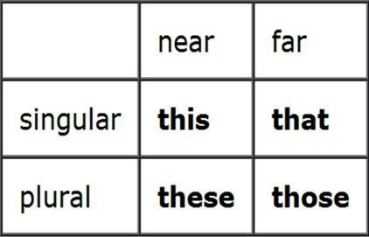
Demonstrative Pronouns
Use according to the chart below:

Slide 36
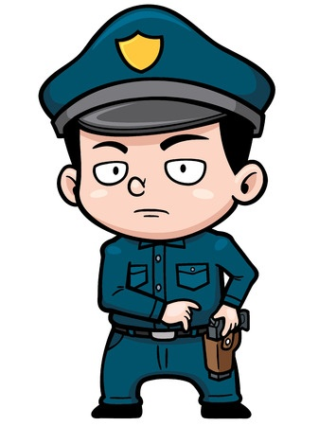
Indefinite Pronouns
Take the place of things
The Indefinite Pronouns:
Another, all, any, anybody, anyone, anything, both, each,
either, enough, everybody, everyone, everything, few,
fewer, less, little, many, more, most, much, neither,
none, nothing, one, other, others, several, some,
somebody, someone, something, such
Example
Office Ramirez heard something moving
behind the dumpster.

Slide 37
Indefinite Pronouns
Another,
all,
any,
anybody,
anyone,
anything,
both,
each,
either,
enough,
everybody, everyone, everything, few,
fewer,
less,
little,
many,
more,
most
much,
neither
none,
nothing,
one,
other,
others,
several,
some,
somebody,
someone,
something,
such

Slide 38

Interrogative Pronouns
Take the place of things
The Interrogative Pronouns:
Who, whom, what, which, whose
Example
What’s inside of that
treasure chest?

Slide 39
That’s not my wife
I’m just a junior detective. I don’t know much, but I know the area around Hollywood Road, the hilly Hong Kong street that runs down to Connaught Road. Strange things turn up in that half-kilometer area crammed with antiques stores, coffee shops and tourist dives.
Right now, I am looking at this hwa-chiao, a Chinese-American tourist at the station house who’s bitching at Inspector Chan. Mr. Wu claims he’s an important visitor, but I think he’s FOB — fresh off the boat Chinese. He’s shaking his finger and saying, “I report my wife Mei-Yuan has disappeared, then I came back to find an imposter in my hotel room, not even a good duplicate.” Of course, from his mouth it comes out like “fucking imposter” and “goddamn duplicate.” Most bad guys use bad language to show their sincerity. This guy Wu is the slickest bad boy I’ve seen and I have seen a lot of them, from Guangzhou to Macao. His missing tài tai was Shanghainese and one of the richest women around.

Slide 40
That’s not my wife
I’m just a junior detective. I don’t know much, but I know the area around Hollywood Road, the hilly Hong Kong street that runs down to Connaught Road. Strange things turn up in that half-kilometer area crammed with antiques stores, coffee shops and tourist dives.
Right now, I am looking at this hwa-chiao, a Chinese-American tourist at the station house who’s bitching at Inspector Chan. Mr. Wu claims he’s an important visitor, but I think he’s FOB — fresh off the boat Chinese. He’s shaking his finger and saying, “I report my wife Mei-Yuan has disappeared, then I came back to find an imposter in my hotel room, not even a good duplicate.” Of course, from his mouth it comes out like “fucking imposter” and “goddamn duplicate.” Most bad guys use bad language to show their sincerity. This guy Wu is the slickest bad boy I’ve seen and I have seen a lot of them, from Guangzhou to Macao. His missing tài tai was Shanghainese and one of the richest women around.

Slide 41
That’s not my wife
Hong Kong street
Author
area
I’m just a junior detective. I don’t know much, but I know the area around Hollywood Road, the hilly Hong Kong street that runs down to Connaught Road. Strange things turn up in that half-kilometer area crammed with antiques stores, coffee shops and tourist dives.

Slide 42
Author
tourist
Right now, I am looking at this hwa-chiao, a Chinese-American tourist at the station house who’s bitching at Inspector Chan. Mr. Wu claims he’s an important visitor, but I think he’s FOB — fresh off the boat Chinese. He’s shaking his finger and saying, “I report my wife Mei-Yuan has disappeared, then I came back to find an imposter in my hotel room, not even a good duplicate.”

Slide 43
Author
“I report …duplicate.”
Mr. Wu
Of course, from his mouth it comes out like “fucking imposter” and “goddamn duplicate.” Most bad guys use bad language to show their sincerity. This guy Wu is the slickest bad boy I’ve seen and I have seen a lot of them, from Guangzhou to Macao. His missing tài tai was Shanghainese and one of the richest women around.
Women
Bad guys

Slide 44
Author
woman
“If that woman…
“Well, it’s simple,” I say. “If that woman in your hotel room is not your wife, then the one you want may be dead or run off to Shenzhen with a pretty boy or kidnapped by pirates….”
Mr. Wu

Slide 45
Face
Mr Wu
Mr Huang/
Detective
Inspector Chan didn’t like me calling the guy a killer and it showed on his little college-boy face. I told him before it was a simple thing to come here on homeland vacation and knock off his old lady. Her disappearance now puts this guy into the top five percent richest club. Wanting to inherit a pile of money is a good motive for murder. Simple as that.
Knock off his old lady
Mr Huang/
Detective
Mrs Wu
Wanting to inherit…

Slide 46
Inspector Chan is insisting over the guy’s objections that the woman back at the Peninsula Hotel in Kowloon really truly is his wife. “She was picked up wandering around Hollywood Road acting confused,” he says again. “Our Detective Huang — a good officer in spite of his impolite attitude — brought her back. May I suggest you may be suffering from delusions?”

Slide 47
Inspector Chan is one of the new breed of cop in China, college-educated and even one year studying at UCLA. Now he’s telling the Chinese-American, “Perhaps your problem is something called Capgras Syndrome and you should see a psychiatrist.” He’s smiling, proud of his analysis.
I light a cigarette and call over to the Inspector, “Crap gas?” He gives me a dirty look, like what do I know. I’m just the junior-grade detective who brought in the dame.

Slide 48
No, Inspector Chan tells us like an encyclopedia, Capgras, after the French psychiatrist who discovered it. “It’s when you think a close relative or spouse has been replaced by an imposter, an exact double. I have seen this in people with Alzheimer’s or bi-polar disorder,” he says. “Go look it up, Junior Detective Huang.”
The American shouts bullshit. Three times. He says, “I came back from dinner to find a counterfeit in my hotel room, not even a good look-alike of the person I love, my dear Mei-Yuan. Why can’t anyone see this isn’t my wife? You must find my real wife, Inspector.”

Slide 49
“Well, if you had her passport or some photos,” Inspector Chan offers.
“She took her passport. I don’t have any pictures or know anyone in Hong Kong! You think I bring a photo album on my vacation?”
Time to get a coffee, I think, but I turn to the guy. “How come her fingerprints match those on the glass where she brushed her teeth?” I ask. “Huh? How come her clothes fit? How come, Mr. Chinese-American Wiseguy? It’s your old lady and I found her.”
He turns three shades of red and purple and his mouth looks like he sucked a lemon, trying to choke back some words. Maybe he wants Chan to give him back his passport, too.

Slide 50
“Maybe you are worried you won’t inherit your old lady’s money, is that it?” I ask. “Yesterday, you say she disappeared. Tomorrow maybe you will admit your wife is at the bottom of the harbor.” I gave him my big two-dollar smile that I reserve for police commissioners and college-graduate inspectors. “If that is not your wife, then maybe we should book you for murder.”
He turns another shade of red, like a firecracker at New Year’s. “Maybe it is my wife,” he mutters and tries to get up. “I think it really is my wife and I should see that shrink.” He walks out the door.

Slide 51
Inspector Chan gets really annoyed and pokes me in the chest. “You pissed off the richest person I’ve ever interviewed,” he shouts. “You do not know how to treat people. You are just a country cop.”
“I knew how to treat this one,” I tell him. “I lied. Of course it is not his wife. Not her fingerprints either. Mei-Yuan Wu has probably been cut up for dumplings. That woman in his hotel room is Officer Lee, a policewoman I brought in from Wanchai. She’s doing me a favor for a few days till Officer Lee gets the guy to admit he killed his wife, or until maybe he really goes nuts. Killers are nuts to begin with. In any case, he won’t get his hands on his wife’s money.

Slide 52
“See, Inspector,” I say, poking him in the chest. “There’s educated people and there’s smart people.”
Then I walk out of the interrogation room, but not before turning around and saying real loud, “Crap gas.”
https://short-story.me/crime-stories/1099-thats-not-my-wife.html

Slide 53
http://www.ereadingworksheets.com/languageartsworksheets/parts-of-speech-worksheets/pronoun-worksheets/

