Slide 1
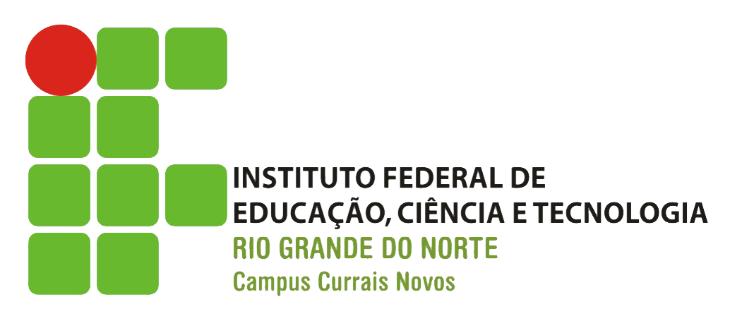
eNGlish
Jadna albino
Jayne Leydianne
Josimara alves

Slide 2
The bigger picture
O que é retratado no texto?
Ao trabalhar em equipes multifuncionais, os membros de P e De podem ver seu trabalho em um contexto totalmente novo. Esta é a era das equipes multifuncionais "Velocidade de entrada no mercado" e "acertar na primeira vez" são chamados de ação padrão para essas equipes, os membros individuais devem não apenas expandir seus conjuntos de habilidades, q verdadeira marca de um membro da equipe multifuncional, com um olho para entender o contexto maior de negócios. Ao aumentar seu conhecimento e compreensão interfuncional, os membros não necessariamente se tornarão especialistas em outros campos. Eles no entanto, desenvolverão um atendimento suficiente para enquadrar questões específicas em um contexto mais amplo.
Qual a novidade que ele traz?
A equipe multifuncional no mercado com habilidades novas diferenciando o contexto no meio dos negócios.

Slide 3
The bigger picture
There was a time when R&D was expected to have skills in R&D and only R&D.
But this is the era of cross-functional teams. "Speed to market" and "do it right the first time" are standard calls to action for these teams and, as such, individual members must not only expand their skill sets , the true mark of a cross-functional team member, but do so with an eye toward understanding the larger business context. R&D is no exception.
In the past, R&D managers often were judged in terms of numbers, namely the number of people they had working for them. Likewise, R&D scientists were measured by the depths of their technical knowledge. This is how so-called "functional silos" began to develop and grow. The new success model for R&D doesn't depend solely on technical knowledge or on the amount of authority a given title confers, but on R&D's influence across a greater spectrum of functions. The cross-functional model presents R&D members with a huge opportunity to grow, develop and become more valuable to the company. Improved and expanded skills are also highly valued in the job market and, accordingly, help to ensure long-term employability.

Slide 4
By increasing their cross-functional knowledge and understanding, R&D members Will not necessarily become experts in other fields. They will, however, develop sufficient understanding to frame specific issues in a larger context; push back or challenge when needed; and engage more freely in exchanges about particular ideas and solutions. R&D groups with greater cross-functional skills do not detract from others on their team. By fostering team dialogue, they raise the cross-functional understanding of all team members, resulting in a better performance by everyone.
Training, coaching, experience
There are three general ways for R&D to develop cross-functional skills within an R&D organization - training, coaching and experiential learning. All are important and best used in combination.
Training is a formal activity in which R&D students are exposed to a range of knowledge in a classroom-like setting. However, timing is critical in order to convert knowledge to true understanding. Hence, training should be provided when it likely will be used and practiced.

Slide 5
Coaching can be used as a supplement to formal training or a substitute for it. In either case, it provides a means for managers or senior technical staff members to share knowledge with more junior R&D members. It is typically practiced on a one-on-one basis and in the course of everyday work. Because it is timely, it reinforces the conversion of knowledge to understanding. Coaching relationships may be formal (as in a manager/subordinate relationship) or they can be spontaneous. Unfortunately, coaching is often overlooked as a result of time and workload pressures.
Hands-on experience is highly effective in developing new skills. While all R&D members eventually learn new functions and tasks, they can accelerate the process by crossing functional boundaries. An R&D member, for instance, may be assigned to marketing, manufacturing, quality assurance or sales. These developmental assignments provide a first-hand understanding of the roles and requirements of other disciplines. Employees also gain a fresh perspective of R&D work, sometimes from the vantage point of the client.
In order to develop cross-functional skills within the R&D group, expectations need to be set for skills and the level of mastery required. A team member right out of school obviously will have limited skills in many cross-functional areas. More experienced staff naturally would be expected to have a higher degree of understanding in these same areas. High- performing organizations develop a "Skills Matrix" to articulate and manage technical and cross-functional skills development.

Slide 6
Legenda:
Simples Presente: Cor roxa
Simples futuro: Cor Laranja
Passado Simples: Vermelho enfâse
Perfeito Passado: Cor Verde
Perfeito Presente: Cor Azul
Perfeito futuro: Laranja+Azul
Modais: Laranja

Slide 7
Perguntas:
Quais são as três maneiras gerais de a P&D desenvolver habilidades interfuncionais dentro de uma organização de P&D? Training, coaching, experience.
O que é ¨training¨? Training is a formal activity in which R&D students are exposed to a range of knowledge in a classroom-like setting.
Para que serve ¨experience¨? Hands-on experience is highly effective in developing new skills. While all R&D members eventually learn new functions and tasks, they can accelerate the process by crossing functional boundaries. These developmental assignments provide a first-hand understanding of the roles and requirements of other disciplines.
O que é ¨coaching¨? Coaching can be used as a supplement to formal training or a substitute for it. In either case, it provides a means for managers or senior technical staff members to share knowledge with more junior R&D members. It is typically practiced on a one-on-one basis and in the course of everyday work. Coaching relationships may be formal (as in a manager/subordinate relationship) or they can be spontaneous.
¨Ao aumentar seu conhecimento e compreensão interfuncional, os membros de P&D não necessariamente se tornarão especialistas em outros campos¨. Com base no texto, explique essa afirmação. They will, however, develop sufficient understanding to frame specific issues in a larger context; push back or challenge when needed; and engage more freely in exchanges about particular ideas and solutions. R&D groups with greater cross-functional skills do not detract from others on their team.

Slide 8
referencias
https://www.foodprocessing.com/articles/2003/152/

