Slide 1
ENGLISH ACTIVITY
TEACHER CRISTIANE CRUZ

Slide 2
His name is Tobias Eaton, but people call him Four. He is Marcus’s son. He is quiet. He is 18 years old.
He choses Dauntless at his Choosing Ceremony.
He gives the initiates a tour of Dauntless HQ.
He’s been asked to become a Dauntless leader several times, and refuses.
He teaches the initiates how to shoot a gun; he is good.
He gives Tris fighting tips.
He picks the fastest initiates and members for his capture the flag team.
His team wins capture the flag.
He teaches the initiates how to throw knives.
He finds out that Tris is Divergent and warns her to hide it.
He saves Tris from Eric by lying about why she left Dauntless HQ

Slide 3
His name is Tobias Eaton, but people call him Four. He is Marcus’s son. He is quiet. He is 18 years old.
He choses Dauntless at his Choosing Ceremony.
He gives the initiates a tour of Dauntless HQ.
He’s been asked to become a Dauntless leader several times, and refuses.
He teaches the initiates how to shoot a gun; he is good.
He gives Tris fighting tips.
He picks the fastest initiates and members for his capture the flag team.
His team wins capture the flag.
He teaches the initiates how to throw knives.
He finds out that Tris is Divergent and warns her to hide it.
He saves Tris from Eric by lying about why she left Dauntless HQ

Slide 4
What’s his name?
His name is Tobias Eaton, but people call him Four.
How old is he?
He is 18 years old.
Where is he from?
He is from Dauntless Faction.
What does he do?
He is a teacher for the initiates.
Does he know Tris?
Yes, he does.
Does he fight for her?
Yes, he does.
Does his team capture the flag?
Yes, it does.
Does he warn Tris to hide?
Yes, he does.
Does he know Tris is divergent?
Yes, he does.
Does he save Tris from Eric?
Yes, he does.
Do they begin a relationship?
Yes, they do.
Do you like this movie?
Yes, we do/ No, we don’t.

Slide 5
Her name is Beatrice Prior, but people call her Tris. She is Nathalie and Andrew’s daughter. She is brave. She is 16 years old.
The results of her Aptitude test were inconclusive- showing equal aptitude for Abnegation, Dauntless, and Erudite.
She chooses Dauntless at the Choosing Ceremony.
She’s on Four’s Capture the Flag Team.
Finds out where Eric‘s Team is hiding their flag by climbing the Ferris Wheel with Four.
Four saves her when Peter, Drew, and Al take her and hang her over the Chasm.
She doesn’t forgive Al when he apologizes.
She gets caught in the Erudite Sector and has to speak with Jeanine
Her mom saves her from drowning. Her mom dies saving her.
Her dad dies saving her.
She refuses to kill Four and saves him.

Slide 6
Her name is Beatrice Prior, but people call her Tris. She is Nathalie and Andrew’s daughter. She is brave. She is 16 years old.
The results of her Aptitude test were inconclusive- showing equal aptitude for Abnegation, Dauntless, and Erudite.
She chooses Dauntless at the Choosing Ceremony.
She’s on Four’s Capture the Flag Team.
Finds out where Eric‘s Team is hiding their flag by climbing the Ferris Wheel with Four.
Four saves her when Peter, Drew, and Al take her and hang her over the Chasm.
She doesn’t forgive Al when he apologizes.
She gets caught in the Erudite Sector and has to speak with Jeanine
Her mom saves her from drowning. Her mom dies saving her.
Her dad dies saving her.
She refuses to kill Four and saves him.

Slide 7
How does she captures the flag?
Finds out where Eric‘s Team is hiding their flag by climbing the Ferris Wheel with Four.
Where does she choose to be at the ceremony?
She chooses Dauntless.
Does she forgive Al?
No, she doesn’t.
Does she get caught?
Yes, she does.
Does her mother visit her?
Yes, she does
Does she kill Four?
No, she doesn’t. She refuses and saves him.
What’s her name?
Her name is Beatrice Prior, but people call her Tris.
How old is she?
She is 16 years old.
Where is she from?
She is from Dauntless Faction.
What does she do?
She is a soldier and revolutionary.
Does she know Tobias?
Yes, she does.
Does she know how to shoot?
Yes, she does.

Slide 8
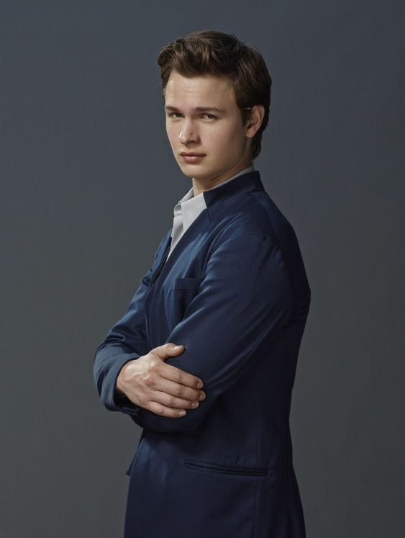
His name is Caleb Prior. He is Nathalie and Andrew’s son. He is older than Tris by 9 months, and doesn’t really look like her. He is good looking and good at being selfless. After his Aptitude test he is pale and his palms are sweating, his fingers shake. He appears calm during the choosing ceremony.
Tells Tris that even though they should think of their families before choosing a Faction, they must also think of themselves. It’s the first time she’s ever heard him be selfish.
Holds Tris’s hand during the Choosing Ceremony until it’s his turn to choose.
He’s in Tris’s Fear Landscape
After researching the simulation serum, he leaves Erudite Initiation.
Proves his book smartness by removing the bullet from Tris’s shoulder and stitching it up.
Goes with Tris to Dauntless HQ because he knows the most about the Erudite plan.
Tris saves him by making him stay with Peter.
Heads to the Amity Sector with Tris, Four, Peter, and Marcus.

Slide 9
His name is Caleb Prior. He is Nathalie and Andrew’s son. He is older than Tris by 9 months, and doesn’t really look like her. He is good looking and good at being selfless. After his Aptitude test he is pale and his palms are sweating, his fingers shake. He appears calm during the choosing ceremony.
Tells Tris that even though they should think of their families before choosing a Faction, they must also think of themselves. It’s the first time she’s ever heard him be selfish.
Holds Tris’s hand during the Choosing Ceremony until it’s his turn to choose.
He’s in Tris’s Fear Landscape
After researching the simulation serum, he leaves Erudite Initiation.
Proves his book smartness by removing the bullet from Tris’s shoulder and stitching it up.
Goes with Tris to Dauntless HQ because he knows the most about the Erudite plan.
Tris saves him by making him stay with Peter.
Heads to the Amity Sector with Tris, Four, Peter, and Marcus.

Slide 10
Her name is Jeanine Mathews. She seems to be around forties. She has sharp, but attractive eyes. She sees problems and forms solutions based on the data she collects.
She is Erudite‘s only city council representative, she was selected based on her IQ store.
Before she was a leader, she worked with Cara. They were trying to develop a longer-lasting serum for the simulations.
She is the voice behind the simulations for the Aptitude Test.
She developed the Aptitude Test.
She developed the serum that was injected into the Dauntless, turning them into “sleepwalkers”.
She wants a new government based on wealth, comfort, and prosperity.
She developed a serum for the Divergent.
She injects Four with the Divergent serum and sends him to the Control Room.
She sends Tris to Room B13 to be executed.

Slide 11
Her name is Jeanine Mathews. She seems to be around forties. She has sharp, but attractive eyes. She sees problems and forms solutions based on the data she collects.
She is Erudite‘s only city council representative, she was selected based on her IQ store.
Before she was a leader, she worked with Cara. They were trying to develop a longer-lasting serum for the simulations.
She is the voice behind the simulations for the Aptitude Test.
She developed the Aptitude Test.
She developed the serum that was injected into the Dauntless, turning them into “sleepwalkers”.
She wants a new government based on wealth, comfort, and prosperity.
She developed a serum for the Divergent.
She injects Four with the Divergent serum and sends him to the Control Room.
She sends Tris to Room B13 to be executed.

Slide 12
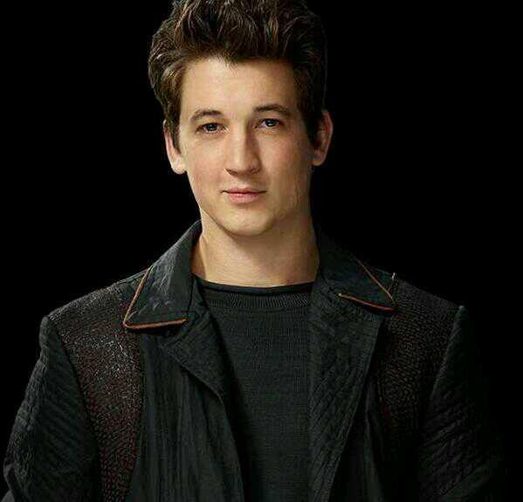
His name is Peter. He is 16 years old. He’s tall, with dark, shiny hair. He has a wide white smile. His eyes are wide and dark green.
Taunts Tris from the very beginning.
Beats Tris in the Arena.
On Eric’s team for capture the flag.
He and Drew are the only ones missing when Edward is stabbed in the eye. He, Drew, and Al take Tris and dangle her over the Chasm.
After Initiation, he wants to be a Dauntless-leader-in-training.
Ranked 5th out of 12 in the final rankings.
Removed from the war simulation by the Dauntless Leaders.
Tells Tris where the control room is only after she agrees to take him with her.
Leaves Dauntless HQ on a Train toward the Amity sector.

Slide 13
His name is Peter. He is 16 years old. He’s tall, with dark, shiny hair. He has a wide white smile. His eyes are wide and dark green.
Taunts Tris from the very beginning.
Beats Tris in the Arena.
On Eric’s team for capture the flag.
He and Drew are the only ones missing when Edward is stabbed in the eye. He, Drew, and Al take Tris and dangle her over the Chasm.
After Initiation, he wants to be a Dauntless-leader-in-training.
Ranked 5th out of 12 in the final rankings.
Removed from the war simulation by the Dauntless Leaders.
Tells Tris where the control room is only after she agrees to take him with her.
Leaves Dauntless HQ on a Train toward the Amity sector.

Slide 14
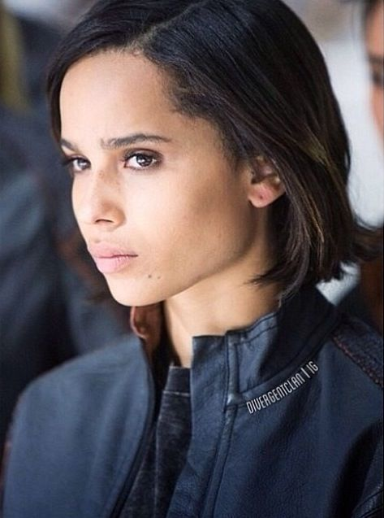
Her name is Cristina. She is 16 years old. She’s tall with dark brown skin and chin length black hair. She has brown eyes and is pretty and lean. She’s fast and strong. During initiation she got a tattoo of the Dauntless seal.
Helps Tris onto the Train for the first time.
She helps make over Tris.
Tris’s first real friend.
Because she forfeits her first fight, Eric makes her hang over
the Chasm for five minutes.
Snatches the flag while playing capture the flag even though Tris gets there first.
Her mom and sister visit her on Visiting Day.
Apologizes to Tris for taking the flag when they played capture the flag.
Wakes Tris up to tell her about Al’s suicide.
She knew that she could never choose to stay in Candor
because she doesn’t want to share everything, and she wants to be in control of her own mind.
After initiation ends, she wants a job like Four’s, training initiates.

Slide 15
Her name is Cristina. She is 16 years old. She’s tall with dark brown skin and chin length black hair. She has brown eyes and is pretty and lean. She’s fast and strong. During initiation she got a tattoo of the Dauntless seal.
Helps Tris onto the Train for the first time.
She helps make over Tris.
Tris’s first real friend.
Because she forfeits her first fight, Eric makes her hang over
the Chasm for five minutes.
Snatches the flag while playing capture the flag even though Tris gets there first.
Her mom and sister visit her on Visiting Day.
Apologizes to Tris for taking the flag when they played capture the flag.
Wakes Tris up to tell her about Al’s suicide.
She knew that she could never choose to stay in Candor
because she doesn’t want to share everything, and she wants to be in control of her own mind.
After initiation ends, she wants a job like Four’s, training initiates.

Slide 16
Simple presente tense
TO BE – am, is, are
I’m Cristiane./ His name is Tobias Eaton./ She is brave./ They are friends.
TO HAVE – have/has
I have a dream./She has sharp, but attractive eyes.
HAS – he,she,it
OUTROS VERBOS:
I teach English./ He teaches the initiates.
They choose Abnegation./ She chooses Dauntless.

Slide 17
Simple presente tense
É formado pelo verbo na sua forma básica sem o to:
To work – trabalhar (infinivo); I work, They work, You work, etc.
A 3ª pessoa do singular (he/she/it) recebe modificação na forma afirmativa:
Acréscimo de S:
A maioria dos verbos apresenta este acréscimo:
I get caught./ She gets caught.
You want to be a Dauntless-leader./ He wants to be a Dauntless-leader.

Slide 18
Simple presente tense
Acréscimo de ES:
Alguns verbos sofrem esta modificação. São os verbos que terminam em S/SH/CH/O/X/Z:
I teach English. / He teaches the initiates.
I go to school./ He goes with Tris to Dauntless HQ.
You snatch the flag. / She snatches the flag.
Acréscimo de IES:
Os verbos que terminam em Consoante e Y trocam o Y por I e acrescentam ES:
I study Portuguese every day./ She studies Spanish every day.

Slide 19
Simple presente tense –NEGATIVA
Para fazer a negativa no presente você utiliza os auxiliaries DO e DOES mais NOT:
DO é usado para as pessoas I, YOU, WE e THEY. DO + NOT = don’t
DOES é usado para as pessoas HE, SHE e IT. DOES + NOT = doesn’t
I do not teach English.
I don’t go to school.
The fathers don’t forgive your sins.
Obs: o verbos perde as modificações na forma negativa.
He doesn’t teach the initiates.
He doesn’t go with Tris to Dauntless HQ.
She doesn’t forgive Al when he apologizes.

Slide 20
Simple presente tense – INTERROGATIVA
Para fazer a interrogativa no presente você utiliza os auxiliaries DO e DOES sempre no início das frases e após pronomes interrogativos:
DO é usado para as pessoas I, YOU, WE e THEY.
DOES é usado para as pessoas HE, SHE e IT.
Do you teach English?
Do they go to school by bus?
Where do you study?
Obs: o verbos perde as modificações na forma interrogativa.
Does he teach the initiates?
Does he go with Tris to Dauntless HQ?
Where does he beat Tris?

