Slide 1
PRESENT SIMPLE

Slide 2
Adverbs
every day
always
on
Mondays
I always have breakfast in the morning (I have breakfast every day)
I sometimes go by bus (sometimes not)
I often go to school by car (It’s not common I go differently)
I usually go to school by car (=often)
I seldom go to school by car (=rarely)
I go to the gym on Mondays and Thursdays (not other days)
I never take the bus to go to school. (0%)
sometimes
usually
often
rarely
seldom
never

Slide 3
PRESENT SIMPLE
We use the Present Simple to describe:
habits,
facts,
states and regular actions.
It is the most common tense in English.

Slide 4
Pronouns
We will divide the Pronouns into 2 groups.
1st Group:
I You We They
2nd Group:
He She It

Slide 5
Positive Sentences
+ +
The boys play soccer.
John plays soccer.
*most of the verbs add S to
he/she/it
Subject
I
You We They
verb1
play
Rest of the
sentence
soccer.
Subject
He/ She/ It
verb1
plays
Rest of the
sentence
soccer.

Slide 6
He She It (3rd singular)
We add es to the base form when the verb ends with ch, sh, s, x, z, o
watch watches
Kiss Wash Watch
Piss Brush Catch
Go Relax Buzz
Do Fix
S
Sh
Ch
O
O
X
Z

Slide 7

2) When the verb ends with Y and there is a consonant before , we will drop it and add ies
fly fl flies
3) When a verb ends with y and there is a vowel before, we will NOT drop the y and add just s
play plays

Slide 8
LET’S PRACTISE
Fill in :
My brother sometimes _____ (go) fishing.
2) The dolls _____ (sit) on the shelf.
3) The boys ______ (play) on the beach every summer.
4) The girl ______ (brush) her hair twice a day.

Slide 9




LET’S PRACTISE
Fill in :
My brother sometimes _____ (go) fishing.
2) The dolls _____ (sit) on the shelf.
3) The boys ______ (play) on the beach every summer.
4) The girl ______ (brush) her hair twice a day.

Slide 10
INTERROGATIVE
My brother sometimes goes fishing.
Does your brother go fishing?
The doll sits on the shelf.
Does the doll sit on the shelf?
The girl brushes her hair twice a day.
Does the girl brush her hair twice a day?

Slide 11
NEGATIVE
My brother sometimes goes fishing.
My brother sometimes doesn’t go fishing.
The dolls sits on the shelf.
The dolls doesn’t sit on the shelf.
The girl brushes her hair twice a day.
The girl doesn’t brush her hair twice a day.

Slide 12

LET’S PRACTISE
5) Karoline _______ (study) English every day.
6) Bob and Tom ________ (watch) TV in the afternoon.
7) The sun ________ (shine) all day.
8) Miss Silva __________ (wash) her hair twice a week.
9) The students _________ (go) home at 12h.
10) I _________ (visit) my relatives every year.

Slide 13





LET’S PRACTISE
5) Karoline _______ (study) English every day.
6) Bob and Tom ________ (watch) TV in the afternoon.
7) The sun ________ (shine) all day.
8) Miss Silva __________ (wash) her hair twice a week.
9) The students _________ (go) home at 12h.
10) I _________ (visit) my relatives every year.

Slide 14
INTERROGATIVE
Bob and Tom watch TV in the afternoon.
Do Bob and Tom watch TV in the afternoon?
The students go home at 12h.
Do The students go home at 12h?
I visit my relatives every year.
Do I visit my relatives every year?

Slide 15
NEGATIVE
Bob and Tom watch TV in the afternoon.
Bob and Tom don’t watch TV in the afternoon
The students go home at 12h.
The students don’t go home at 12h
I visit my relatives every year.
I don’t visit my relatives every year

Slide 16
Adverb of Frequency | Time expressions
Before the main verb After family Be She always walks to school. He is often late for school. They don’t usually read. | Beginning or end of sentence They go to ballet lesson once a week.
every..
once a..
always
never
sometimes
On Sundays
twice a..
usually
often
seldom

Slide 17
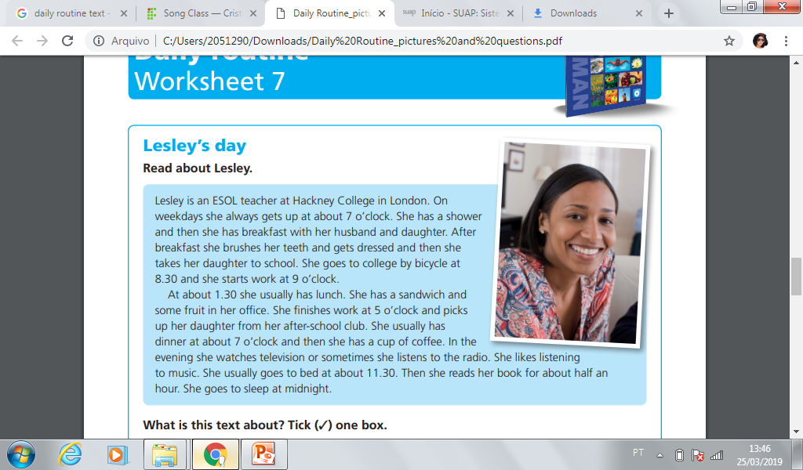

Slide 18
Check Yourself
Double click on the sites
http://www.homepages.ihug.com.au/%7Eadelegc/grammar/present_simple/pres_simple3.html
http://www.homepages.ihug.com.au/%7Eadelegc/grammar/present_simple/pres_simple4.html
http://www.agendaweb.org/verb.htm

