Slide 1
Anderson

Slide 2

Lucas Lira
Name: Lucas Lira Soares.
Nation: Brazilian.
Birth: April 16, 1994.
Age: 24 years old.
Profession/Ocupation: Youtuber.
Marital status: Dating to Sunaika Bruna.
Children's: None.
Extra information: He has a dog named slinky.

Slide 3
Victor Danilo

Slide 4
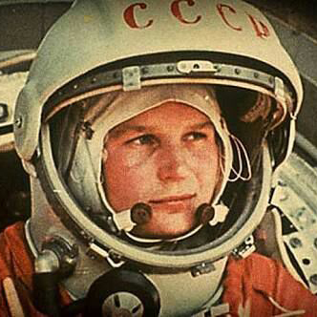
Gagarin
Name: Yuri Alekseievitch Gagarin.
Nation: Soviet Union.
Birth: March 9th, 1934.
Died: March 27th, 1968.
Age: 34 years old.
Profession/Ocupation: Military, Cosmonaut.
Marital status: Married with Valentina Ivanovna Goryacheva.
Children's: Yelena and Galina Yurievna Gagarina.
Extra information: He was the first man who traveled through space, on April 12, 1961, a board of Vostok 1.

Slide 5
Fernanda

Slide 6
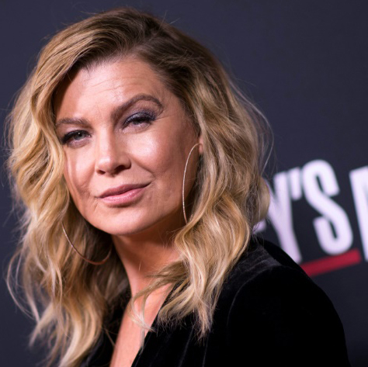
Ellen Pompeo
Name: Ellen Pompeo.
Nation: North American.
Birth: November 10, 1969.
Age: 49 years old.
Profession/Ocupation: Actress, director
and producer.
Marital status: Is married to Chris Ivery.
Children’s: Stella Luna, Sienna May and Eli Christopher.
Extra information: Protagonist of the Gray's Anatomy series, was nominated for the Drama Act tv category with the character of Meredith Gray, and won in 2016 the award of the people's choice awards as a favorite drama actress.

Slide 7
Thamara

Slide 8
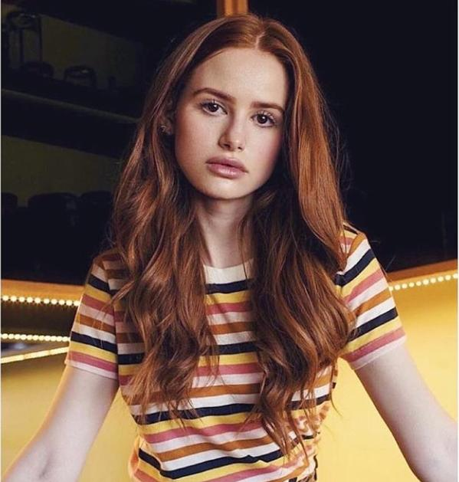
Madelaine
Name: Madelaine Petsch.
Nation: Washington, north- American.
Birth: August 18th, 1994.
Age: 25 years old.
Profession/Ocupation: Actress.
Marital status: Girlfriend of Travis Mills.
Children’s: None.
Extra information: She is an actress best known for playing Cheryl Blossom on Riverdale's The CW.

Slide 9
Maria clara

Slide 10
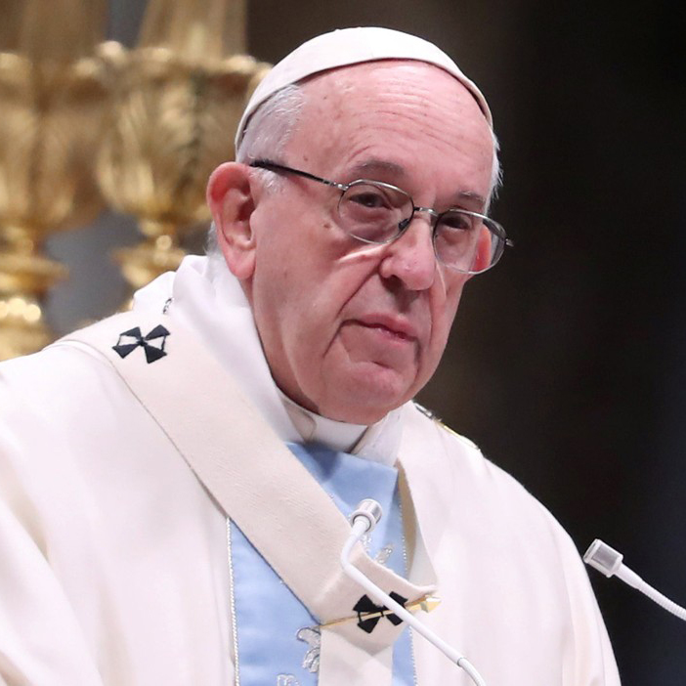
Papa Francisco
Name: Jorge Mario Bergoglio.
Nation: Argentine.
Birth: December 17th, 1932.
Age: 82 years old.
Profession/Ocupation: Bishop, Archbishop and Pope.
Marital status: Single.
Children’s: None.
Extra information: Son of Mario Bergoglio and Regina Maria.

Slide 11
Ana Alice

Slide 12
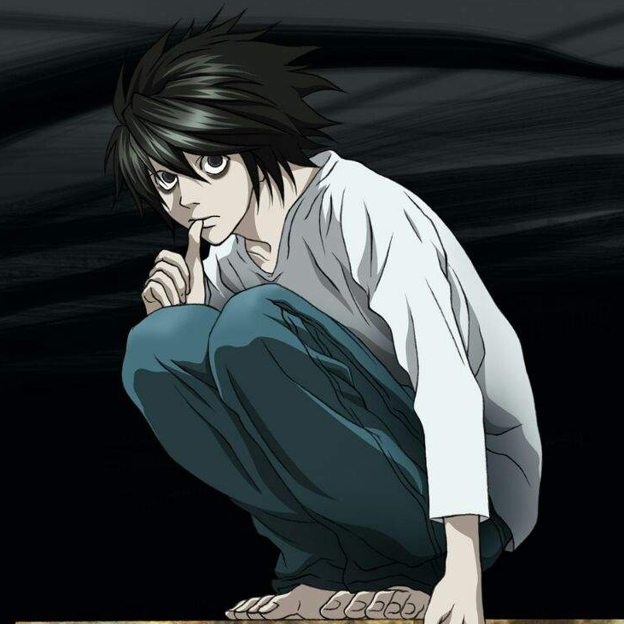
Lawliet
Name: Lawliet.
Nation: England.
Birth: October, 31th.
Age: 24 years old.
Profession/Ocupation: Private International Detective.
Marital status: Single
Children’s: None.
Extra information: I was killed by a serial killer named Kira by a heart attack.

Slide 13
Andriel

Slide 14

Light Yagami
Name: Light Yagami.
Nation: Japan, Japanese.
Birth: February 28th, 1986.
Died: January 28th, 2010.
Age: 23 years old.
Profession/Ocupation: Detective and Kira.
Marital status: Was dating Misa Amane.
Children’s: None.
Extra information: Light had a "distorted" desire to become god, or somehow "divine," he had a genuine love for his family and a good intention to make the world "a better place."

Slide 15
André

Slide 16
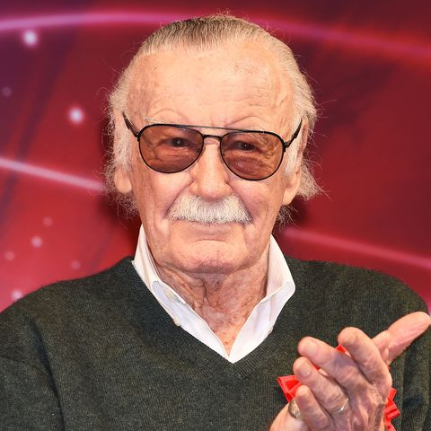
Stan Lee
Name: Stanley Martin Lieber.
Nation: United States of America.
Birth: December 28th, 1922.
Died: November 12th, 2018.
Age: 95 years old.
Profession/Ocupation: Comic book writer, editor,
publisher, producer.
Marital status: Widower.
Children’s: Two.
Extra information: In collaboration with others at Marvel, he co-created numerous popular fictional characters, including superheroes, like Spider-Man, the X-Men and Iron Man, for example.

Slide 17
Felipe Martins

Slide 18
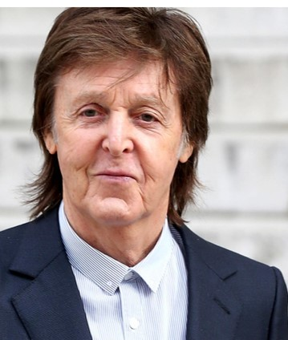
Paul McCartney
Name: Paul McCartney.
Nation: England.
Birth: June 18th, 1942.
Age: 76 years old.
Profession/Ocupation: Singer, song-writter
and film producer.
Marital status: Married to Nancy Shevell.
Children's: Mary, Stella, James, Heather and Beatrice.
Extra information: Paul McCartney was a member of The Beatles, his songwriting partnership with John Lennon remains the most successful in history.

Slide 19
Isabelle

Slide 20
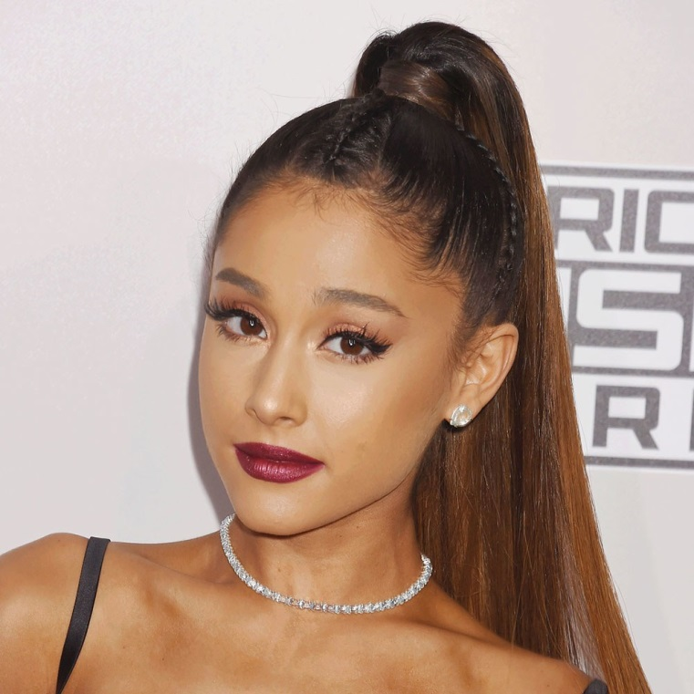
Ariana Grande
Name: Ariana Grande-Butera.
Nation: Boca Raton-Florida/United States.
Birth: June 26th, 1993.
Age: 25 years old.
Profession/Ocupation: American actress,
singer, songwriter and presenter.
Marital status: Single.
Children’s: None.
Extra information: Began his career in 2008; Also known as the princess of pop; Won a Grammy/Six nominations.

Slide 21
Manoel

Slide 22
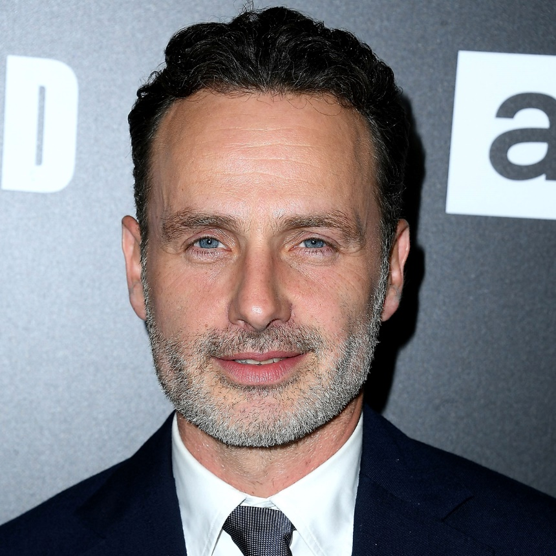
Andrew James
Name: Andrew James Clutterbuck.
Nation: United Kingdom.
Birth: September 14th,1973.
Age: 45 years old.
Profession/Ocupation: Actor.
Marital status: Married to Gael Anderson.
Children’s: Two.
Extra information: Without any information.

Slide 23
Maria Isabelle

Slide 24
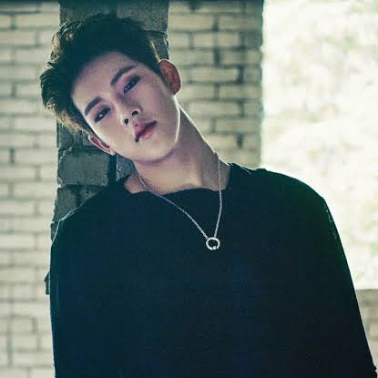
Jooheon
Name: Lee Hojoon.
Nation: South Korea.
Birth: October 6th, 1994.
Age: 24 years old.
Profession/Ocupation: Rapper, lyricist, songwriter,
arranger, producer.
Marital status: Single.
Children’s: None.
Extra information: He is a member of the South Korean male group Monsta X he is part of rap line. he participated in the fourth season of the rap competition Show me the money.he participated as co-lyricist in ten songs on the album The Clan Part 2.5 which reached the top position in the position of the Billboard World Records Album and second place in the Gaon Album Album in South Korea.

Slide 25
Gilliard

Slide 26

Felps
Name: Felipe.
Nation: Americana (SP), Brazilian.
Birth: June 5th, 1994.
Age: 24 years old.
Profession/Ocupation: Youtuber
and Streamer.
Marital status: Dating to Gabi.
Children’s: None.
Extra information: He’s very cute, but does’t accept.

Slide 27
Felipe de Azevedo

Slide 28
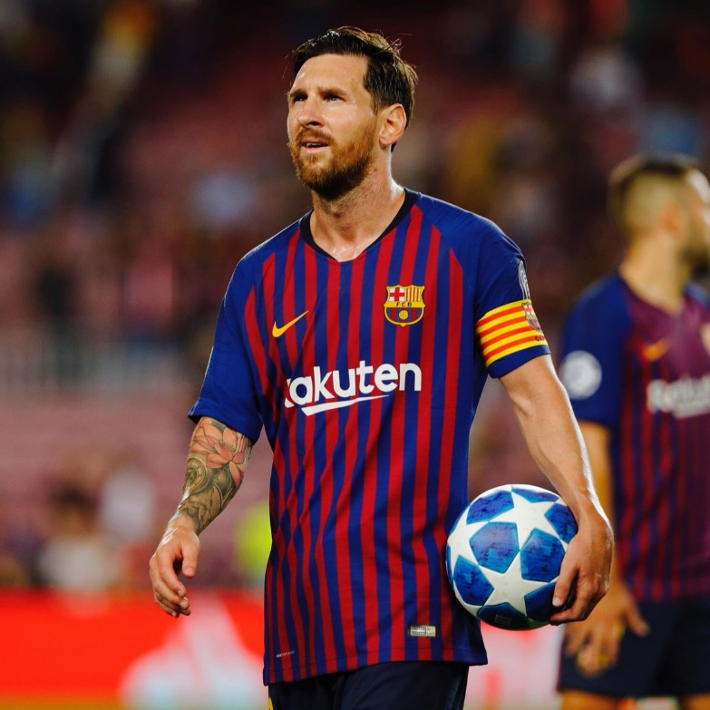
Messi
Name: Lionel Andres Messi.
Nation: Argentine.
Birth: June 24th, 1987.
Age: 31 years old.
Profession/Ocupation: Play soccer.
Marital status: Married to Antonella.
Children’s: Three.
Extra information: He has won 5 times the prize for best player in the world, plays for Barcelona, ​​where he has won several titles, where he is also the shirt 10 and the captain.

Slide 29
David

Slide 30
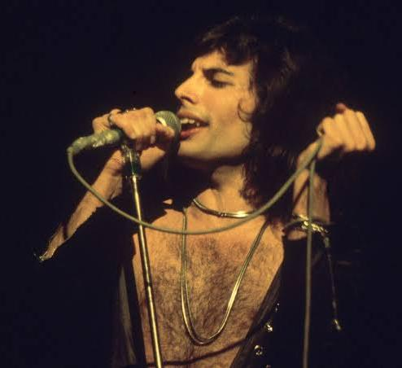
Freddie Mercury
Name: Freddie Mercury.
Nation: Tanzânia.
Birth: September 5th, 1946.
Died: November 24th, 1991.
Age: 45 years old.
Profession/Ocupation: : Komponist, Komponist,
Singer-Songwriter, Texter, Pianist, Organist,
Keyboarder.
Marital status: Without any information.
Children’s: Without any information.
Extra information: Farrokh Bulsara or as he is known Freddie Mercury has always been judged by his sexuality and never said anything to the respect.

Slide 31
David Gabriel

Slide 32
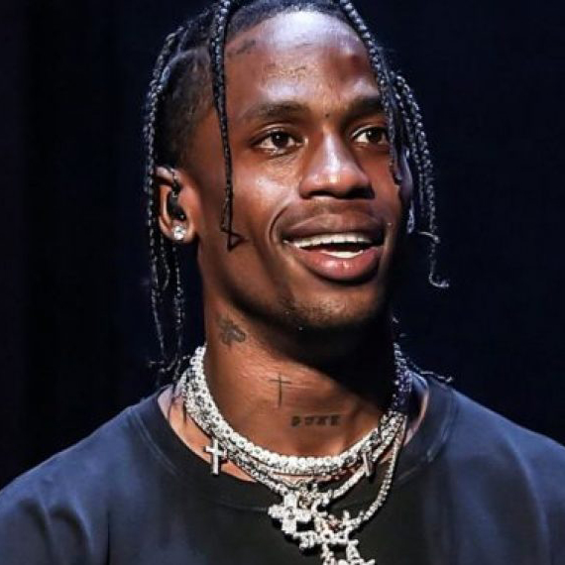
Travis Scott
Name: Jacques Berman Webster II .
Nation: American.
Birth: April 30th, 1991
Age: 27 years old.
Profession/Ocupation: Rapper, singer, songwriter
and music producer.
Marital status: Date with Kylie Jenner.
Children’s: Stormi Webster
Extra information: Jacques Webster was born in Houston, Texas. He grew up in Missouri City, a middle-class city on the southwest border of Houston. Scott lived with his grandmother, but later moved to the suburbs, where his father had a business of his own. He studied elementary school in a private school and graduated from high school at Elkins High School, a public school, at age seventeen.

Slide 33
Ana Caroline

Slide 34
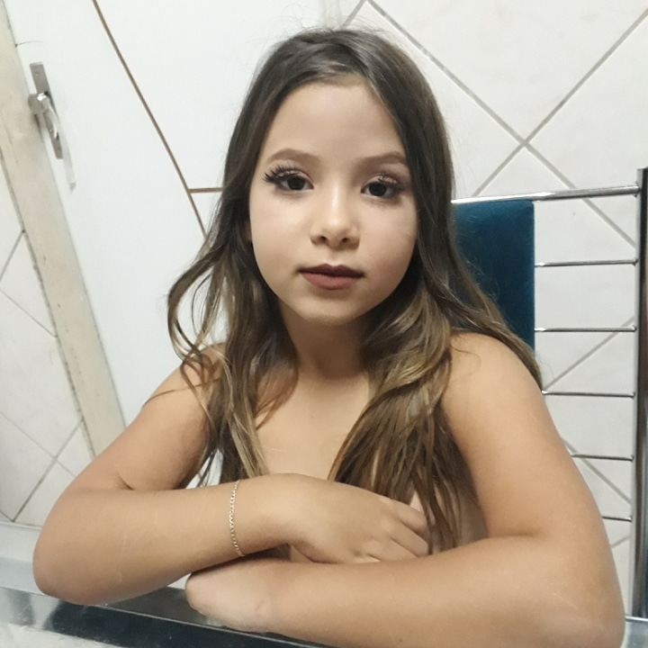
Raquel
Name: Anna Raquel.
Nation: Brazilian.
Birth: April 21th, 2012.
Age: 06 years old.
Profession/Ocupation: Student.
Marital status: Single.
Children’s: None.
Extra information: She is my sister.

Slide 35
Álvaro

Slide 36
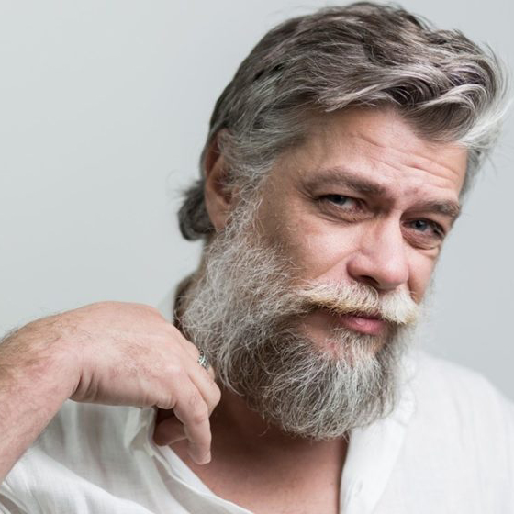
Fábio Assunção
Name: Fábio Assunção Pinto.
Nation: Brazilian.
Birth: August 10th, 1971.
Age: 47 years old.
Profession/Ocupation: Actor.
Marital status: Divorced.
Children’s: Three.
Extra information: Fábio Assunção is an actor and Brazilian theater director, widely known for his work on soap operas by Globo Network. He won several awards for his performance on television.

Slide 37
Mayane

Slide 38
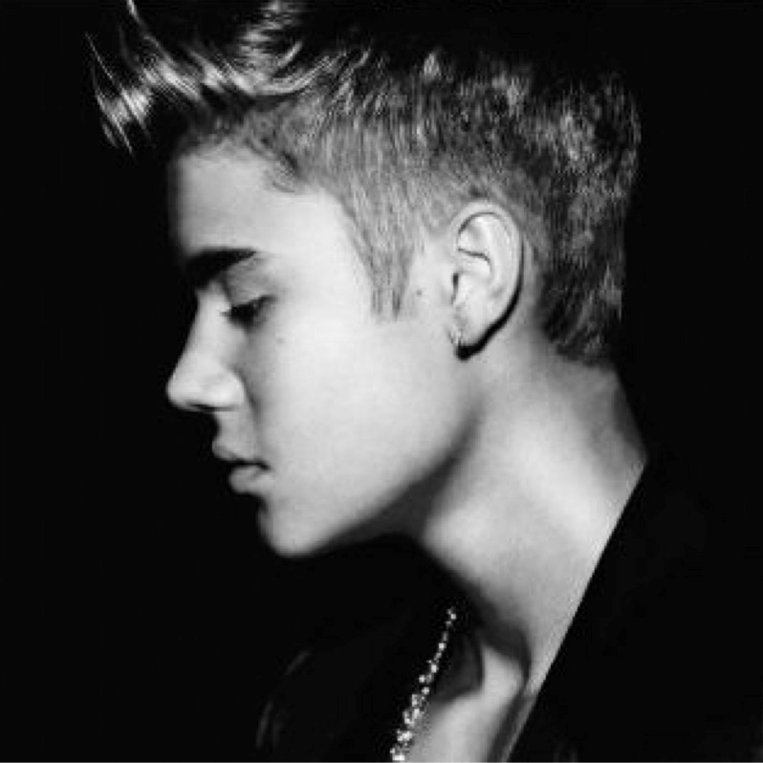
Justin Bieber
Name: Justin Drew Bieber
Nation: London, Canadá.
Birth: March 1st, 1994
Age: 25 years old.
Profession/Ocupation: Singer
Marital status: Engaged to Hailey Baldwin.
Children’s: None.
Extra information: I'm from the fish sign, I'm learned to sing whithout a music lesson.

Slide 39
Matheus

Slide 40
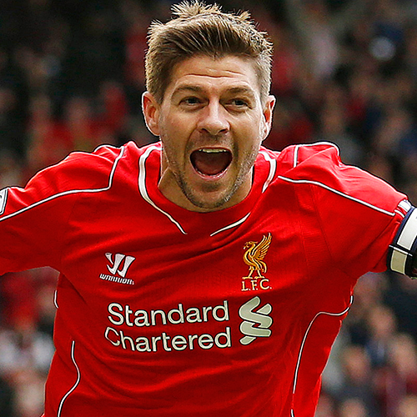
Gerrard
Name: Steven Gerrard.
Nation: England.
Birth: May 30th, 1980
Age: 38 years old.
Profession/Ocupation: Soccer coach
Marital status: Married to Alex Curran
Children’s: Four
Extra information: Before being a coach, Steven Gerrard was england's captain for 15 years, Liverpool, where he became the greatest idol in club history.

Slide 41
Ana Clara

Slide 42
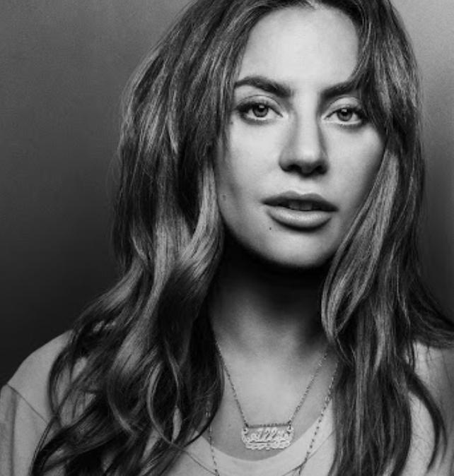
Lady Gaga
Name: Lady Gaga.
Nation: Nova Iorque, EUA.
Birth: March 28th, 1986.
Age: 32 years old.
Profession/Ocupation: Singer, actress,
songwriter and producer musician.
Marital status: Single.
Children’s: None.
Extra information: She was raped, suffered bullying to the point of being thrown in a trash can, was fired from her first record label, went through depression, and today she is the winner of 9 grammys, 2 gold globes and 1 Oscar.

Slide 43
Anthony (faltou)

Slide 44
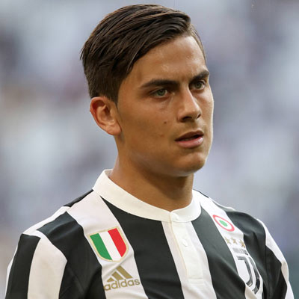
Dybala
Name: Paulo Bruno Dybala.
Nation: Argentine.
Birth: November 15th, 1993.
Age: 27 years old.
Profession/Ocupation: Football player.
Marital status: Married to Antonella Cavalieri.
Children’s: None.
Extra information: You have already won the following titles Italian League - Serie B: 2013, Italian League: 2015-16, 2016-17, 2017-18, Coppa Italia: 2015-16, 2016-17, 2017-18, Supercup of Italy: 2015, Superclassic of the Americas: 2017.

Slide 45
José felipe

Slide 46
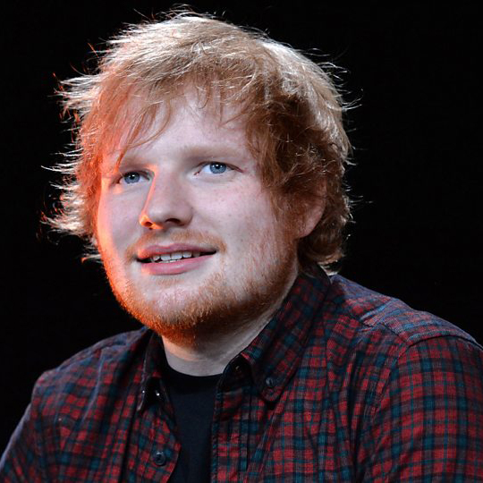
Ed Sheeran
Name: Edward Christopher Sheeran.
Nation: United Kingdom.
Birth: February 17th, 1991
Age: 28 years old.
Profession/Ocupation: Singer and
Composer.
Marital status: Married to Cherry Seaborn.
Children’s: None.
Extra information: His songs have already been used as soundtracks in several films, as in the case of How to Train Your Dragon 3 and Me Before You.

Slide 47
Maria Vitória Bruna

Slide 48
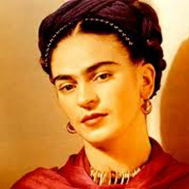
Magdalena Carmen
Name: Magdalena Carmen Frida Kahlo
Nation: Mexican.
Birth: July 6th ,1907.
Died: July 13th, 1954.
Age: 46 years old.
Profession/Ocupation: Painter.
Marital status: Divorced.
Children’s: None.
Extra information: She is an icon of feminism and fought for the rights of women until the end of her life.

Slide 49
Maria Vitória

Slide 50
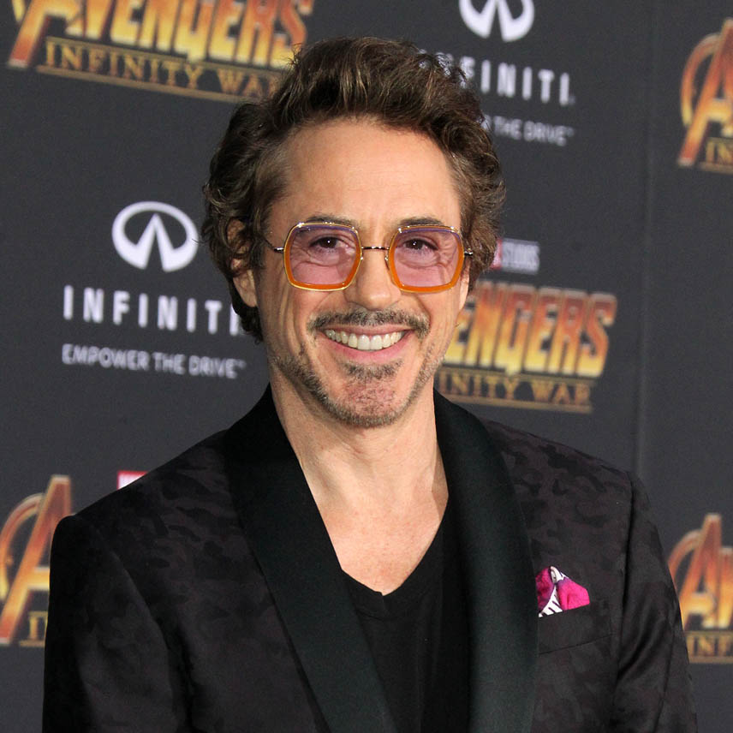
Robert Downey Jr.
Name: Robert John Downey Jr.
Nation: New Yorker, EUA.
Birth: April 4th, 1965.
Age: 53 years old.
Profession/Ocupation: Actor, singer,
songwriter and american pianist.
Marital status: Married to Susan Downey. Children’s: Three.
Extra information: He is the iron man and protagonist in the film series.

Slide 51
Camilly

Slide 52
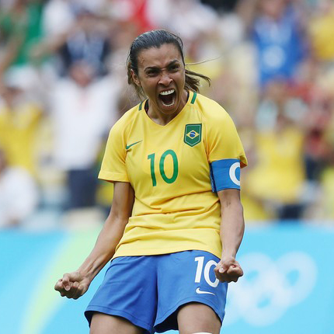
Marta
Name: Marta Vieira da Silva.
Nation: Brazilian.
Birth: February 19th, 1986.
Age: 33 years old.
Profession/Ocupation: Professional
footballer.
Marital status: Single.
Children’s: None.
Extra information: Best footballer in the world for six times.

Slide 53
Lázaro

Slide 54
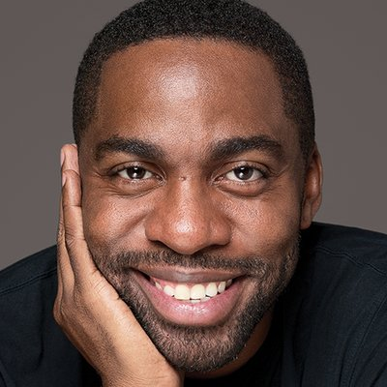
Lázaro Ramos
Name: Luís Làzaro Sacramento
Ramos.
Nation: Brazilian.
Birth: November 1th, 1978.
Age: 40 years old.
Profession/Ocupation: Actor.
Marital status: Married to Taís Araújo.
Children’s: Two.
Extra information: Emmy nomination for best actor.

Slide 55
Lívia

Slide 56

Pedrinho Pegação
Name: Pedrinho Pegação.
Nation: Brazilian.
Birth: July 11th, 1990.
Age: 28 years old.
Profession/Ocupation: Singer.
Marital status: Single.
Children’s: None.
Extra information: Without any information.

Slide 57
Yago

Slide 58
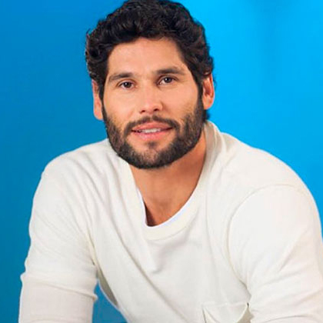
Dudu Azevedo
Name: Carlos Eduardo Cardoso
de Azevedo.
Nation: Brazilian.
Birth: November 7th, 1978.
Age: 40 years old.
Profession/Ocupation: Actor,
presenter e drummer.
Marital status: Spouse Fernanda Mader.
Children’s: None.
Extra information: Currently Works And plays Jesus, in The soap opera If The same name.

Slide 59
Marcos

Slide 60
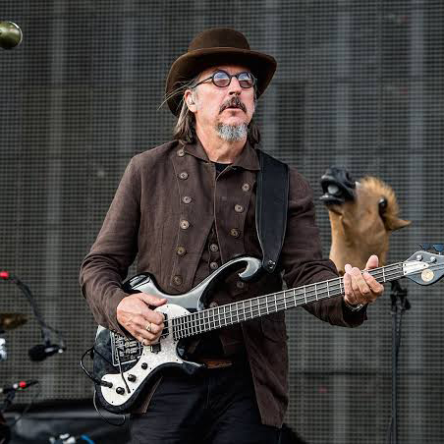
Leslie Edward
Name: Leslie Edward "Les" Claypool.
Nation: American.
Birth: September 20th, 1963.
Age: 55 years old.
Profession/Ocupation: Musician, singer,
songwriter, producer, author and director.
Marital status: Married to Cheney Claypool.
Children’s: Cage Oliver Claypool and Lena Tallulah Claypool.
Extra information: In 1986, after the death of Metallica bassist Cliff Burton, Hammett encouraged Claypool to audition for Metallica as Burton's successor.

Slide 61
Carlos Roberto

Slide 62
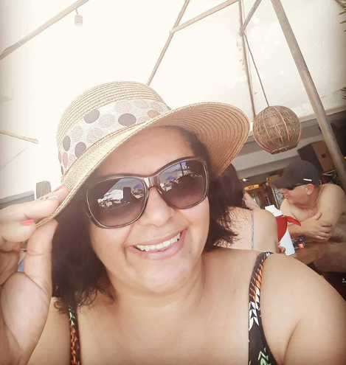
Cristiane
Name: Cristiane de Brito Cruz.
Nation: Brazilian.
Birth: Jun 21th, 1978.
Age: 40 years old.
Profession/Ocupation: English teacher.
Marital status: Single.
Children’s: None.
Extra information: The best IFRN English teacher.

Slide 63
Kauê

Slide 64
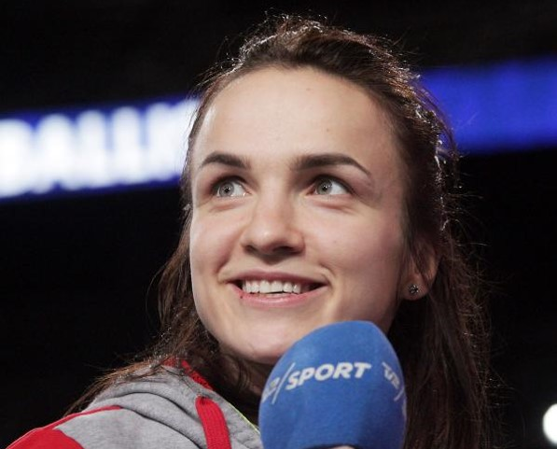
Vyakhireva
Name: Anna Viktorovna Vyakhireva.
Nation: Russian.
Birth: March 13th, 1995.
Age: 23 years old.
Profession/Ocupation: Professional
handball player.
Marital status: Single.
Children’s: None.
Extra information: She started playing handball at her sister's training sessions at the age of six. Anna's older sister is Polina, 2007 world champion and a member of the All-Star team at the 2012 European Women's Handball Championship.

Slide 65
Sidney

Slide 66

Edward Joseph
Name: Edward Joseph snowden
Nation: American.
Birth: July 21ft, 1983.
Age: 35 years old.
Profession/Ocupation: Systems analyst,
former CIA systems administrator and former NSA contractor.
Marital status: Single.
Children’s: None.
Extra information: Leaked details of the US spy program and took refuge in Russia.

Slide 67
Jeremias

Slide 68
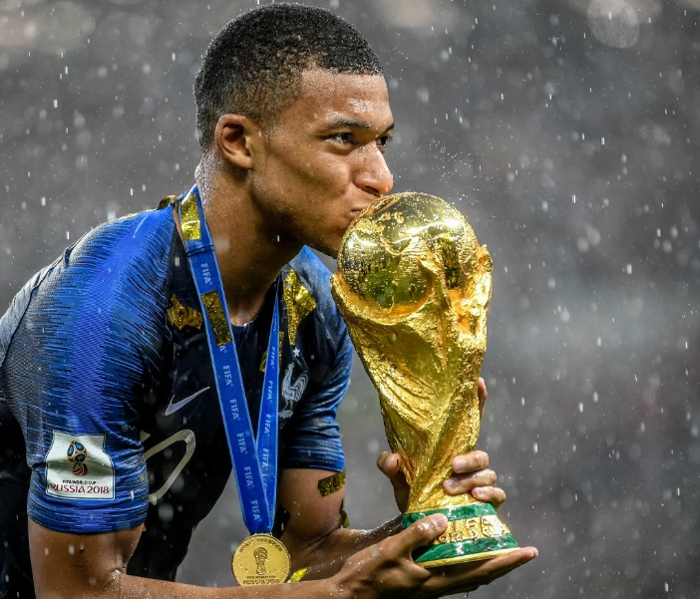
Mbappé
Name: Kylian Mbappé.
Nation: France.
Birth: December 20th, 1998.
Age: 20 years old.
Profession/Ocupation: Soccer Player.
Marital status: Single.
Children’s: None.
Extra information: He is the second youngest player in history to score a goal in a world cup final, second only to Pelé. And he is currently the most valuable soccer player in the world.

Slide 69
Charles

Slide 70

Mirio Togata
Name: Mirio Togata
Nation: Japanese.
Birth: July 15th, 2000.
Age: 18 years old.
Profession/Ocupation: Student Hero.
Marital status: Single.
Children’s: None.
Extra information: He is the man closest to be the number one hero including the pros.He has the ability of permeation (he can trespass anything and anything can trespass him).

Slide 71
Maria Caroline

Slide 72
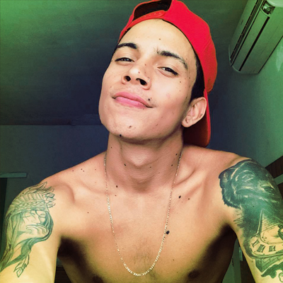
LORDELO
Name: Matheus Lordelo (Matheus Yurley)
Nationality: Brazilian
Birth: April,2nd in 1999
Age: 19 years old
Profession/Occupation: Youtuber,Singer and Songwriter
Marital Status: Married to Mariana Matarazzo
Children: Waiting for his first daughter (Maria Julia)
Extra Information: He started producing, vídeos im March 2015. In his you tube, channel,he publishes vídeos of vlogs, trolagens, tags and music.In October 2018, he lost his channel with more tham 7 million subscribers ,due to violation of the platform rules. He started another channel from the account of a fan club,which reached more than 1.5 million subscribers. Then managed to recover it’s old channel that now has reached almost 10 millon subscribers.

