Slide 1
Idioms - Memes
Docente:
CriStiane Cruz
Discentes:
Fernando José Alves dos Santos;
Grazielly Pereira Dantas Feitosa;
Viviane Aparecida Silva Soares Lima.

Slide 2
Phrasal Verbs:
- Put the wind up (alarmar ou assustar)/frase 18 (Weather);
- Run out of (ficar sem ou esgotar)/ frase 14 (Weather);
- Roll out (estender algo) / frase 32 (Colours);
- Take off (despir-se ou tirar uma peça de roupa, decolar, tirar uma folga, sair rapidamente e imitar. / Frase 5 (Clothes);
- Pull up (parar ou “encostar” um veículo; conseguir informações de um computador e puxar algo, geralmente para cima) / Frase 10 (Clothes).

Slide 3
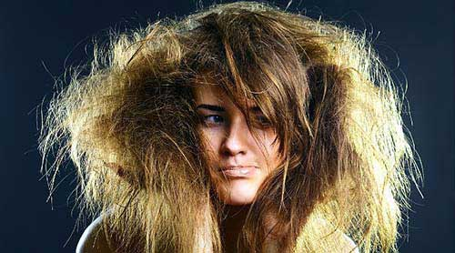
idioms and other expressions using animals
I'm not going out with you looking like that. You look like something that the cat dragged in! Brush your hair and put on some clean clothes! (to have a very dirty or untidy appearance)

Slide 4
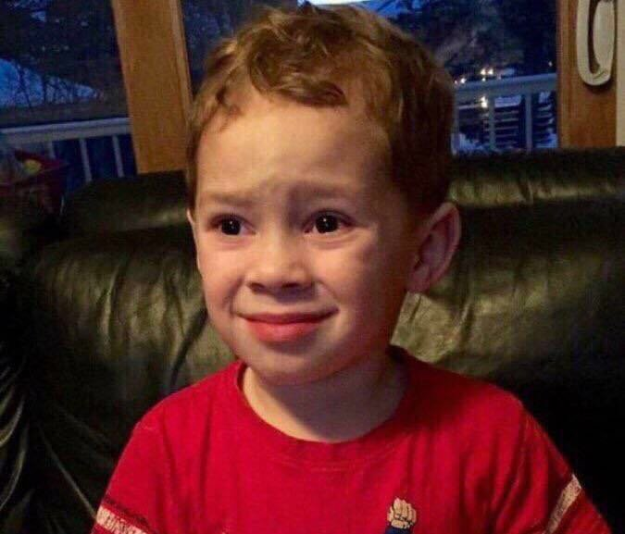
idioms and other expressions using animals
It really gets my goat, the way she keeps interrupting all the time. (to annoy someone)

Slide 5
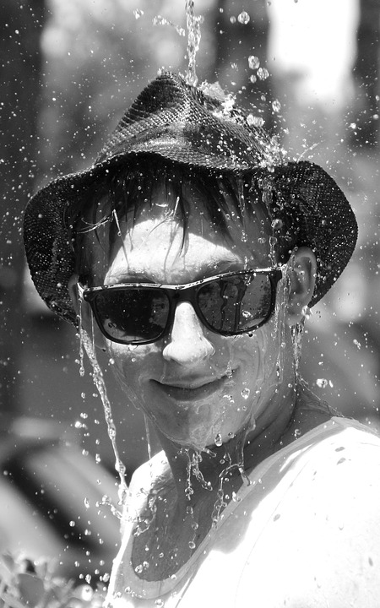
Where have you been? You're soaking wet! You look like a drowned rat! (looking very wet and cold)

Slide 6
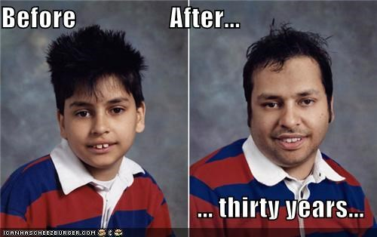
Tony! What a surprise! It's wonderful to see you again. I haven't seen you for donkey's years! (an extremely long time)

Slide 7
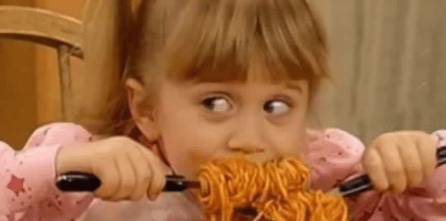
idioms and other expressions using animals
That's the third burger you've eaten. I wish you'd stop making such a pig of yourself. (to eat a lot of food)

Slide 8
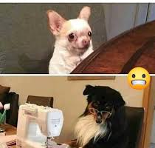
idioms and other expressions using clothes
Look, I'm sorry I lost your camera. Keep your shirt on. I'll buy you a new one, I promise.

Slide 9
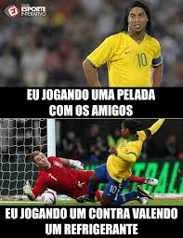
idioms and other expressions using clothes
Up until now the game has been quite friendly, but now the gloves are off!

Slide 10
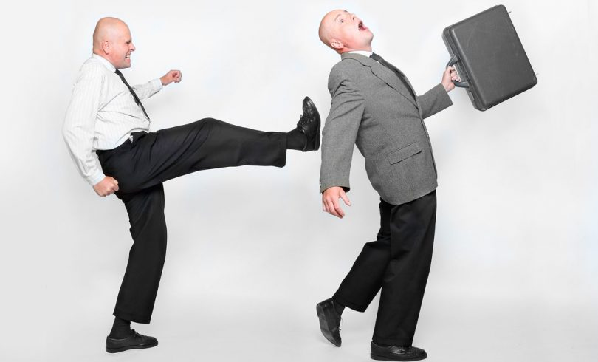
Poor old Bob was given the boot last week.

Slide 11
She told me that I was stupid and ugly, which I felt was a bit below the belt.

Slide 12
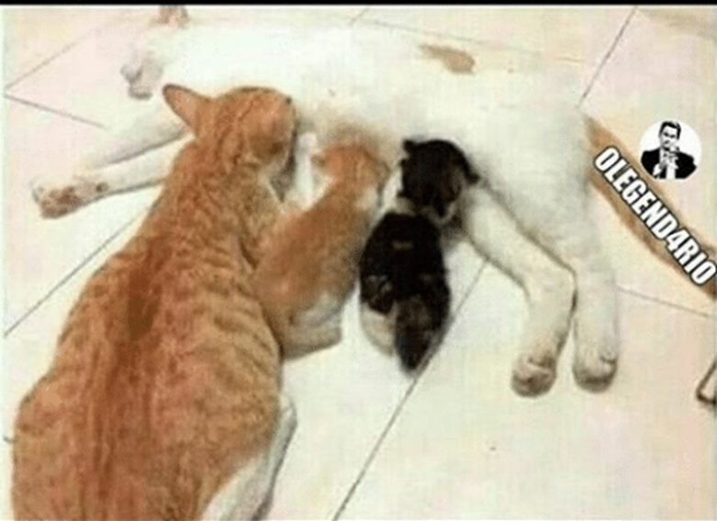
idioms and other expressions using clothes
Clarice is 25 years old, but she's still tied to her mother's Apron strings.

Slide 13

I hate applying for a new passport. There's so much red tape involved.

Slide 14
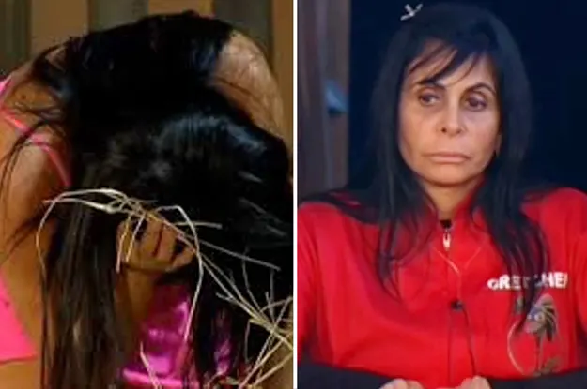
You can ask me to lend you money until you're blue in the face, but my answer is still 'No'.

Slide 15
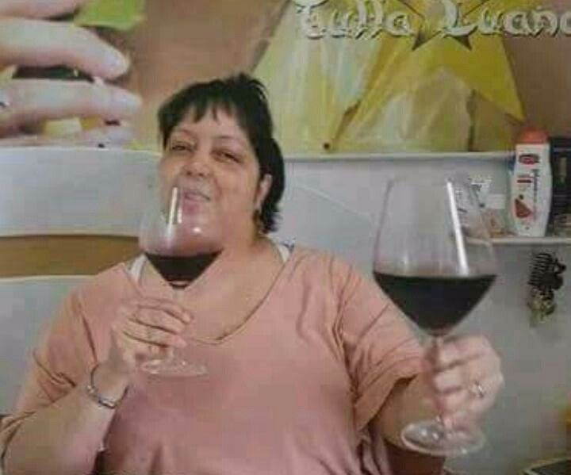
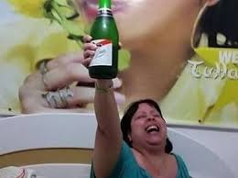
idioms and other expressions using colours
Everyone in my department is very happy because the project we've been working on for six months has finally been given the green light.

Slide 16
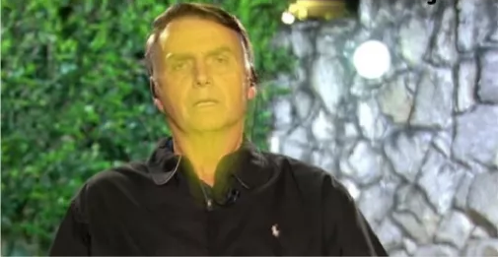
idioms and other expressions using colours
He would never argue with or contradict his boss. He's far too yellow.

Slide 17
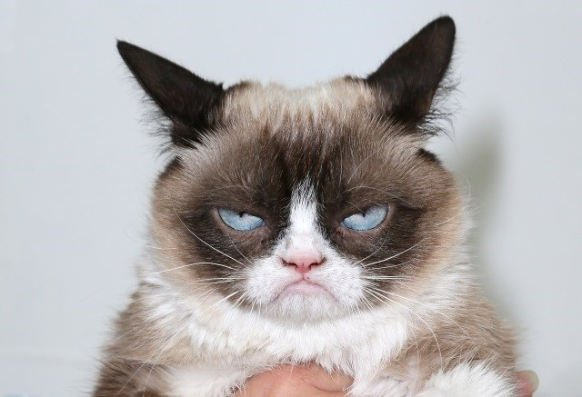
idioms and other expressions using colours
What's the matter with you? You've been in a black mood all evening.

Slide 18
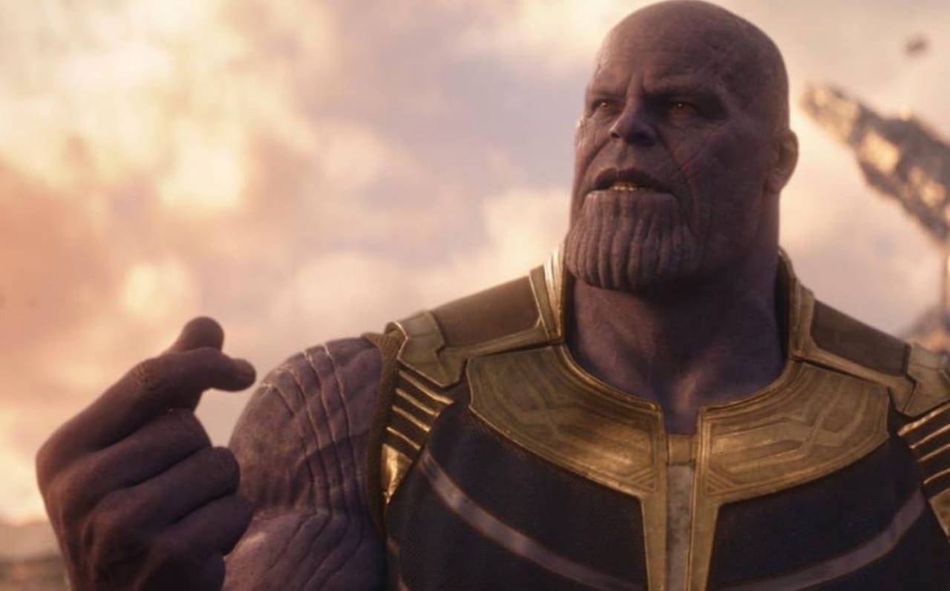
idioms and other expressions to talk about health, feelings and emotions
The Spider-man is at death's door.
Digite para inserir uma legenda.

Slide 19
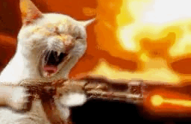
idioms and other expressions to talk about health, feelings and emotions
I already said i'm not het up.
Digite para inserir uma legenda.

Slide 20

idioms and other expressions to talk about health, feelings and emotions
Don't stress me that today i am hopping mad.

Slide 21
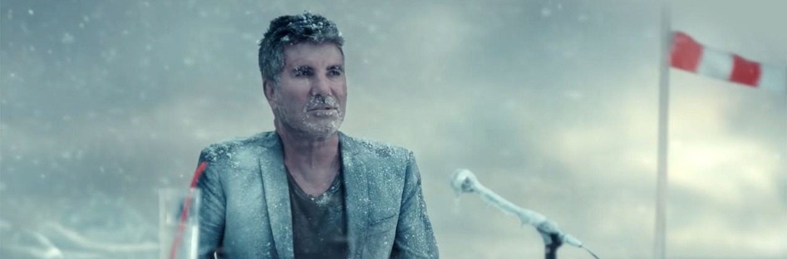
idioms and other expressions that use words connected with the weather
Me after arriving in a place with a lot of excitement but having a frosty reception:

Slide 22
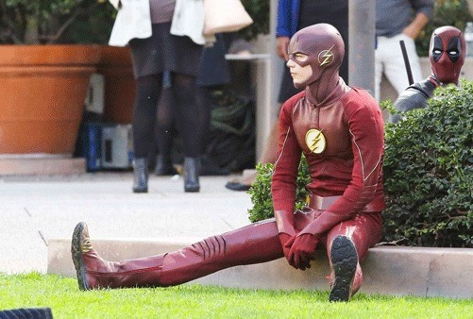
idioms and other expressions that use words connected with the weather
"run like the wind if you want to reach your goals"
me:

Slide 23
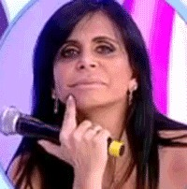
idioms and other expressions that use words connected with the weather
me sell the bitch i don't like to say it's pure as the driven snow:

