Slide 1
English Activity
Teacher:
► Cristiane de Brito Cruz Students:
► Alyson Santos
► Joalison Medeiros
► Rallyson Garcia

Slide 2
Idioms Using Animals

Slide 3
IT REALLY GETS MY GOAT, THE WAY SHE KEEPS INTERRUPTING ALL THE TIME.

Slide 4
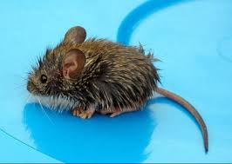
WHERE HAVE YOU BEEN? YOU'RE SOAKING WET! YOU LOOK LIKE A DROWNED RAT!

Slide 5
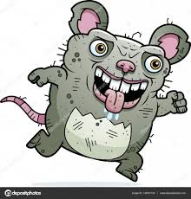
I DON'T TRUST ERIC WHEN HE SAYS HE'S WORKING LATE AT THE OFFICE. TO BE HONEST, I SMELL A RAT.

Slide 6
Idioms Using Clothes

Slide 7
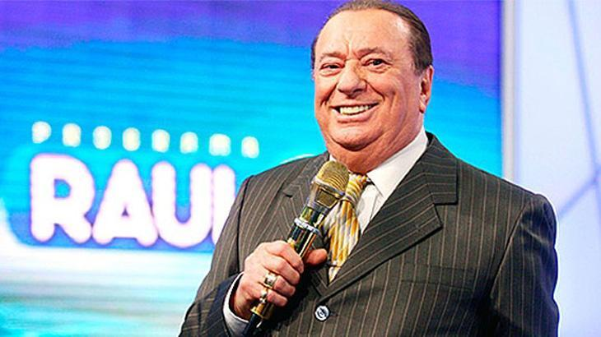
YOU'VE DONE REALLY WELL. I TAKE MY HAT OFF TO YOU.

Slide 8
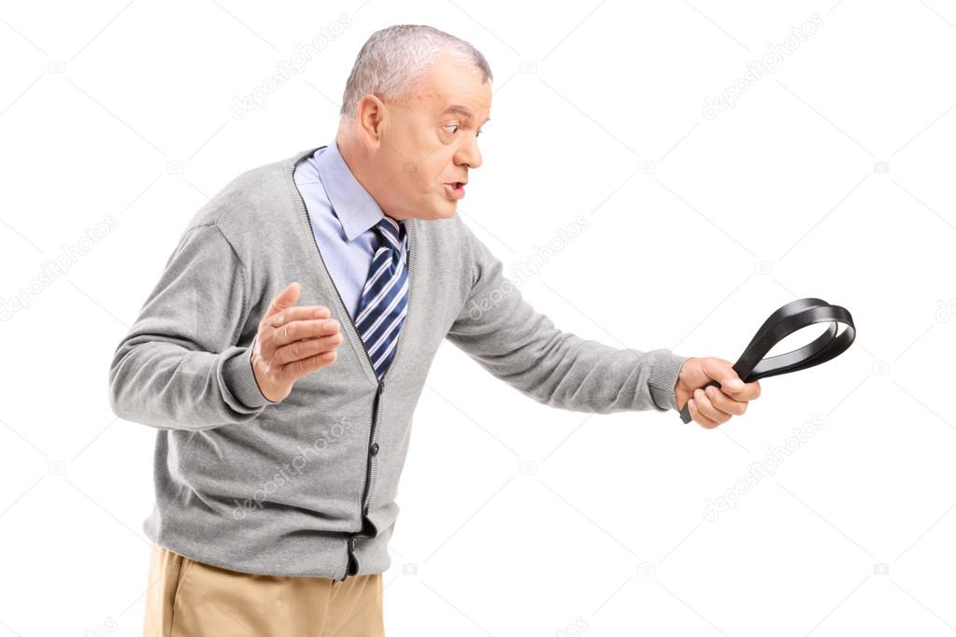
POOR OLD BOB WAS GIVEN THE BELT LAST WEEK.

Slide 9
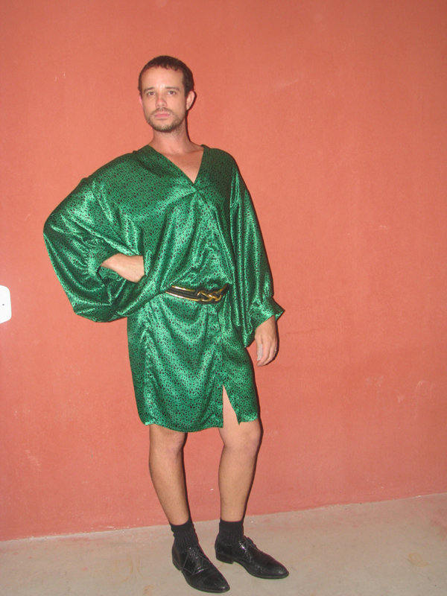
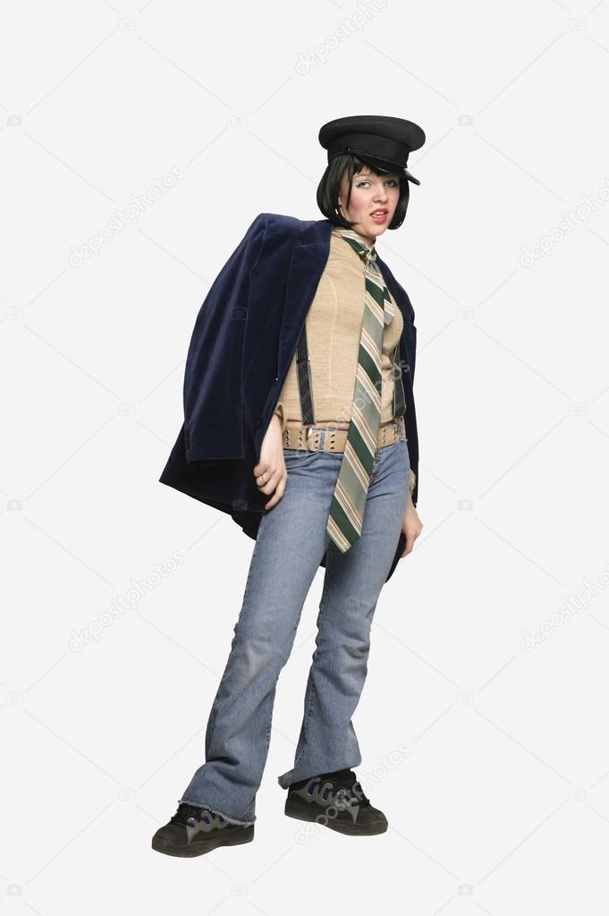
MY FATHER USED TO PRETEND THAT HE MADE ALL THE MAJOR DECISIONS IN OUR FAMILY, BUT IT WAS REALLY MY MOTHER WHO WORE THE TROUSERS.

Slide 10
Idioms Using Weather

Slide 11
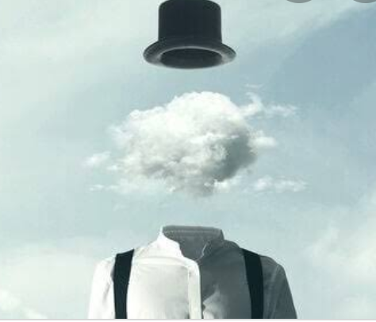
MY MIND IS IN A FOG

Slide 12
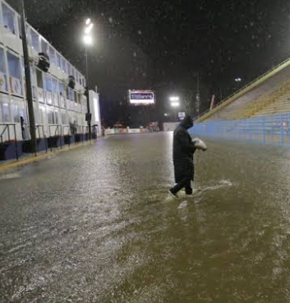
YOU RAINED ON HER PARADE

Slide 13
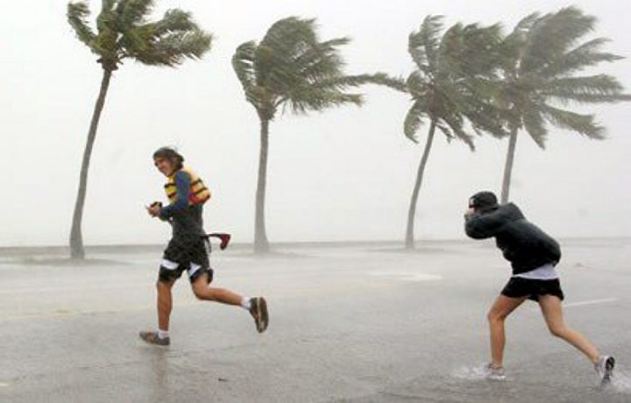
YOU WIIL HAVE TO RUN LIKE THE WIND

Slide 14
Idioms Using Colours

Slide 15
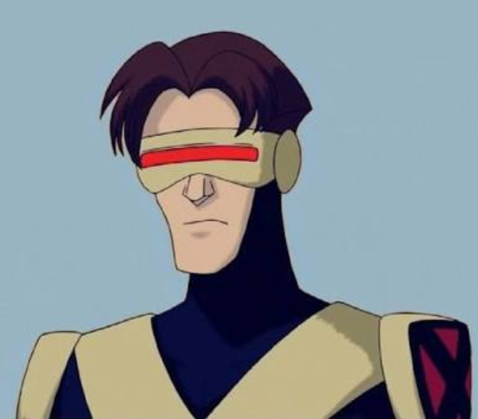
WHEN I´M ANGRY I START TO SEE EVERRYNTHING
RED

Slide 16
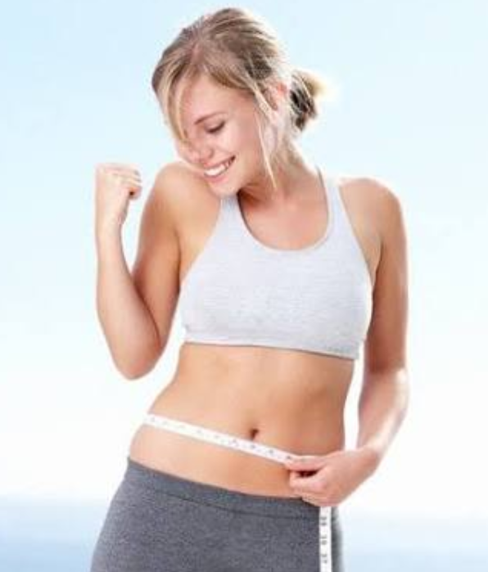
THE BEST WAY TO STAY IN THE PINK IS TO EAT
SENSIBLY, TAKE REGULAR EXERCISE, DRINK IN
MODERATION NAD NOT SMOKE

Slide 17
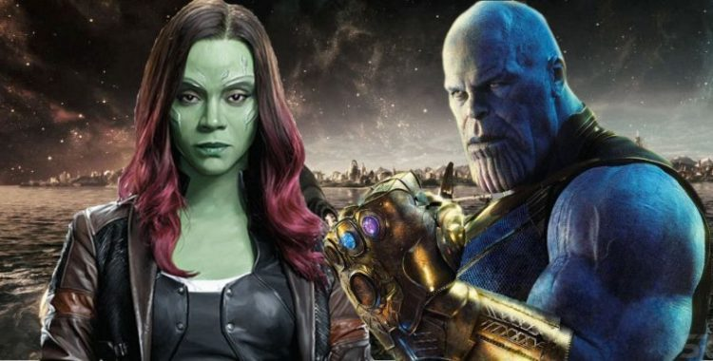
WHEN I SAY I´M NOT ENVY GREEN

Slide 18
Idioms Using Emotions

Slide 19
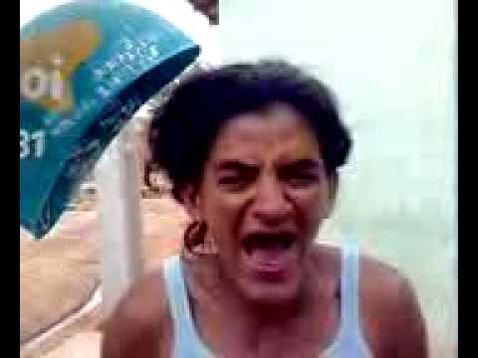
AMANDA IS AT HER WITS' END

Slide 20
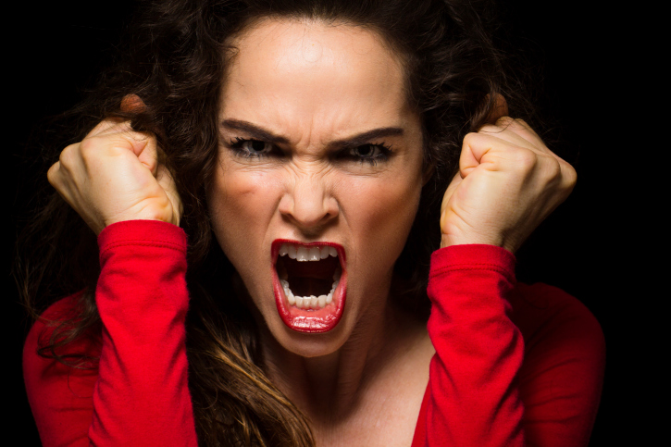
BELINDA IS IN A BLACK MOOD

Slide 21
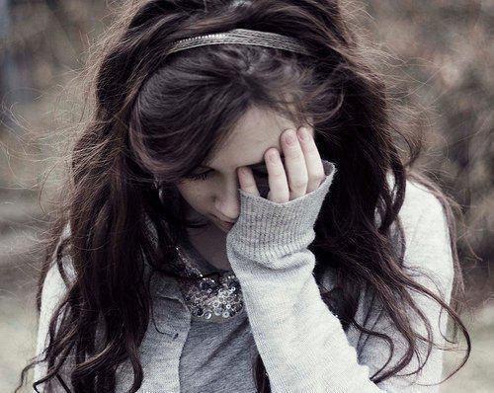
FELICITY IS FEELING BLUE

Slide 22
Phrsal Verbs

Slide 23
I don't think I can go on working for her much longer.
"Do you think we should employ more staff?" "I'm not sure. Let's see which way wind up in the next few weeks".
Brush your hair and put on some clean clothes!
Camilla has come down with something.
When I told Sara that I wanted to go out for a drink with my ex-girlfriend, she didn't say anything

