Slide 1
IDIOMS AND PHRASAL VERBS
Disciplina: Inglês II – Professora: Christiane
Componentes: Aysha Joyce, Ana Gabrielle, Isabelly Cristina e Maria Beatriz.

Slide 2
Idioms about Animals

Slide 3
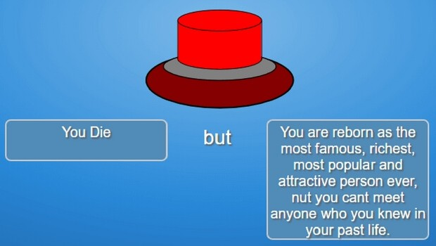
KILL TWO BIRDS WITH ONE STONE
Meaning: to achieve two aims with one action.

Slide 4
LIKE A DOG WITH TWO TAILS
Meaning: to be very happy because something good has happened.

Slide 5
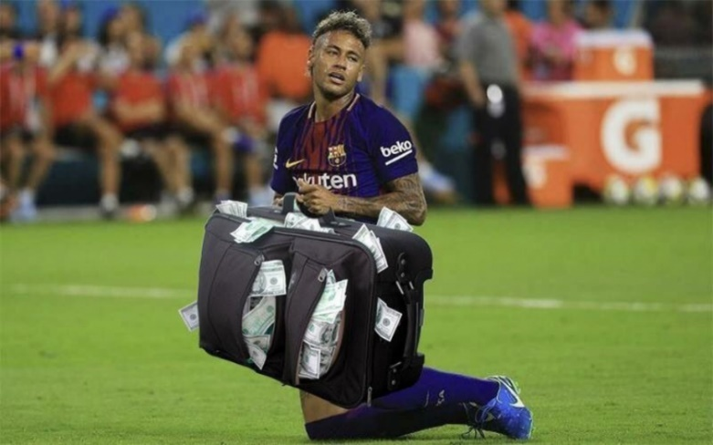
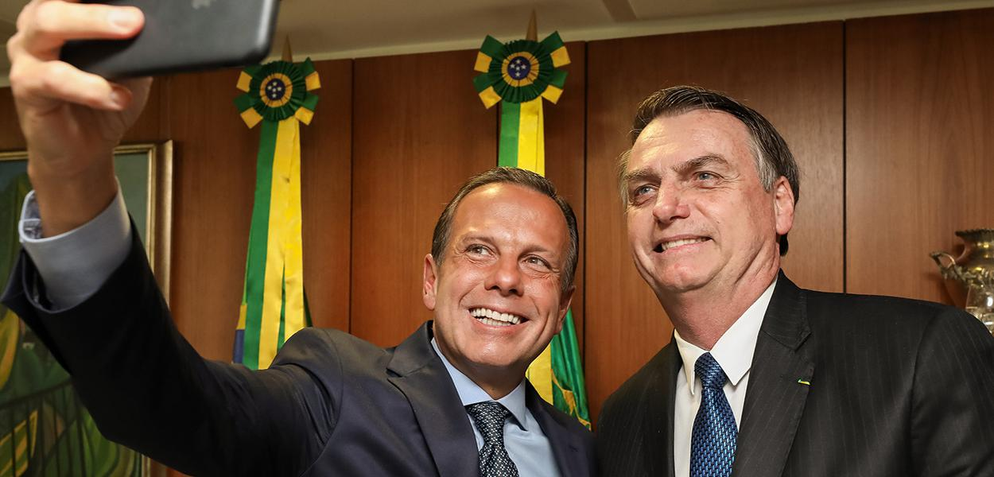
FAT CATS
Meaning: people who receive too much money for the job they do.

Slide 6
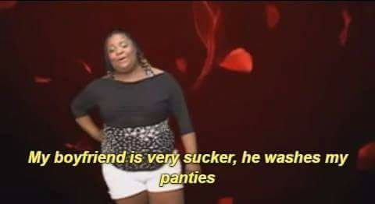
HENPECKED
Meaning: criticised and given orders all the time by a wife or female partner.

Slide 7
GONE TO THE DOGS
Meaning: not as good as it was in the past.

Slide 8
Idioms about Clothes

Slide 9
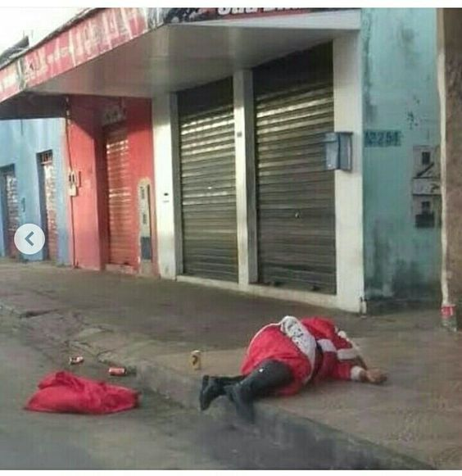
A BIG GIRL’S BLOUSE
Meaning: refers to someone what is weak na lacking strength of character.

Slide 10
TAKE MY HAT OFF YOU
Meaning: you admire them for something tath they have done.

Slide 11
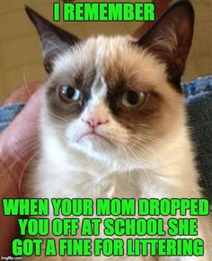
BELOW THE BELT
Meaning: is cruel and unfair.

Slide 12
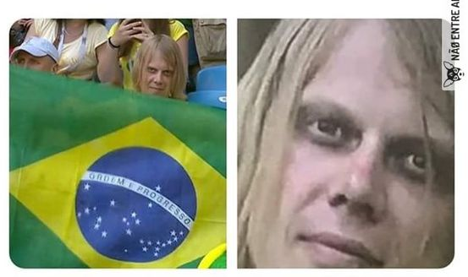
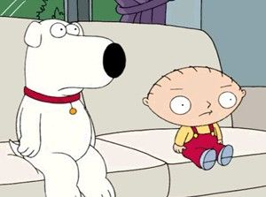
CLOAK-AND-DAGGER
Meaning: involves mystery and secrecy.

Slide 13
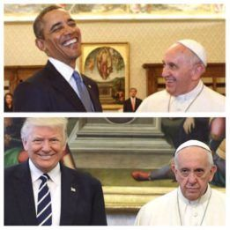
IN MY SHOES
Meaning: is to be in the same situation.

Slide 14
Idioms about colors

Slide 15
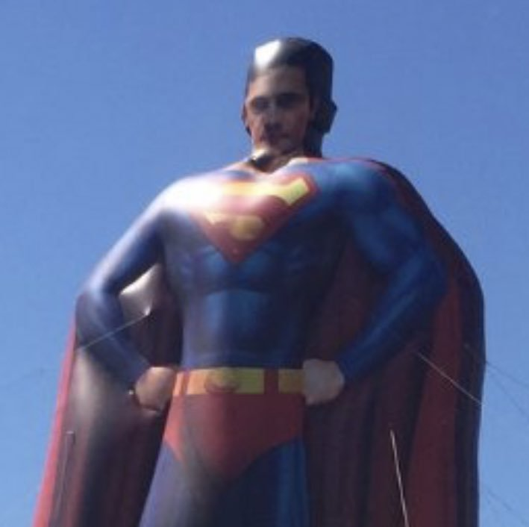
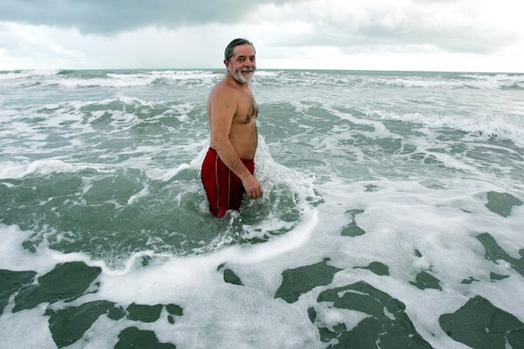
“BE” IN THE PINK
Meaning: to be in very good health or condition.

Slide 16
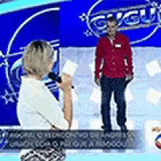
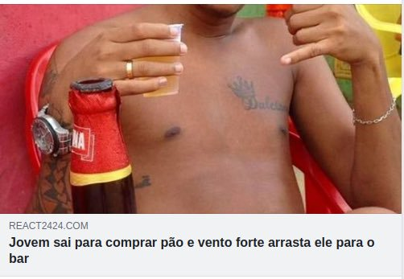
OUT OF THE BLUE
Meaning: an event that occurs unexpectedly.

Slide 17
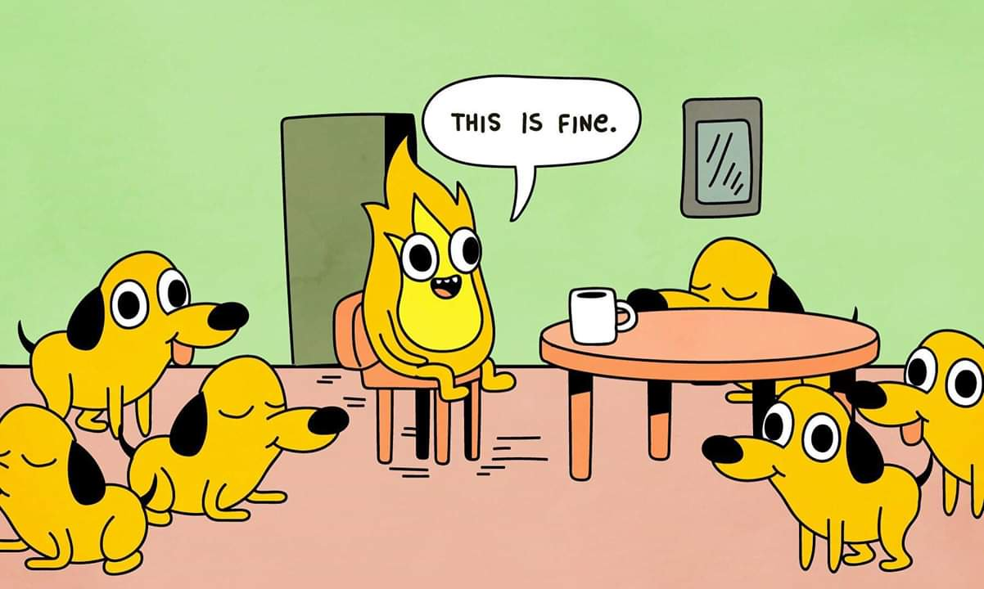
TO BE YELLOW
Meaning: to have no courage.

Slide 18
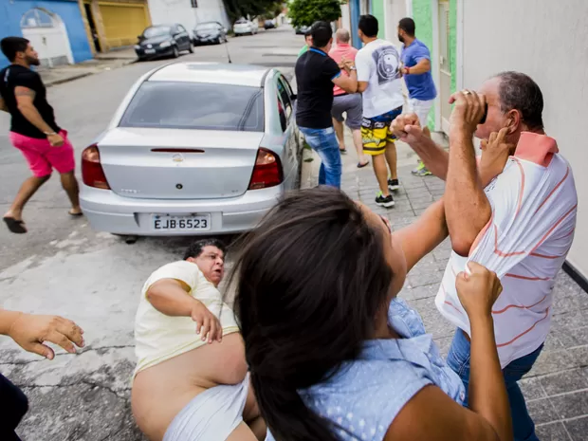
IN (SOMEONE'S) BLACK BOOKS
Meaning: to be in trouble with someone.

Slide 19
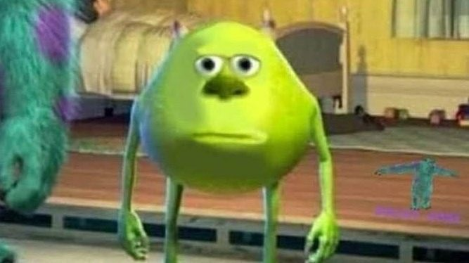
BLACK LOOK
Meaning: an expression on your face that is full of anger and hate.

Slide 20
PHRASAL VEBS
Come out – “The clouds finally parted and the sun came out.”
Run away – “When I was 13, I ran away from home.”

Slide 21
Idioms about health, feelings and emotions

Slide 22
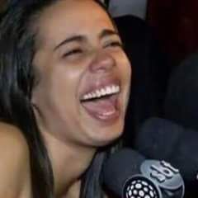
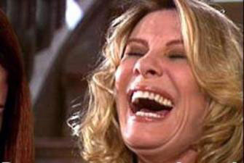
ON TOP OF THE WORLD
Meaning: to be extremely happy.

Slide 23
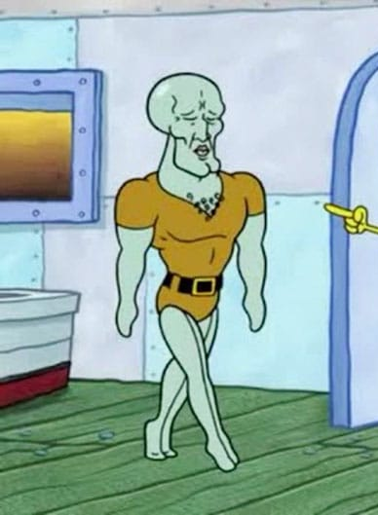
AS FIT AS A FIDDLE
Meaning: to be very healthy and strong.

Slide 24
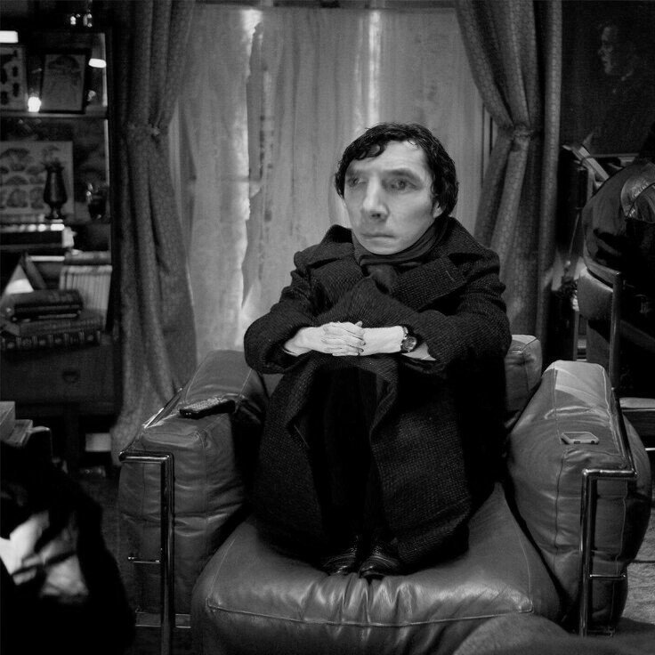
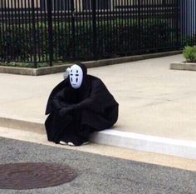
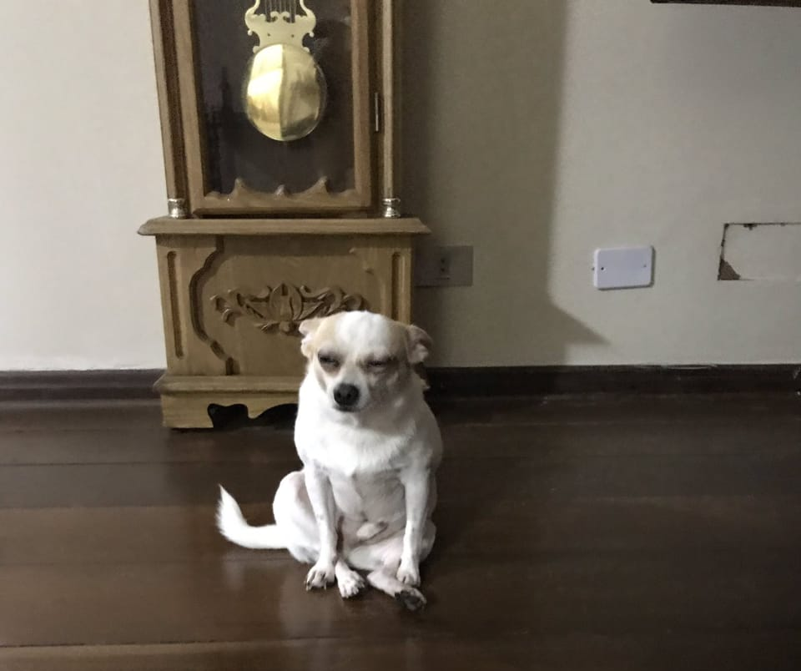
WASHED OUT
Meaning: to be tired or exhausted.

Slide 25
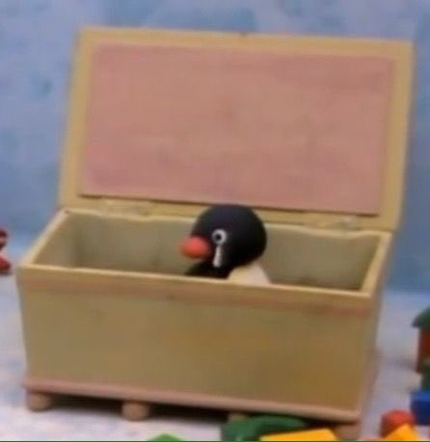
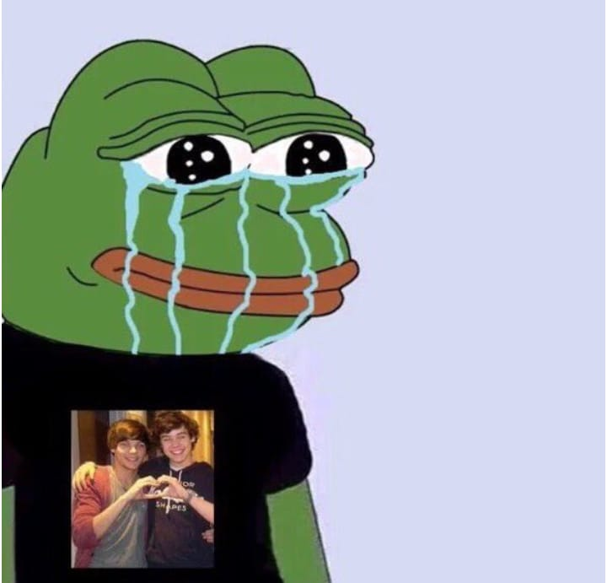
FEELING BLUE
Meaning: to feel sad.

Slide 26
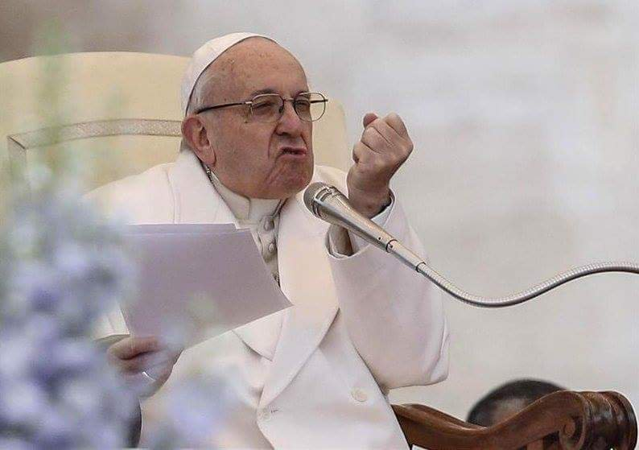
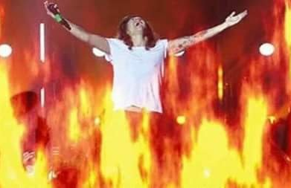
HOPPING MAD
Meaning: to be extremely angry.

Slide 27
PHRASAL VERBS
Wash out – “That stain will easily wash out.”
Run down – “The battery has run down.”
Warm up – “He blew on hid hands to warm them up.”

Slide 28
Idioms that use words connected with the weather

Slide 29
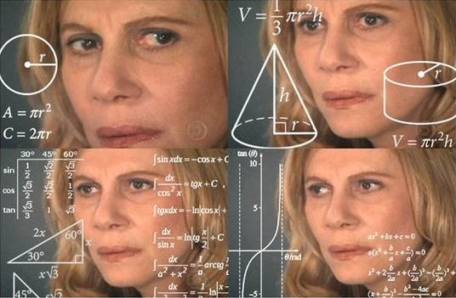
MY MIND IS IN A FOG
Meaning: the speaker can’t think clearly.

Slide 30
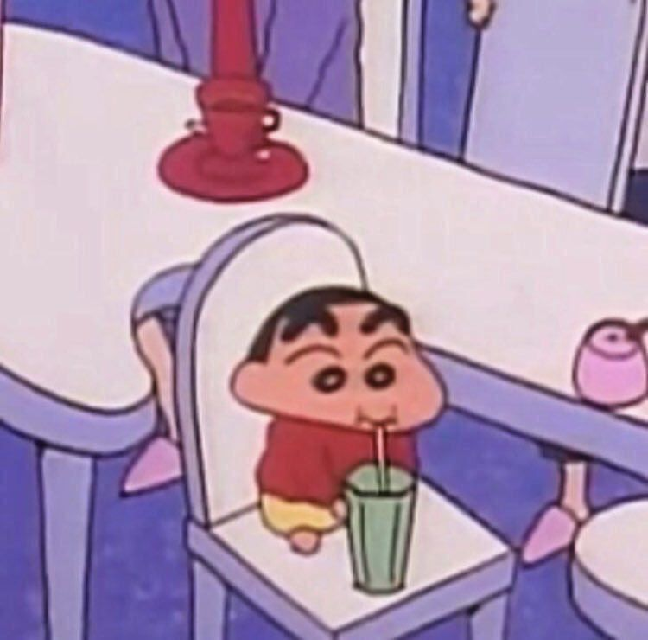
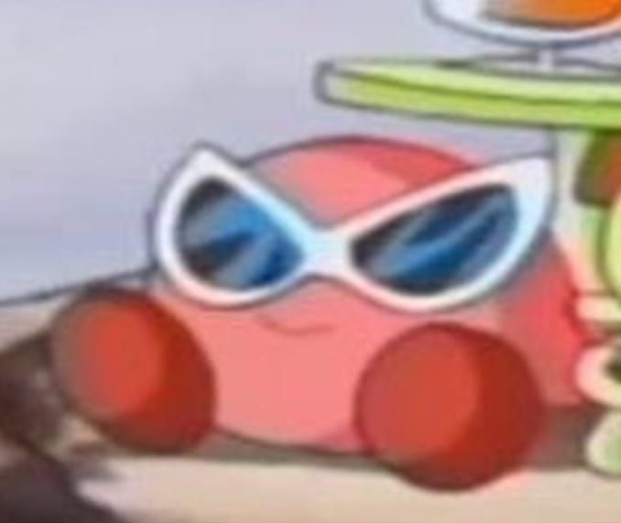
RIGHT AS RAIN
Meaning: feeling well.

Slide 31
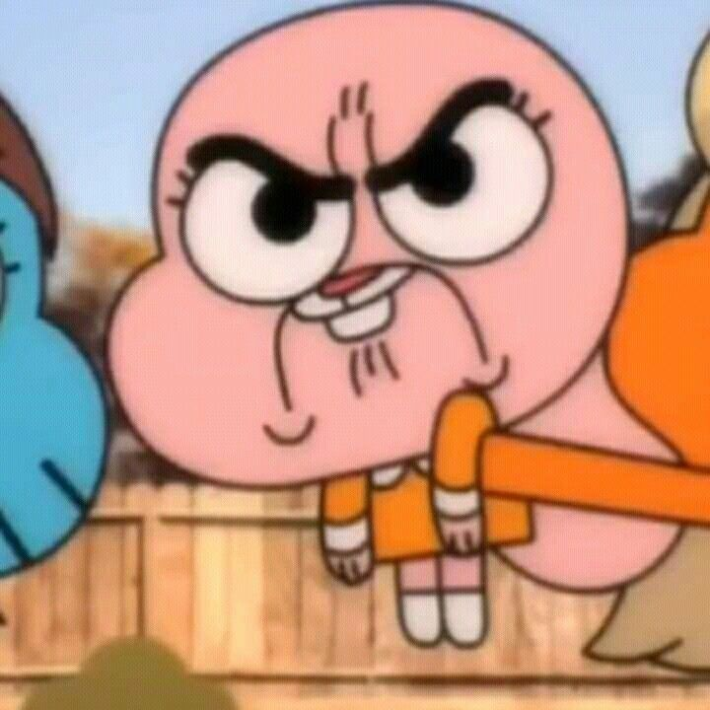
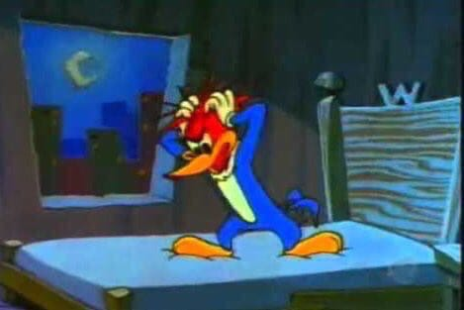
GOT THE RED MIST
Meaning: became extremely angry.

Slide 32
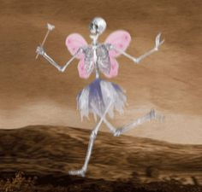
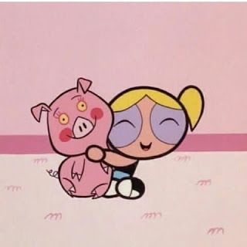
HAS A REALLY SUNNY DISPOSITION
Meaning: very happy, cheerful, friendly, etc.

Slide 33
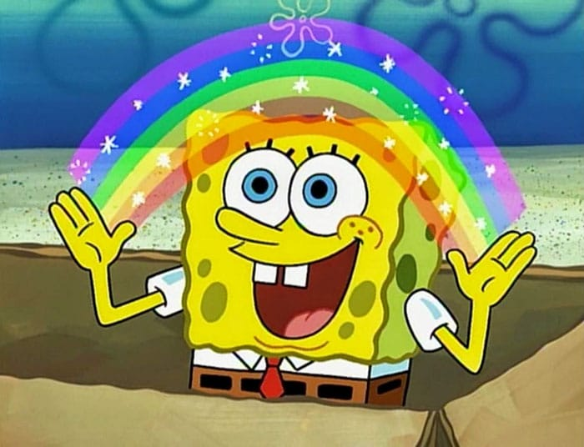
ON CLOUD NINE
meaning: to be extremely happy.

Slide 34
PHRASAL VERBS
Go to – “I was just going to sleep when the phone rang.”
Go for – “What I said about Peter goes for you, too.”
Take to – “The birds took to the air before the cat reached them.”

