Slide 1

Idioms and phrasal verbs
Components:
Carlos Daniel
Débora Ellem
Vinicius Gabriel

Slide 2
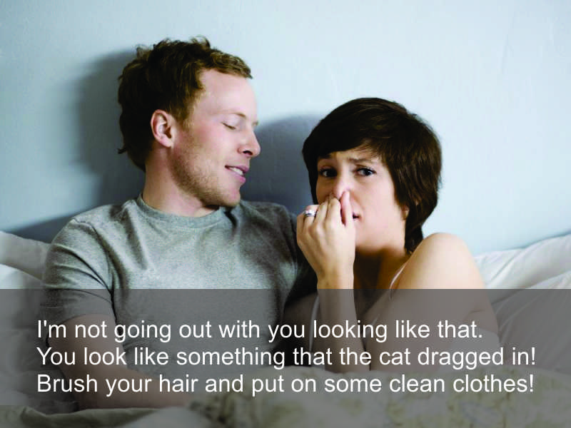
Animals

Slide 3
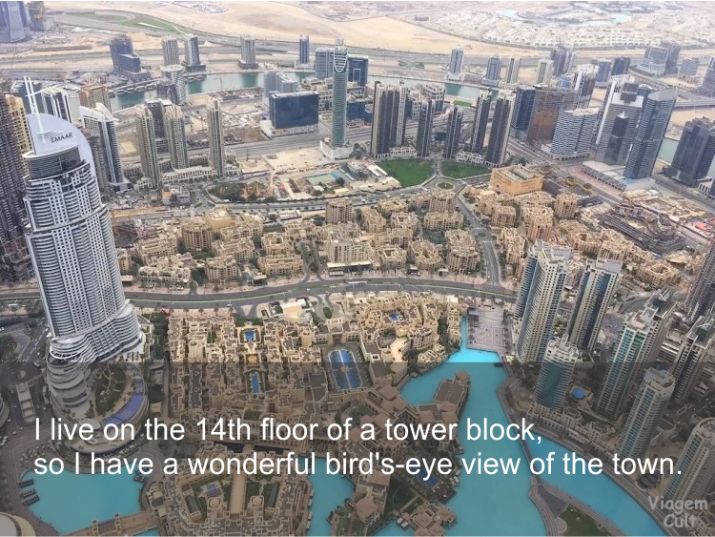
Animals

Slide 4
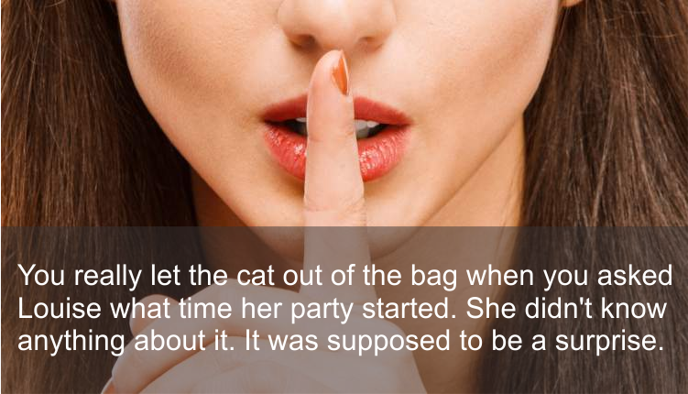
Animals

Slide 5
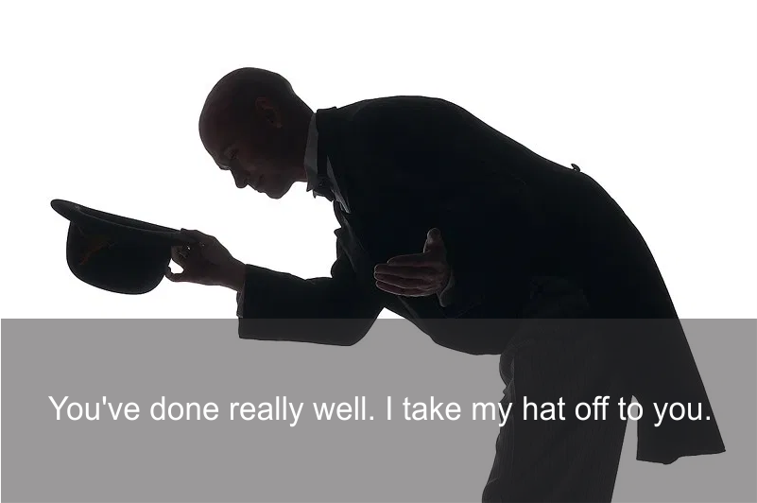
Clothes

Slide 6
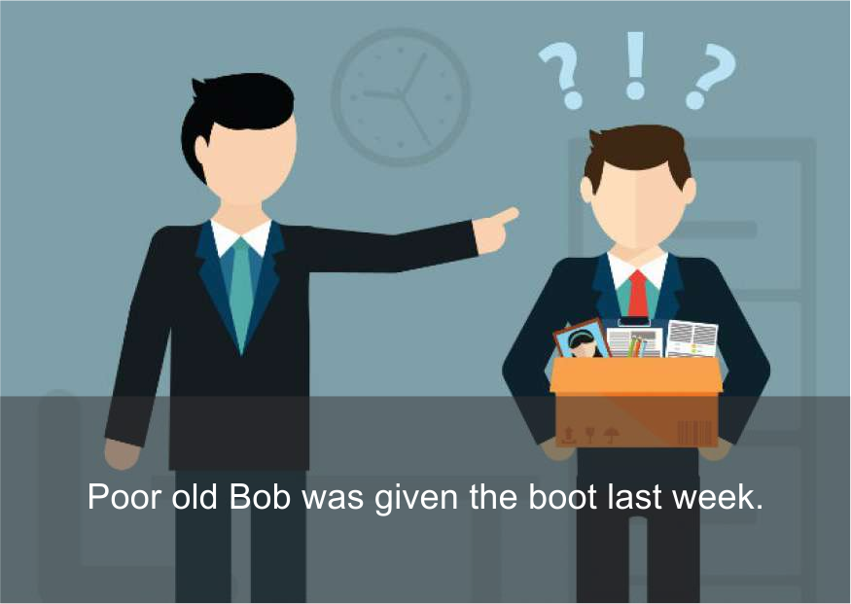
Clothes

Slide 7
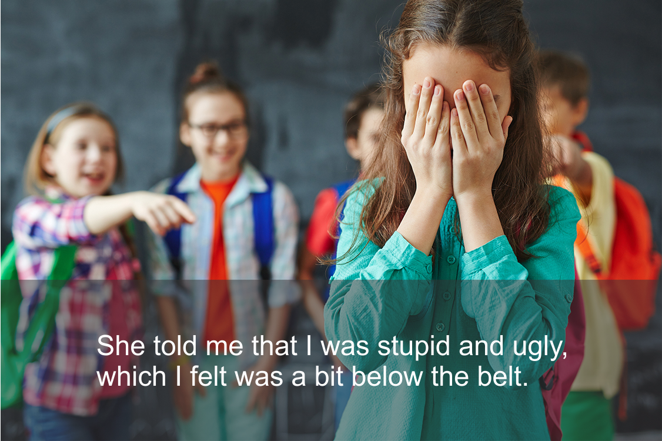
Clothes

Slide 8
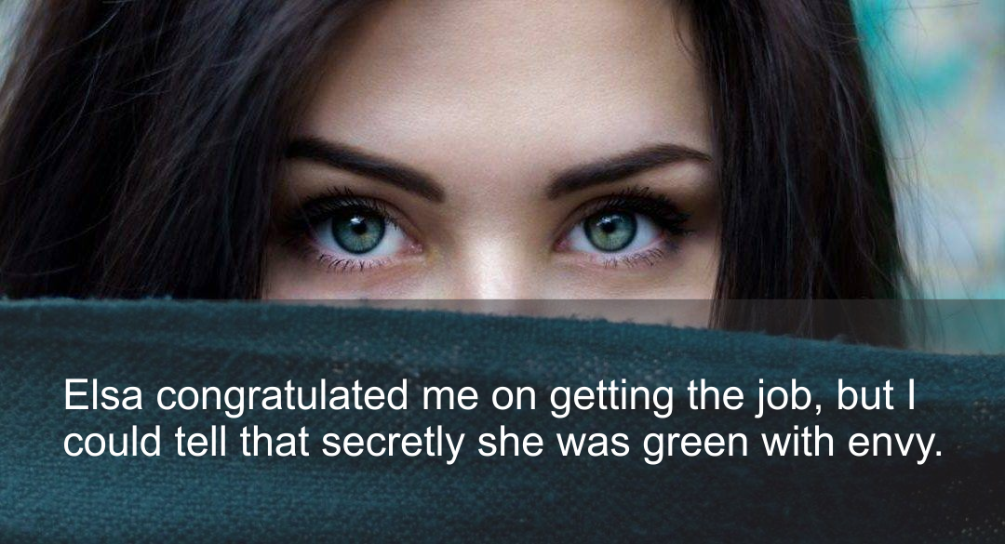
Colours

Slide 9
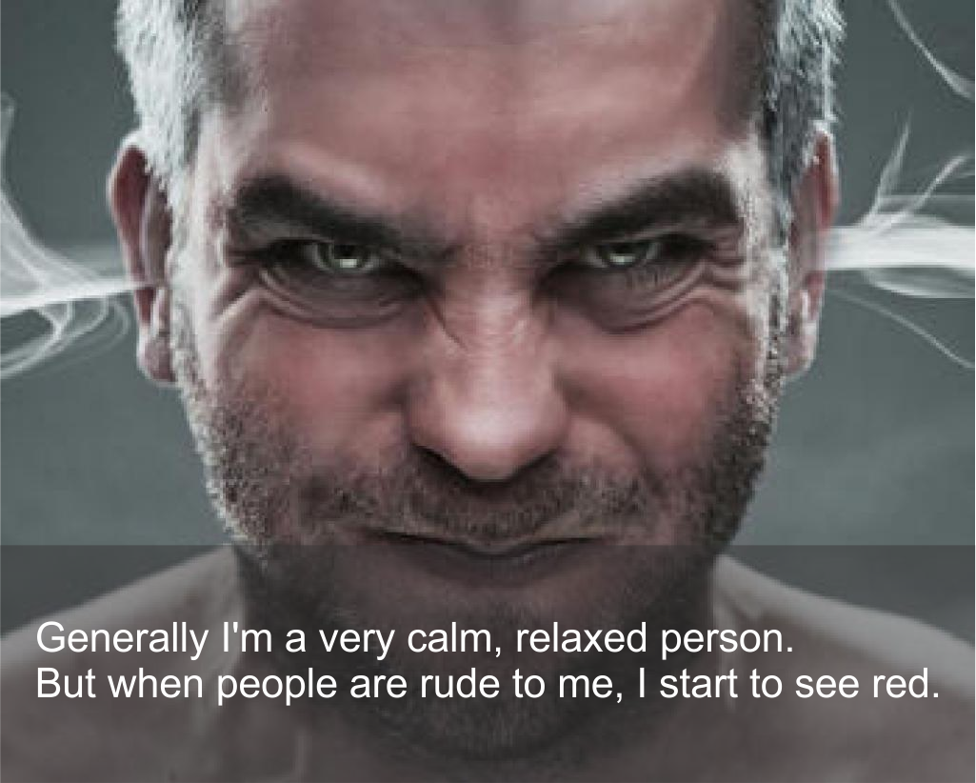
Colours

Slide 10
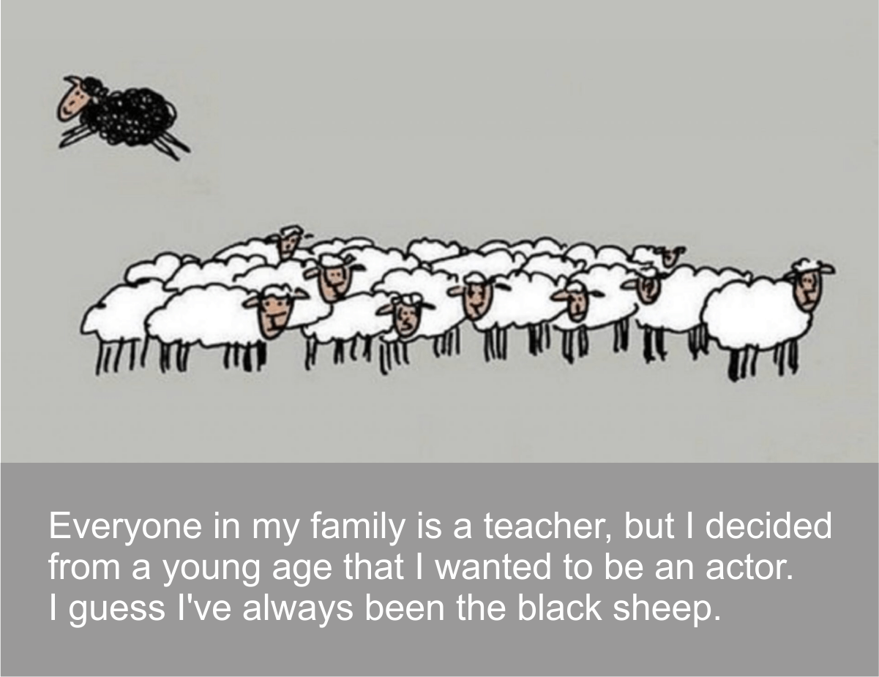
Colours

Slide 11
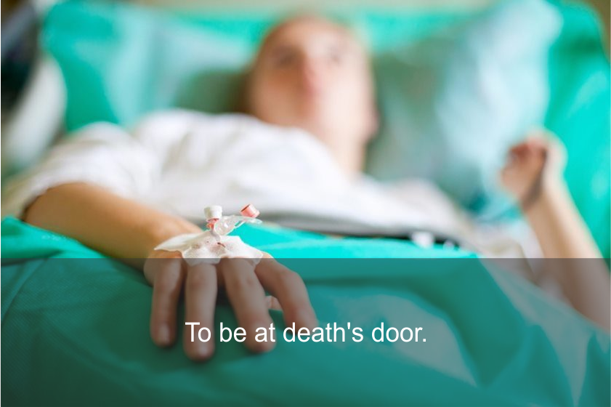
Health, feelings and emotions

Slide 12
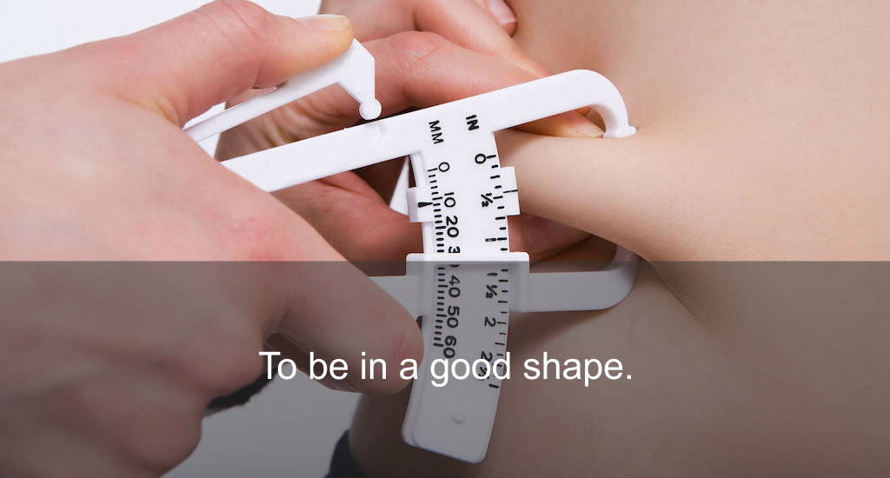
Health, feelings and emotions

Slide 13
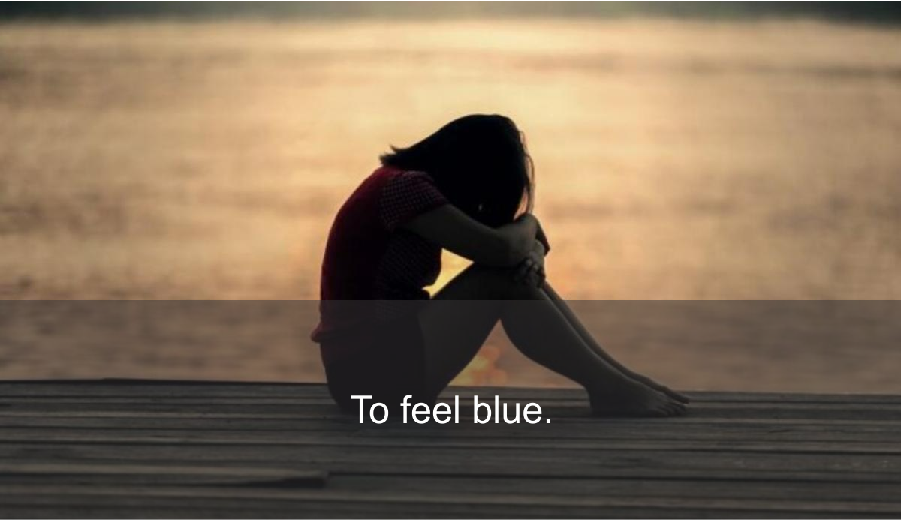
Health, feelings and emotions

Slide 14
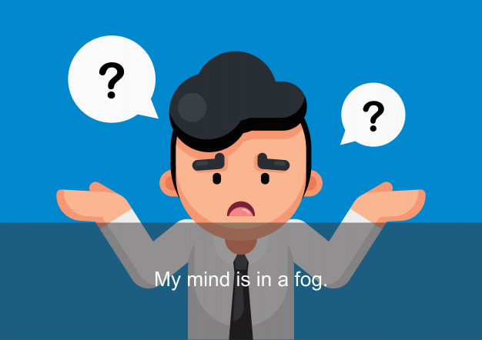
Weather

Slide 15
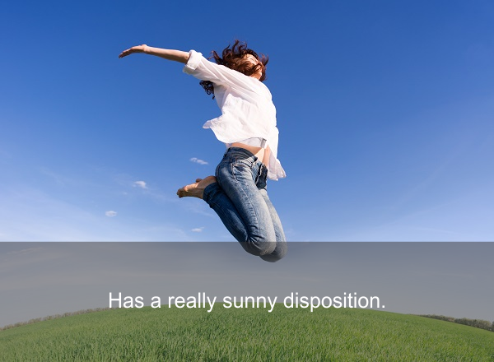
Weather

Slide 16
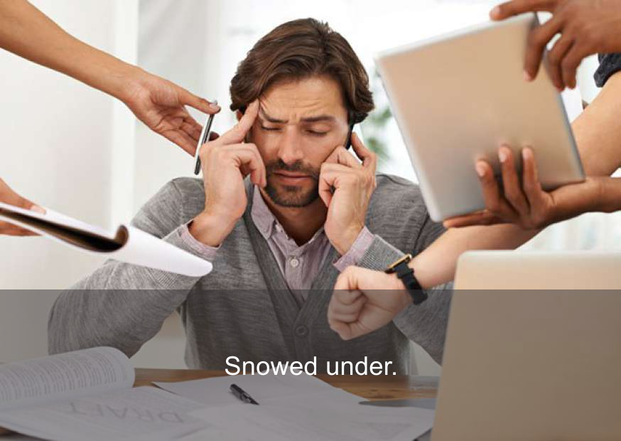
Weather

