Slide 1
Idioms and phrasal verbs
Disciplina: Inglês II;
Docente: Cristiane Cruz;
Discentes: Alyce Ewellin de Azevedo, Guilherme Gomes de Medeiros e Lucas Eduardo Silva de Medeiros.

Slide 2
What are idioms?
A group of words established by usage as having a meaning not deducible from those of the individual words.
Examples:
“Break a leg”
Tradução: “quebre uma perna”
2. “Once in a blue moon”
Tradução: “uma vez em uma lua azul”

Slide 3
Idioms and other expressions using animals

Slide 4
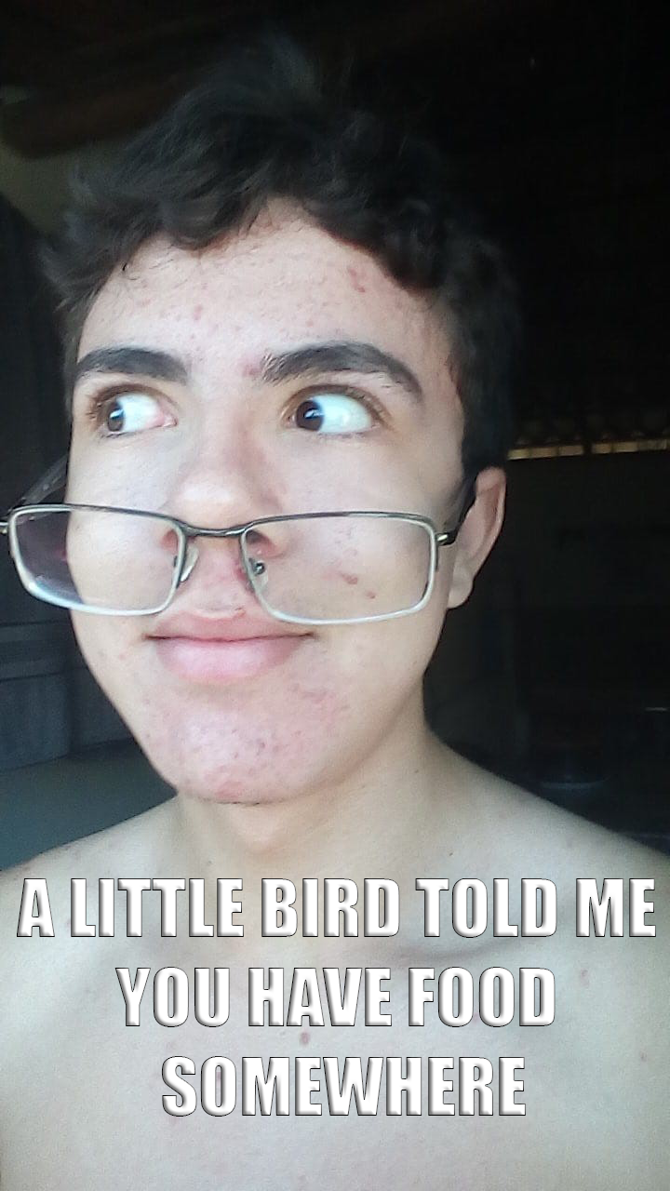
1. A little bird told me
Said if you know who gave you the information being discussed but do not want to say who it was.

Slide 5
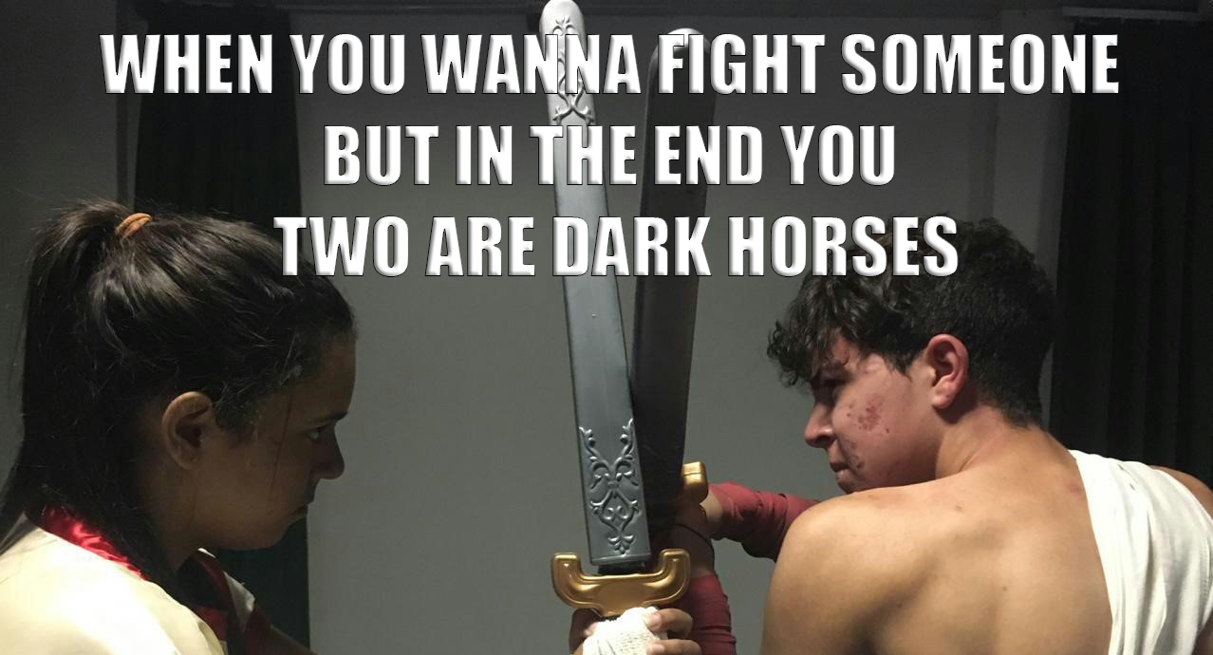
2. Dark horse
A person who keeps their interests and ideas secret, especially someone who has a surprising ability or skill.

Slide 6
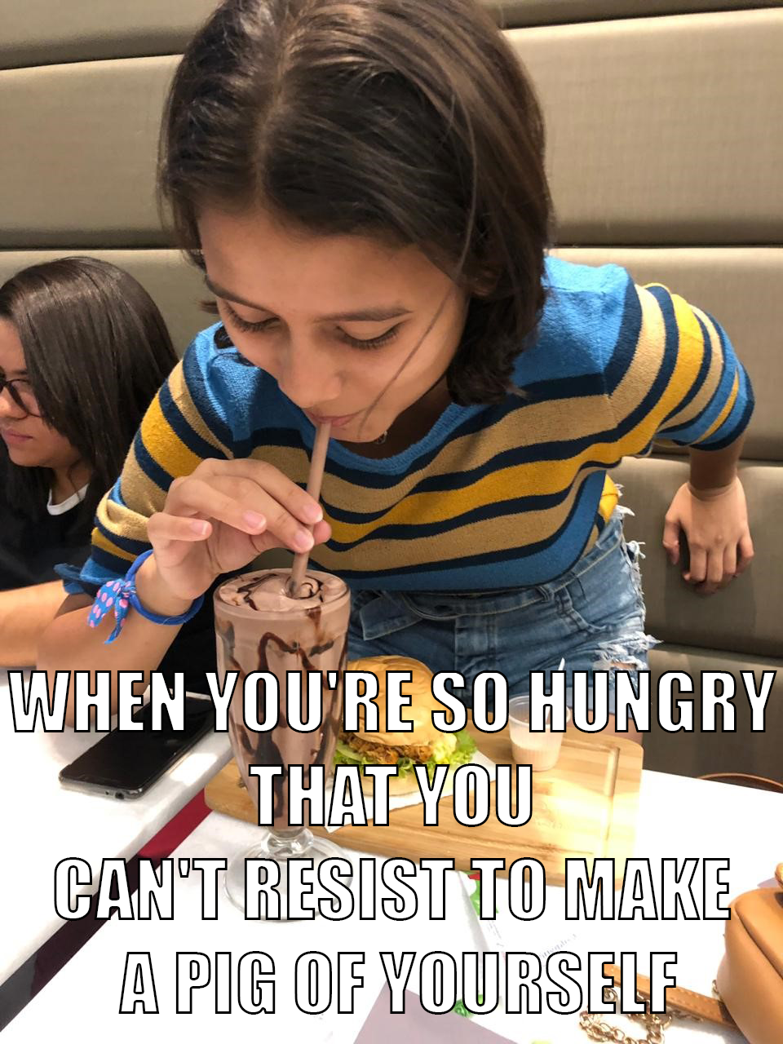
3. Make a pig of oneself
Too eat too much.

Slide 7
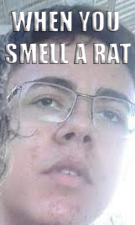
4. Smell a rat
To recognize that something is not as it appears to be or that something dishonest is happening.

Slide 8
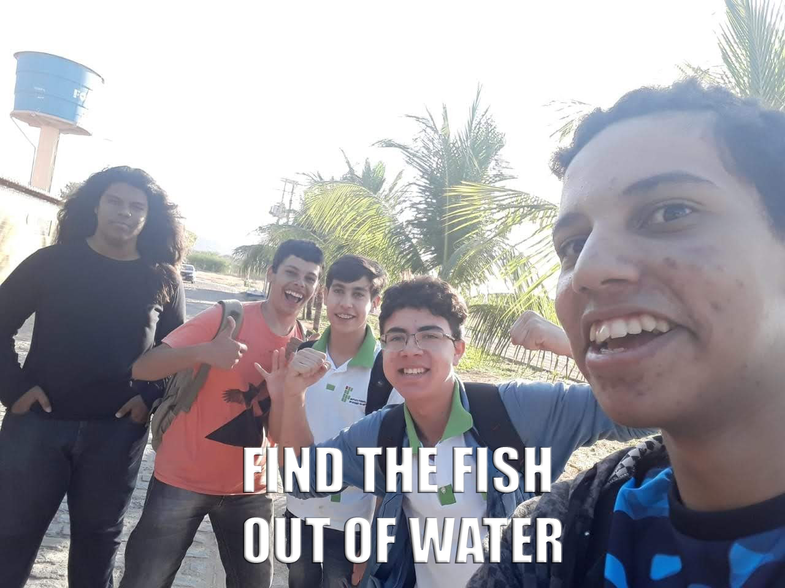
5. A fish out of water
Someone who is uncomfortable in a specific situation.

Slide 9
Idioms and other expressions using clothes

Slide 10
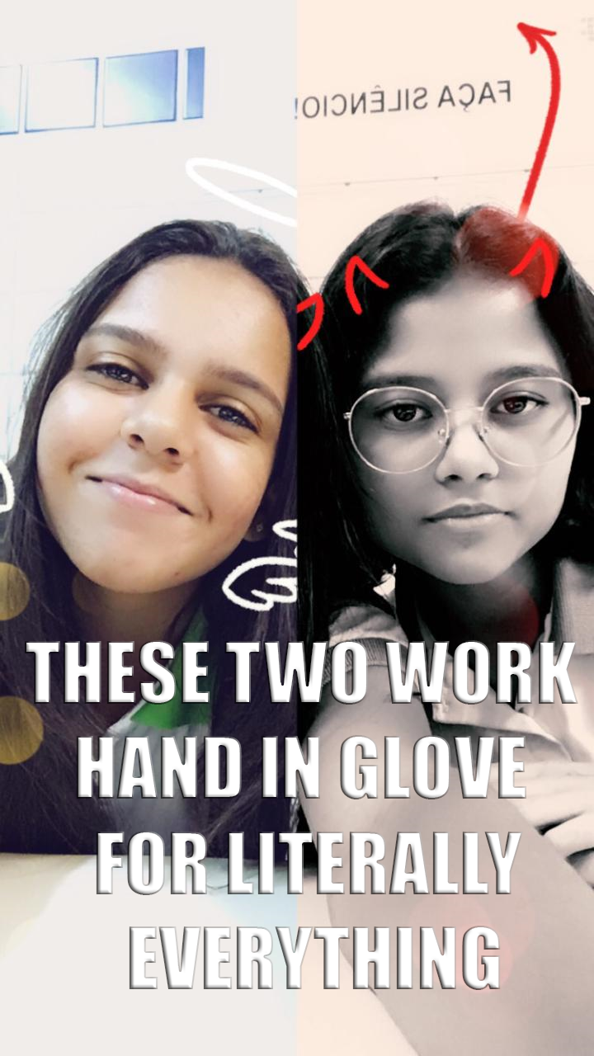
1. Hand in glove
Working together, often to do something dishonest.

Slide 11
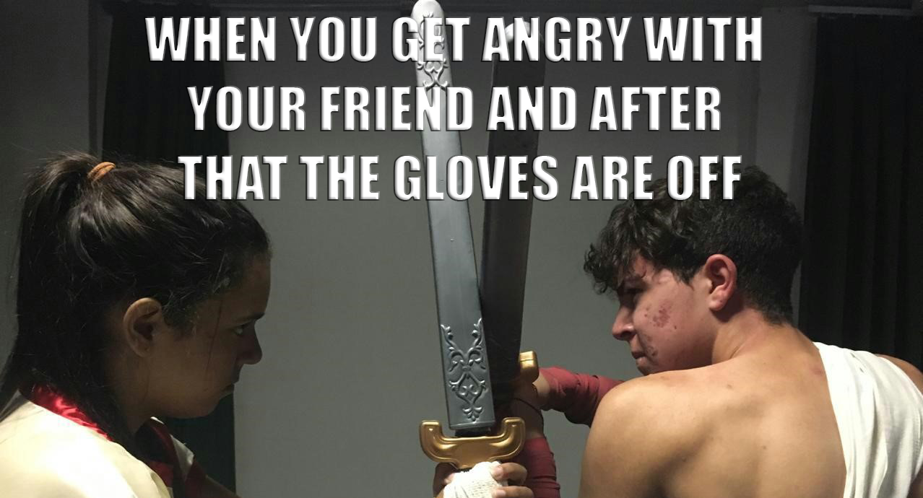
2. The gloves are off
People are beginning to behave in a more hostile or tenacious way. Usually used to describe a dispute or fight.

Slide 12
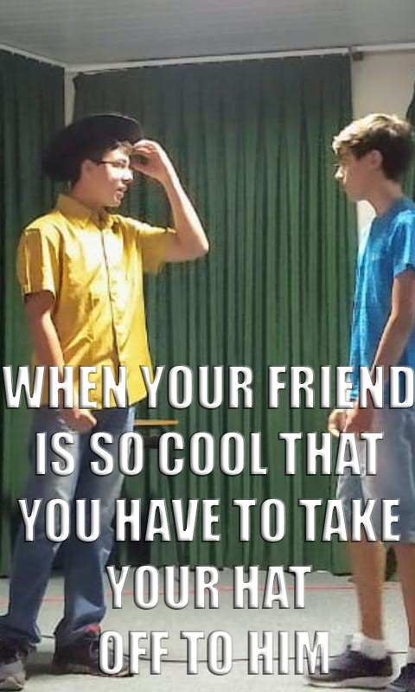
3. Take the hat off to
If you say that you take your hat off to someone, you mean that you admire them for an achievement.

Slide 13
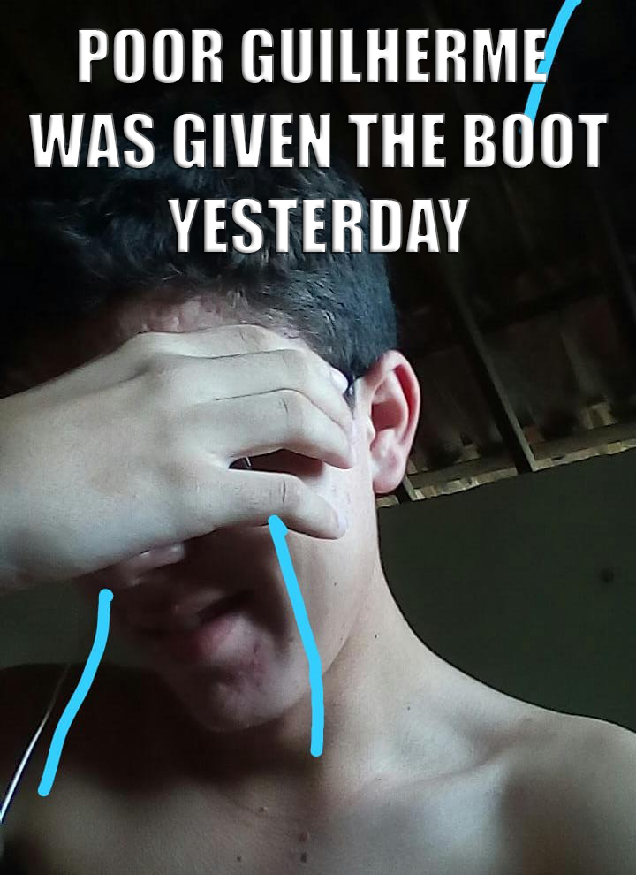
4. Get the boot
Be dismissed from one's job.

Slide 14
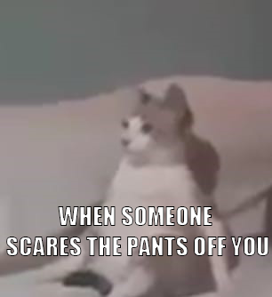
5. The pants off
Used for emphasis after words like charm, scare, frighten, bore, and beat.

Slide 15
Idioms and other expressions using colours

Slide 16
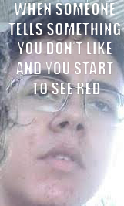
1. See red
To become very angry.

Slide 17
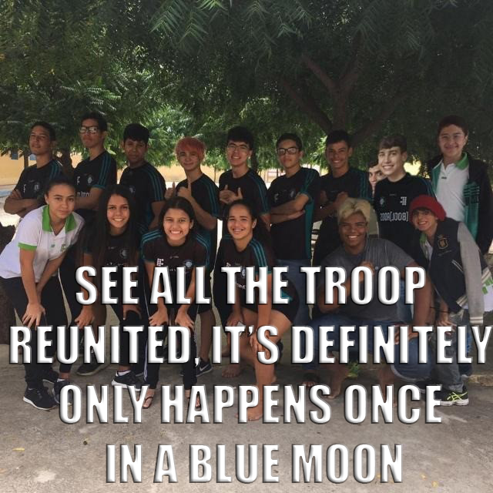
2. Once in a blue moon
Something that rarely happens.

Slide 18
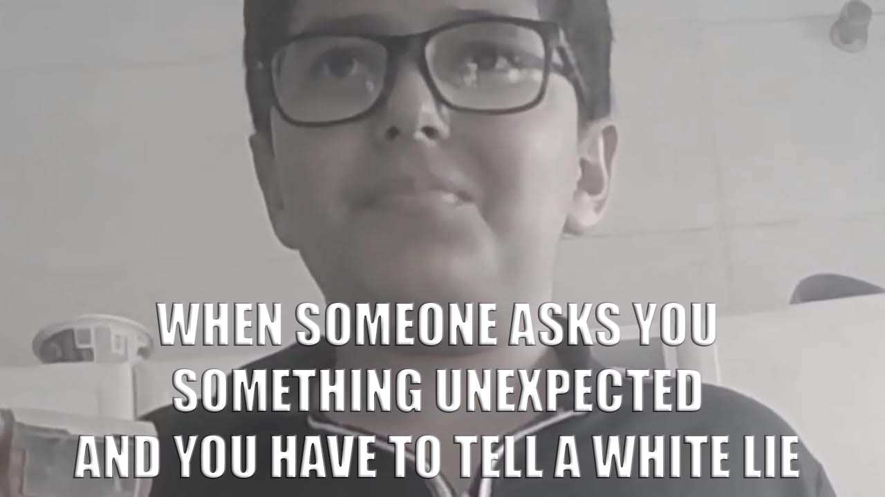
3. White lie
A lie that is told in order to be polite or to stop someone from being upset by the truth.

Slide 19
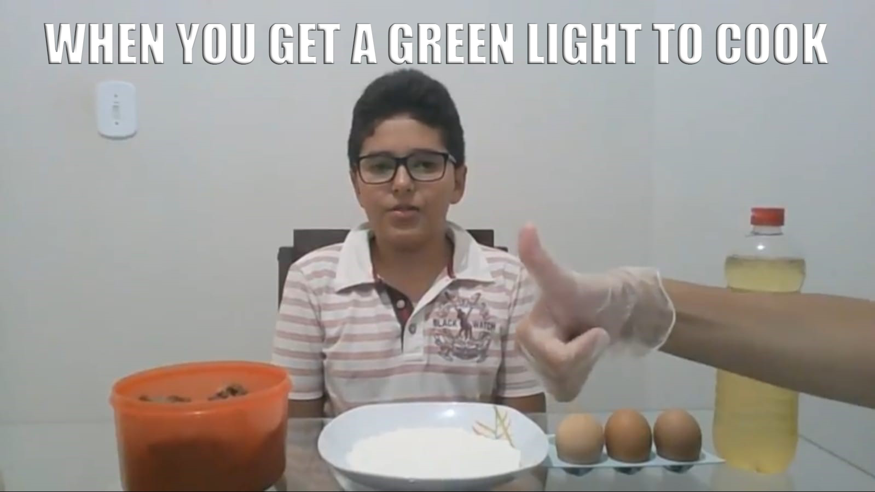
4. Green light
To give permission for something to happen.

Slide 20
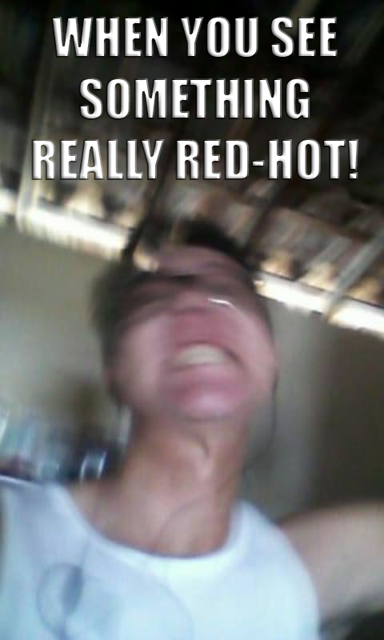
5. Red-hot
Extreme; extremely new, exciting, etc.:

Slide 21
Idioms and other expressions to talk about health, feelings and emotions

Slide 22
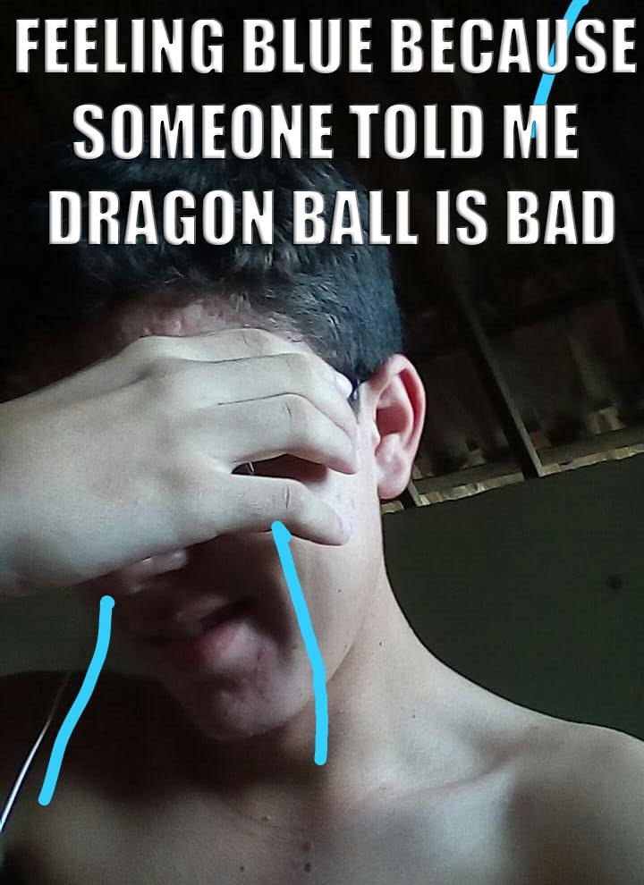
1. Feel blue
Feel sad.

Slide 23
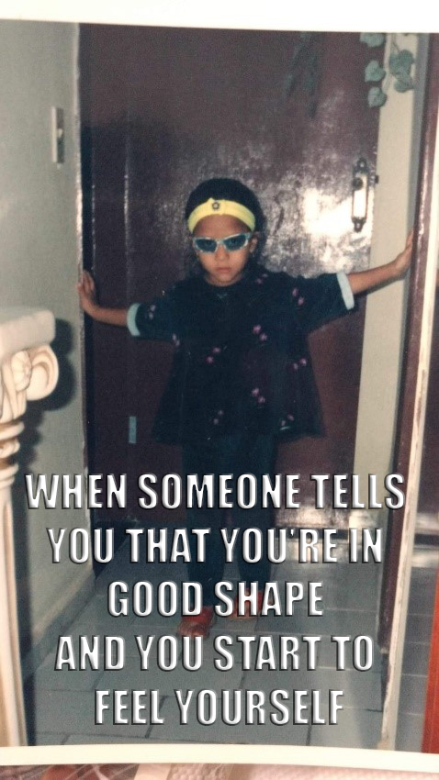
2. In good shape
To be prepared and ready to do something.

Slide 24
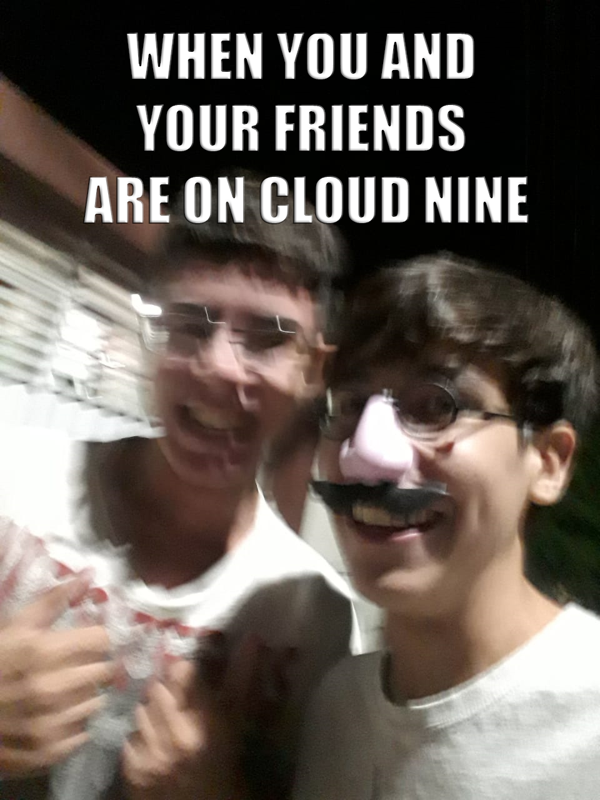
3. On cloud nine
To be extremely happy and excited.

Slide 25
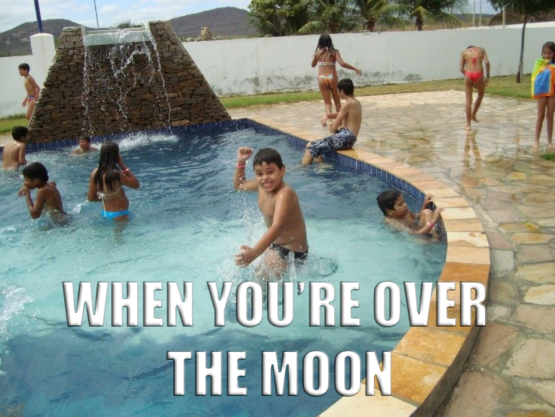
4. Over the moon
To be very pleased.

Slide 26
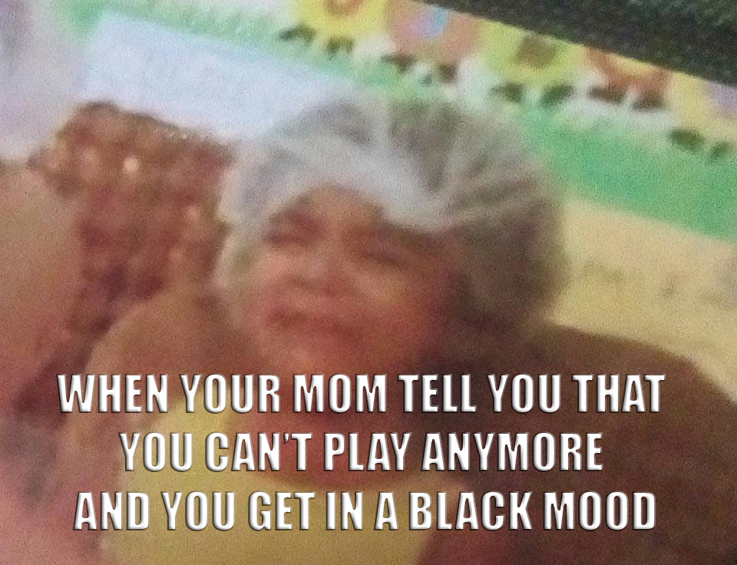
5. In black mood
A very unhappy feeling.

Slide 27
Idioms and other expressions that use words connected with the weather

Slide 28
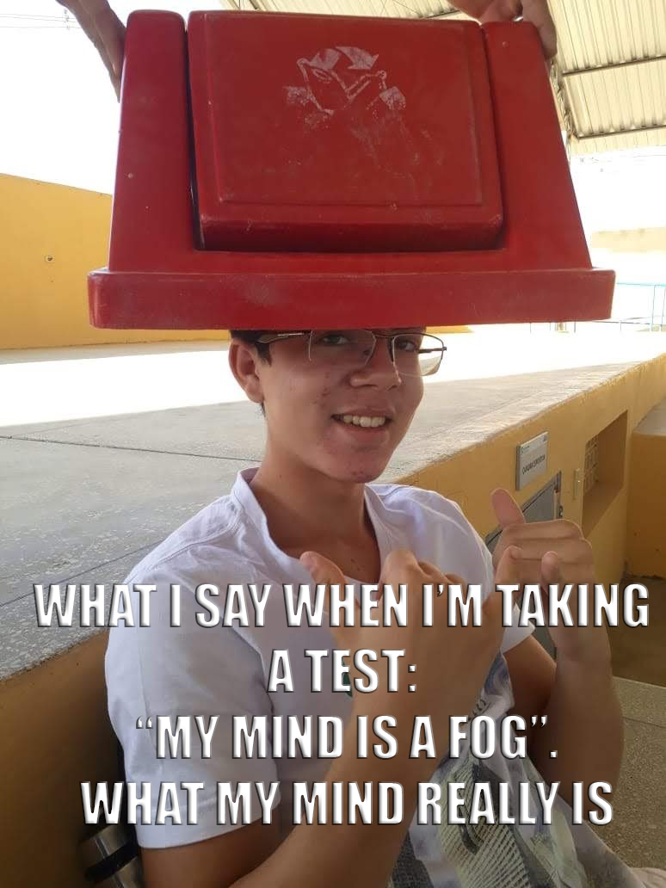
1. Mind is a fog
A condition in which you cannot think clearly or pay attention to things in a satisfactory way.

Slide 29
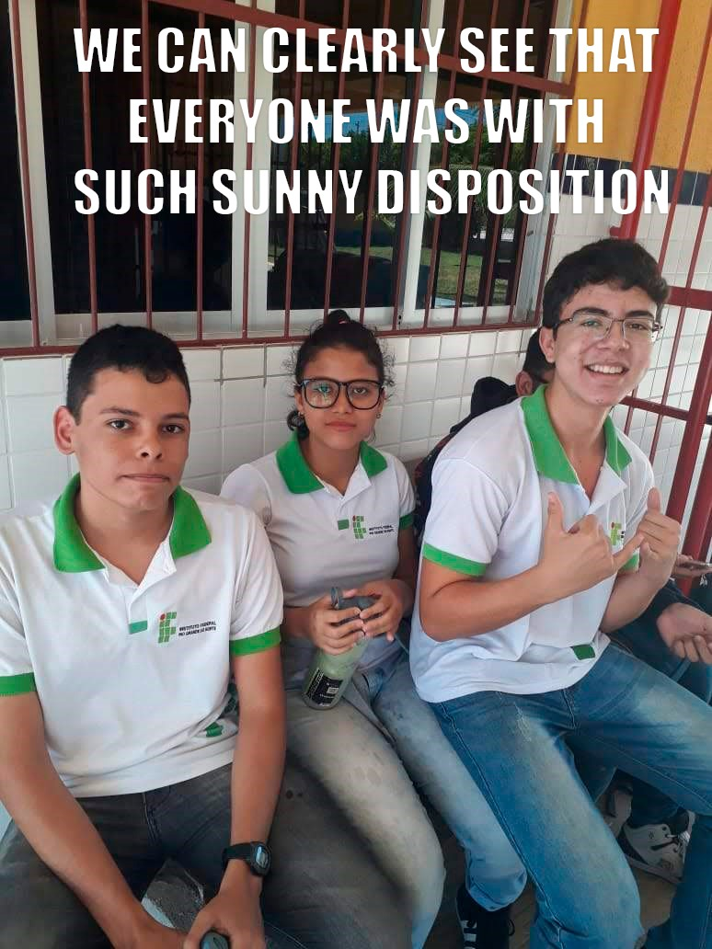
2. Sunny disposition
To be in a happy mood.

Slide 30
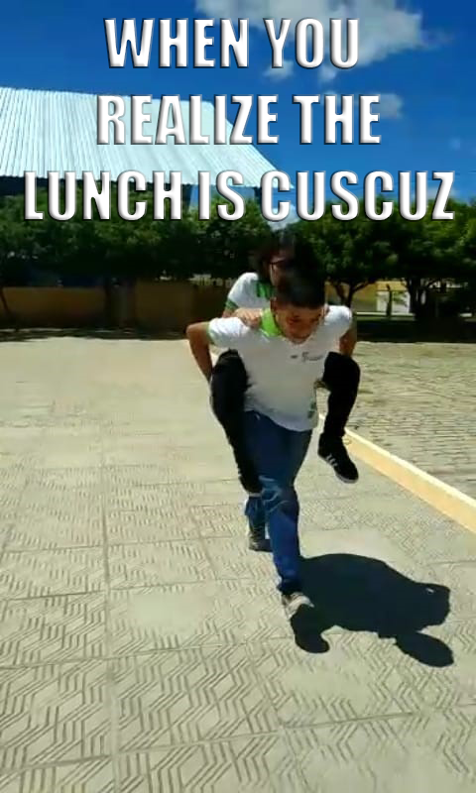
3. Run like the wind
To run very fast.

Slide 31
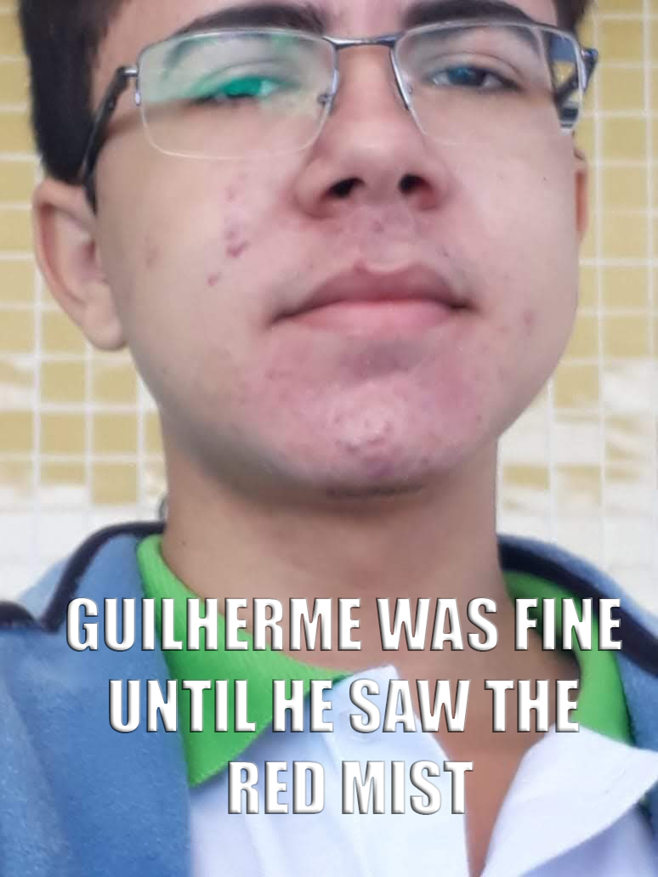
4. Got the red mist
A feeling of extreme competitiveness or anger that temporarily clouds one's judgment.

Slide 32
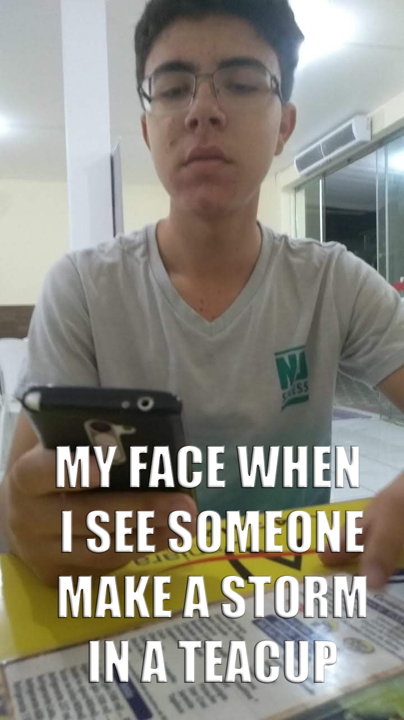
5. A storm in a teacup
A lot of unnecessary anger and worry about a matter that is not important.

Slide 33
What are phrasal verbs?
A phrasal verb is a combination of words (a verb + a preposition or verb +adverb) that when used together, usually take on a different meaning to that of the original verb.

Slide 34
Idioms and other expressions using animals:
(2) I'm not going out with you looking like that.
Go out - leave home to go on a social event.
Idioms and other expressions using clothes:
(10) […] he would have to move me down to a lower class.
Move down - to change to a lower group, rank, or level.
Idioms and other expressions using colours:
(8) – […] instead of running away she started screaming.
Run away - leave unexpectedly, escape.
Idioms and other expressions to talk about health, feelings and emotions:
(29) Camilla has come down with something.
Come down with something – become sick.
Idioms and other expressions that use words connected with the weather:
(14) I got a parking ticket, then someone drove into my car in the supermarket car park, and to top it all I ran out of petrol.
Run out - have none left

