Slide 1
DIalogues – Valentine’s Day
Components:
Eliezer Ribeiro
Luiz Eduardo
Joabson da Silva
Thiago Henrique

Slide 2
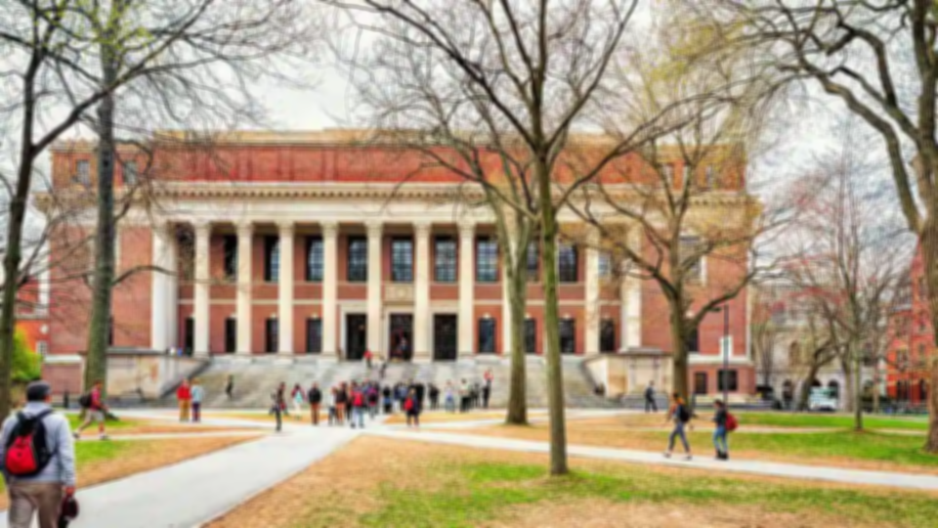
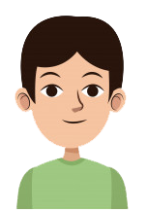
HE IS ALEX
He is a shy timid, enjoy a lot of music, likes to play, and does not even have friendships throught college, just from your older school, is his first day of the class and it is having a party for the beginners

Slide 3
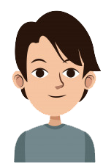
HE IS FRANKLIN
Franklin is very extroverted loves to go out with his friends going on party and drink enough, it is a fairy face, and also like to meet new people, he's Alex Veteran

Slide 4
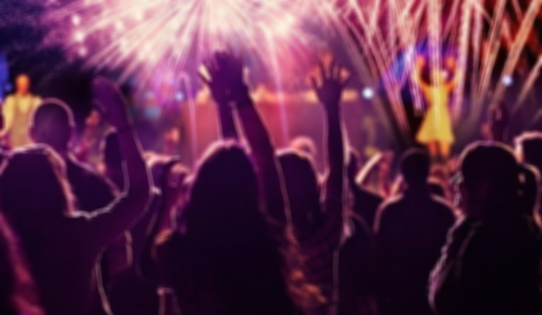
Hello, What's your name?

Slide 5
Hi, I am Bruce, and about you?

Slide 6
I’m Franklin, is yours first party?

Slide 7
Yes, the people here are lively

Slide 8
for sure!, Where did you come from, Alex?

Slide 9
I am from Colorado, Loveland

Slide 10
Hum... Interesting

Slide 11
What's it?

Slide 12
nothing , i am from Duncer, what do you like to do?, Talk to your routine.

Slide 13
Well, I Iike to play the guitar, and games and casually drink, go out with friends, and you?

Slide 14
I like go to partys with my friends get drunk, but also i like watch series and sleep.

Slide 15
I found a good deal

Slide 17
Let's Go! Move it.

Slide 18
Stop bro! I am straight!

