Slide 1
DIALOGUE
Discentes:
Bruno Fernando
José Clayton;
Isabelly Cristina;
Rallyson Garcia;
Viviane Soares
Teacher: Cristiane Cruz

Slide 2
Description:
Son: has white skin and red hair. Wears a blue shirt, black jacket, blue pants and brown shoe.
father: he has white skin, a red beard and red hair. Wears a blue shirt, red tie, black jacket, green pants and brown shoe.

Slide 3
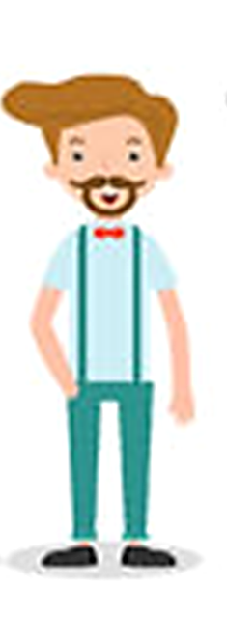
Hi son, I arrived.

Slide 4
Hi dad, you’re home late, has anything happened today?

Slide 5
I had to do extra hours today and how was your day?

Slide 6
Ah, it was a very normal day, I wake up at 6 o’clock as usual, I took a shower, I had breakfast and I went to school, I arrived at one o’clock p.m, I set up my room and hang with my friends to play football and I got at home almost now.

Slide 7
Your day sounds really nice, and the girls, did you meet someone new?

Slide 8
Ahh, there’s one I’ve known…

Slide 9
Really? Tell me how she is, who knows I can help you with her.

Slide 10
Her name is Jenifer, I meet her at school, she’s not my girlfriend but she could be…

Slide 11
And how did you meet her?

Slide 12
She studies in my classroom, she is my height, she is 16 years old just like me, she has brown hair and eyes and is the most beautiful girl I have ever meet.

Slide 13
Where is she from?

Slide 14
She is from Louisville.

Slide 15
And she likes you?

Slide 16
I think so, I’m of asking her to date tomorrow.

Slide 17
I bet if you say everything you feel for her, everything will work out.

Slide 18
Okay dad, thank you, but now I have to sleep, I do not want to be late for school tomorrow.

Slide 19
The next day
I arrived.

Slide 20
Guess dad… she accepted.

