Slide 1
Valentine’s day
English activity
Date: 18/02/2019
Members: Alyce, Ericy, Joalison, Maria Beatriz and Ronivon

Slide 2
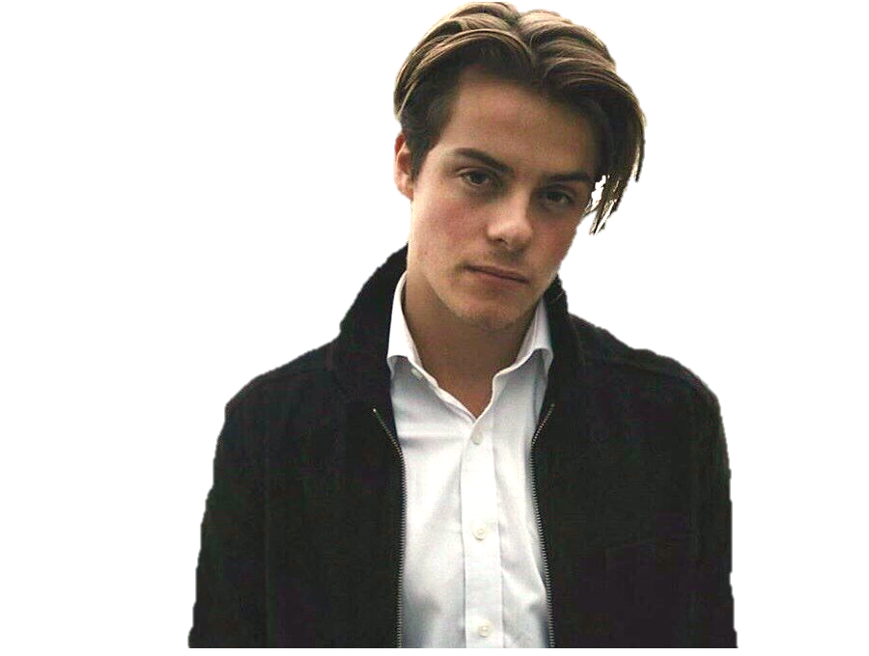
Narrator: Today is Valentine’s Day. It’s a sunny day outside. John is in a coffee shop. He is tall and fit. His hair is straight and brown, and the color of his eyes is black. He is wearing a white social shirt and a black coat

Slide 3
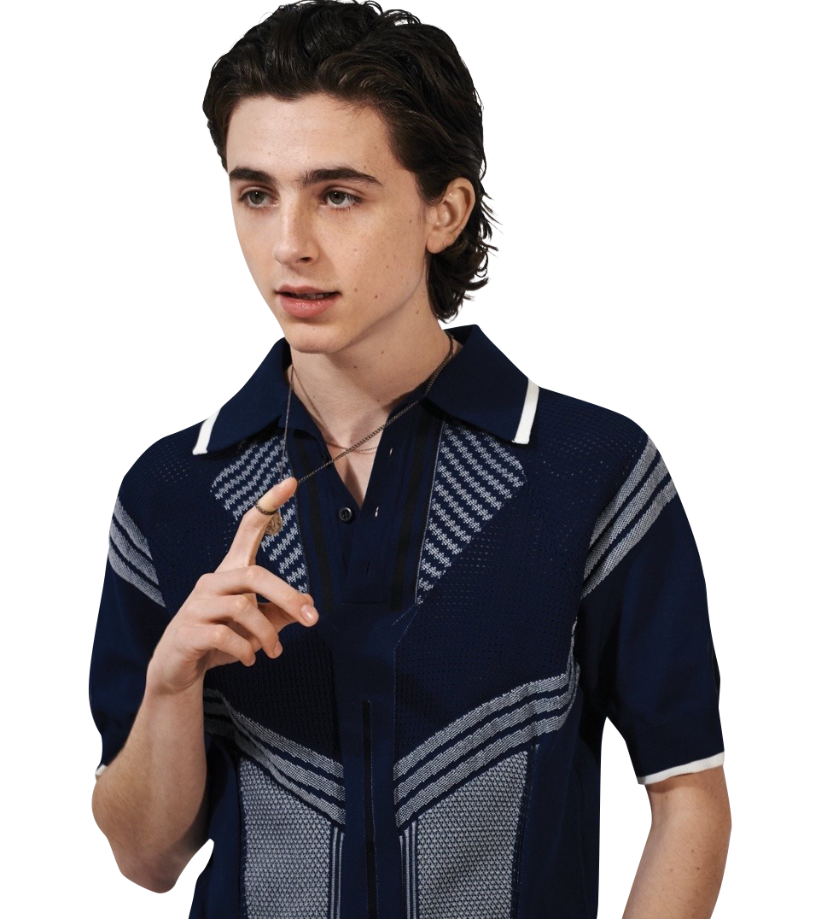
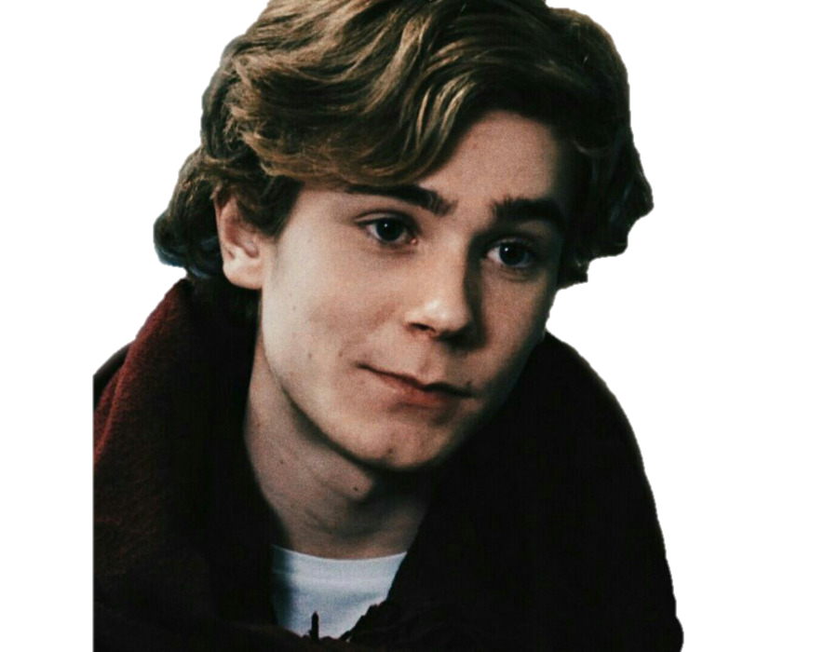
Narrator: John is drinking a cup of coffee with his friends James and Albert.

Slide 4
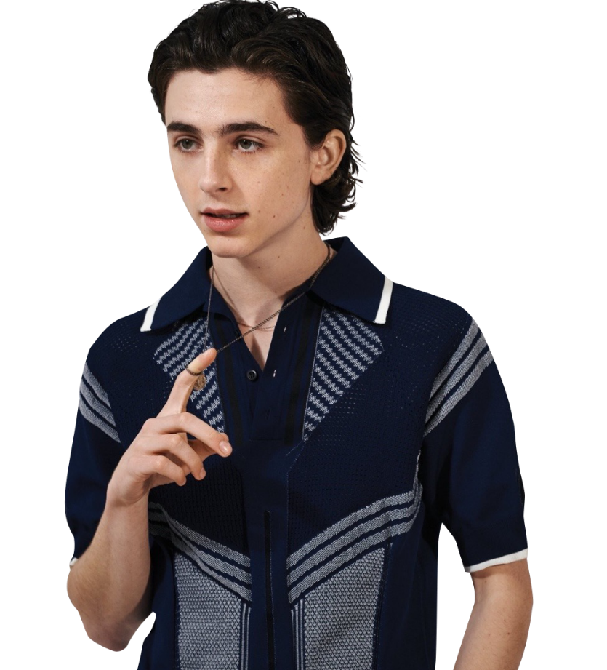
Look at that girl!
You can’t! I’m not kidding!
You will never going out with her!

Slide 5
I will try to talk with her!

Slide 6
Hello, can I sit here?
Oh, of course. Sit down. Hmm, so what’s your name?

Slide 7
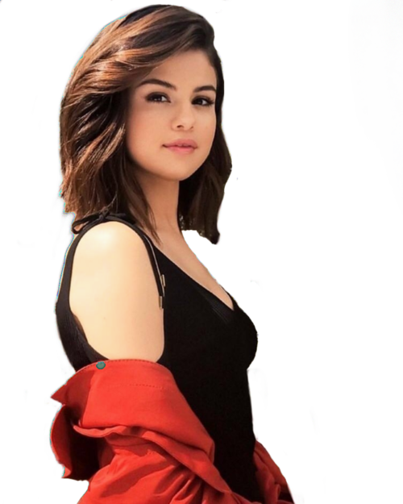
My name is Carol.
My name is John. And you?

Slide 8
Yeah, i like it a lot. I came here everyday. It’s calm, beautiful, and near from job.
Hm, great name. Do you like this place?

Slide 9
Oh, what do you do?
I’m a Teacher.

Slide 10
Wow! I’m a student yet. I study Math in college. What do you like to do?
I like to read. My favorite book is Harry Potter. Do you like it?

Slide 11
Oh, yes! I love it! I’m from Gryffindor. But where are you from? You speak different.
I’m from Brazil, but I’m living here, in New York City, hmm, since last year. And you?

Slide 12
I’m from here. Oh my God, you are so cool! Let’s going out together sometime! Can I have you number?
Oh, you are really amazing, but I have a boyfriend, so...

Slide 13
Hm, bye bye
Nice to meet you, too!
Oh, ok. So nice to meet you! ☹

Slide 14
Narrator: And this was one more sad day in John’s life.

