Slide 1
Valentine’s Day

Slide 2
2nd year of computer science
Components:
Débora Ellem da Silva Nunes;
Jeová José da Silva Oliveira;
Luigi Eduardo Silva de Lima;
Thérvyson Elyedson de Araújo paz.

Slide 3
Hi, my name is Jeová, and our history will have as caracters:
Amanda: A young, rich black woman with a great black power.
Roberto: A poor and deluded guy, who falls in love with Amanda at first sight.
Cláudio: A mad teacher who was fired because he smoked marijuana and harassed the students.

Slide 4
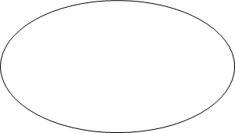
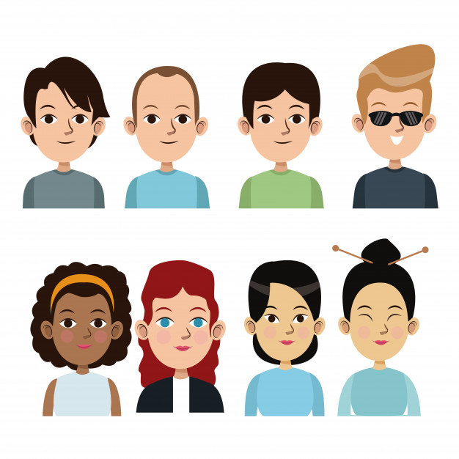

Oh, hi, i’m fine, and you?
Hi, how are you?
Amanda
Roberto
Cláudio

Slide 5
Who is your friend?
Me too.

Slide 6
Ah, nice to meet you.
This is the Cláudio.

Slide 7
I’m student, and you?
Me too.
Amanda, how do you do?
Ah...

Slide 8
And you friend?
I’m a teacher.
Me too.

Slide 9
How can i tell you this... I like you, like not, i love you.
Yes.
Oh, cool.

Slide 10
Ah... Sorry, i have boyfriend.
Oh... Okay, it was good to meet you again.

Slide 11
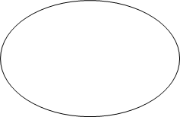
Okay, good bye.
Bye.
Good bye.

Slide 12
Thanks for listening!

