Slide 1

VALENTINE’S DAY
DOCENTE: CRISTIANE BRITO
DISCENTES:
AYSHA JOYCE
GUILHERME GOMES
JOSÉ ALYSON
ODAIR JOSÉ
VITORIA TALUANY

Slide 2
DESCRIPTION - 1
His name is Steve. He’s tall and wear a red coat and jeans pants. He’s wearing shoes, use glasses and have black eyes. His hair is black and short.
Her name is Agatha. She’s tall and wear a white shirt and jeans pants. She’s wearing sandals. She use glasses and have black eyes, her hair is short and curly.

Slide 3
They were walking on the street and
suddenly they ran into each other.

Slide 4
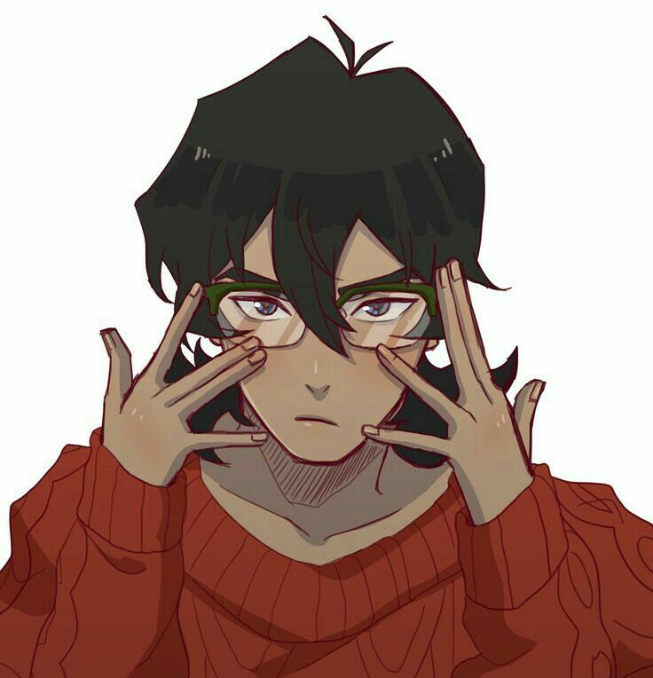
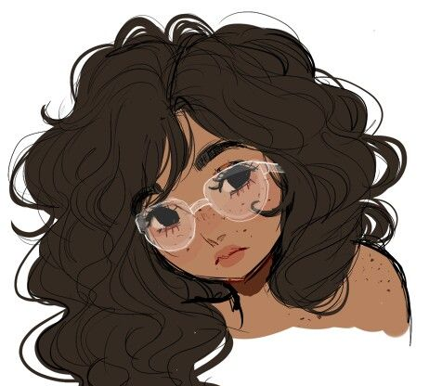
Sorry, I didn’t see you.

Slide 5
No problem!

Slide 6
Did you get hurt?

Slide 7
No, I’m okay.

Slide 8
What’s your name?

Slide 9
My name is Agatha, and you are?

Slide 10
My name is Steve, where are you from?

Slide 11
I live here in Natal, and you?

Slide 12
I live here too, do you study?

Slide 13
Yes, I do. What do you do?

Slide 14
I work at home. How old are you?

Slide 15
I’m twenty years old, and you?

Slide 16
I’m twenty-five years old. Are you single?

Slide 17
Yes, I am, and you?

Slide 18
I’m single too.

Slide 19
I have to go, what’s your number? We can talk later.

Slide 20
It’s 99912-3865.

Slide 21
Okay, goodbye. Have a nice day!

Slide 22
Goodbye!

Slide 23
DESCRIPTION - 2
His name is John. He is tall and wear a white shirt and black pants. Hes is wearing shoes. His eyes are blue and his hair is brown.
Her name is Joana. She is tall and wear a red shirt and black pants. She is wearing shoes, her hair is straight and her eyes are black.

Slide 24
John and Joana already met
and now he called her so they can go out.

Slide 25
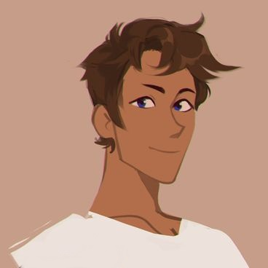
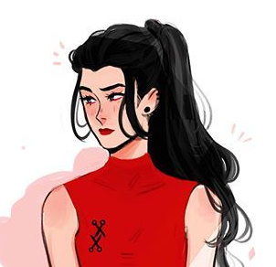
Hi Joana!

Slide 26
Hi John, how are you?

Slide 27
I’m fine, and you?

Slide 28
I’m very well.

Slide 29
Can we go out tonight?

Slide 30
Yes, of course! What time?

Slide 31
7:00pm?

Slide 32
Okay. See you in the park?

Slide 33
Yes, see you later. Bye bye!

Slide 34
Bye bye.

