Slide 1

ENGLISH ACTIVITY
STUDENTS:
Carlos Daniel;
Jadilson José;
José Douglas;
Ricaely Guimarães.
VALENTINE’S DAY

Slide 2
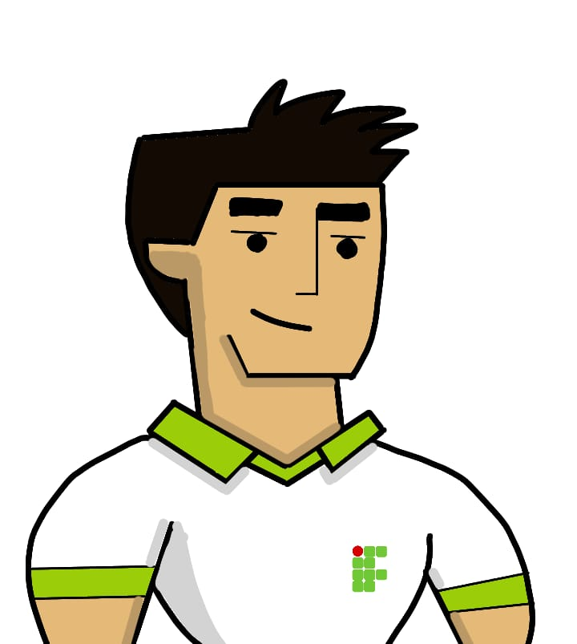

at the entrance of the school...
GOOD MORNING! CAN YOU TELL ME WHERE ROOM THIRTEEN IS?

Slide 3
at the entrance of the school...
WHAT A COINCIDENCE! IT'S THE SAME ROOM AS MINE!

Slide 4
at the entrance of the school...
TRIIIIIIMMMMMMM

Slide 5

in the hallway of the school…
WHAT’S YOUR NAME?

Slide 6
in the hallway of the school…
MY NAME IS JULIA. AND WHAT'S YOURS?

Slide 7
in the hallway of the school…
MY NAME IS HENRIQUE. HOW LONG HAVE YOU BEEN STUDYING HERE?

Slide 8
in the hallway of the school…
THREE YEARS AGO!

Slide 9
After this, they arrive in the room and all morning they exchange glances.
At the end of class, Julia loses the bus and asks:

Slide 10
on leaving school...
WHERE DO YOU LIVE?

Slide 11
on leaving school...
IN THE CENTER, ON THE MAIN STREET!

Slide 12
on leaving school...
I LIVE IN THE NEXT STREET!

Slide 13
on leaving school...
DO YOU WANT ME TO JOIN YOU?

Slide 14
on leaving school...
YES PLEASE!

Slide 15
On the way home he asks:

Slide 16
on the way home…
HOW OLD ARE YOU?

Slide 17
on the way home…
EIGHTEEN AND YOURS?

Slide 18
on the way home…
EIGHTEEN ALSO!

Slide 19
on the way home…
WITH WHOM YOU LIVE?

Slide 20
on the way home…
WITH MY AUNT!

Slide 21
on the way home…
DO YOU WORK?

Slide 22
on the way home…
NO, MY ROUTINE IS GOING TO SCHOOL AND STUDYING AT HOME!

Slide 23
Some time after that, they arrived at the gate of the house and Julia confesses:

Slide 24
at the house gate...
I CONFESS, I MISSED THE BUS ON PURPOSE TO ACCOMPANY YOU!

Slide 25
at the house gate...
I ALSO WANTED TO SPEND SOME TIME ALONE WITH YOU!

Slide 26
Theys approach each other staring into each other's eyes and kiss!
End!!!

