Slide 1
Trabalho de Inglês
2° informática
Professora: Cristiane Cruz
Componentes:
Clarice Nobrega Aparecida
Sérgio Vitor
Jamily Kelly
Lucas Eduardo Silva de Medeiros

Slide 2
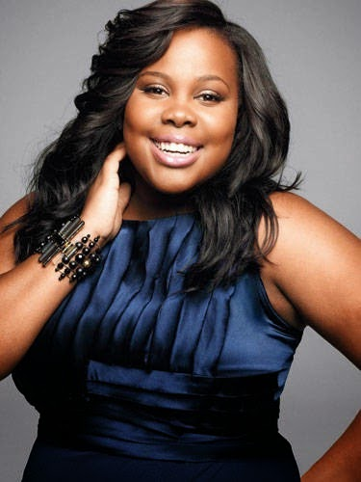
Descrição dos personagens
Chiquinha,30 years old:
She wearin:dress,earring,creepy.
She is tall,black,fat,have a blach hair,brons
eyes.

Slide 3
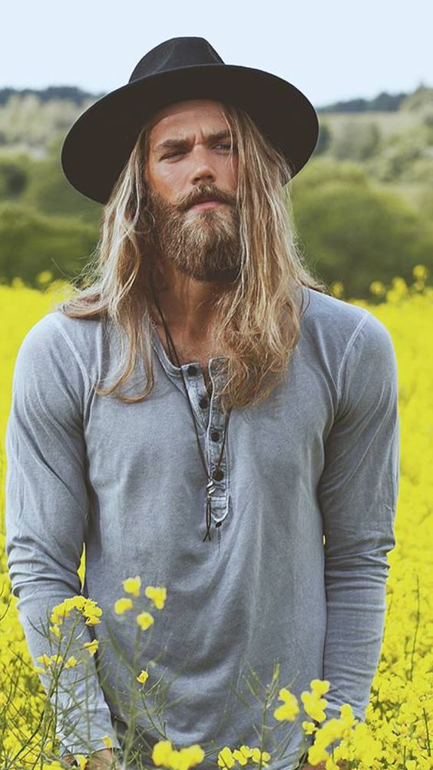
Chicó,25 years old:
He wearin: long-sleeve shirt,pants,social shoes,hat.
He is small,white,skinny,blonde hair,long hair,
blu eyes.

Slide 4
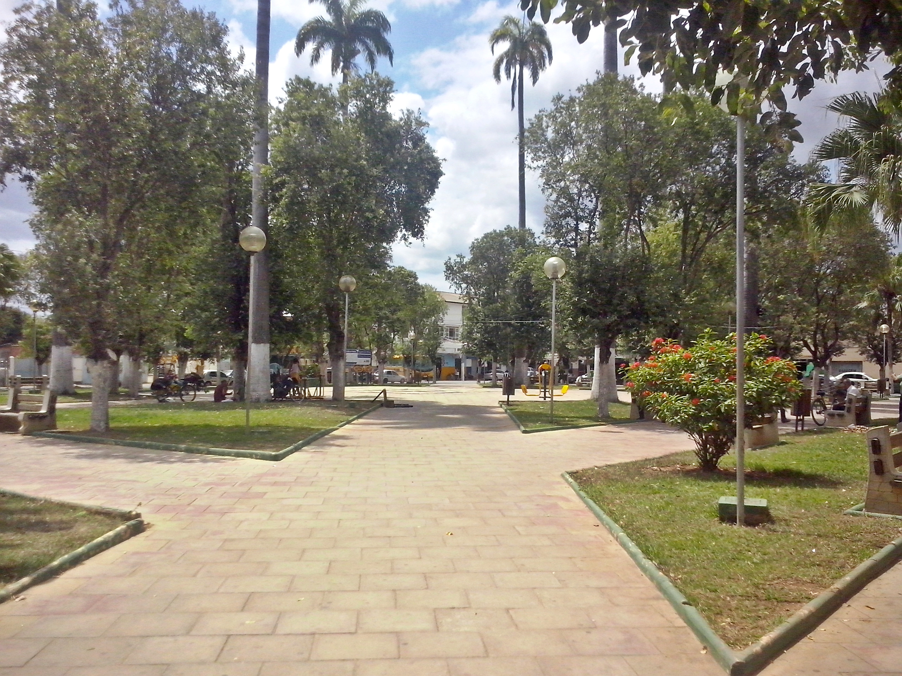


Diálogo
*They come across the square*

Slide 5
My name is Chiquinha,
and your?
Hello,sorry, whats your name?.

Slide 6
My name is Chicó,nice to meet you.
Nice to meet you too.

Slide 7
Who old are you?.
I am 30 years old,and you?

Slide 8
I am lawyer,
what do you do?
I am 25 years old, what do you do?

Slide 9
Nice,do you have girlfriend?
I am portuguese teacher.

Slide 10
Whats your number?
no,i dont.

Slide 11
lets talking after!
4002-8922

Slide 12
Bye!
Bye!

