Slide 1

Componentes : Marcelo Alves , Heitor Vinicius e Vitória Taluany.
Disciplina : inglês Turma : 2°informatica
Professor(a) : Cristiane de Brito Turno : matutino

Slide 2
Description
- Juvêncio: Young engineer, 22 years old, shy, tall, brown eyes, black hair, loves math and has a girlfriend.
- Tayrone: He is a teacher, 21 years old, loves to read and teach, likes men and is discreet. He has black eyes, he is tall and has brown hair.

Slide 3
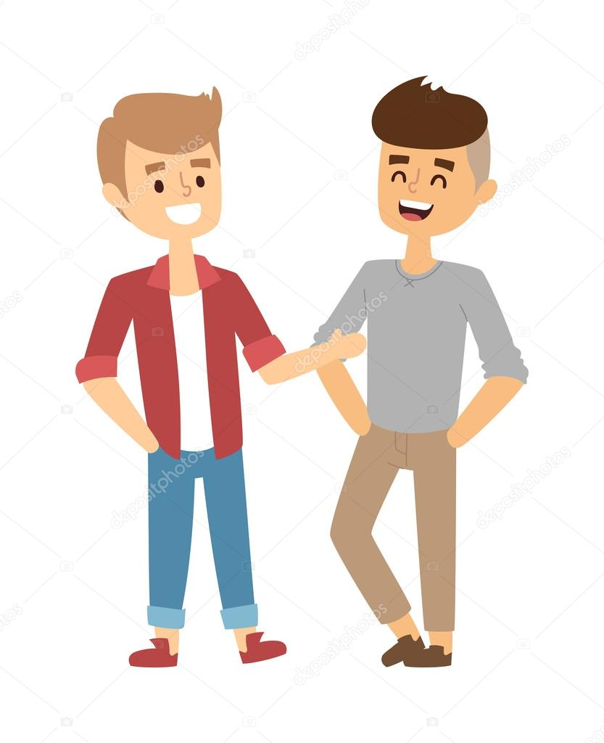
Yes I agree
Beautiful day, no?

Slide 4
My name is Juvêncio ,and you , what´s your name?
What's your name?

Slide 5
My name is Tayrone , nice to meet you Juvêncio .
Also Tayrone.

Slide 6
I'm 22 years old, and you?
How old are you?

Slide 7
I'm 21, what's your job?
I'm an engineer and you?

Slide 8
I am a teacher
Nice

Slide 9
Do you have Whatsapp?
Yes I have

Slide 10
I like men, but I'm discreet, do you like it too?
I'm sorry, I like women and I have a girlfriend

Slide 11
Okay, see you later, my friend.
Bye

