Slide 1
SIMPLE PAST
X
PAST progressive
Questions tags

Slide 2
Students:
Alyce Ewellin de Azevedo;
Guilherme Gomes de Medeiros;
Jamily Kelly Silva Gomes;
Jadilson José de Oliveira Santos;
Lucas Eduardo Silva de Medeiros;
Thérvyson Elyedson de Araújo Paz.

Slide 3
Simple Past
Expressa ações ou fatos pontuais que já aconteceram no passado. Nas frases afirmativas ele não utiliza o verbo auxiliar. No entanto, o did (passado de do) é empregado como verbo auxiliar nas frases negativas e interrogativas. Além disso, nos verbos principais regulares acrescenta-se –d, –ed ou –ied.
Exemplos:
Affirmative Form: He liked your new hair.
Negative Form: He did not like your new hair.
Interrogative Form: Did he like your new hair?

Slide 4
Past Continuous
Expressa uma ou mais ações contínuas que estavam ocorrendo no passado. Sua formação é sempre feita com o verbo auxiliar to be conjugado no Simple Past, seja nas frases afirmativas, negativas ou interrogativas. Ao verbo principal é acrescido o –ing. Essa partícula é semelhante ao nosso gerúndio –ando (andando), –endo (comendo), –indo (rindo).
Exemplos:
Affirmative Form: You were studying when he called.
Negative Form: You were not studying when he called.
Interrogative Form: Were you studying when he called?

Slide 5
Tag questions
As tag questions, também chamadas de question tags, são perguntas curtas utilizadas no fim de uma frase para solicitar a confirmação de uma informação dita na frase anterior. A frase anterior à vírgula costuma expressar uma ideia incerta e a frase posterior à vírgula (a tag question), tem a função de obter a confirmação dessa possibilidade.

Slide 6
Tag questions formation
Uma das principais características das tag questions é que se o verbo estiver na afirmativa na frase anterior à vírgula, a tag question apresentará o verbo na negativa e vice-versa. Para saber que verbo/auxiliar deve ser utilizado na tag question, basta passar a frase anterior à vírgula para a forma interrogativa.
Exemplo:
They play the guitar, don't they?
Affirmative Form: They play the guitar.
Interrogative Form: Do they play the guitar?

Slide 7
Tag question in past continuous
She was watching the game, wasn’t she?
They weren’t studying, were they?

Slide 8
Tag question in simple past
He wasn’t invited for her party, was he?
They studied together, didn’t they?

Slide 9
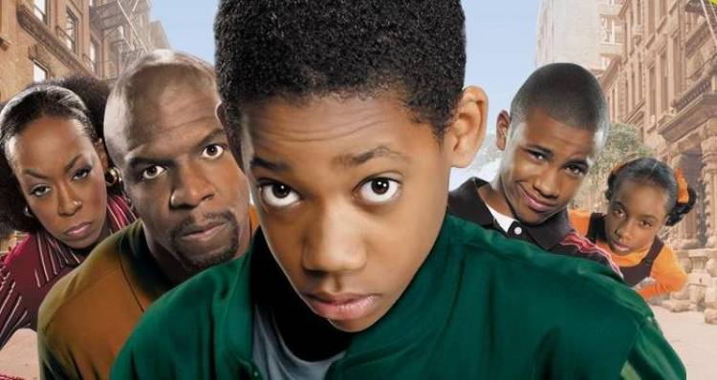
Série escolhida
Everybody hates Chris (Todo mundo odeia o Chris)
Episode 16, 2 season

Slide 10
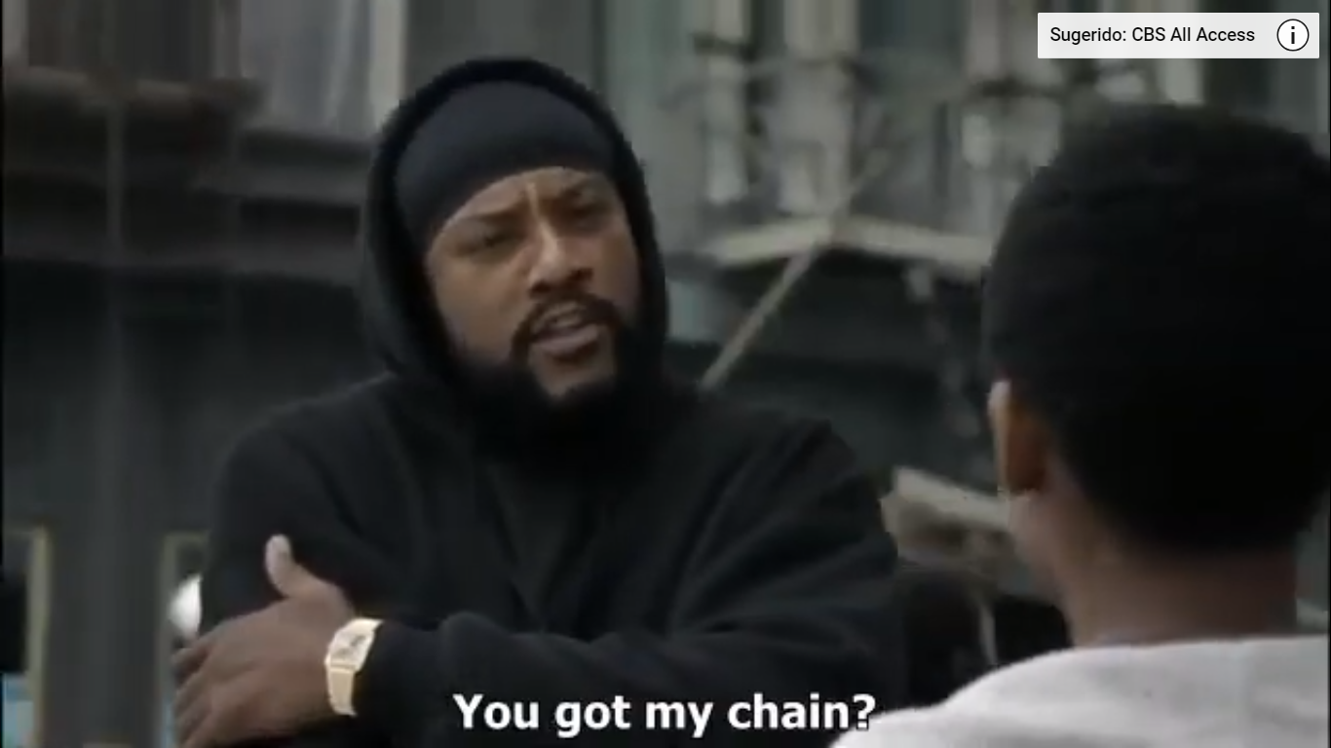

Slide 11
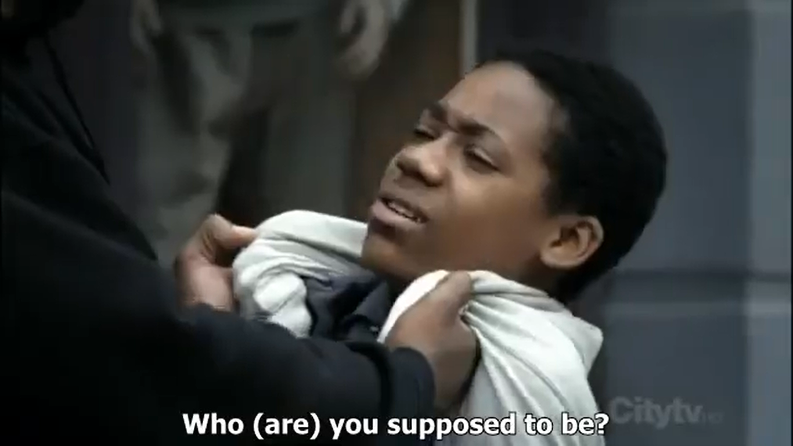

Slide 12
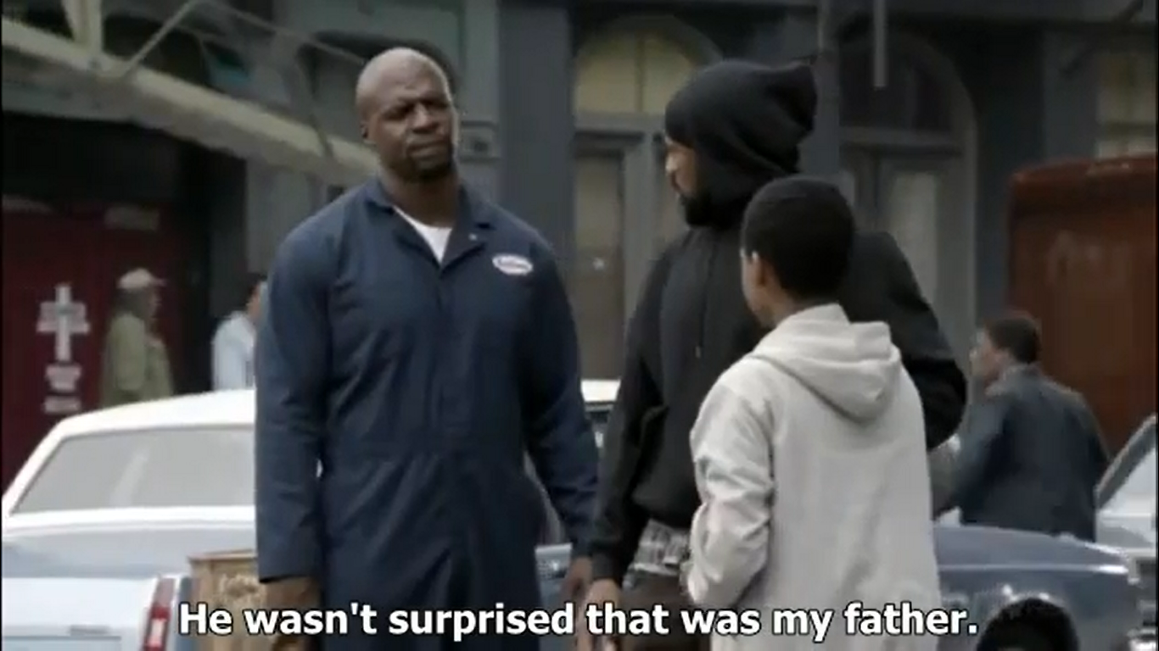

Slide 13
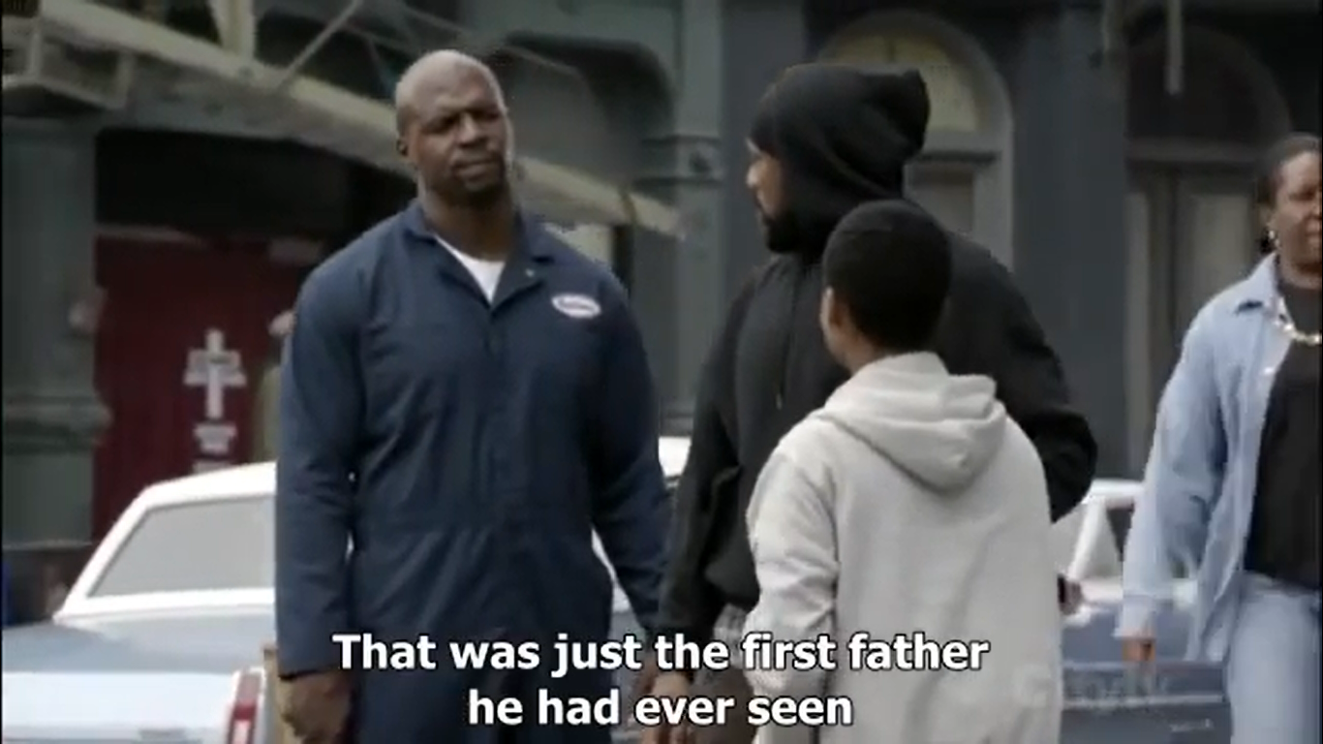

Slide 14
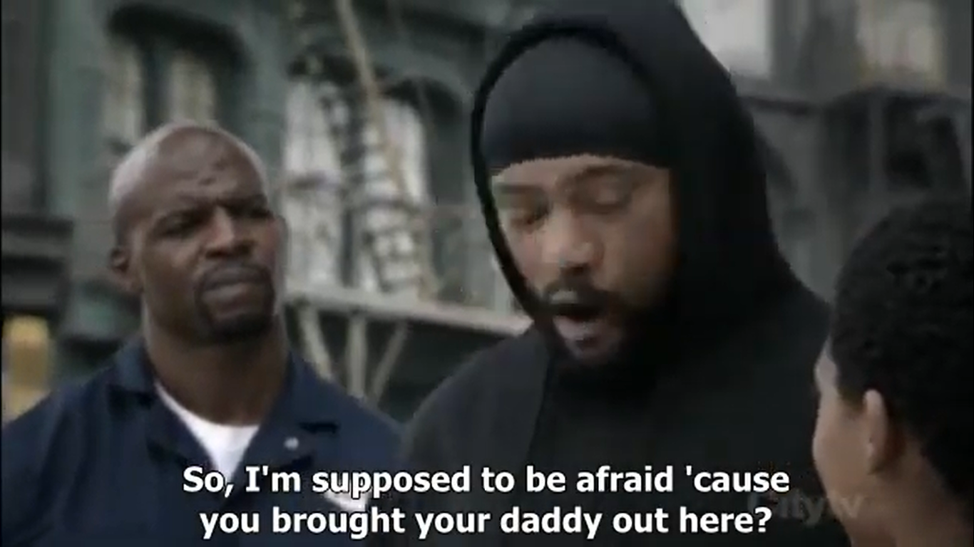

Slide 15
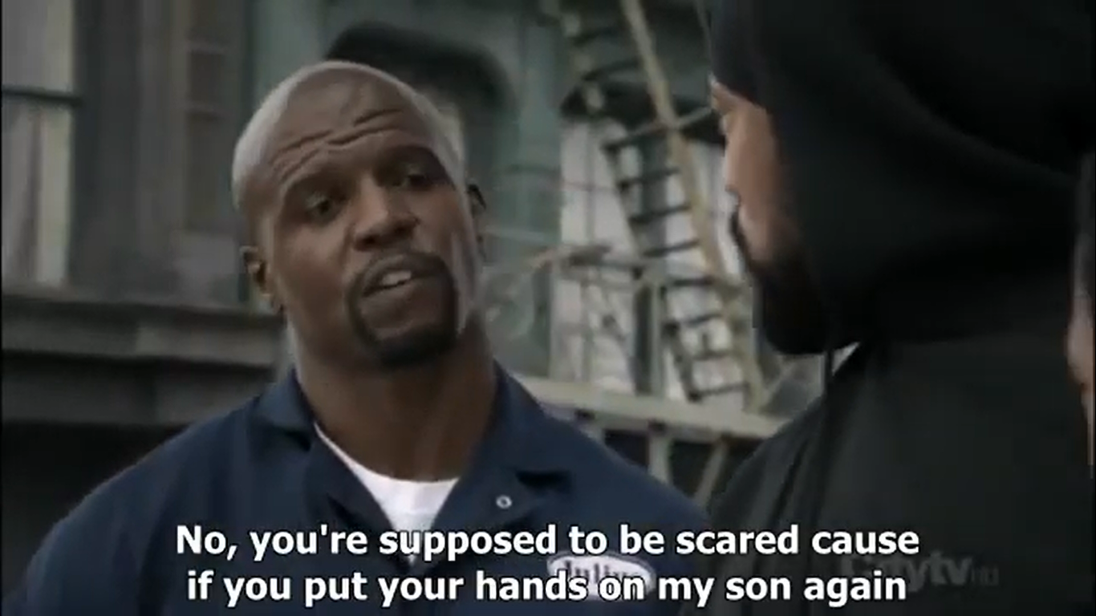

Slide 16
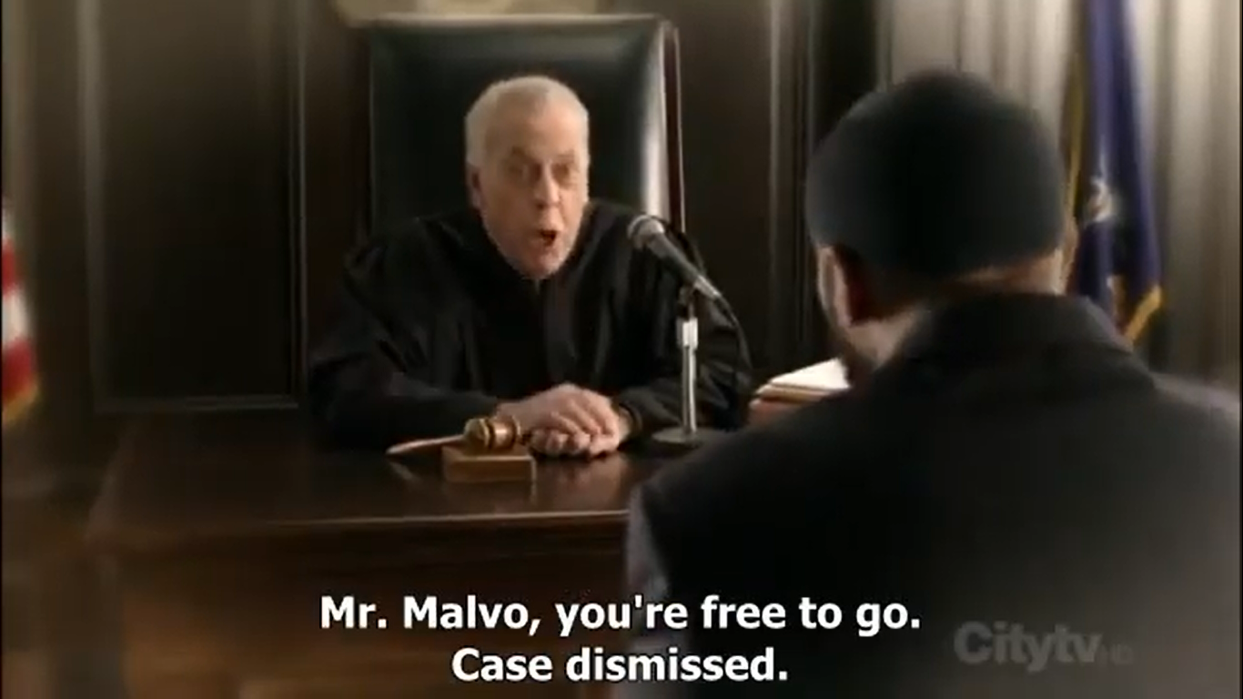

Slide 17

TAG QUESTION IN MUSICS
A Little Time (The Beautiful South)
Funny how quick the milk turns sour
Isn't it, isn't it
Your face has been looking like that for hours
Hasn't it, hasn't it
Promises, promises turn to dust
Wedding bells just turn to rust
Trust into mistrust

Slide 18
TAG QUESTION IN MUSICS
You need a little room for your big head
Don't you, don't you
You need a little space for a thousand beds
Won't you, won't you
Lips that promise fear the worst
Tongue so sharp the bubble burst
Just into unjust

Slide 19
Question 1
What is the difference between past simple and past continuous?
a) the simple past indicates an action in progress and the continuous past indicates an action already completed
b) both indicate an action that began and ended in the past
c) the simple past indicates an action already completed and the continuous past indicates an action that began in the past but not completed
d) the simple past indicates an action that never happened and the continuous past indicates an action in progress

Slide 20
Question 2
Check the incorrect alternative about tag question.
a) question tags are small questions that come at the end of the sentences in order to question / confirm something
b) if the main phrase is in the affirmative, the question tag should come in the negative form. But if the main clause is in the negative the question tag should come in the affirmative
c) the questions tag should always come between commas
d) question tags should always come after commas

Slide 21
QUESTION 3
What does Malvo ask Chris?
a) if he got his bracelet
b) if he got his earring
c) if he got his chain
d) if he got his ring

Slide 22
Question 4
What is Malvo’s dream?
a) he is robbed
b) he dies
c) he dreams about his father
d) he is at his own judgment

Slide 23
Question 5
Why is Malvo surprised when he sees Julius?
a) because he's Chris's father
b) because he thinks he's his own father
c) because was the first father he have ever seen
d) because he is afraid of Julius

Slide 24
references
https://www.todamateria.com.br/past-continuous/
https://www.todamateria.com.br/tag-questions/

