Slide 1

English
Teacher: Cristiane
Class: 3° MSI - MAT

Slide 2
Erionaldo

Slide 3
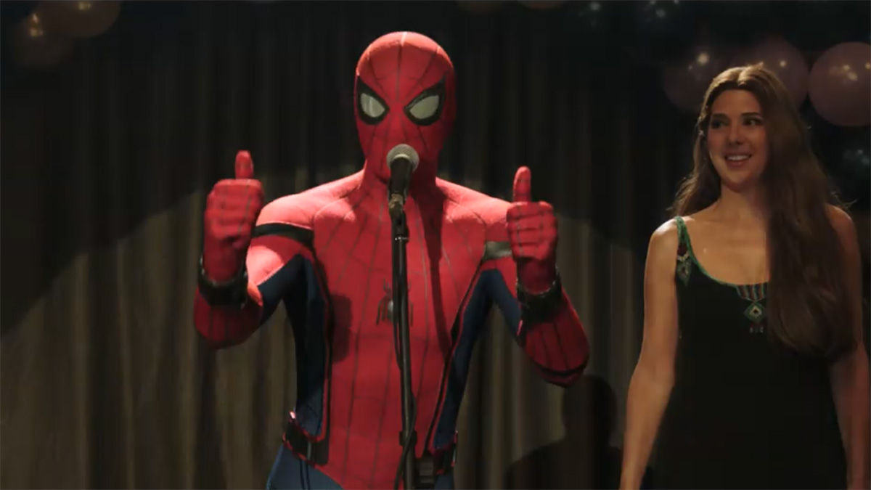

Slide 4
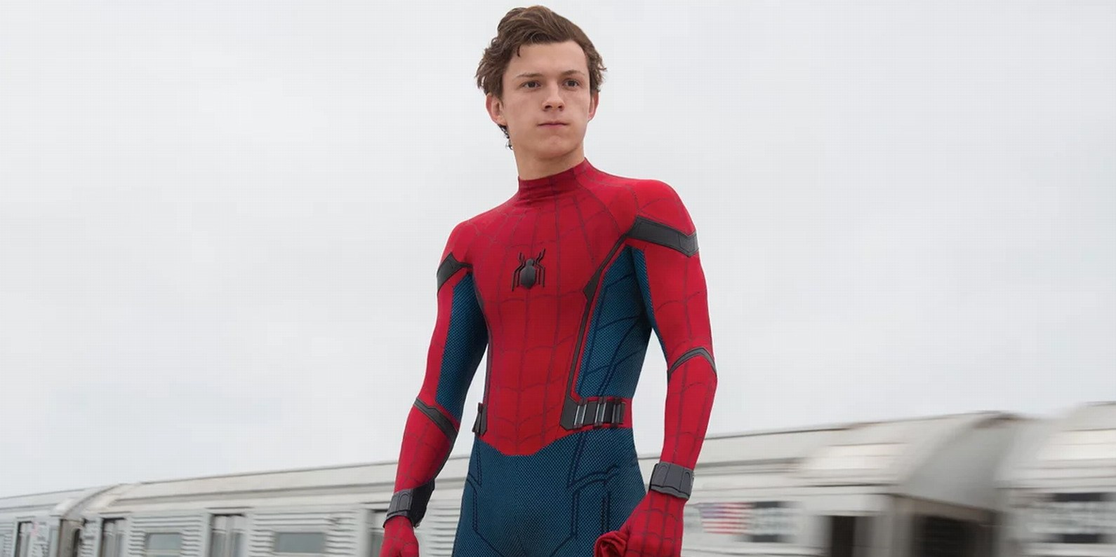
Tom Holland
Name: Tom Holland
Nacionality: British
Birth: June 1, 1996
Age: 21 years old.
Prof: Actor
Status: Alone.
Children: Does not have children.

Slide 5
Anderson

Slide 6
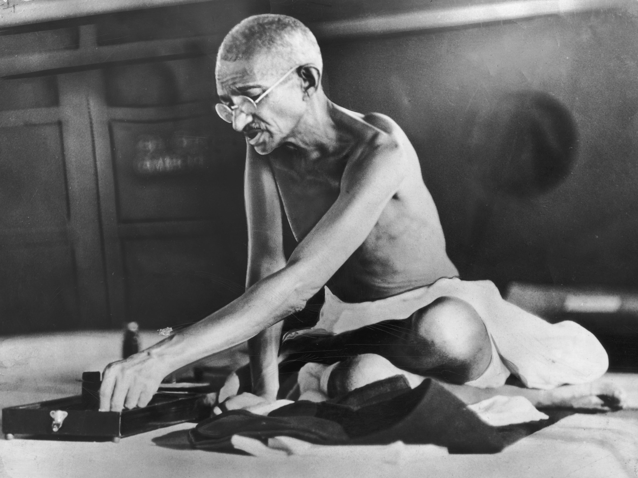
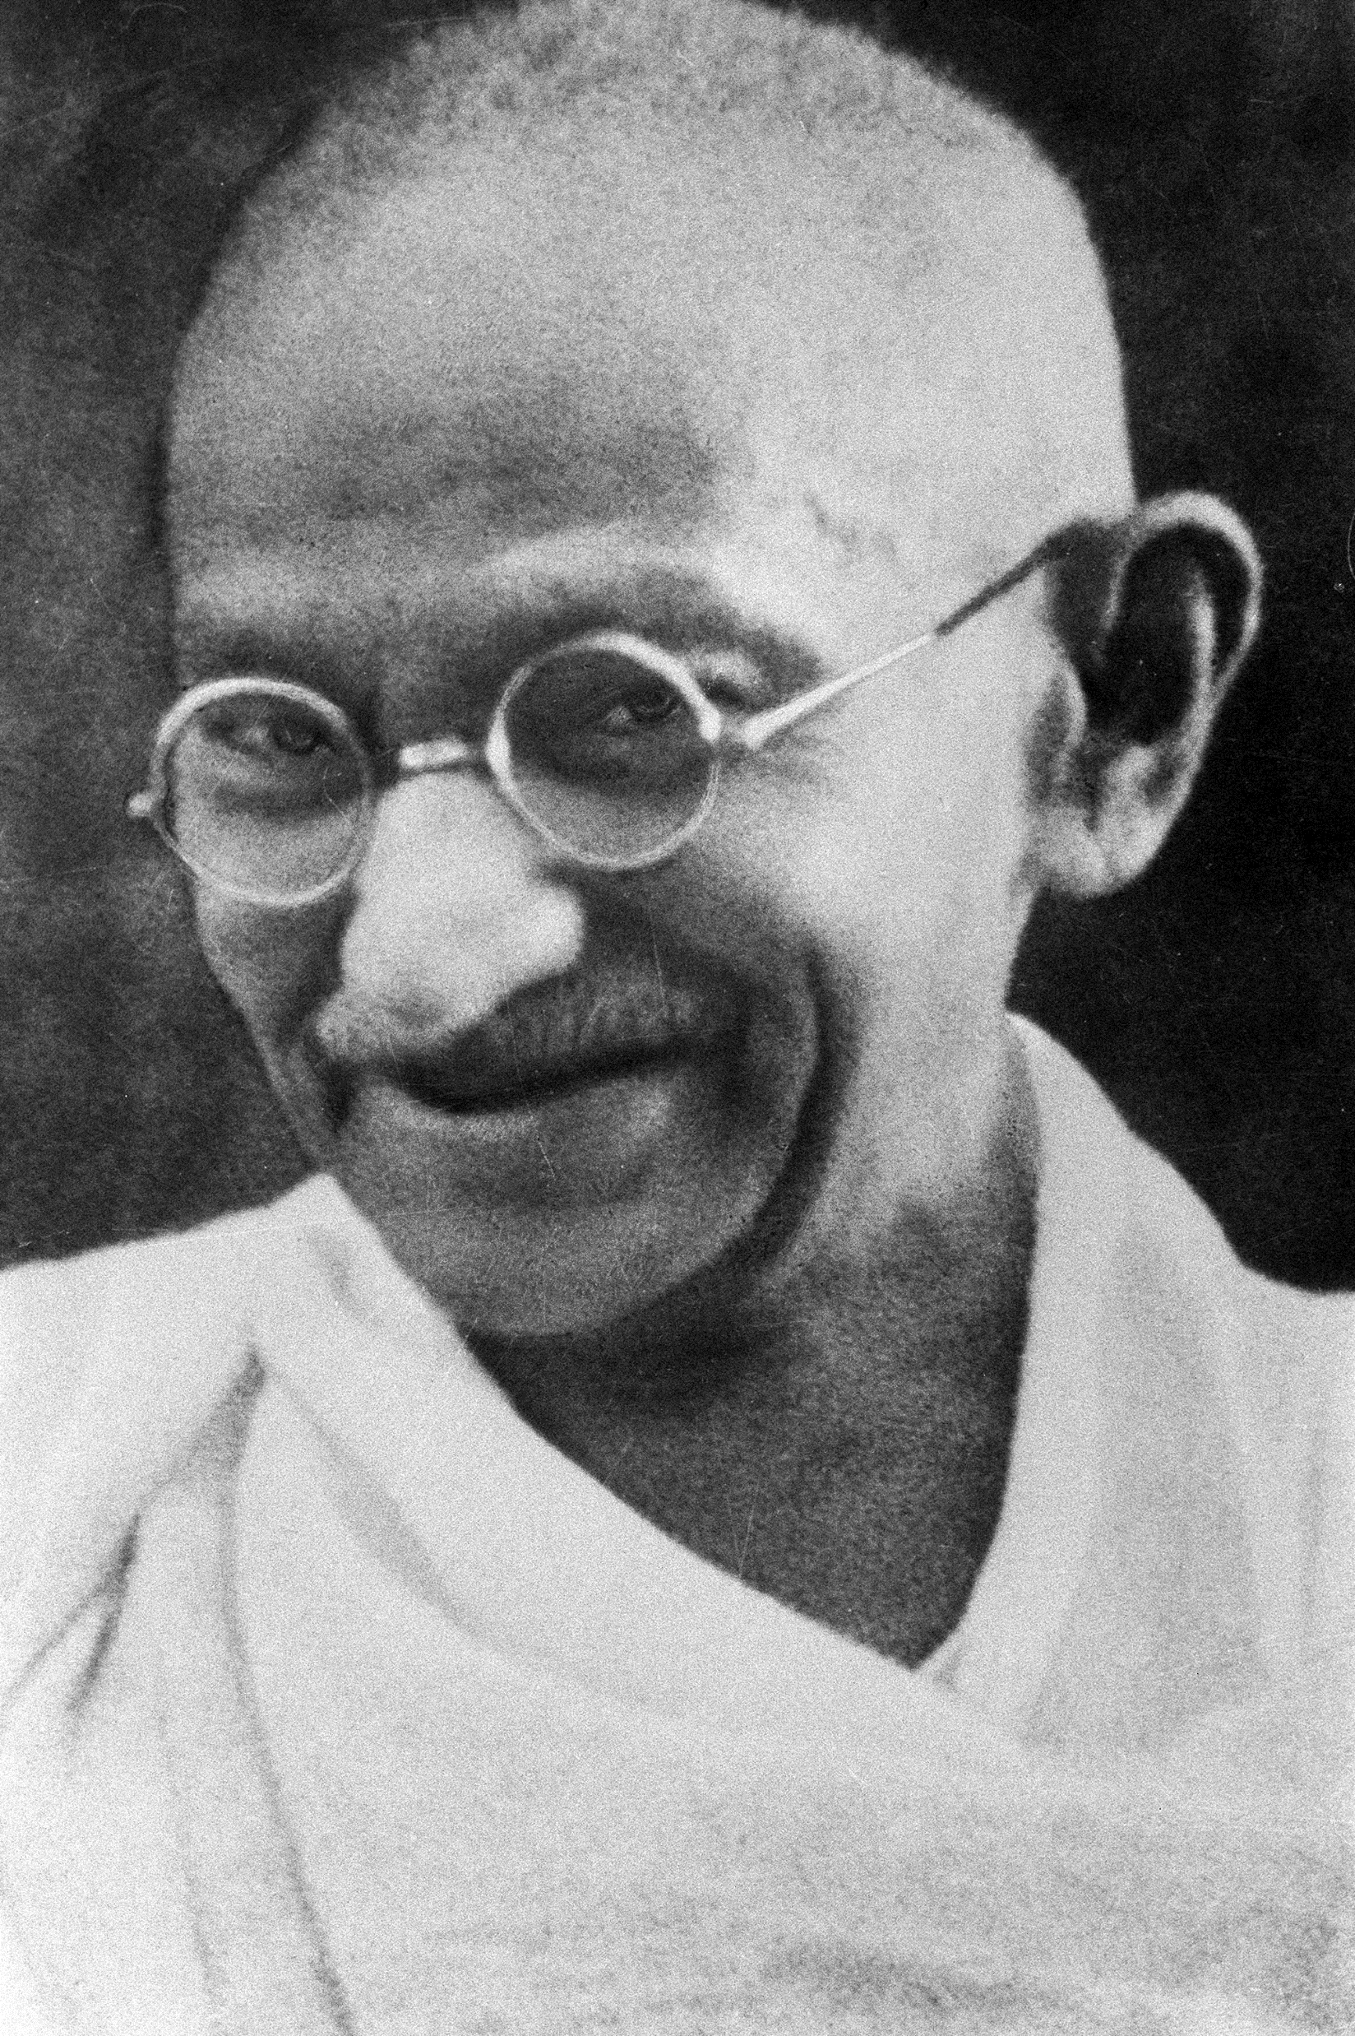
NAME: Mahatma Ghandi
NATIONALITY: Indian
BIRTH: Octuber, 2nd in 1869
AGE: 79 years-old
DEATH: January, 30th in 1948
OCCUPATION: Leader of the Indian
Independence movement in British-ruled
India.
MARITAL STATUS: Married with Kasturba
Gandhi
CHILDRENS: Harilal, Devdas, Ramdas and
Manilal.
Anderson Monteiro
GHANDI

Slide 7
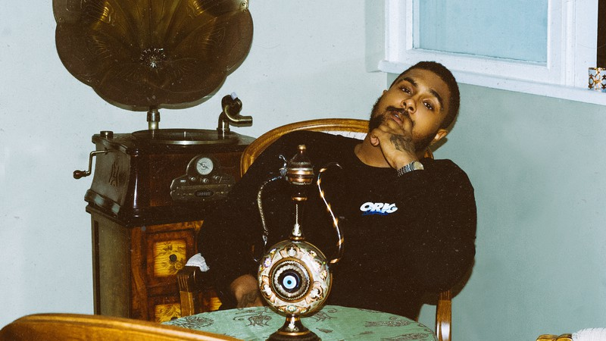
BACO EXU DO BLUES
NAME: Diogo Ferreira Moncorvo
NATIONALITY: Brazilian
EXTRA INFORMATION:
the song "Te Amo Disgraça" was chosen Song of the Year by the PRÊMIO MULTISHOW DE MÚSICA BRASILEIRA.
BIRTH: January, 11th in 1996
AGE: 23 years-old
PROFESSION: singer,
rapper and composer.
Anderson Monteiro

Slide 8
Paulo Guilherme

Slide 9
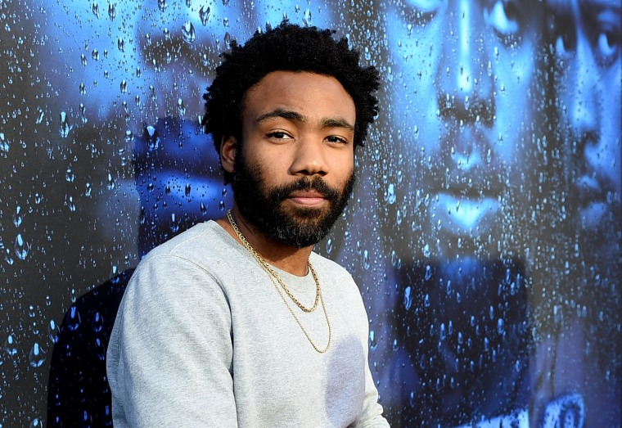
Name: Donald Glover
Nationality: American
Birth: September 25th, 1983
Age: 35 years old
Profession/Ocupation: Actor, writer, comedian, rapper and singer
Matrial Status: Married to Michelle White
Children: Two children, one is called Legend

Slide 10
Cristina

Slide 11
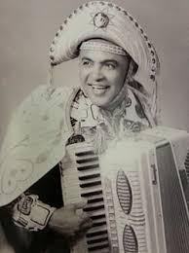
Luiz Gonzaga
Name: Luiz Gonzaga do Nascimento
Nationality: Brazilian
Birth: December 13, 1912
Death: August 2, 1989
Profession/Occupation: Singer, accordionist and composer
Marital Status: Married to Helena Neves Cavalcanti
Children: Two children (an adopted girl)
Extra information: Known as the King of Baião, responsible for the valorization of Northeastern rhythms and one of the composers of the song "White Wing" that became an anthem of the Brazilian Northeast.
Maria Cristina O. Alves

Slide 12
Christy

Slide 13

Cristiano Ronaldo
Name: cristiano ronaldo
Nationality: portuguese
Born in: February, 5th 1985
Age: 34 years
Occupation: soccer player and model
Marital status: dating only, the her name is georgina
Children: 4, Alana, Cris jr., Eva and Mateo
Bonus information: #I´mBeatifull

Slide 14

Seiya de pégaso
Name: Seiya
Nationality: Japanese
Birth: December, 1st of 2001
Age: 17 years old
Ocupation: Athena soldier
Marital status: Case with Saori Kido (Athena)
Children: None

Slide 15
Raquel Leticia

Slide 16
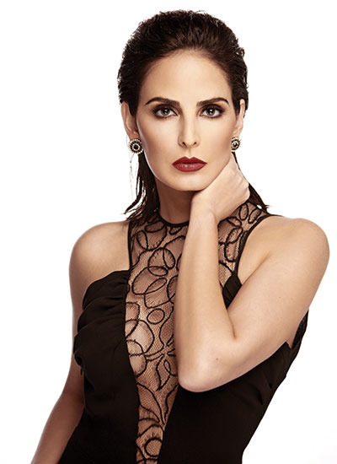

Slide 17
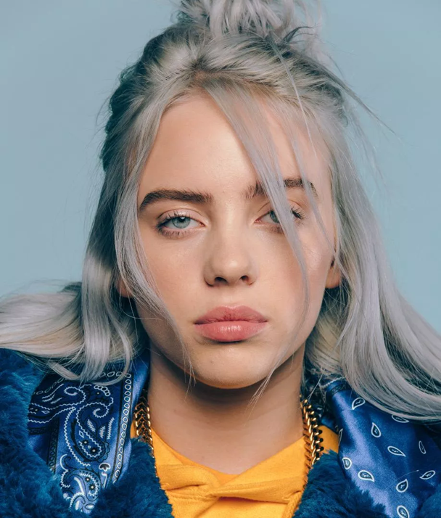
her name is Billie Eilish
She is britsh , born in American
her birthday on December 18th 2001;
she is 17 years old
Her profession is Singer-songwriter
she is single
she does not have children

Slide 18
Clara Macedo

Slide 19
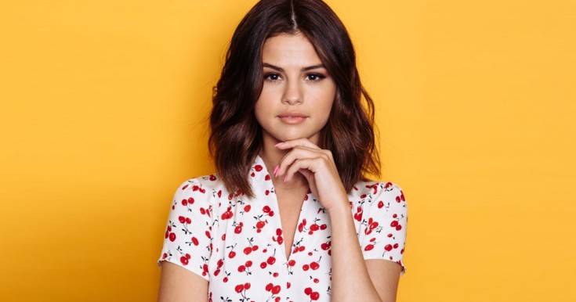
Selena Gomez

Slide 20
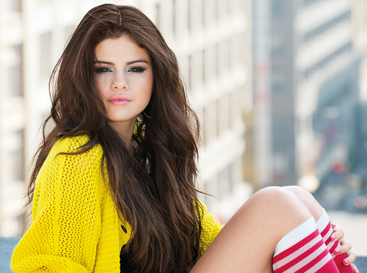
Gomez
Name: Selena Marie Gomez
Nationality: U.S
Birth: July, 22th 1992
Age: 26 years old
Profession: Singer, actress, composer
Matrial Status: Not mentioned
Children: None

Slide 21

Gomez
Hi, my name is Selena Marie Gomez, I´m from U.S, was born on july 22th 1992, i’m 26 years old, my profession is singer; composer; actress, i’m not married and do not have children.

Slide 22
Joao marcos

Slide 23
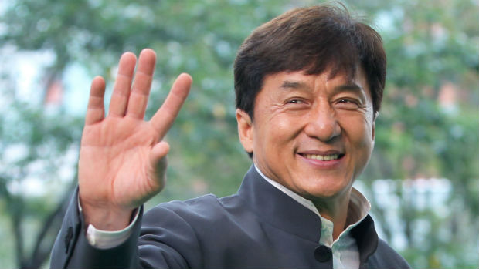
Jackie Chan
Name: Jackie Chan;
Nationality: Chinese;
Birth: April, 7th 1954;
Age: 64 yars old;
Profession/Occupation: Actor, martial artist, film director, producer, stutman, and singer;
Children: Jaycee Chan, Etta Ng Chock Lam.

Slide 24
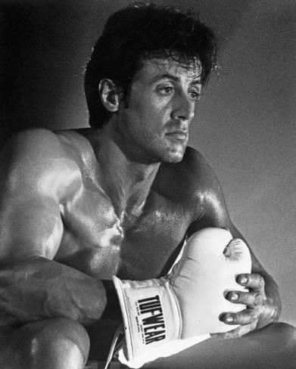
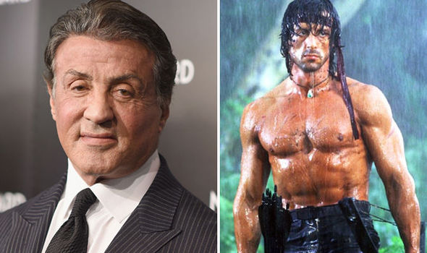
Who is Sylvester Stallone?

Slide 25
Sylvester Stallone
Is fron the United States;
Was born on july, 6th 1946;
He is 72 years old;
Works as na actor, screenriter and diretor;
Married to Jenifer Flavin;
Has five children: Sage Stallone, Seargeoh Stallone, Sistine Rose Stallone, Sophia Rose Stallone and Searlet Rose Stallone.

Slide 26
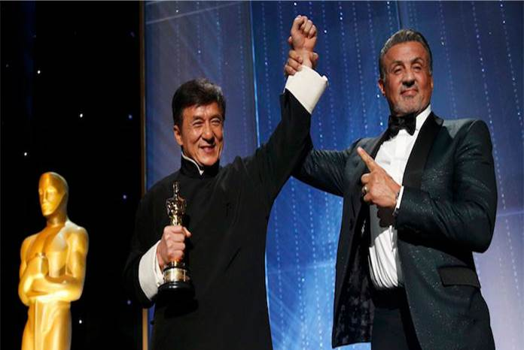
Thank you very much!

Slide 27
Leticia

Slide 28
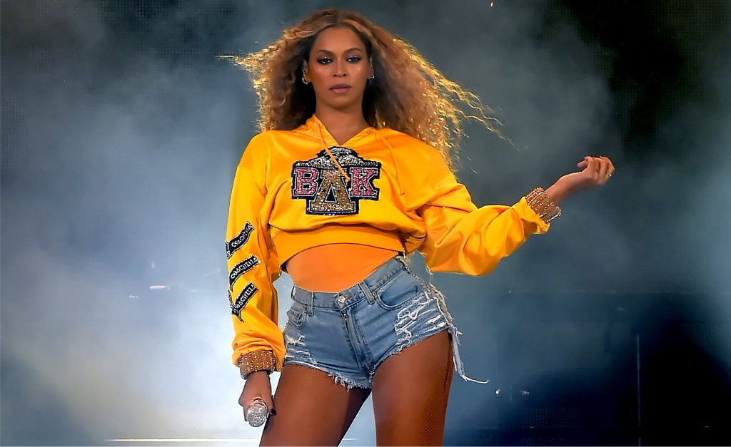
BEYONCÉ
Name: Beyoncé
Nationality: American Birth: September 4, 1981
Age: 37 years old
Profession: Singer, Songwriter, and Actress
Marital Status: Married to jay z Children: Blue Ivy Carter

Slide 29
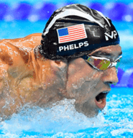
Michael Phelps
American
June, 30, 1985
33 years old
Swimmer
Nicole Phelps
Boomer Phelps and Beckett Phelps

Slide 30
Jonatan

Slide 31
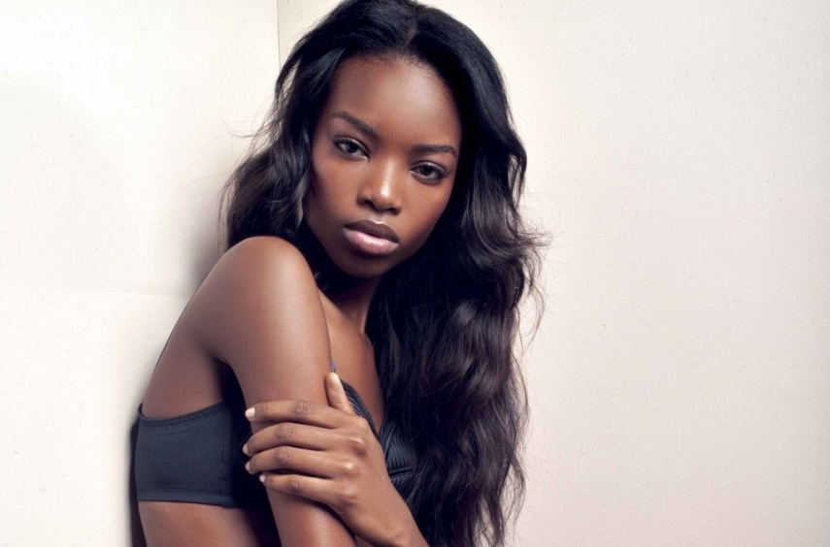
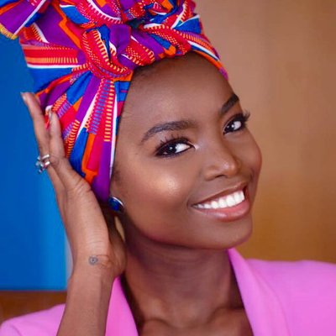
BORGES
Name: Maria Borges
Nationality: Angolan
Birth: October , 28th in 1992
Age: 26 years old
Occupation: model
Marital Status: Not mentioned
Children: None

Slide 32
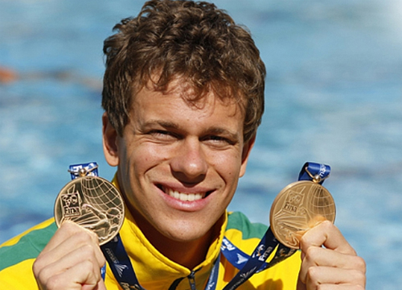
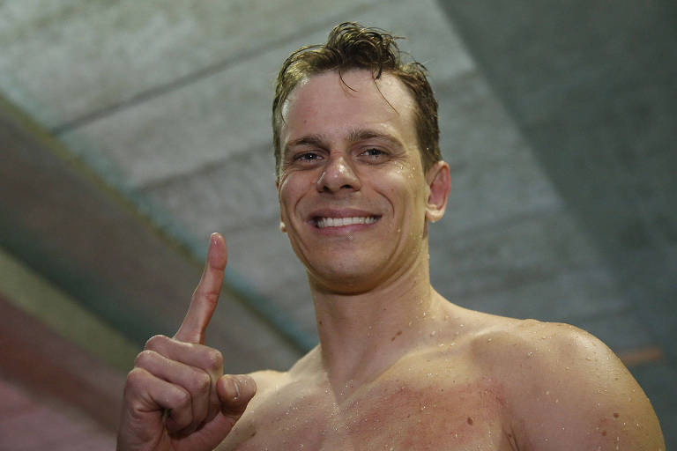
CIELO
Name: Cesar Augusto Cielo Filho
Nationality: Brazilian
Birth: January, 10th in 1987
Age: 32 years old
Occupation: Swimmer, businessman and scheduler of other athletes
Marital Status: Married to Gisch
Children: Thomas

Slide 33
Reizin

Slide 34


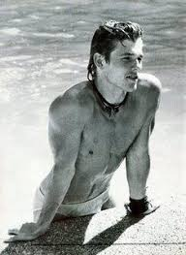
name
Morten harket

Slide 35
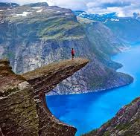
nationality
norwegian

Slide 36
birth
September , 14th in 1959

Slide 37
age
56 years old

Slide 38
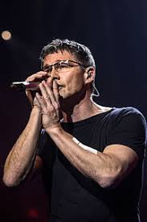
profession/occupation
Singer , songwriter , activist

Slide 39
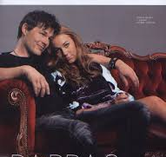
Marital status
Married to camilla malmquist

Slide 40
children
Tomine harket , jonathan harket , jakob harket ,henny harket , karmen harket

Slide 41
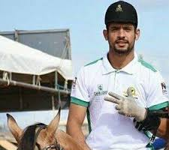
Name
Nathan queiroz

Slide 42

nationality
brazil

Slide 43
Birth
July , 22th in 1991

Slide 44
age
28 years old

Slide 45
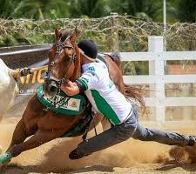
Profession/ occupation
Cowboy and tamer

Slide 46
Marital status
I'm single

Slide 47
children
I do not have children

Slide 48
Artur

Slide 49
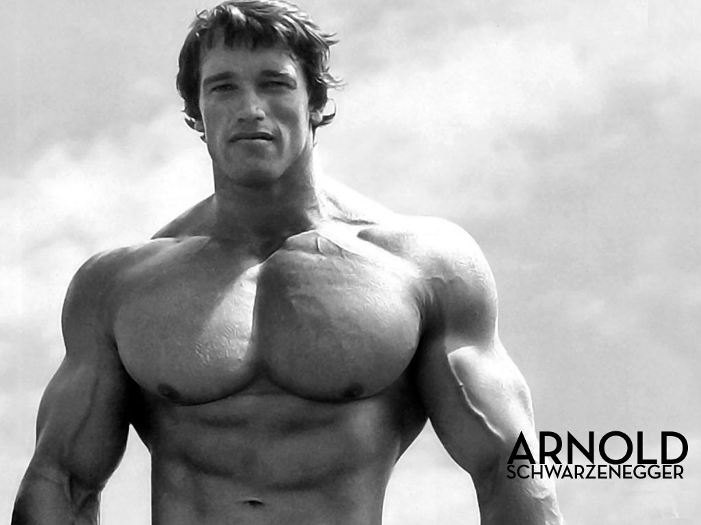
"I'll Be Back"

Slide 50
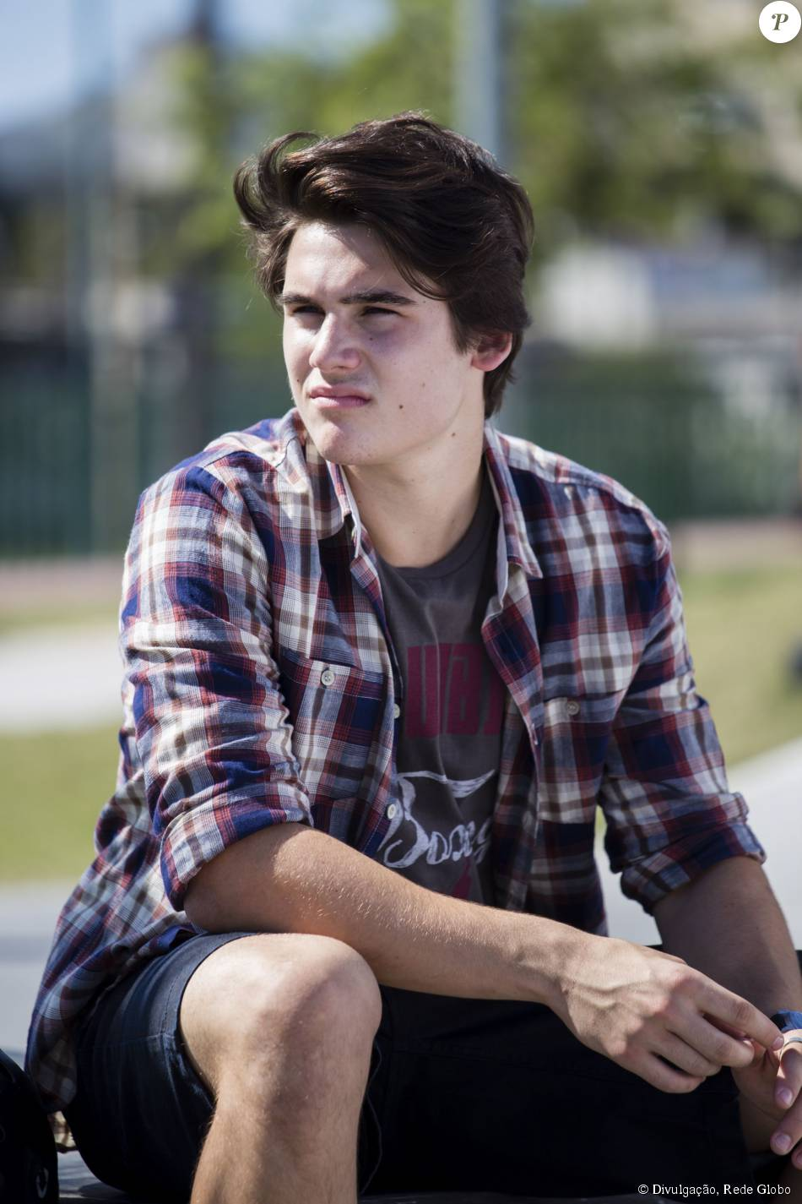
NAME: Gustavo
NATIONALITY: Brazilian
BIRTH: December, 11th, in 2001
AGE: 17 years old
PROFESSION: He is a student
MARITAL STATUS: He dates
CHILDREN: he does not have children

Slide 51
Vinicius

Slide 52
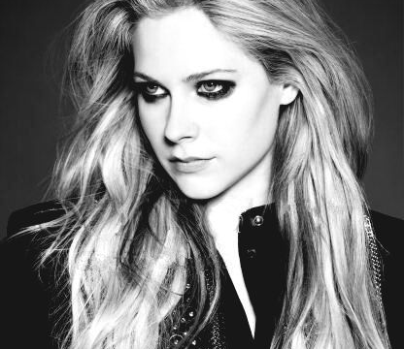
Avril Lavigne
Aluno: José Vinícius

Slide 53
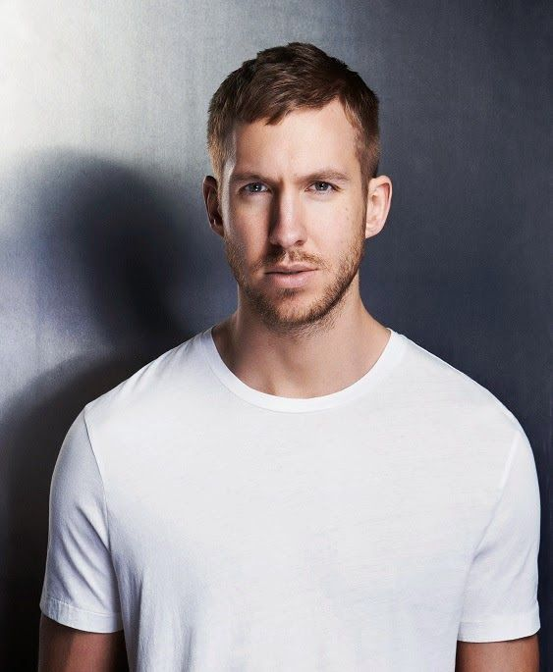
Calvin Harris
Name: Adam Richard Wile, better known as Calvin Harris;
Nationality: Scottish;
Birth: January 17, 1984;
Age: 35 years old
Profession: Producer, musician, lyricist, singer, composer and DJ;
Marital Status: none
Aluno: José Vinícius

Slide 54
Pedro Neto

Slide 55
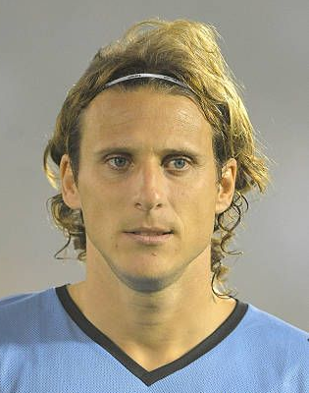
Diego Forlan
Aluno: Pedro Fernandes

Slide 56
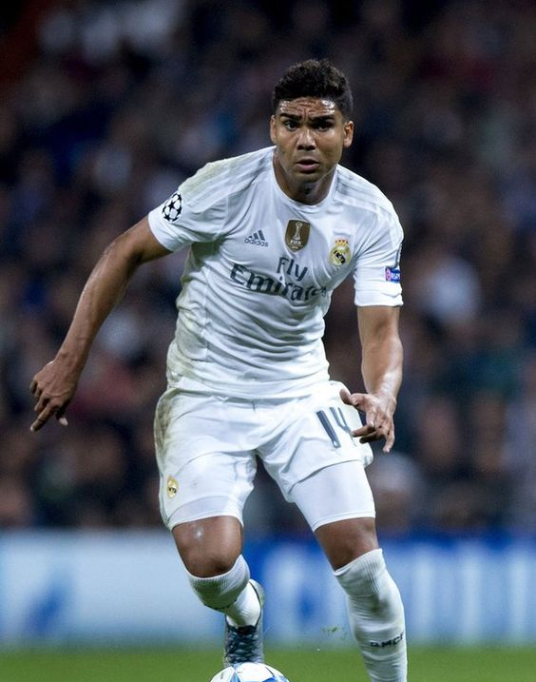
Casemiro
Name: Carlos Henrique “Casemiro”
Nationality: Brazillian
Birth: 23th February, 1992
Age: 27 years old
Profession: Soccer Player
Married : Yes, With Anna Mariana Casimiro
Children: One kid (Sara)
Aluno: Pedro Fernandes

Slide 57
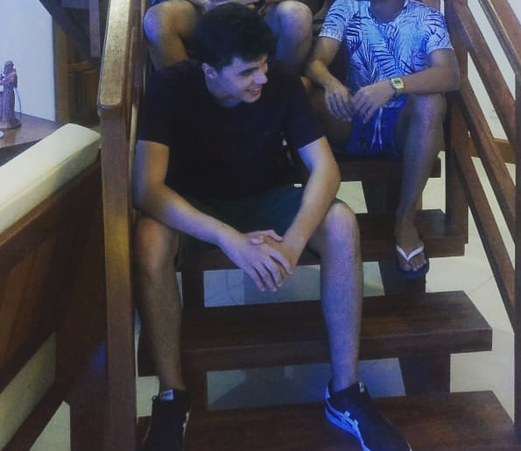
Pedro Fernandes
Name: Pedro Fernandes
Nationality: Brazillian
Profession/Occupation: Student
Birth: 9th April, 2002
Age: 16 Years Old
Married: No
Children: None
Aluno: Pedro Fernandes

Slide 58
Luis Antonio

Slide 59
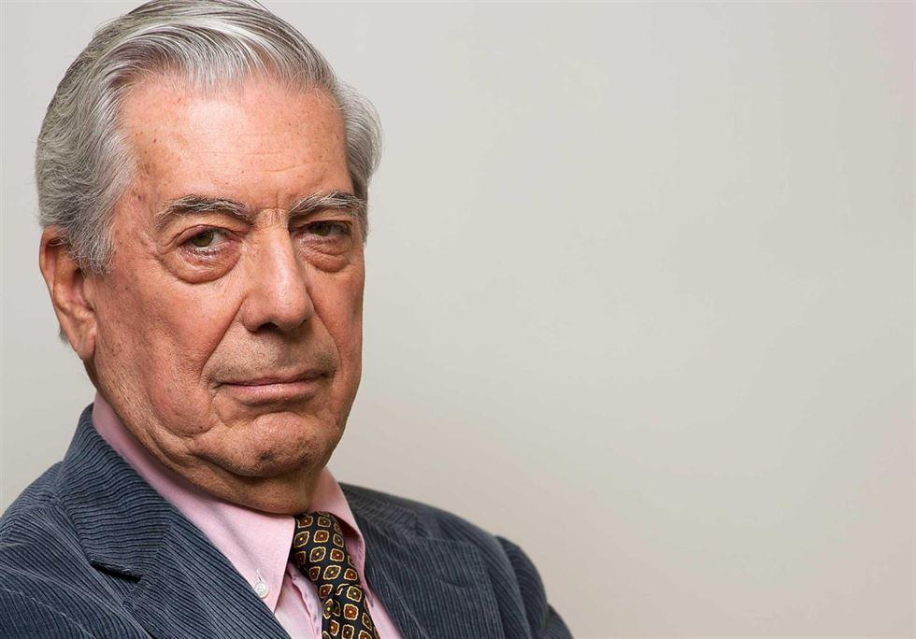
LLOSA
Name: Mario Vargas LLosa
Nationality: Peruvian
Birth: March, 28th in 1936
Age: 82 years old
Occupation: Writer, politician, journalist, essayist and college professor
Marital Status: Married to Patricia Llosa
Children: Álvaro Vargas Llosa, Gonzalo Vargas Llosa and Morgana Vargas Llosa

Slide 60
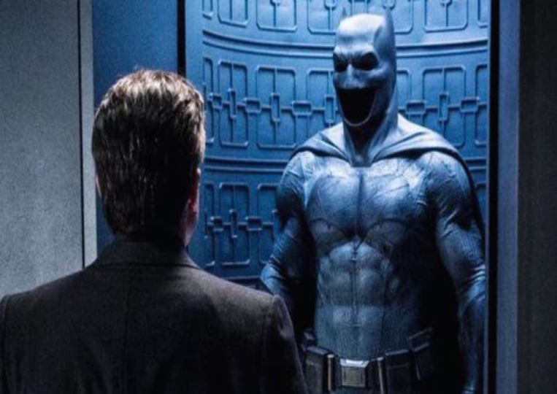

BATMAN (Bruce Wayne)
Name: Batman (Bruce Wayne)
Nationality: American
Birth: February, 19th in 1916 or 1939
Age: 80 or 103 years old
Occupation: Business tycoon, Philanthropist, Owner of the Wayne Enterprises Corporation, Masked Watcher, Defender of the law, Detective, Leader of the Corporation and Batman.
Marital Status: Married to Selina Kyle
Children: Helena Wayne

Slide 61
Andre

Slide 62
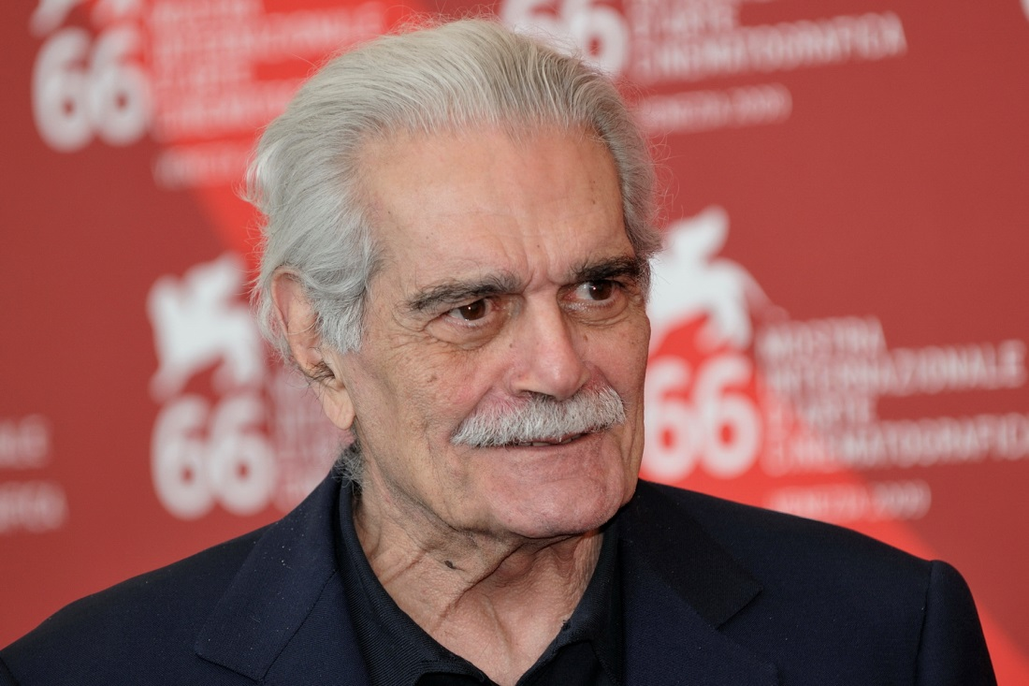
Omar Sharif

Slide 63

WENDEL
My name’s Wendel bezerra
I’m Brazilian
I was born in June, 18th 1974
I’m 44
I’m voice actor, actor, dubbing director and speaker.
I am married to Aline Larcerda.
I have 3 childrens: Melissa, Enzo and Eric.

Slide 64
Ryan

Slide 65
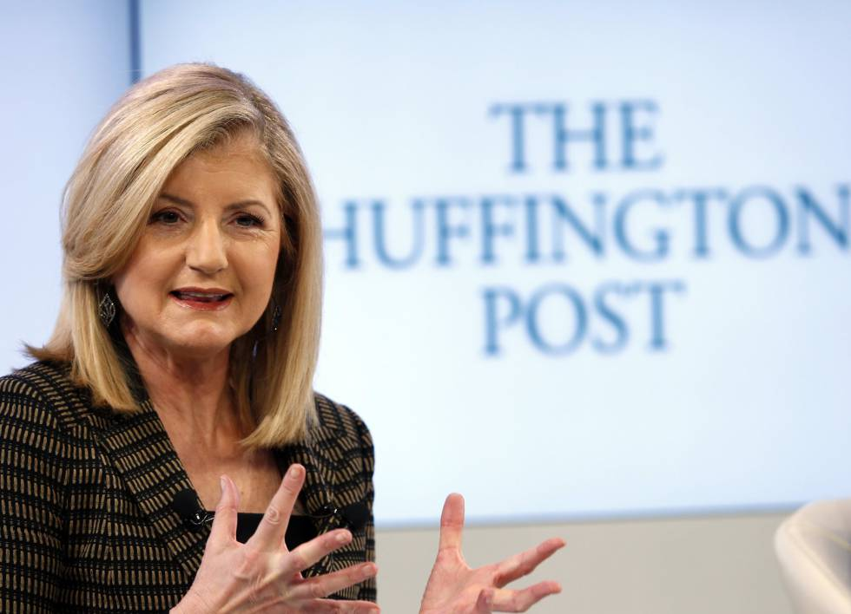

Slide 66
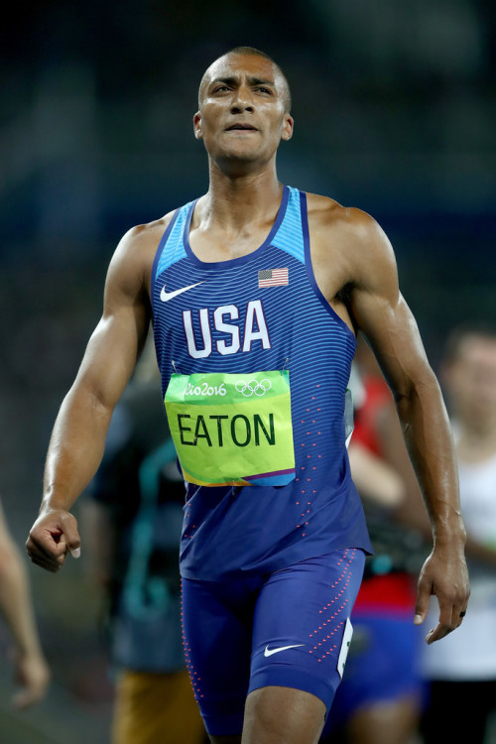
Name: Ashton James Eaton
Nacionality: American.
Birth: January 21th, 1988.
Age: 31 years old.
Prof: Former athlete.
Status: Married to Brianne Theisen-Eaton.
Children: Does not have children.

Slide 67
Dyego Vinicius

Slide 68
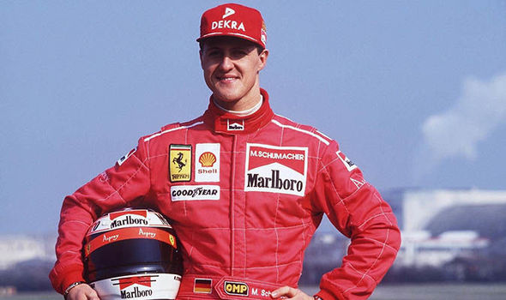
Michael Schumacher

Slide 69
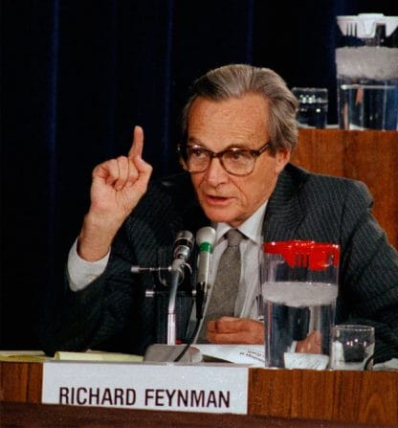
Richard Feynman
Name: Richard Phillips Feynman
Nacionality: American
Birth: May, 18th, in1918
Dead: February, 15th in 1988
Age: 69 years old
Prof: Theoretical Physicist
Status: Married to Gweneth Howarth
Children: Michelle Feyman, Carl Feynman
Extra: Winner of the novel Prize in physics, pioner in nanotechnology, professir if ekectridynamics ad considered one of the 10 most influential physicists of the twentielth centuary.

Slide 70
Antonio carlos

Slide 71
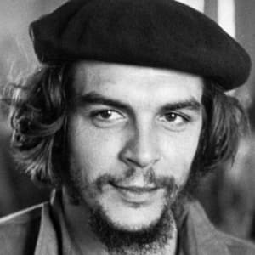
Che Guevara
Name: Che Guevara
Nacionality: Argentine
Birth: June, 14th, in 1928
Dead: October 9th in 1967
Age: 39 years old
Prof: Physician, author, gurrilla leader, diplomat
Status: Married to Aleida March
Children: Five. Aleida, Hilda, Camilo, Célia and Henesto

Slide 72
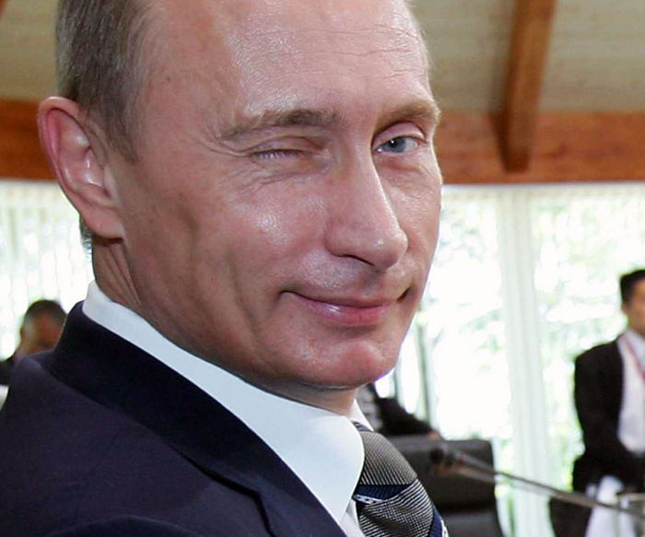
Vladimir Putin
Name: Vladimir Vladimirovitch Putin
Nacionality: Russian
Birth: October 7th, in 1952
Age: 66 years old
Prof: Current President
Status: Married to Ludmilla Putina
Children: TwoMaria and Ekaterina Putina

Slide 73
Andreia

Slide 74

Name: Anitta
Nationality: Brazilian
Birth: March 30, 1993
Age: 25 years old
Profession/Ocupation: Singer and songwriter
Matrial Status: None
Children: None

Slide 75
Kleylton

Slide 76
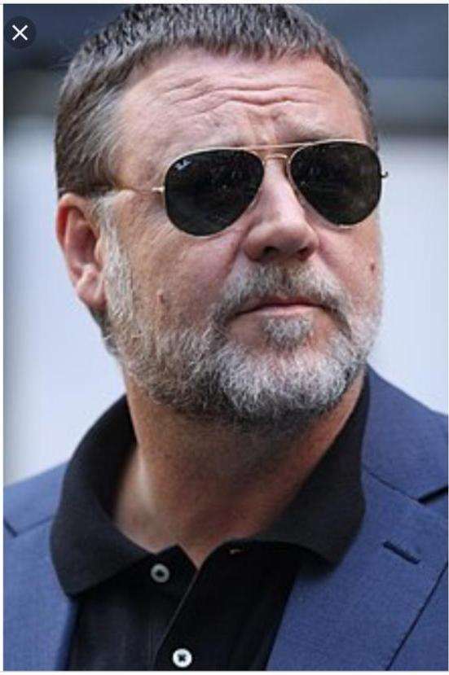

Slide 77
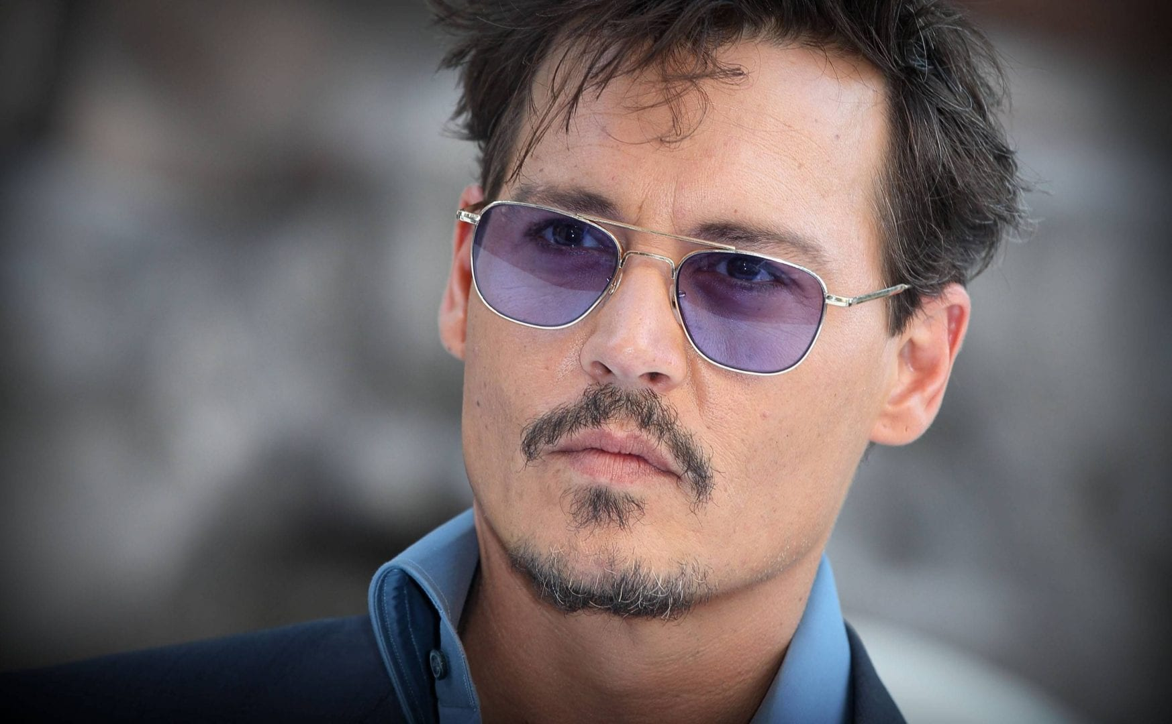
Name: John Christopher Depp II;
Nationality: North American;
Birth: June 9, 1963;
Age: 56 years old;
Profession/Ocupation: Voice actor, cinema director, guitar player, oenologist, restaurateur, cinematograpich producer, actor;
Matrial Status: Married to Vanessa Paradis
Children: Lily-Rose Depp and Jack Depp

Slide 78
Clara Medeiros

Slide 79
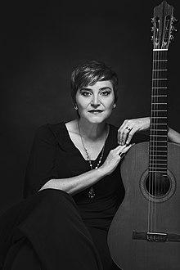
Rojas
Name: Berta Rojas
Nationality: Paraguayan
Birth: September 23rd in 1966
Age: 52 years old
Profession/Occupation: Classical Guitarrist
Marital Status: Not Mentioned
Children: Not Mentioned

Slide 80
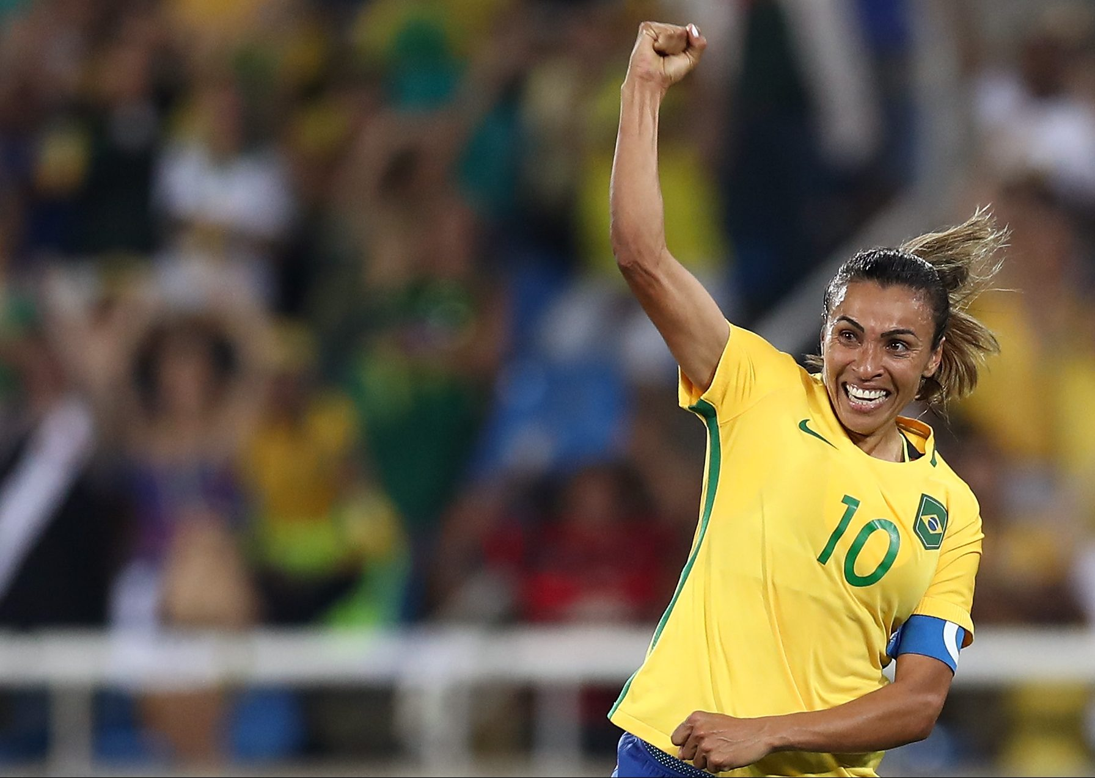
Marta Vieira da Silva
Brazilian
February 19, 1986
33 years old
Soccer Player
Not mentioned
Not mentioned

Slide 81
Ana Clara e Luana

Slide 82
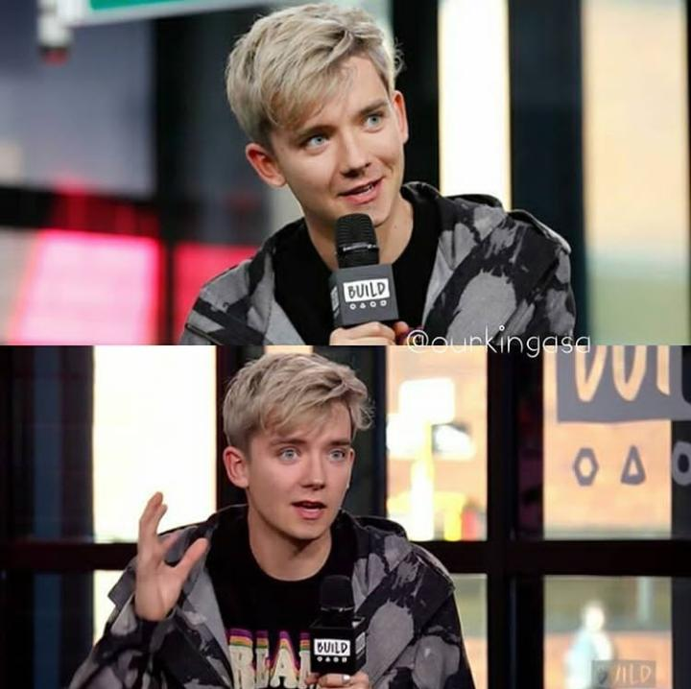
This is Asa Butterfield
His nationality is British
Your birthday is on April, 1, 1997
He is 21 years old
Your profession is Actor
Is single
Has no children

Slide 83
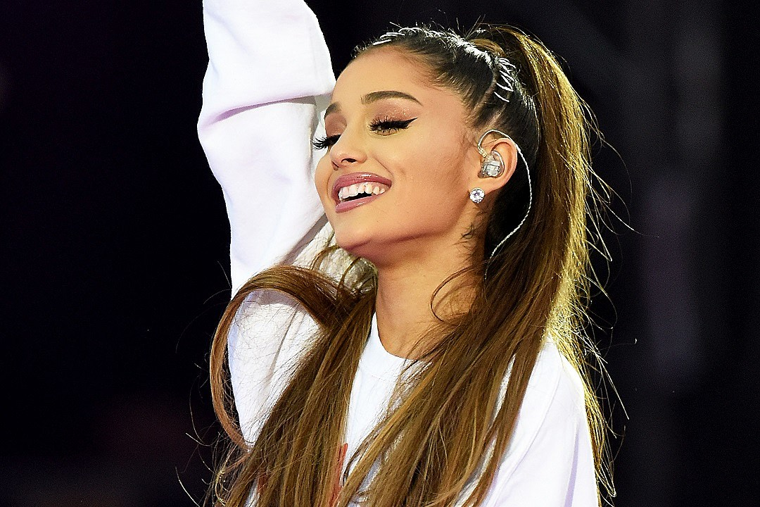
She is Ariana Grande
His nationality is American
Your birthday is on June, 26, 1993
She is 25 years old
Your profession is Singer, actress and model
Is single
Has no children

Slide 84
Julio Cesar

Slide 85
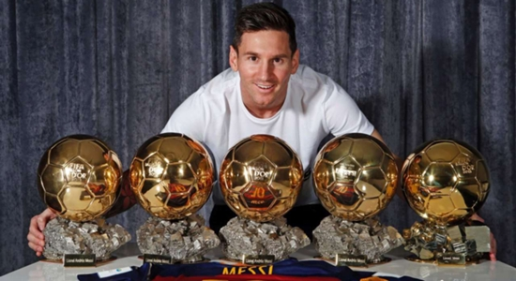
This person calls himself , Lionel Andrés Messi Cuccittini

Slide 86

Is Argentinian

Slide 87

His birthday date is June, 24, 1987, today he is 31 years old.

Slide 88

He is a soccer player

Slide 89

He is married to Antonella Roccuzzo.

Slide 90

Father of Thiago, Mateo and Ciro .

Slide 91
Eduarda

Slide 92

Anne Frank
Name: His name is Annelies Marie Frank;
Nationality: She was German;
Birth: Was born in Juny 12, 1929;
Death: Died in March 12, 1945 (15 years old);
Age (2019): It would have 90 years old;
Profession/Occupation: Was victim of the Nazi Holocaust
Marital status: She was single.

Slide 93
Ari Filho

Slide 94

Nelson Mandela
Name: Nelson Rolihlahla Mandela
Nationality: South African
Birth: July 18, 1918
Death: December 5, 2013 Age: 95
Profession/Occupation: Anti-apartheid revolutionary, political leader, and philanthropist
Marital Status: Married to Graça Simbine Machel
Children: Madiba; Makaziwe; Makgatho; Zenani; Zindziswa

Slide 95

Fallen
Name: Gabriel Toledo de
Alcântara Sguário
Nationality Brazilian
Birth: May 30, 1991
Age: 27 years old
Profession/Occupation: Professional Counter-Strike: Global Offensive player
Marital Status: Married to Leticia Lorena
Children: None

Slide 96
Fernanda

Slide 98

His name is Ed Sheeran
He is British, born in England;
His birthday on February, 17th 1991;
He is 28 years old;
His profession is singer and songwriter;
He is married to Cherry Seaborn;
He does not have children.

Slide 99
Mayk

Slide 100

Name: Rodrigo Santoro
Nationality: Brazilian
Birth: August, 22nd 1975
Age: 40 years
Profession: Actor
Marital Status: Married to Mel Fronckowiak
Children: None

Slide 101

Mia Khalifa
Name: Mia Khalifa
Nationality: Lebanon
Birth: February, 10nd 1993
Age: 26 years
Profession: Pornographic actress
Marital status: Single
Children: None

Slide 102
Matheus vasconcelos

Slide 103


Slide 104

This man is called Mateus Vasconcelos Ramos, he is Brazilian, born on February 26, 2001, is 18 years old, student, single and without children.

Slide 105
weslley

Slide 106


Tiririca
Name: Francisco Everardo Oliveira Silva (Tiririca)
Nationality: Brazilian
Birth: May 1st, 1965
Age: 53 years old
Prof: Political, musician, comedian, joker
Children: Everson de Brito Silva (Tirulipa)
M. Status: Married to Nana Magalhães

Slide 107


Slide 108
?

Slide 109


Slide 110

NAME: Rogério Mücke Ceni
NATIONALITY: Brazilian
BIRTH: January 22, 1973
AGE: 46 years old
PROFESSION: Soccer coach, ex soccer player (goalkeeper)
MARITAL STATUS: Sandra Ceni
CHILDREN: Henrique Vieira Ceni, Beatriz Ceni, Clara Ceni
EXTRA INFORMATION:
goalkeeper with more goals in football history.

