Slide 1
Houses and apartments
Teacher Cristiane Cruz

Slide 2
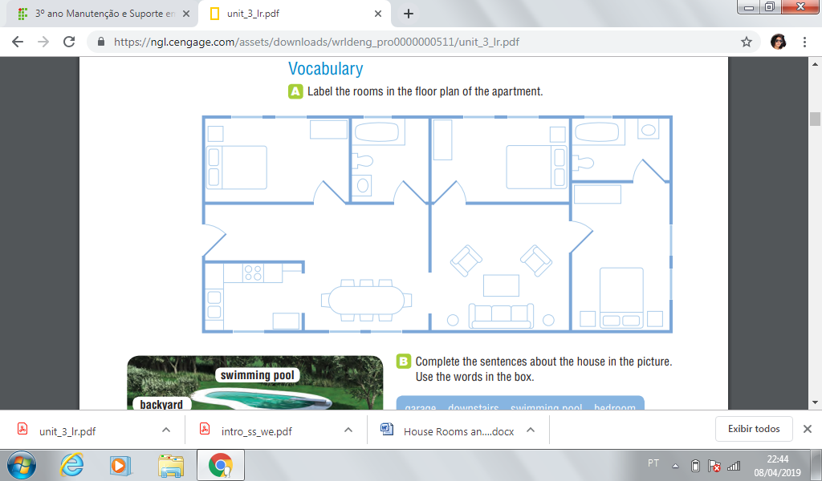

Slide 3
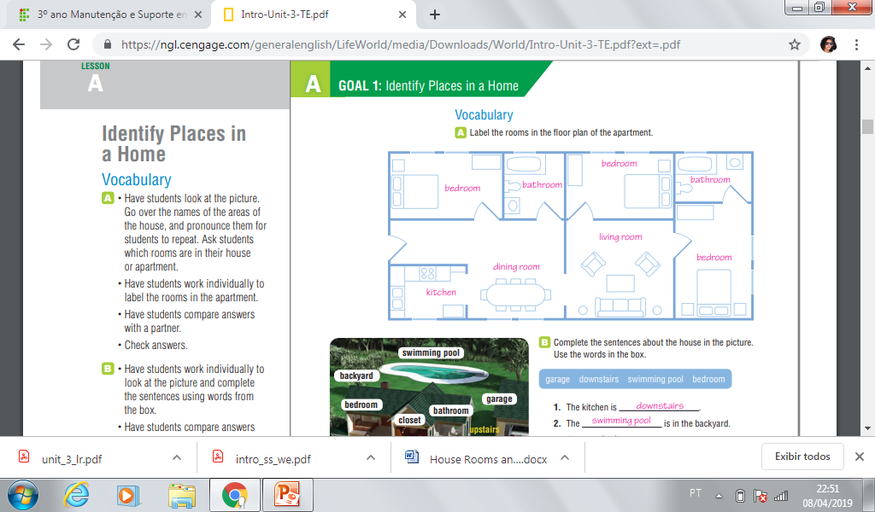

Slide 4
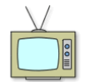
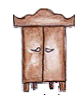
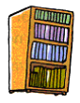
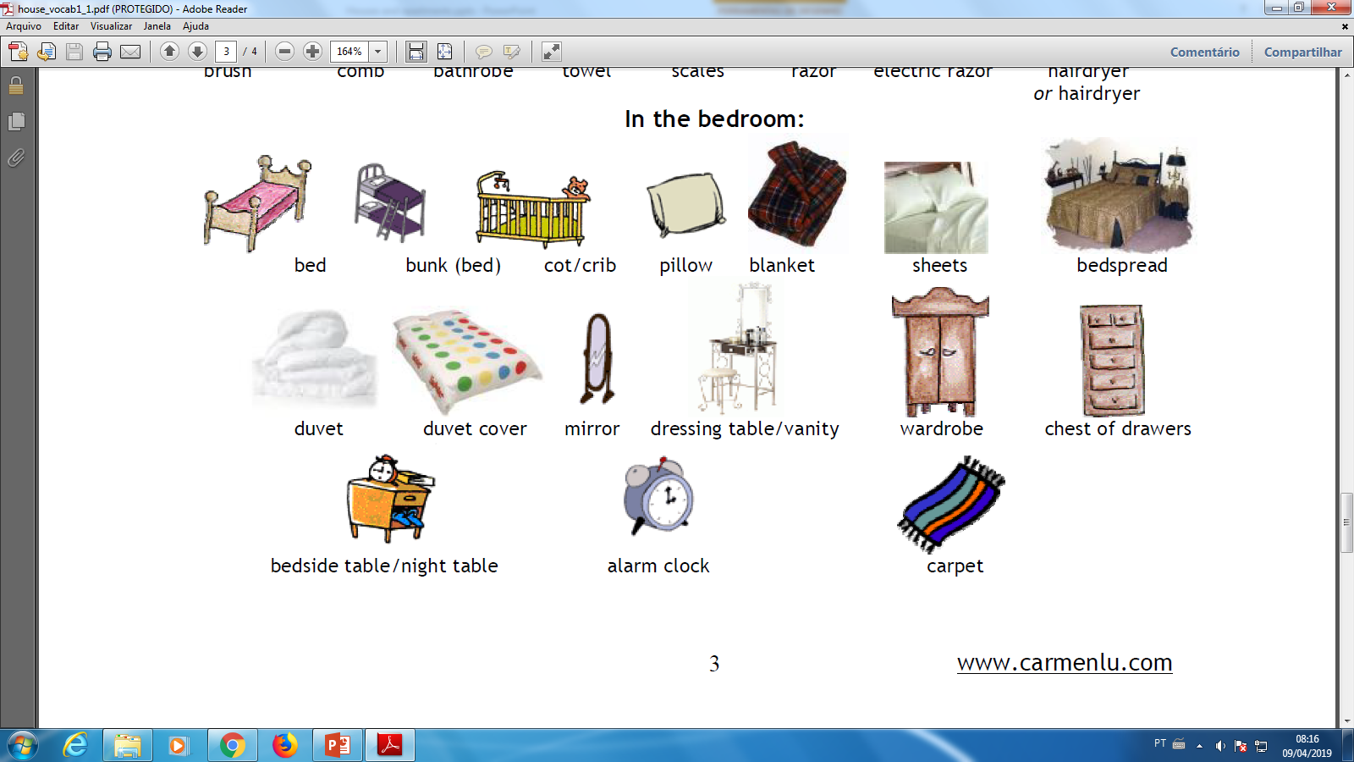

I live in a house;
My house has six rooms and two bathrooms;
This is my aunt bedroom. Her name is Mary.
In her bedroom there is a double bed, two pillows and a wardrobe.
She has a smart TV and an armchar and one bookcase full os books.

Slide 5
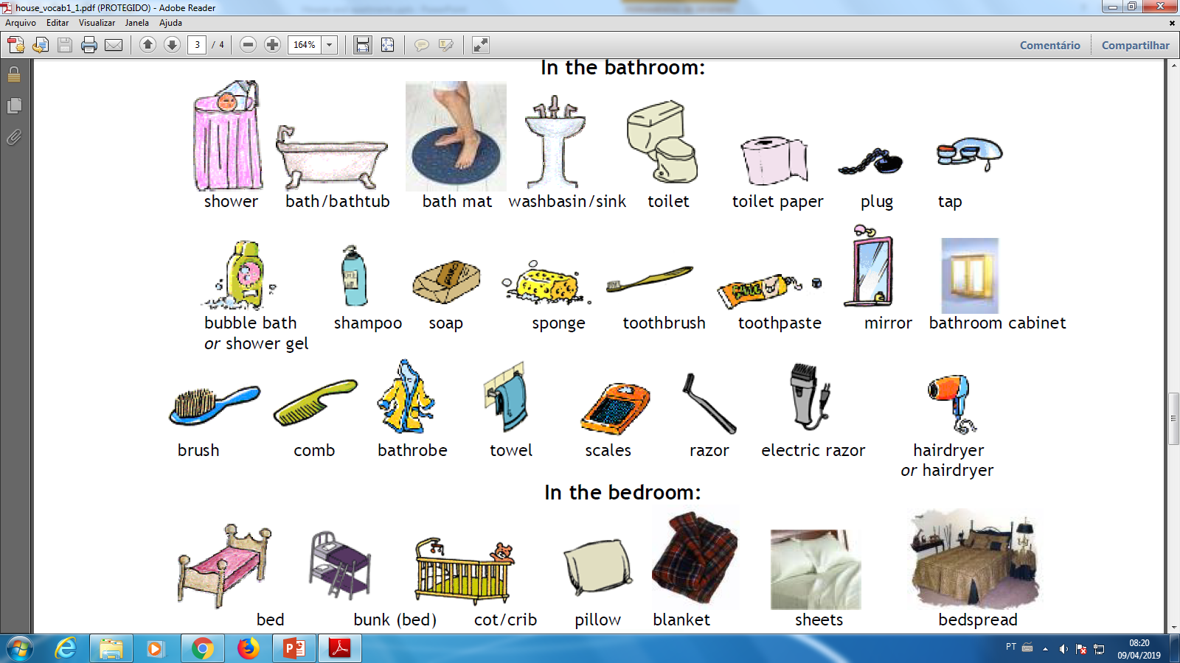
This is the hall bathroom;
It has a sink (washbasin), a toilet, a bathtub and a shower;
In this bathroom my aunt keeps her products: shower gel, shampoo, soap, sponge, toothbrush, toothpaste, brush, comb, bathrobe, towel and razor

Slide 6
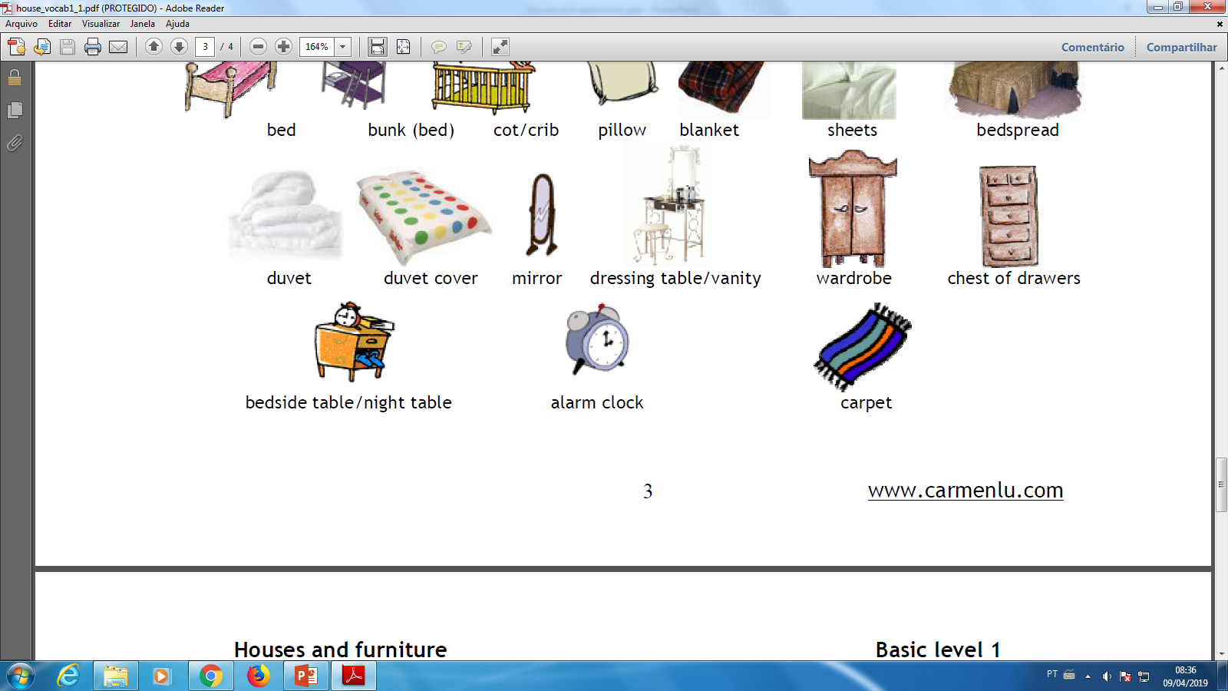
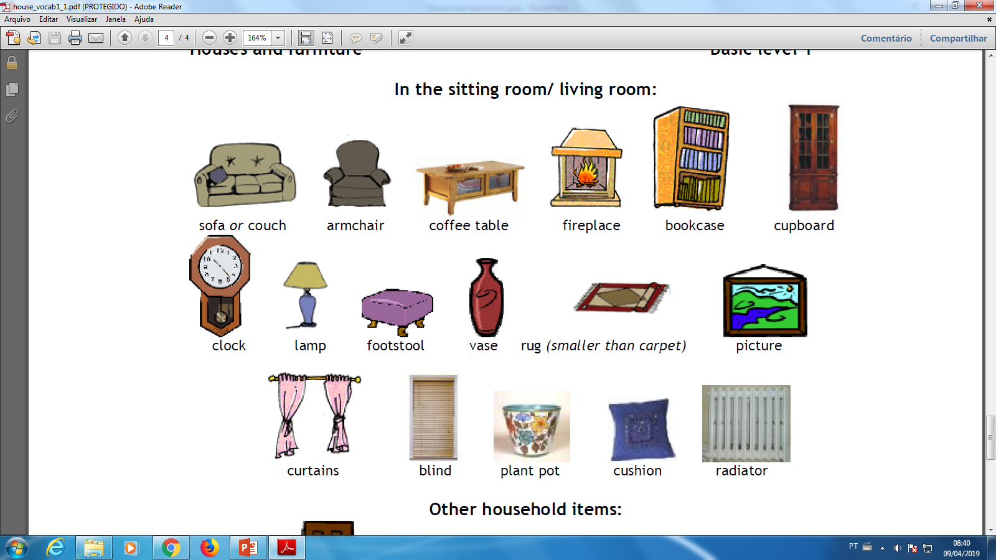
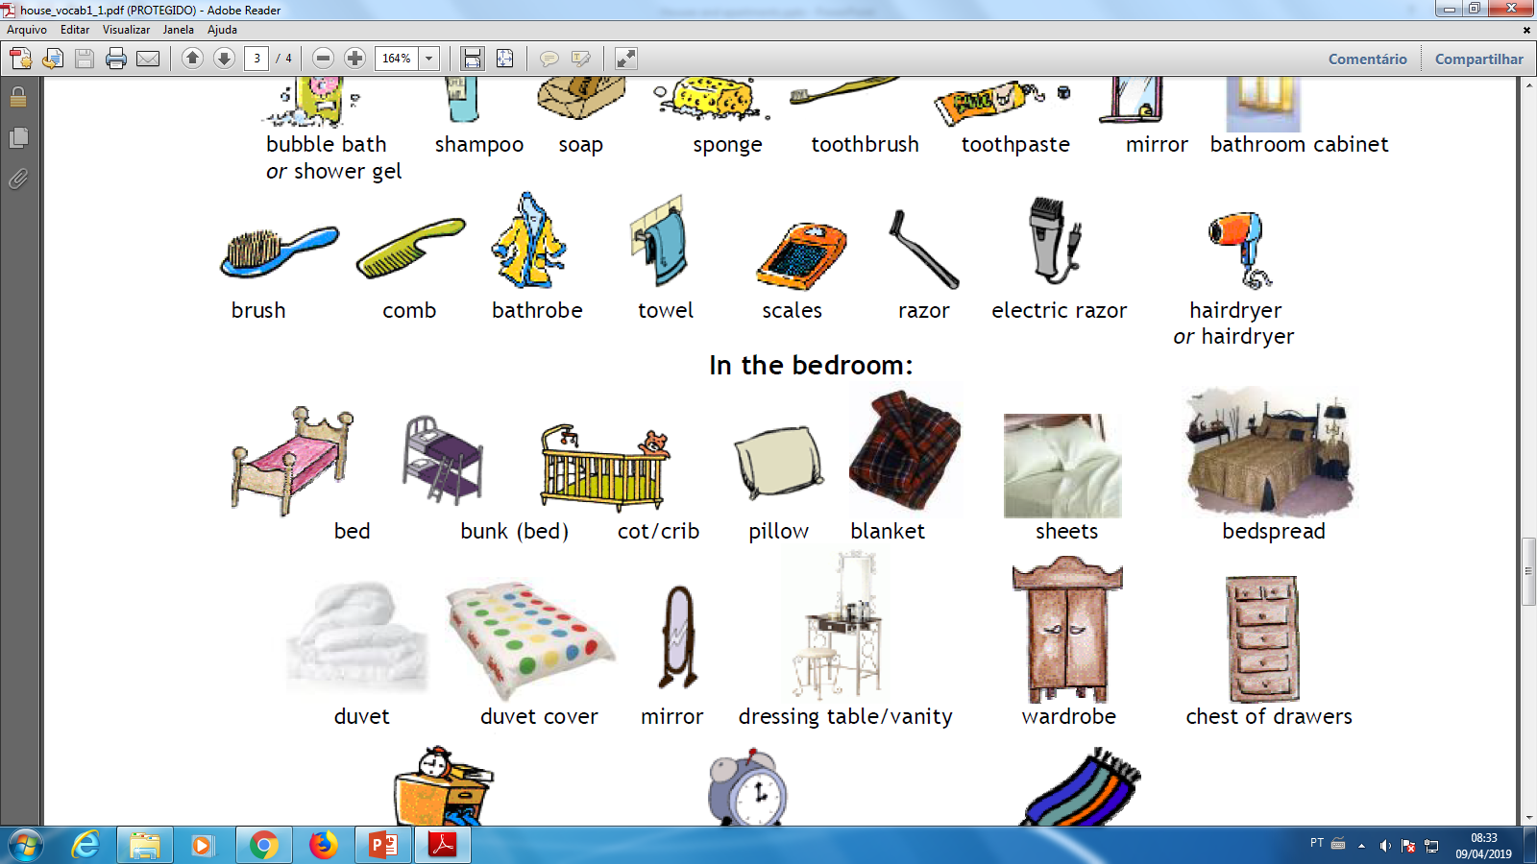
This is my bedroom;
It has a chest of drawers, curtains, a single bed, a pillow, a bedside table, a mirror and a lamp.

Slide 7

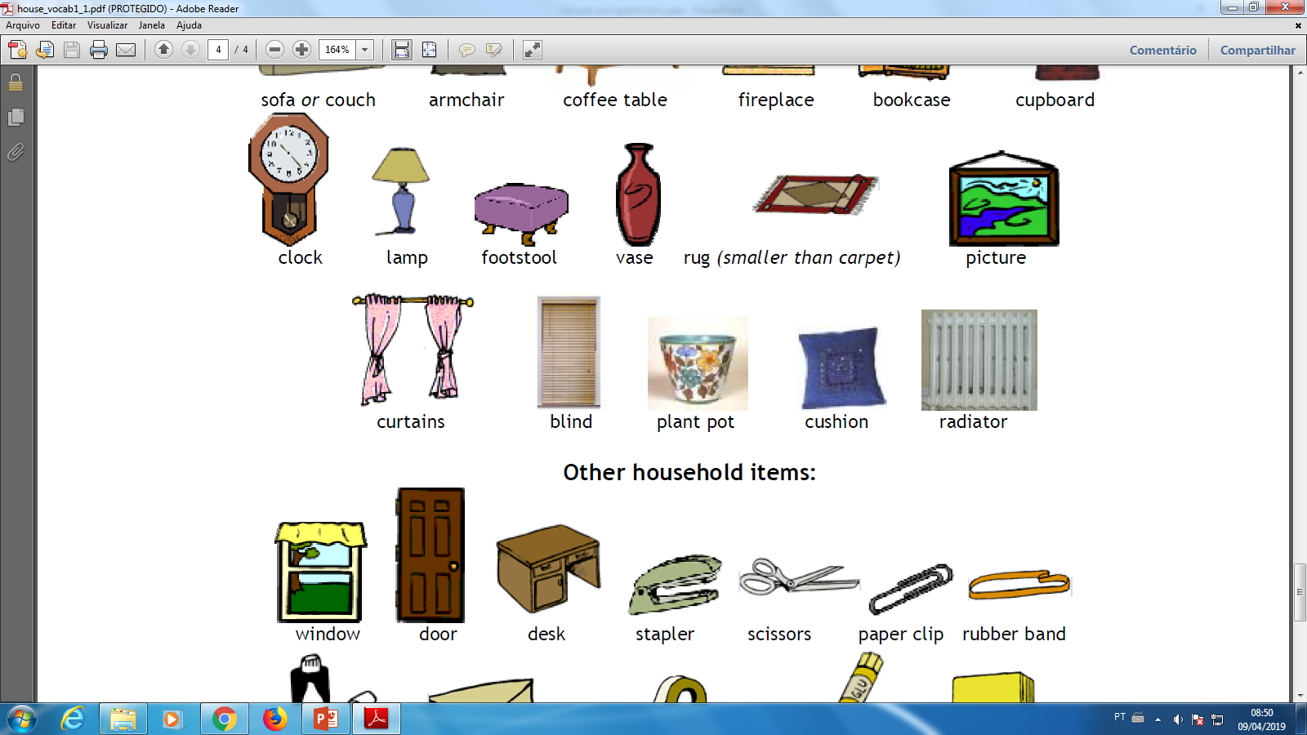
This is the living room;
It has a sofa, two armchairs, a coffee table, curtains, two footstools and four cuchions.
In the living-room my parents use to receive our guests and have chats.

Slide 8
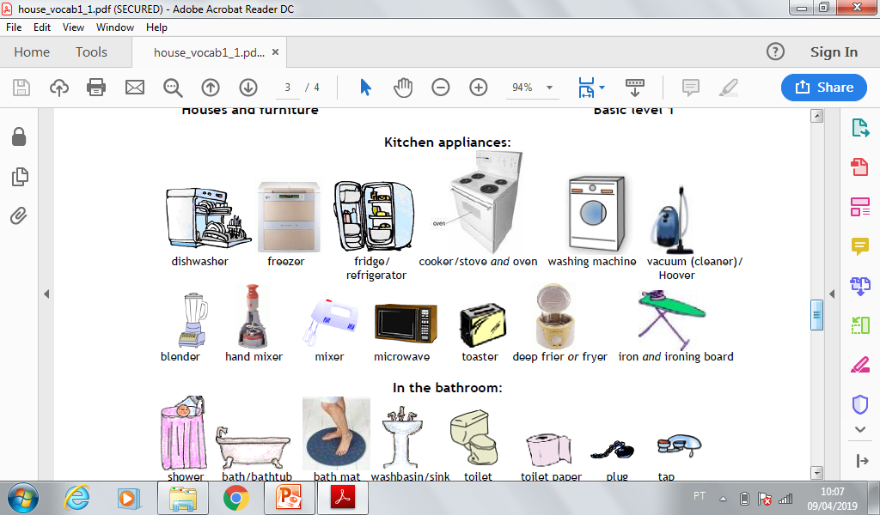
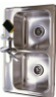
This is the kitchen;
At this place my father cooks many types of delicious food. He is a chef at a restaurant;
In our kitchen there is a microwave oven, a fridge, an oven, a sink and a washing machine;
My mother and I just don’t know how to cook at all!

Slide 9
Cada grupo representará uma família;
Cada família terá que apresentar a sua casa;
Cada membro da família se apresenta e apresenta um cômodo;
Utilize o aprendizado passado para se descrever antes de descrever o cômodo;
Se o grupo for grande e tiver poucos cômodos algum aluno poderá fazer uma introdução contando a história da casa e/ou da família e outro aluno poderá fazer uma conclusão também (usem a criatividade).
Próxima semana haverá um dia de revisão e depois a prova.

