Slide 1
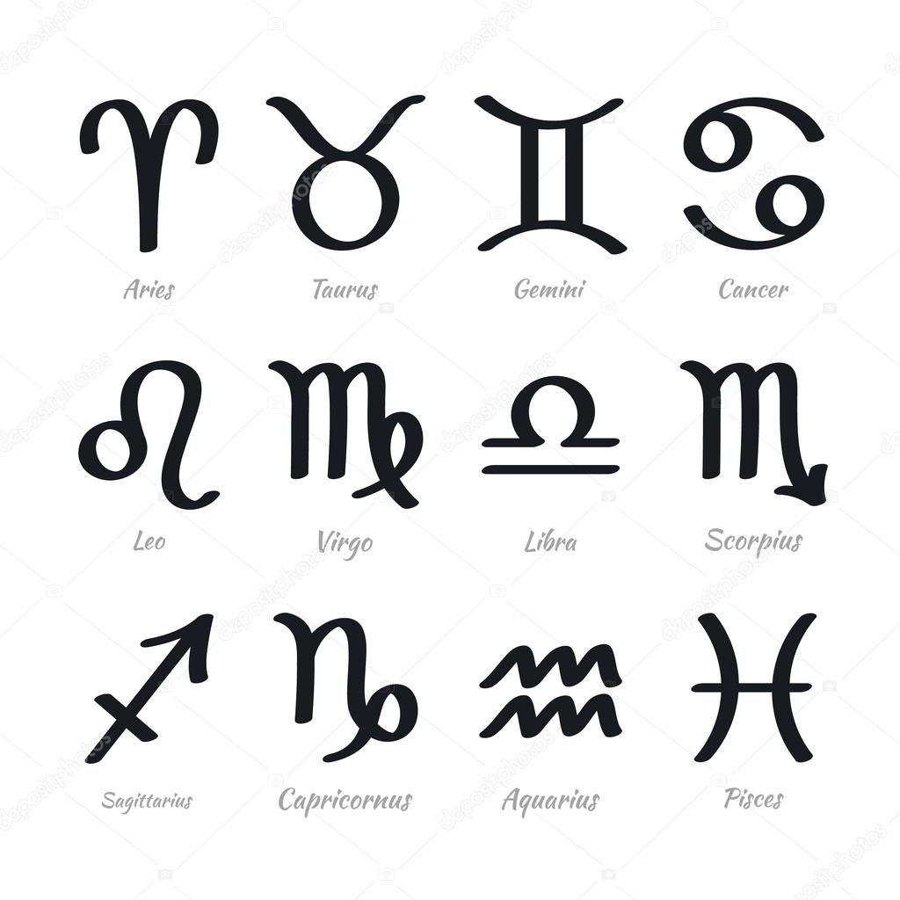
Zodiac Signs Months of the year
Anna Clara A. Medeiros, Dyego Feijó, Luana, Gabriel e Matheus Vasconcelos

Slide 2
Antes, “what’s your star sign?” Ou seja, “qual o seu signo?“ Aliás, “ do you believe in signs? “

Slide 3
Aries (March 21 - April 19)
§ Arians: independent, competitive, and adventurous.
(Arianos: independentes, competitivos, e aventureiros.)

Slide 4
Taurus (April 20 - May 20)
§ Taurians: materialistic, practical, and down to earth.
(Taurinos são materialistas, práticos, e pé-no-chão)

Slide 5
Gemini (May 21 - June 21)
§ Geminis: witty, intellectual and adaptive.
(Geminianos são sagazes, intelectuais, e adaptativos.)

Slide 6
Cancer (June 22 - July 22)
§ Cancerians: sweet, caring, and family-oriented.
(Cancerianos: meigos, carinhosos, e orientados à família.)

Slide 7
Leo (July 22 - August 23)
§ Leos: loyal, courageous, and have a flair for drama.
(Leoninos: leais, corajosos, e tem uma inclinação ao drama.)

Slide 8
Virgo (August 23 - September 22)
§ Virgos: opinionated, detail-oriented, and perfeccionists. (Virginianos: de opinião forte, detalhistas, e perfeccionistas.)

Slide 9
Libra (September 23 - October 22)
§ Librans: diplomatic, polite, and gracious.
(Librianos: diplomáticos, educados, e graciosos.)

Slide 10
Scorpio (October 23 - November 21)
§ Scorpios: passionate, mysterious, and magnetic.
(Escorpianos : passionais, misteriosos, e magnéticos.)

Slide 11
Sagittarius (November 22 - December 21)
§ Sagittarius: talkative, natural entertainers, and freedom-seekers.
(Sagitarianos: falantes, entretém naturalmente, e buscam a liberdade.)

Slide 12
Capricorns (December 22 - January 19)
§ Capricorns: purposeful, hard workers, and ambitious.
(Capricornianos: de propósito forte, trabalham duro, e são ambiciosos.)

Slide 13
Aquarius (January 20 - February 18)
§ Aquarians: one-of-a-kind, cool, and inventive.
(Aquarianos: únicos, descolados, e inventivos.)

Slide 14
Pisces (February 19 - March 20)
§ Pisceans: friendly, imaginative, and moody.
(Piscianos: amigáveis, imaginativos, e temperamentais.)

Slide 15
The four elements
Design de movimento
Experiência do usuário
Computação física
HTML, CSS,JS
Air
Signs: Aquarius, Gemini, Libra
Water
Signs: Cancer, Pisces, Scorpio
Fire
Signs: Aries, Leo, Sagittarius
Earth
Signs: Capricorn, Taurus, Virgo

Slide 16
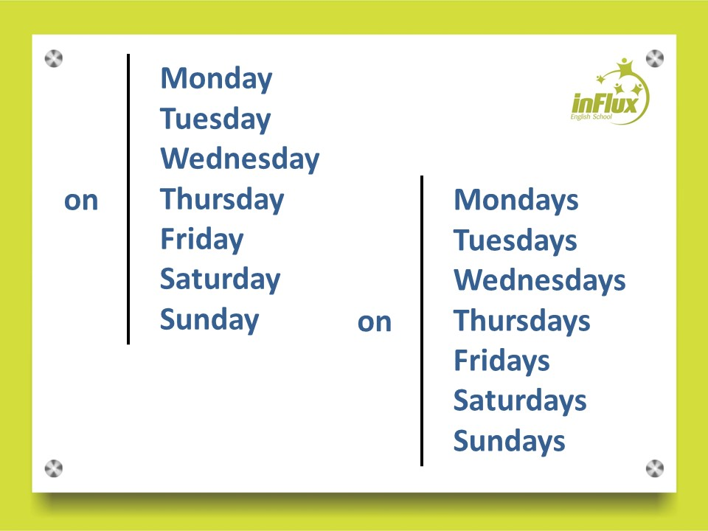
Dias da semana
Dias da Semana
Sunday (Domingo)
Monday (Segunda-feira)
Tuesday (Terça-feira)
Wednesday (Quarta-feira)
Thursday (Quinta-feira)
Friday (Sexta-feira)
Saturday (Sábado)

