Slide 1
CHEMICAL BALANCE

Slide 2
GOALS
MAIN GOAL
Understand the main characteristics of the chemical balance theme and the importance of the English language to enable access to information relevant to this theme.

Slide 3
GOALS
SPECIFIC OBJECTIVES
Identify the main points addressed in the theme chemical equilibrium;
Analyze national and international scientific materials related to the theme under study;
Recognize the importance of English as a means of facilitating access to information and knowledge about chemical balance.

Slide 4

INTRODUCTION
WHAT IS CHEMICAL BALANCE?

Slide 5
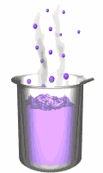
CONCEPTING ...
“Branch of Physicochemical that studies any and all reversible reactions, in which there are two possible reactions, one direct (in which reactants become products) and an inverse (in which products become reactants).”

Slide 6

REVERSIBLE AND IRREVERSIBLE REACTIONS
O₃ + UV (λ < 320 nm) → O₂* + O*

Slide 7
FACTORS AFFECTING CHEMICAL BALANCE
TEMPERATURE
CONCENTRATION
PRESSURE

Slide 8
CHEMICAL BALANCING
“In a chemical reaction done in a sealed container, the sum of the reagent masses is equal to the sum of the product masses.”

Slide 9

EVALUATING DYNAMICS

Slide 10
https://phet.colorado.edu/sims/html/balancing-chemical-equations/latest/balancing-chemical-equations_en.html

Slide 11
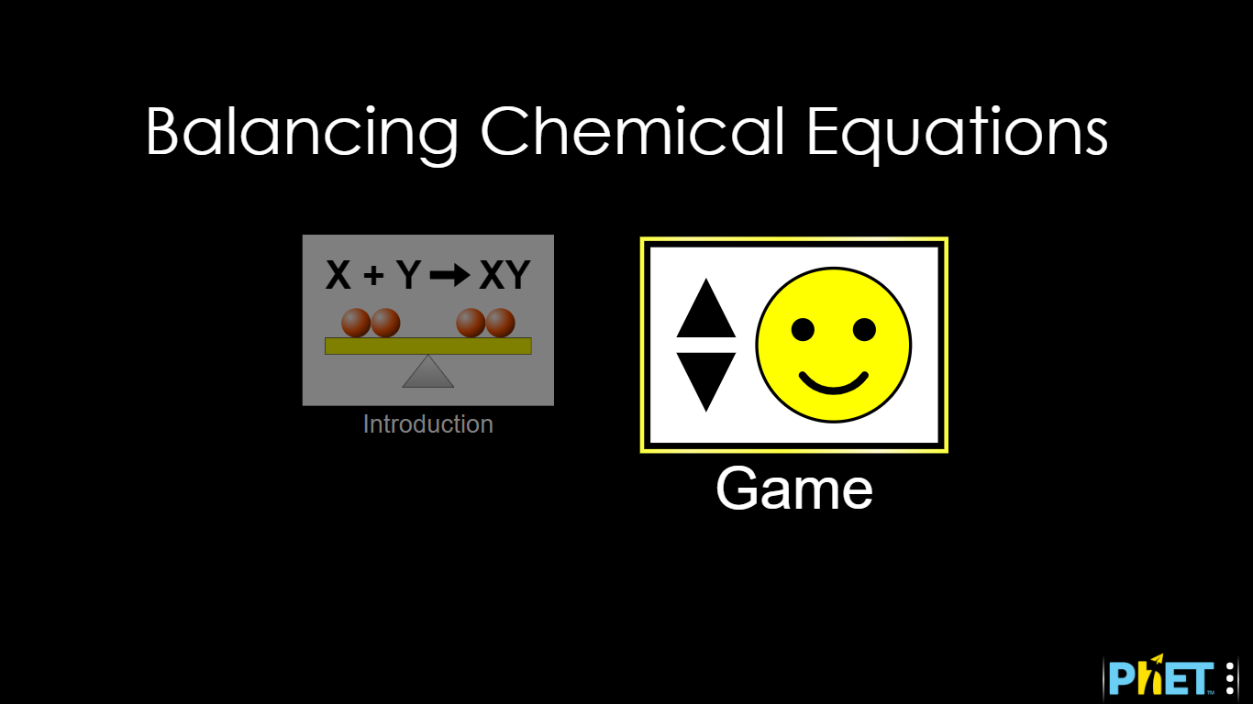

Slide 12

CONCLUSIONS

