Slide 1


SELF LEARNING
Estratégias para desenvolver o aprendizado de língua inglesa de forma autônoma.
CRISTIANE DE BRITO CRUZ

Slide 2
Learning Strategies
Self-study
Sites
Applications
Videos
Songs
Games
Grammar
Reading
Writing
Speaking

Slide 3

SPEAKING
How to learn English with speaking.

Slide 4

How to speak English fluently and confidently: 10 simple tips
You want to learn how to speak English fluently, but do not know where to start? Here are 10 simple tips from Rin Career Ready Academy.

Slide 5

How to speak English fluently and confidently: 10 simple tips
1. Start with believing in yourself
“I was afraid to speak. I was scared people would make fun of me. Will they judge me?
One day, I thought if so many people can, even I can. So I spoke in English and my confidence increased.” – Rin Career Ready Academy participant, 2015

Slide 6
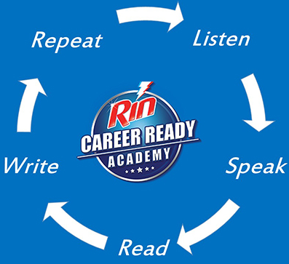
How to speak English fluently and confidently: 10 simple tips
2. Listen. Speak. Read. Write. Repeat.
Listen a little. Speak a little. Read a little. Write a little. Then, listen a little more. Speak a little more. Read a little more. Write a little more. Do this, till it becomes a habit.

Slide 7

How to speak English fluently and confidently: 10 simple tips
3. Keep your ears open.
English is everywhere. It’s in online videos, news channels, on radio. So listen and build your vocabulary.

Slide 8
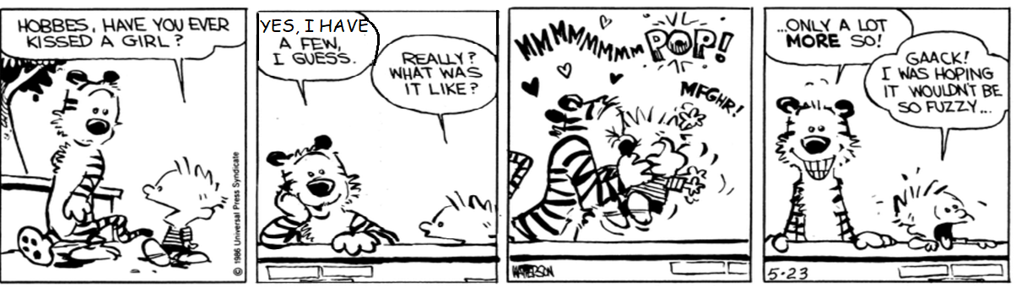
How to speak English fluently and confidently: 10 simple tips
4. Find the answer in the question.
Questions are like mirrors. Reverse the question, and find the answer.
Does he…? | Yes, he does
Is it…? | Yes, it is
Can you? | Yes, I can

Slide 9
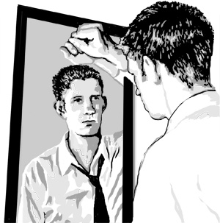
How to speak English fluently and confidently: 10 simple tips
5. Make the mirror your best friend.
Speak to it in English, and it will make you feel confident about the way you are speaking.

Slide 10

How to speak English fluently and confidently: 10 simple tips
6. Read full sentences
You learnt Hindi, Tamil or Telugu in full sentences. Then why should learning English be any different. Read full sentences, speak in sentences.

Slide 11

How to speak English fluently and confidently: 10 simple tips
7. Keep calm and do not worry about grammar.
Remember, even those who speak English fluently make grammatical mistakes. But, what they do right, is communicate without worrying about them.

Slide 12

How to speak English fluently and confidently: 10 simple tips
8. Find an English newspaper and learn a word a day.
Keep your fear of new English words away.

Slide 13

How to speak English fluently and confidently: 10 simple tips
9. Use the word before it leaves you.
Use the new word immediately to feel confident about it’s usage.

Slide 14

How to speak English fluently and confidently: 10 simple tips
10. Practice. Practice. Practice. Till it makes you perfect.
There are no shortcuts in life. Definitely, no shortcuts to learn English.
https://www.rin.in/tips/tip/how-to-speak-english-fluently-and-confidently--10-simple-tips/15

Slide 15

How To Improve English Speaking Skills
A.J. Hoge
April 27, 2017
How To Improve English Speaking Skills
Many students master the fine points of English grammar but find themselves at a loss when it comes to actually having a conversation with native speakers. In reality, the only way to develop fluency in speaking is by huge amounts of listening, and then practicing. The following are a few tips for improving English speaking skills. Don’t forget that listening is the foundation for speaking! When you also want to practice speaking, here are some suggestions for how to improve English speaking skills.

Slide 16
How To Improve English Speaking Skills
A.J. Hoge
April 27, 2017
1. Find An English-Speaking Conversation Partner
First of all, it’s important to find native speakers to practice with. Students who are living around many English speakers may be able to find informal opportunities to chat with neighbors and local business people. Joining a club or a volunteer organization can be a great way to get to know people informally. If that isn’t an option, consider hiring a private tutor. A lot of students find and meet with tutors online via tools like Skype or Google Hangouts.

Slide 17
How To Improve English Speaking Skills
A.J. Hoge
April 27, 2017
2. Make Sure To Listen As Well As Speak
When practicing with a native speaker, try to balance your listening and speaking. It’s a good idea to prepare questions in advance so that the conversation will flow back and forth. If your conversation partner asks you a question and you answer at length, you can always turn the question back to your partner by asking, “What do you think?” or “What about you?”

Slide 18
How To Improve English Speaking Skills
A.J. Hoge
April 27, 2017
3. Record Your Conversation Practice
Recording is a great way to get the maximum benefit from a conversation with a native speaker. When you listen again, you can evaluate your own pronunciation and notice areas where you need to improve. You can also review the content of the conversation, take notes on new vocabulary or misunderstandings, and prepare questions for the next meeting.

Slide 19
How To Improve English Speaking Skills
A.J. Hoge
April 27, 2017
4. Surround Yourself With The English Language
Another way to improve your English speaking skills is to immerse yourself in English as much as possible. Watch movies or TV in English, with subtitles if you need them, and watch the same programs over and over. Most people find that they understand more each time. Listening helps you become familiar with the rhythms and intonations of English. Once the sounds are familiar, try imitating them.

Slide 20
How To Improve English Speaking Skills
A.J. Hoge
April 27, 2017
5. Practice With Music and Movies
Listen to music in English and sing along. Music is one of the best tools for learning intonation pronunciation. Listening to and singing songs might also help you remember vocabulary and phrases (if the song is easy to understand), and it will help you learn to pronounce English rhythm in a more natural way. By unconsciously imitating the singer, you’ll learn to pronounce phrases the way native speakers do. One good song for ESL or EFL students is “Tom’s Diner” by Suzanne Vega because it uses simple language to describe everyday scenes and actions. Movies are a much better choice for learning English. You’ll learn vocabulary, idioms, slang, pronunciation, and listening by watching movies. Be sure to use my movie technique when you do this!

Slide 21
How To Improve English Speaking Skills
A.J. Hoge
April 27, 2017
6. Read Aloud
Reading out loud is a great way to practice speaking when there are no conversation partners available. Reading aloud gives you a chance to focus on pronunciation and pacing without worrying about coming up with words. Make sure to practice with material that you can understand. Some students find videos online that have transcripts. Many TED talks, for example, include word-for word transcripts of the talk. By reading aloud from a transcript, you can check your pronunciation by listening to how the speaker says something.

Slide 22
How To Improve English Speaking Skills
A.J. Hoge
April 27, 2017
7. Talk To Yourself
Saying your thoughts out loud or narrating your actions (“I am drinking coffee, and now I’m going to open my book”) can be a very effective way to practice spoken English. By talking to yourself, you can become more fluent in translating your thoughts into spoken words. Practicing alone is also a low-pressure way to practice, since no one will hear your mistakes.
https://effortlessenglishclub.com/improve-english-speaking-skills

Slide 23

How to speak English fluently and confidently: REVIEW
1. Start with believing in yourself
2. Listen. Speak. Read. Write. Repeat.
3. Keep your ears open.
4. Find the answer in the question.
5. Make the mirror your best friend.
6. Read full sentences.
7. Keep calm and do not worry about grammar.
8. Find an English newspaper and learn a word a day.
9. Use the word before it leaves you.
10. Practice. Practice. Practice. Till it makes you perfect.
https://www.rin.in/tips/tip/how-to-speak-english-fluently-and-confidently--10-simple-tips/15

Slide 24
How To Improve English Speaking Skills - REVIEW
A.J. Hoge
April 27, 2017
Find An English-Speaking Conversation Partner
Make Sure To Listen As Well As Speak
Record Your Conversation Practice
Surround Yourself With The English Language
Practice With Music and Movies
Read Aloud
Talk To Yourself
https://effortlessenglishclub.com/improve-english-speaking-skills

