Slide 1


SELF LEARNING
Estratégias para desenvolver o aprendizado de língua inglesa de forma autônoma.
CRISTIANE DE BRITO CRUZ

Slide 2
Learning Strategies
Self-study
Sites
Applications
Videos
Songs
Games
Grammar
Reading
Writing
Speaking

Slide 3

Appliances
How to learn english with apps?

Slide 4


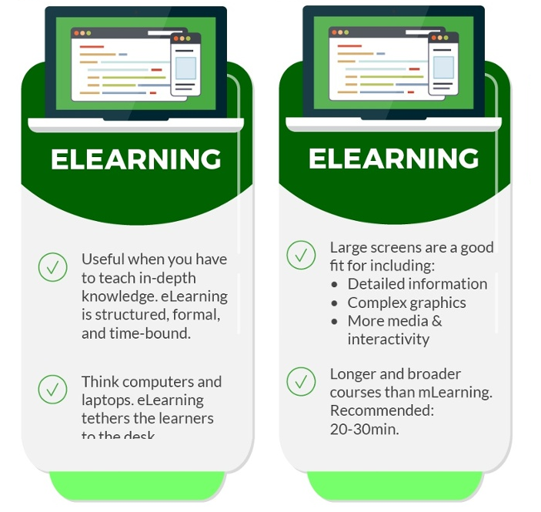
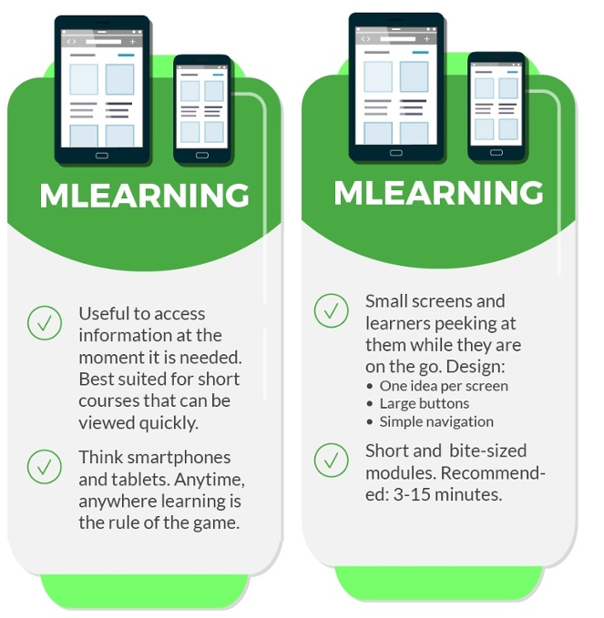

https://www.shiftelearning.com/blog/difference-between-elearning-and-mlearning

Slide 5


Which app is the best for me?
Levels:
Payment:
Writing:
Reading:
Listening:
Speaking:
Games:
Review:
Likes:

Slide 6
I finished all app levels – now what?
Need to improve:
Vocabulary:
Grammar:
Listening:
Speaking:
Reading:
Writing:

Slide 7













Teacher’s Suggestions: Learning vocabulary and setences
Hello English

Slide 8




Teacher’s Suggestions: Learning vocabulary and setences – More difficult

Slide 9




Teacher’s Suggestions: Learning Speaking
English Conversation
English Speaking Practice
SpeakingPal

Slide 10




Teacher’s Suggestions: Learning Grammar

Slide 11









Teacher’s Suggestions: Learning Listening
American English
CBC Radio

Slide 12









Teacher’s Suggestions: Learning Reading/Listening
Feedly

Slide 13



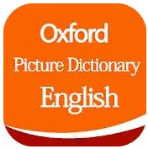
Teacher’s Suggestions: Dictionaries
Word Reference

Slide 14
Teacher’s Suggestions: Study Sequel
Escolha um aplicativo fácil;
Termine os níveis;
Escolha outros apps e tente não ficar repetindo muito o que você aprendeu;
Faça um teste de nível;
Escolha aplicativos mais difíceis;
Tente focar onde você tiver mais dificuldades;
Não utilize demais os apps! Tente estudar com outras estratégias!

